Slide 1
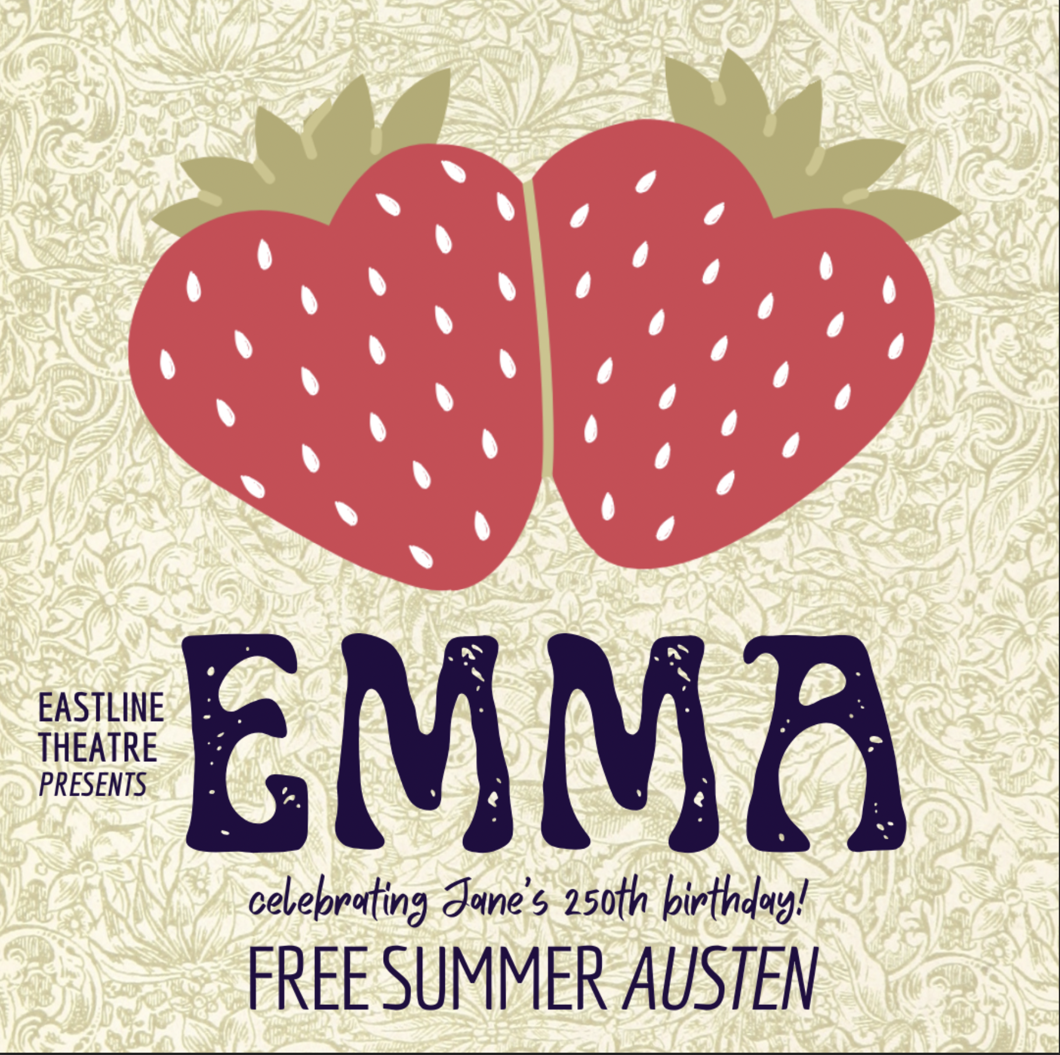
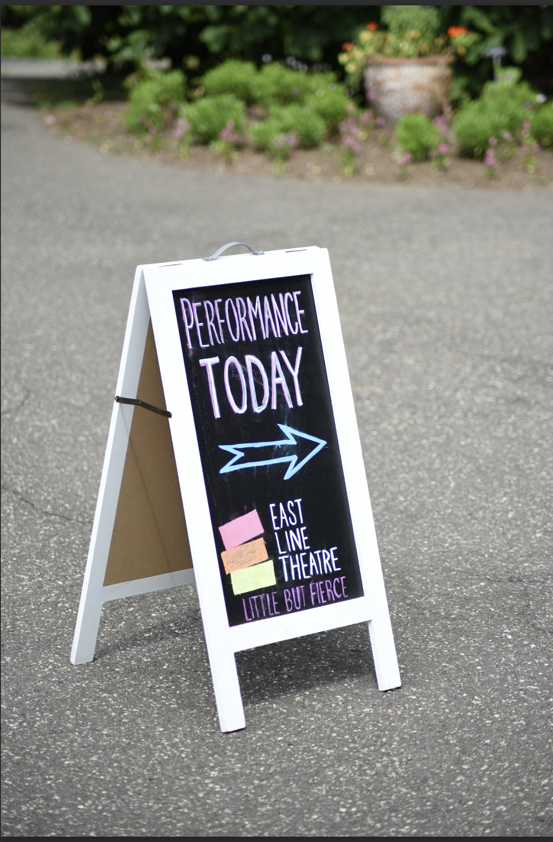

Slide 2
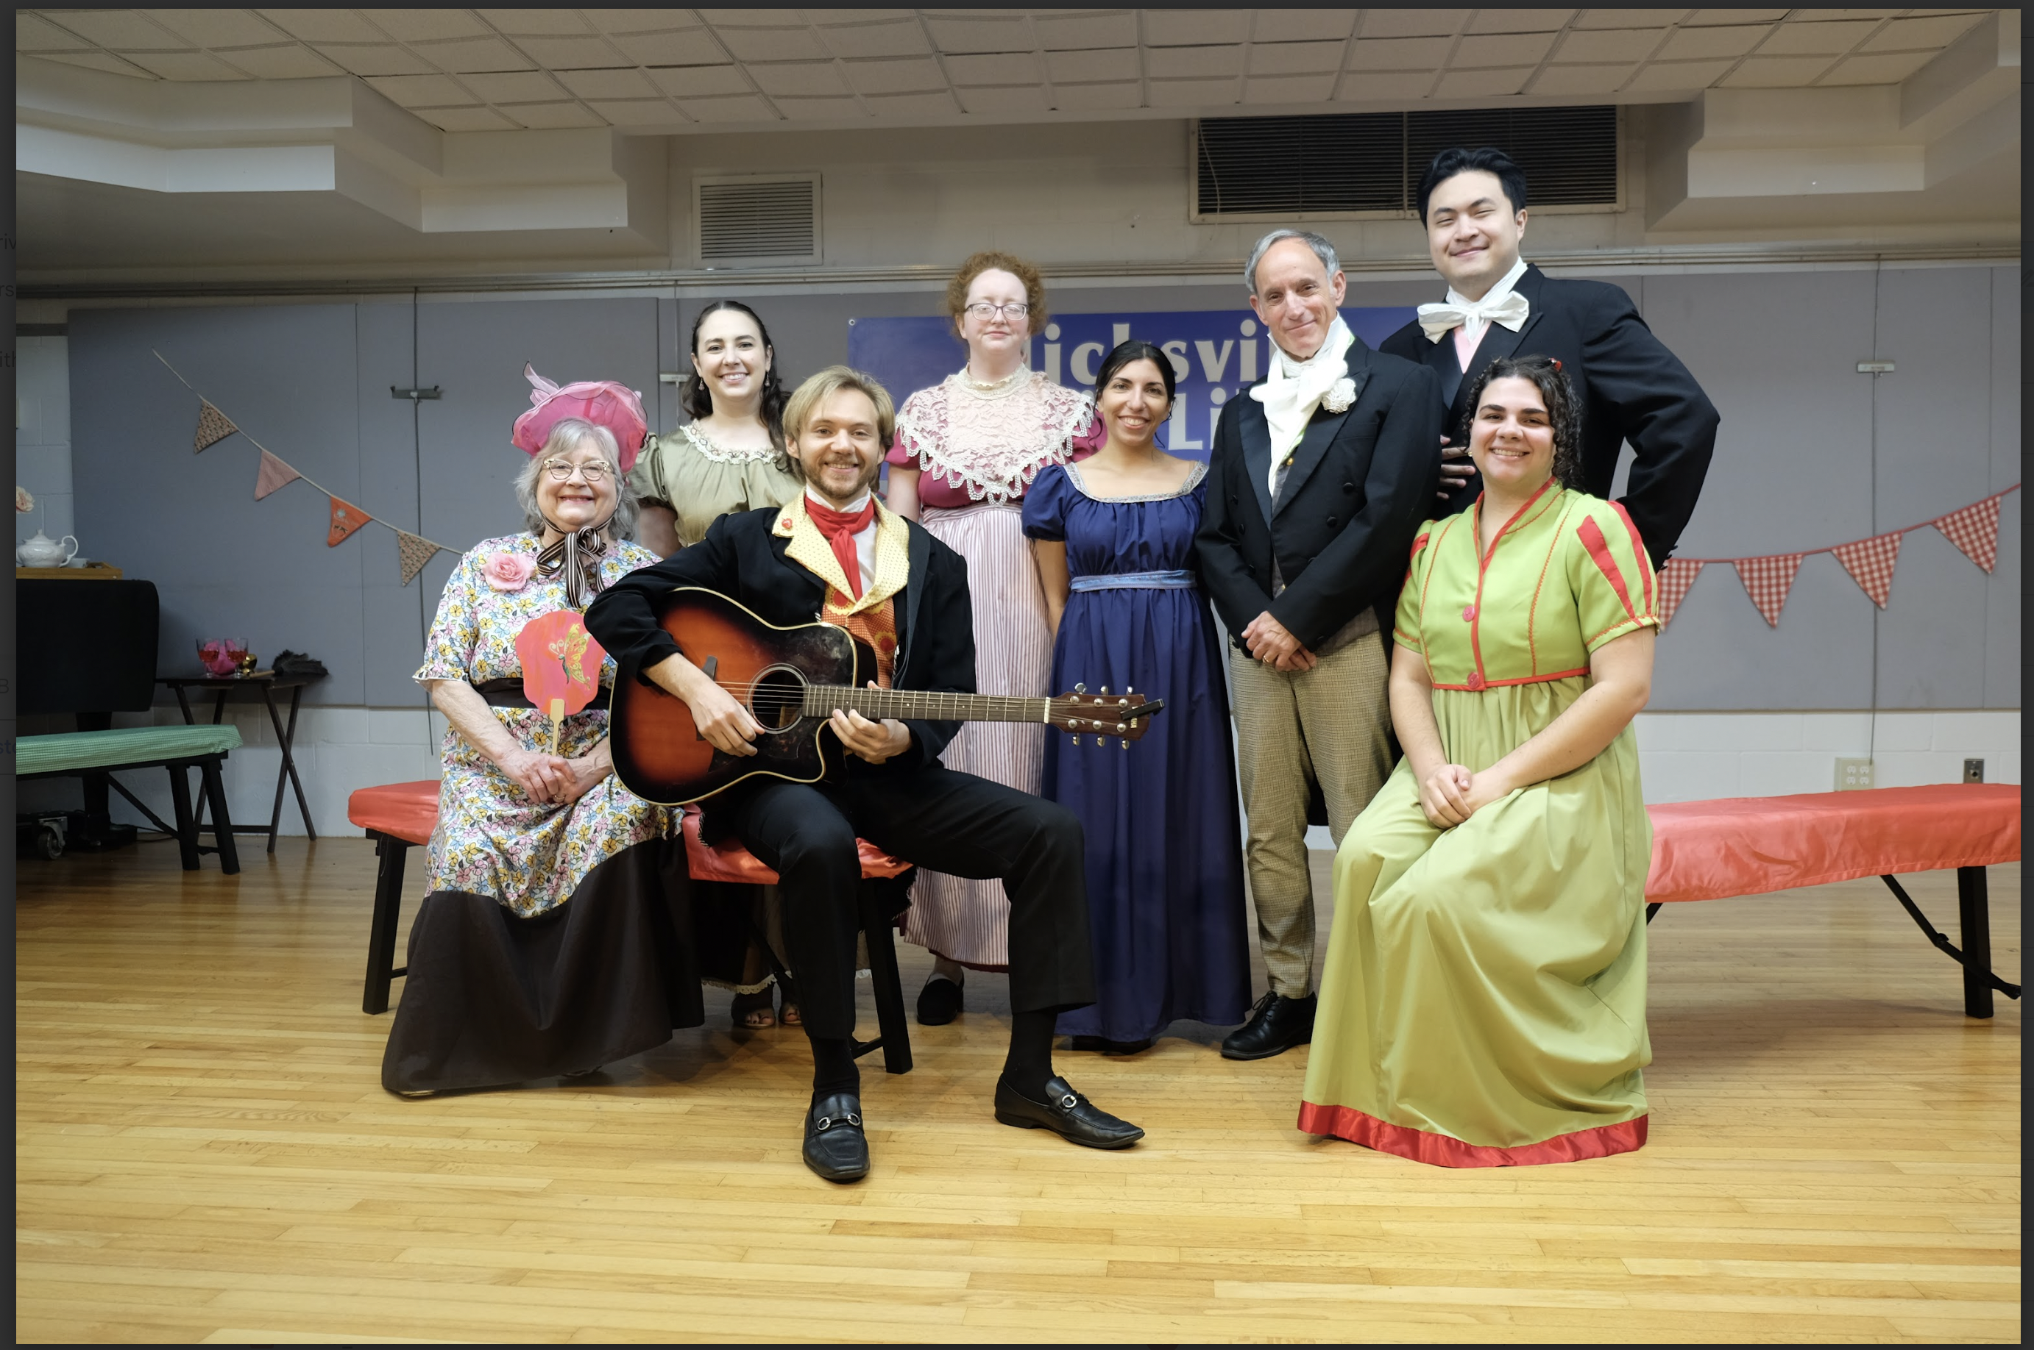

Slide 3
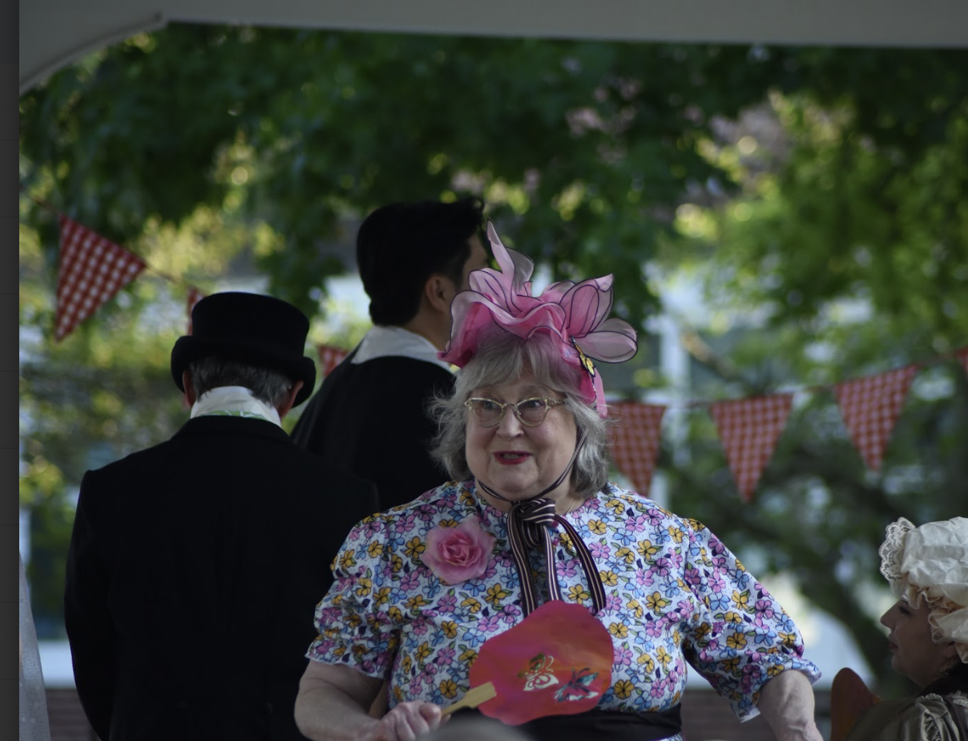
Oh, Miss Woodhouse, I understand you
alone are to credit for this happy day.
If only my niece could join us. Jane does
love a celebration. Sweet, amiable Jane.
Jane is so accomplished, Jane is so elegant,
Jane is so charming. Jane, Jane, Jane….

Slide 4
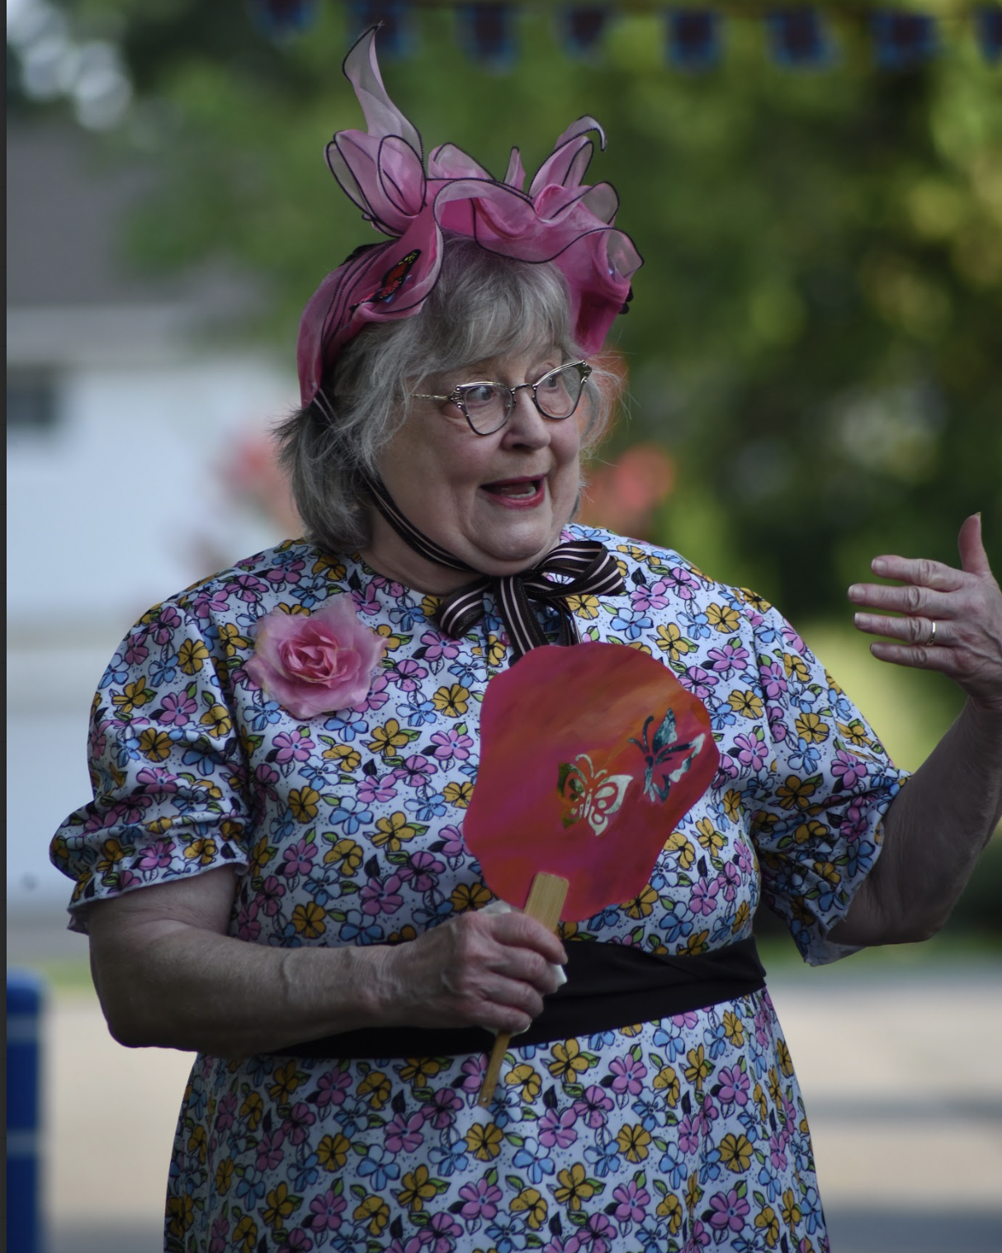
Miss Woodhouse, may I introduce
Miss Harriet Smith. Harriet is one of
the students recently graduated from
my little school.

Slide 5
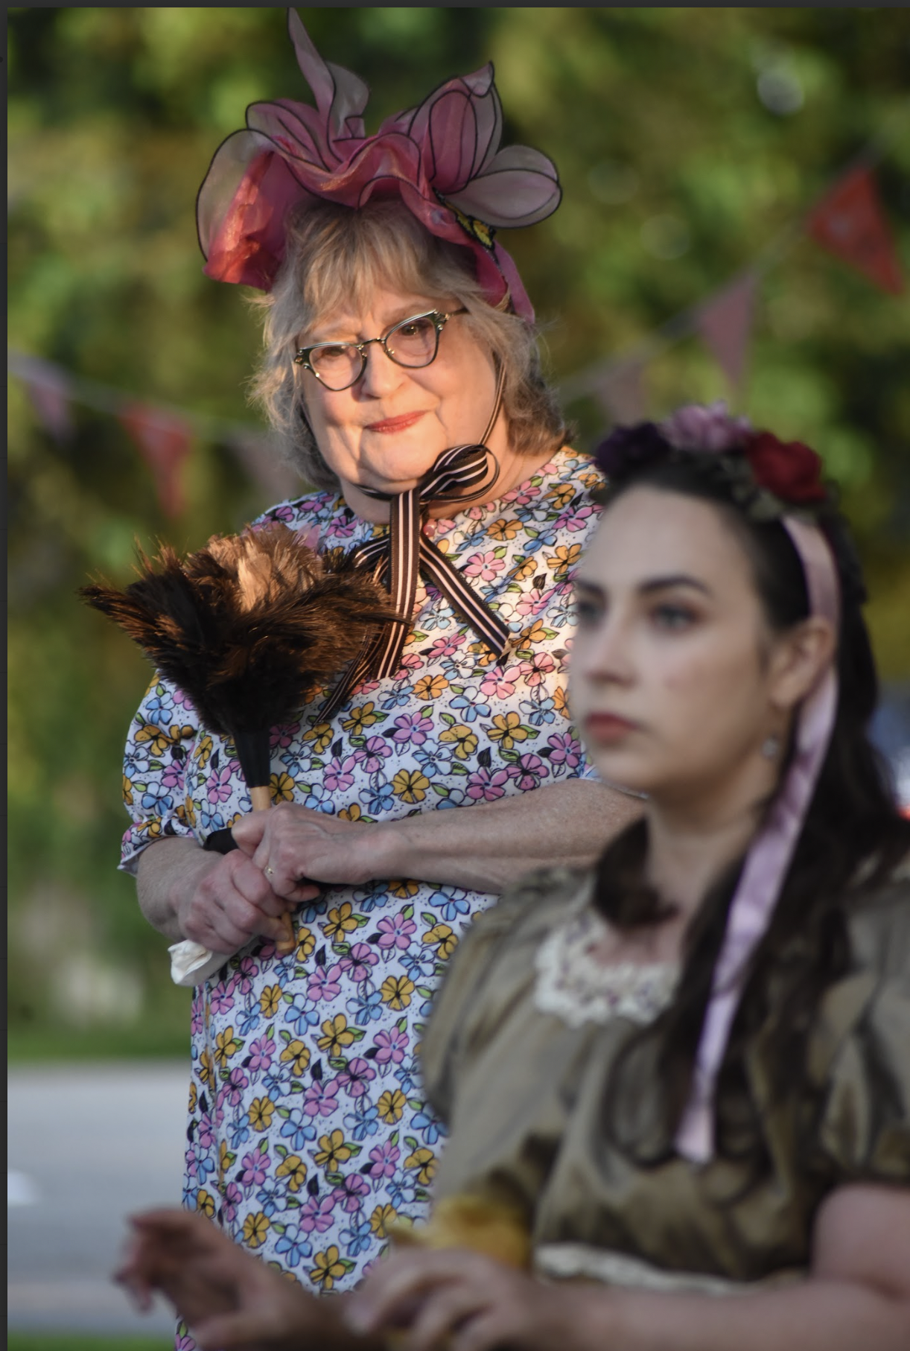
Jane has such a genius, you know, for knitting and embroidery
and painting and singing and cooking and arranging flowers,
and lifting big iron weights, and…

Slide 6
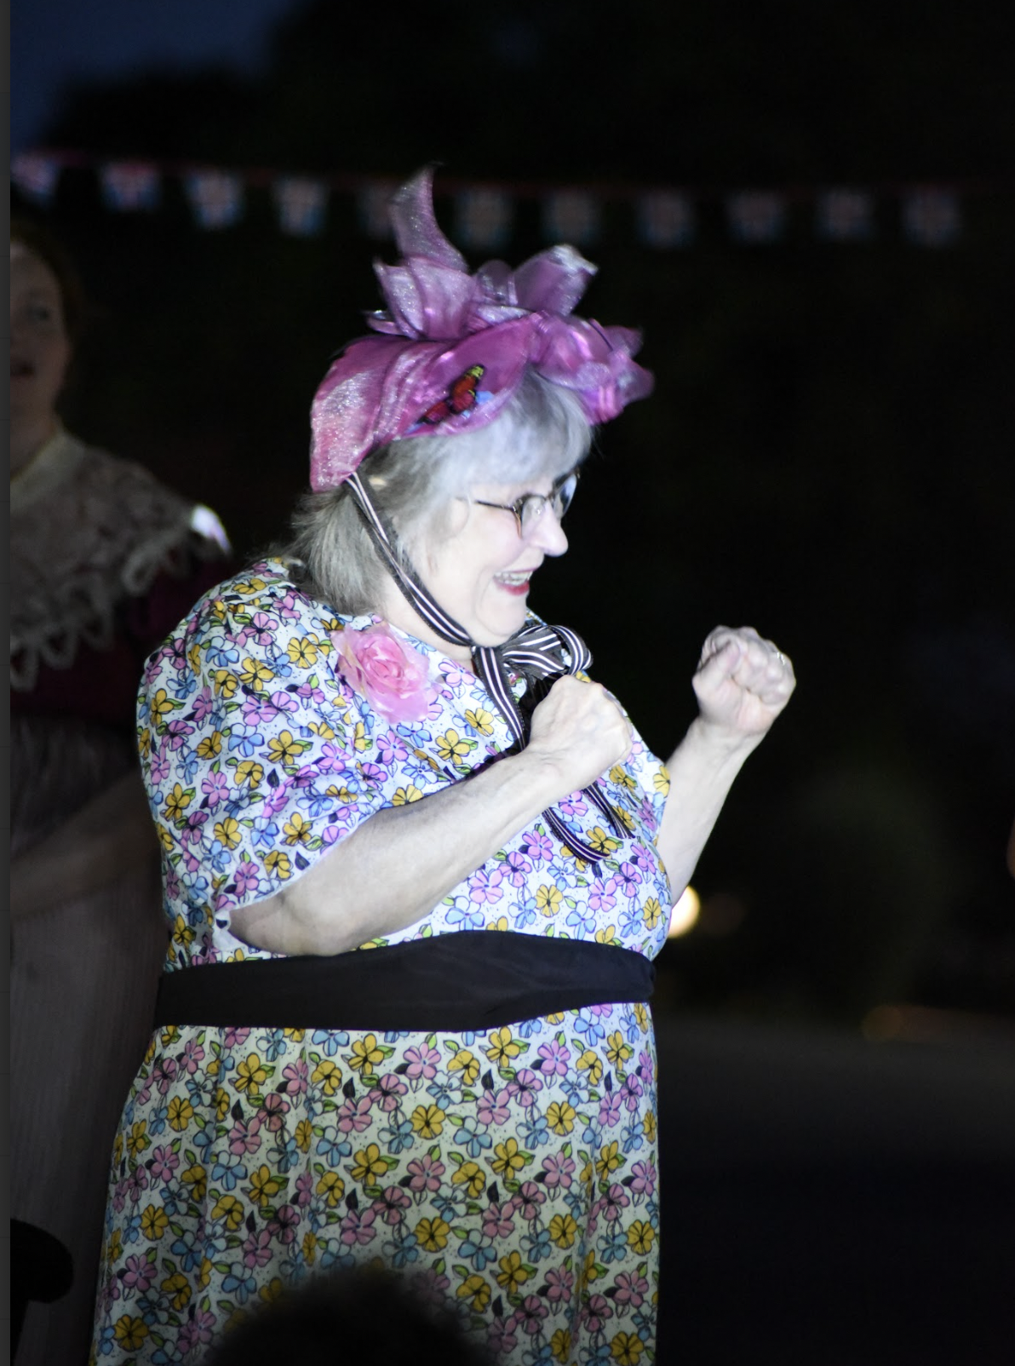
There is truly nothing like a dance to showcase young
ladies, and Jane is without equal tonight. Oh, and
Miss Woodhouse, you look very splendid as well.
Doesn’t Emma look lively, Mother?

Slide 7
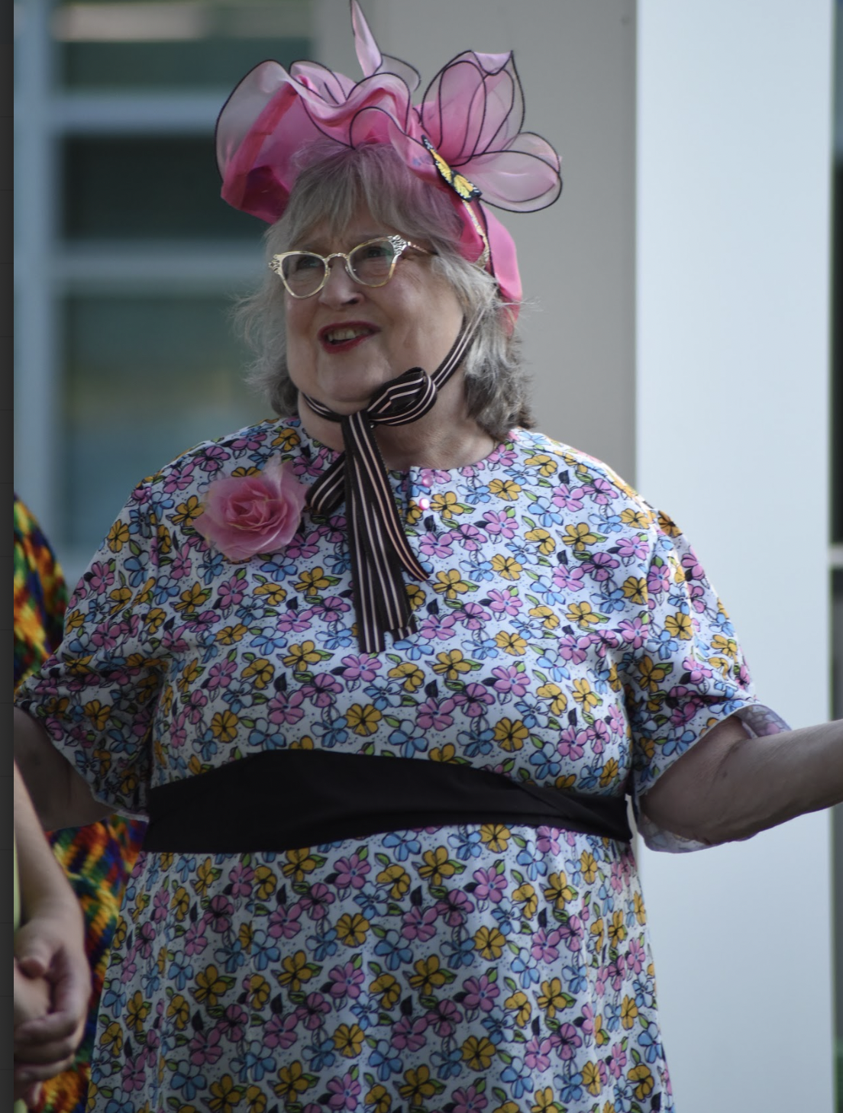
They do make a handsome couple, don’t they?
Mr. Knightley admires Jane so openly. Everybody
remarks upon it. Mother and I have been plotting,
you know, and you are not the only matchmaker
in the county. What would you say to conspiring
to play Cupid, Miss Woodhouse?

