Slide 1
Words for Emotions and Moods Volume III
sulky
upbeat
hopeful
hopeless
festive
dreary
spiteful
gracious
homesick
adventurous
argumentative
easy-going
astonished
unsurprised
disorganized
organized
exhilarated
gloomy
dramatic
low-key

Slide 2
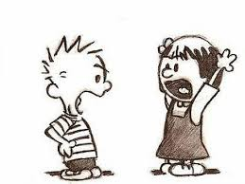
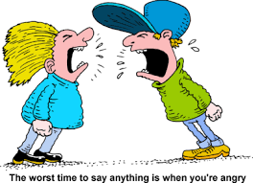
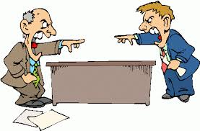
argumentative
Talk to your partner about
a time when you thought someone
was being argumentative.

Slide 3
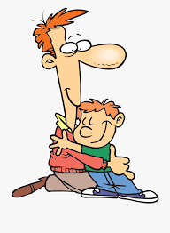
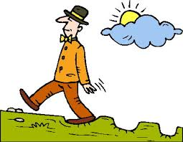
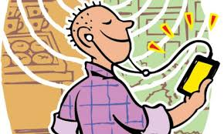
easy-going
Talk to your partner about
whether you feel easy-going
or argumentative today.

Slide 4
argumentative or easy-going?

Slide 5
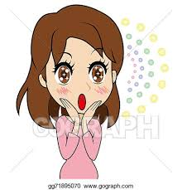
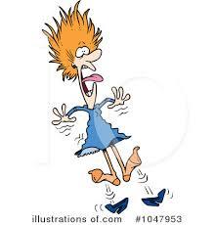

astonished
Talk to your partner about
something that would
astonish you.

Slide 6
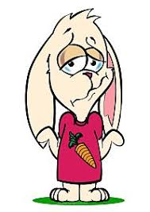


unsurprised
Talk to your partner about
whether you would be astonished
or unsurprised if it snows tomorrow.

Slide 7
astonished or unsurprised?

Slide 8

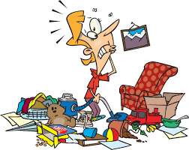
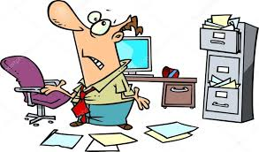
disorganized
Talk to your partner about
what a disorganized
desk would look like.

Slide 9
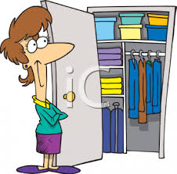

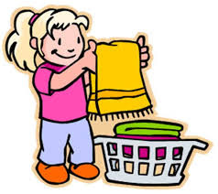
well-organized
Talk to your partner about
whether your desk is
well-organized or disorganized.

Slide 10
disorganized or well-organized?

Slide 11
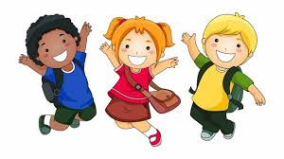
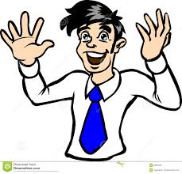
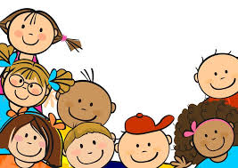
exhilarated
Talk to your partner about something
that makes you feel exhilarated.

Slide 12
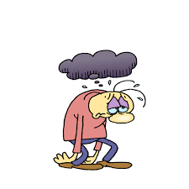
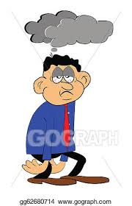
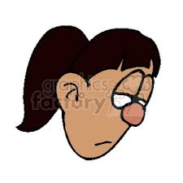
gloomy
Talk to your partner
about what you can
do to cheer up when
you are feeling gloomy.

Slide 13
exhilarated or gloomy?

Slide 14
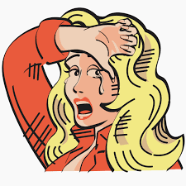
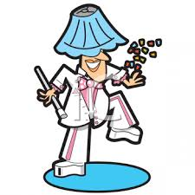
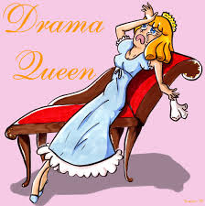
dramatic
Talk to your partner about
whether you consider yourself
a dramatic person.

Slide 15
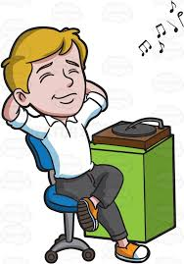

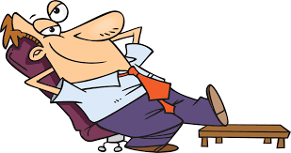
low-key
Talk to your partner about whether
you are a dramatic person or a low-key person.

Slide 16
dramatic or low-key?

Slide 17
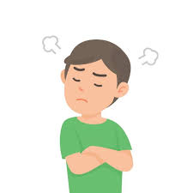
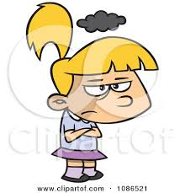
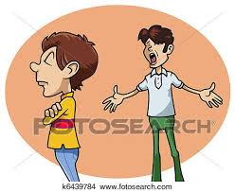
sulky
Talk to your partner about a day
when you felt sulky.

Slide 18


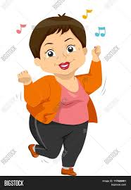
upbeat
Talk to your partner about
whether you feel sulky or
upbeat today.

Slide 19
sulky or upbeat?

Slide 20
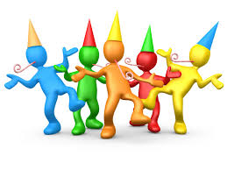
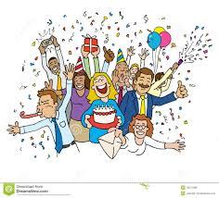
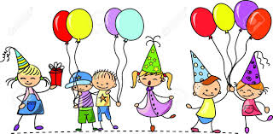
festive
Talk to your partner about
something festive that you
like to do on your birthday.

Slide 21
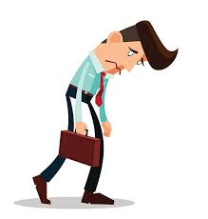
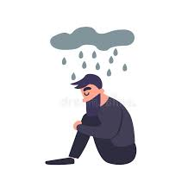
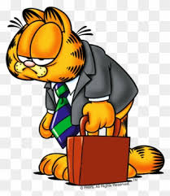
dreary
Talk to your partner about
how you can turn an ordinary
day into a festive day.

Slide 22
festive or dreary?

Slide 23
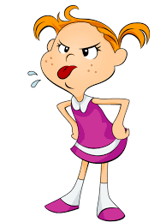
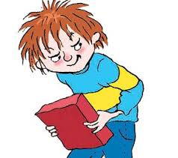
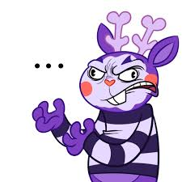
spiteful
Talk to your partner about
a time when you decided not to
do something spiteful.

Slide 24
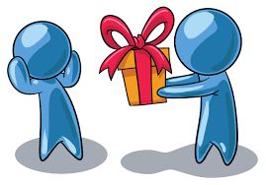
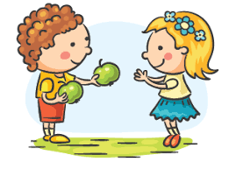
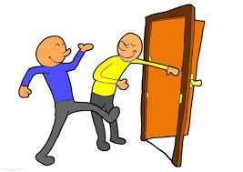
gracious
Talk to your partner about a time
when someone treated you graciously.

Slide 25
spiteful or gracious?

Slide 26
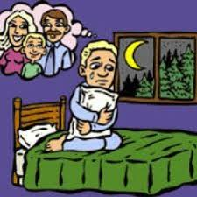
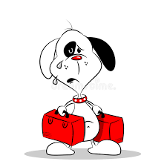
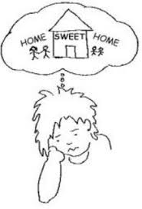
homesick
Talk to your partner about
a time when you felt homesick.

Slide 27
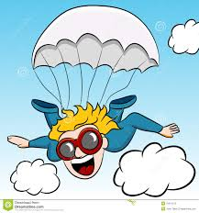
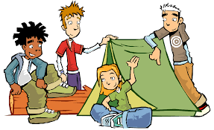
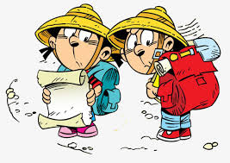
adventurous
Talk to your partner about
whether you are adventurous.

Slide 28
homesick or adventurous?

Slide 29
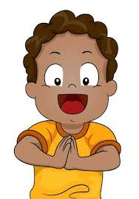

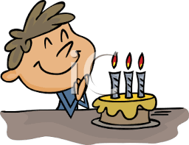
hopeful
Talk to your partner about
something you are hopeful about.

Slide 30
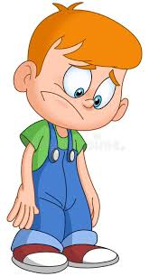

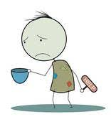
hopeless
Talk to your partner about
how you could cheer someone
up who feels hopeless about something.

Slide 31
hopeful or hopeless?

