Slide 1
Words for Emotions and Moods
Volume II
content
frustrated
positive
negative
generous
stingy
stubborn
cooperative
giddy
serious
agreeable
disagreeable
reluctant
eager
encouraged
discouraged
focused
fidgety
enthusiastic
uninterested

Slide 2
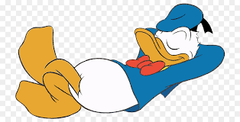
content
Talk to your partner about a place where you
go to feel content.

Slide 3
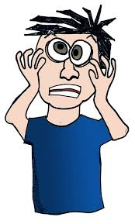
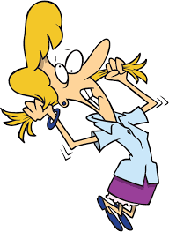
frustrated
Talk to your partner about something that
makes you frustrated.

Slide 4
content or frustrated?

Slide 5
positive attitude
Talk to your partner about someone who gives
you a positive attitude.

Slide 6
negative attitude
Talk to your partner about what you can do
when you have a negative attitude.

Slide 7
positive or negative attitude?

Slide 8
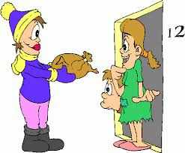
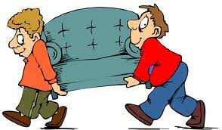
generous
Talk to your partner about something you
shared with someone because you are
generous.

Slide 9
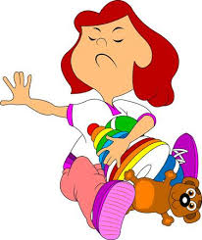
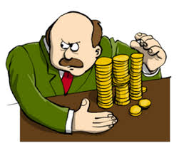
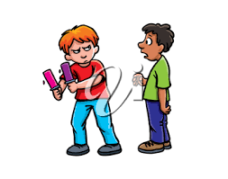
stingy
Talk to your partner about what you might
say to someone who is being stingy.

Slide 10
generous or stingy?

Slide 11
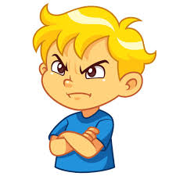
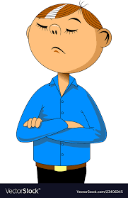
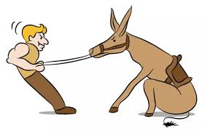
stubborn
Talk to your partner about a time when you
were stubborn because you didn’t want to
do something.

Slide 12
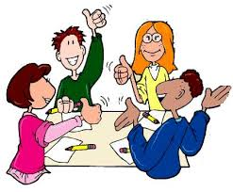
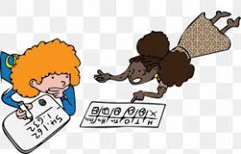
cooperative
Talk to your partner about a time when you
had a good day because you were cooperative.

Slide 13
stubborn or cooperative?

Slide 14
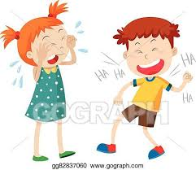
giddy
Talk to your partner about what makes
you feel giddy.

Slide 15
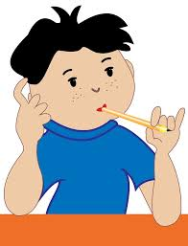
serious
Talk to your partner about what makes
you feel serious.

Slide 16
giddy or serious?

Slide 17
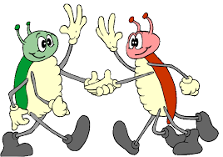
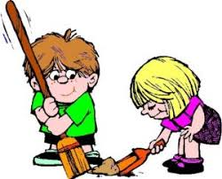
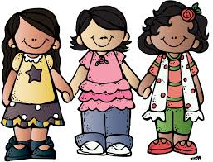
agreeable
Talk to your partner about why agreeable
people have friends.

Slide 18
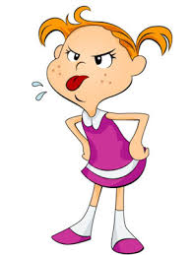
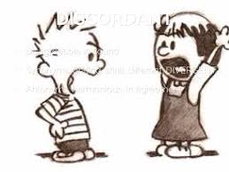
disagreeable
Talk to your partner about something that a
disagreeable person might say when asked
to cooperate.

Slide 19
agreeable or disagreeable?

Slide 20
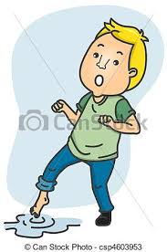
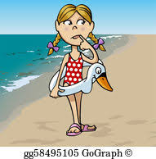
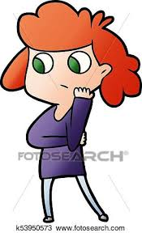
reluctant
Talk to your partner about a time when
you felt you were reluctant to do something.

Slide 21
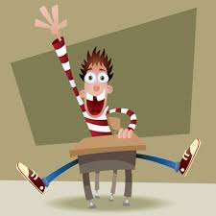
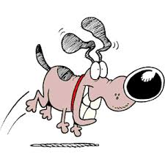
eager
Talk to your partner about something you
are eager to do today.

Slide 22
reluctant or eager?

Slide 23
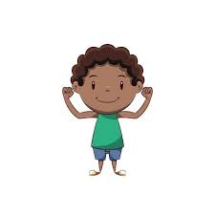
encouraged
Talk to your partner about someone who
encourages you to do your best.

Slide 24
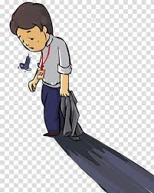
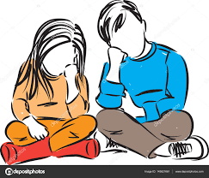
discouraged
Talk to your partner about what you can
say to someone who is feeling discouraged.

Slide 25
encouraged or discouraged?

Slide 26
focused
Talk to your partner about why your teacher
wants you to be focused.

Slide 27
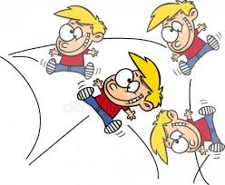
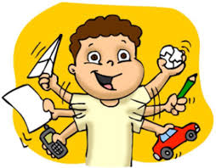
fidgety
Talk to your partner about what you can do to
be focused when you feel fidgety.

Slide 28
focused or fidgety?

Slide 29
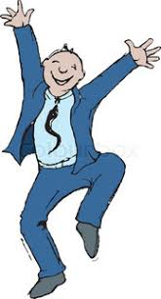
enthusiastic
Talk to your partner about why it is good to
be enthusiastic in school.

Slide 30
uninterested
Talk to your partner about why it is not good to
be uninterested in school.

Slide 31
enthusiastic or uninterested?

