Slide 1
Words for Emotions and Moods
Volume I
sociable/unsociable
energetic/sluggish
wary/unwary
joyful/gloomy
nervous/confident
delighted/disappointed
eager/hesitant
cooperative/uncooperative
inspired/uninspired
focussed/distracted

Slide 2
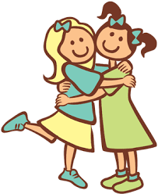
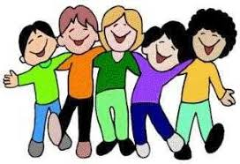
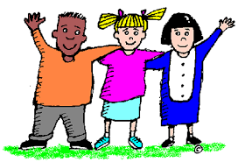
sociable
Talk with your partner about
what a sociable person likes to do.
sociable

Slide 3
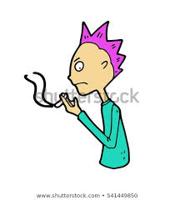
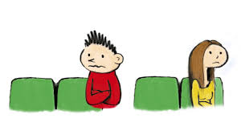
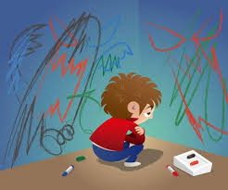
unsociable
Talk with your partner about
what an unsociable person does
not like to do.
esquivo, esquiva

Slide 4
sociable or unsociable?

Slide 5
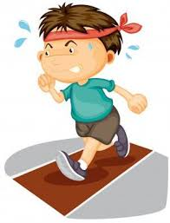
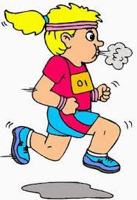

energetic
Talk with your partner about
whether you felt energetic when
you woke up this morning.
energico

Slide 6
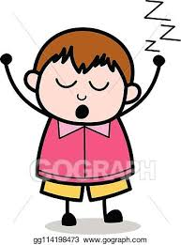
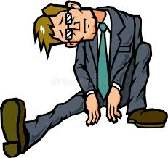
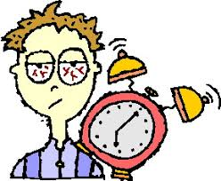
sluggish
Talk with your partner about whether
you felt sluggish when you woke up
this morning.
lenta, lento

Slide 7
energetic or sluggish?

Slide 8
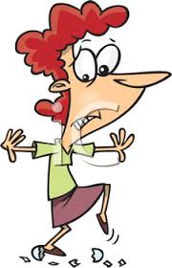
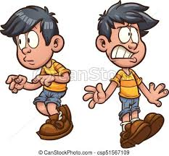
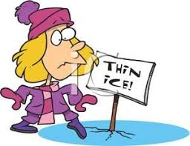
wary
Talk to your partner about
a time when you had to be
wary of something dangerous.
cauteloso, cautelosa

Slide 9
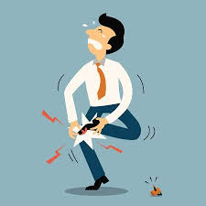
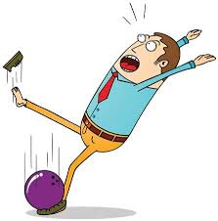
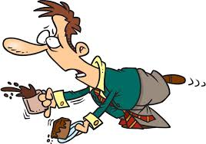
unwary
Talk to your partner about a time when
you or someone you know got hurt
because you or they
were unwary.
incauto, incauta

Slide 10
wary or unwary?

Slide 11


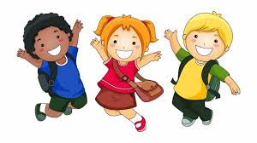
joyful
Talk to your partner about
whether or not you feel
joyful today.
feliz

Slide 12

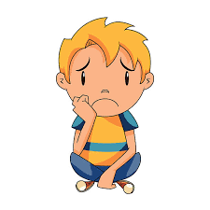
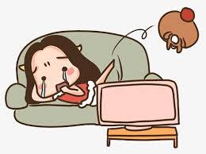
gloomy
Talk to your partner about
whether or not you feel gloomy
today.
miserable

Slide 13
joyful or gloomy?

Slide 14
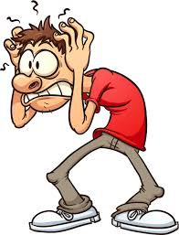
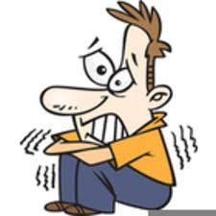
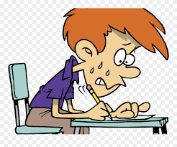
nervous
Talk to your partner about whether
or not you feel nervous today.
nervioso, nerviosa

Slide 15
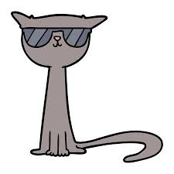
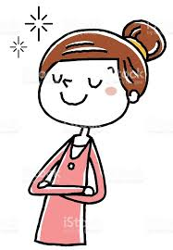

confident
Talk to your partner about
whether or not you feel
confident today.
seguro, segura

Slide 16
nervous or confident?

Slide 17
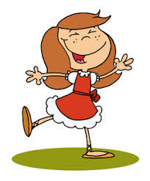
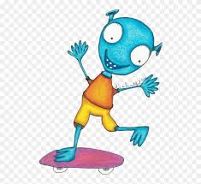
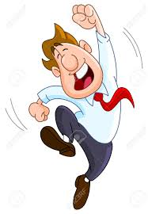
delighted
Talk to your partner about
something that would
make you feel delighted
today.
encantado encantada
E

Slide 18
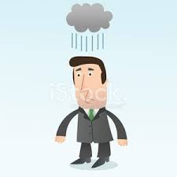
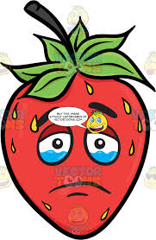
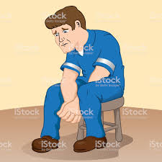
disappointed
Talk to your partner about
whether or not you feel
disappointed today.
decepcionado, decepcionado

Slide 19
delighted or disappointed?

Slide 20
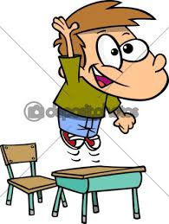
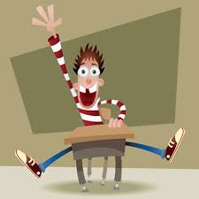
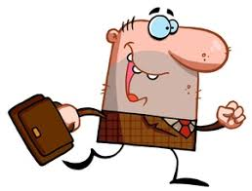
eager
Talk to your partner about
whether you are eager to
play sports.
ansiosa, ansioso

Slide 21
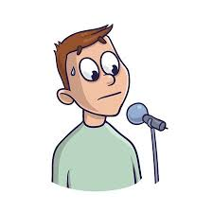
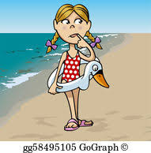
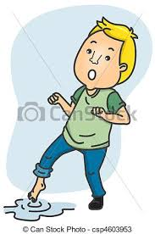
hesitant
Talk to your partner about
something that a shy person
would be hesitant to do.
dudoso, dudosa

Slide 22
eager or hesitant?

Slide 23
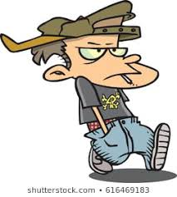
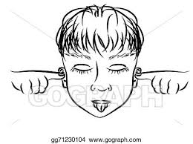

uncooperative
Talk to your partner about
something an uncooperative person
might do.
uncooperative,
uncooperative

Slide 24
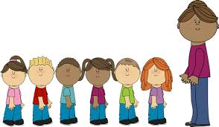
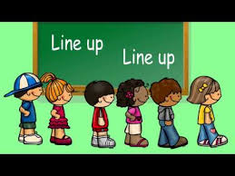

cooperative
Talk to your partner about why it is
important to be cooperative when there
is a fire drill.
cooperativo
cooperativa

Slide 25
uncooperative or cooperative?

Slide 26
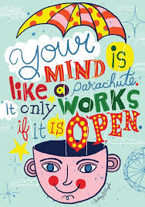


inspired
Talk to your partner about someone
who inspires you to do your best in school.
inspirado,
inspirada

Slide 27
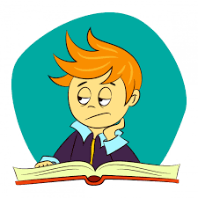

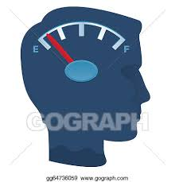
uninspired
Talk to your partner about what someone
can do to feel inspired when they are
feeling uninspired.
no inspirado,
no inspirada

Slide 28
inspired or uninspired?

Slide 29
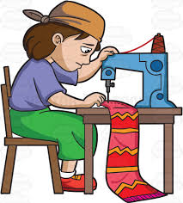
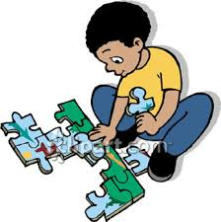

focussed
Talk to your partner about an activity
that you can become focussed on.
enfocado,
enfocada

Slide 30
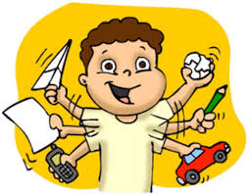
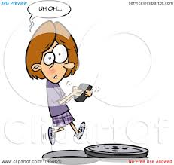
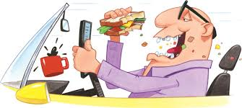
nervous
nervous
Talk to your partner about something that
distracts you when you are trying to
concentrate.
distraido,
distraida

Slide 31
engrossed or distracted?

