Slide 1
Words for Emotions and Moods__Volume V
bitter/compassionate
disappointed/grateful
optimistic/pessimistic
agitated/composed
introverted/extroverted
flattered/insulted
ornery/agreeable
resentful/pleased
triumphant/defeated
alienated/gregarious

Slide 2
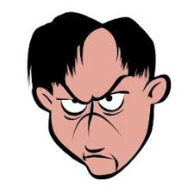
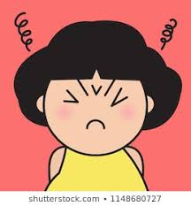

bitter
Talk with your partner about why
one of the people in the picture might
feel bitter.

Slide 3
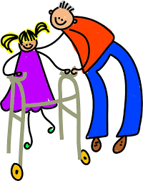
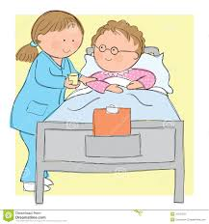
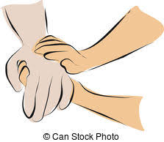
compassionate
Talk with your partner about what you might
say to let someone know that you feel
compassionate about them.

Slide 4
bitter or compassionate?

Slide 5
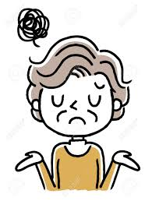
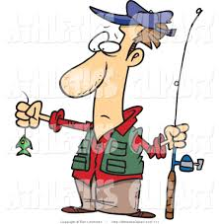
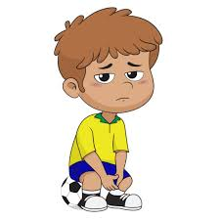
disappointed
Talk with your partner about why
one of the people in the picture might
feel disappointed.

Slide 6



grateful
Talk with your partner about what you might
say to let someone know that you feel
grateful to them.

Slide 7
disappointed or grateful?

Slide 8



optimistic
Talk with your partner about whether
you feel optimistic today.

Slide 9
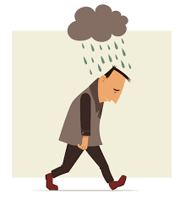

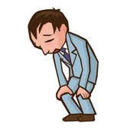
pessimistic
Talk with your partner about whether you
feel optimistic or pessimistic today.

Slide 10
optimistic or pessimistic?

Slide 11

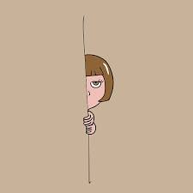
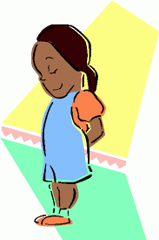
introverted
Talk with your partner about a time when
you felt introverted.

Slide 12
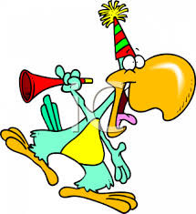
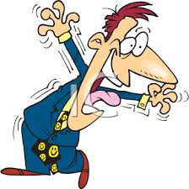
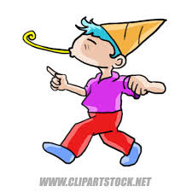
extroverted
Talk with your partner about a time when
you felt extroverted.

Slide 13
introverted or extraverted?

Slide 14
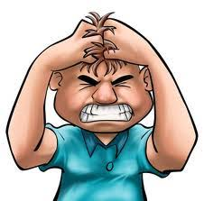
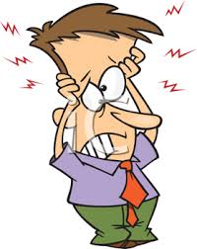
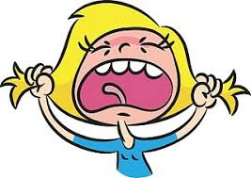
agitated
Talk with your partner about a time when
you felt agitated.

Slide 15

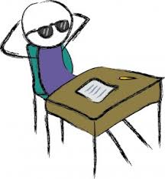
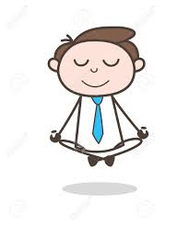
composed
Talk with your partner about what you can
do to feel composed when you are agitated.

Slide 16
agitated or composed?

Slide 17
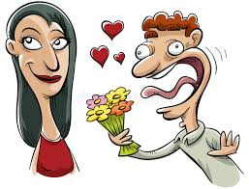
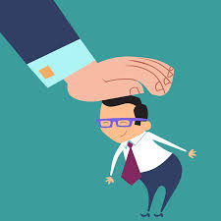

flattered
Talk with your partner about what you can
say to your teacher to flatter her (or him).

Slide 18
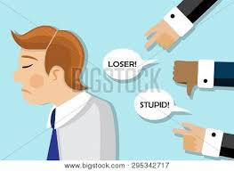
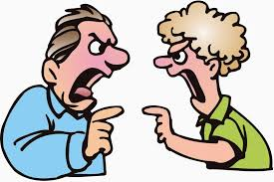
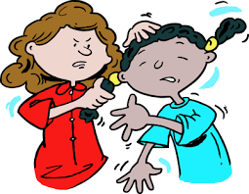
insulted
Talk with your partner about what you should
not say to your teacher because he or she might
feel insulted.

Slide 19
flattered or insulted?

Slide 20

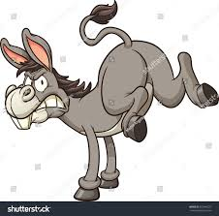
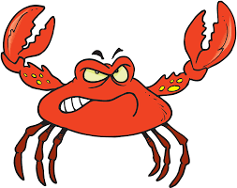
ornery
Talk with your partner about how your
friend might feel if you were being ornery.

Slide 21
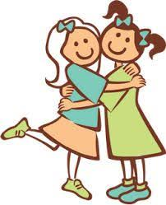
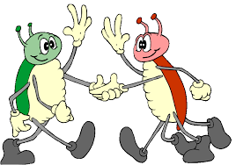

agreeable
Talk with your partner about how your friend
might feel if you were being agreeable.

Slide 22
ornery or agreeable?

Slide 23


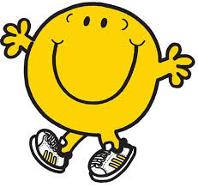
pleased
Talk with your partner about what you
can do to make your teacher feel pleased.

Slide 24
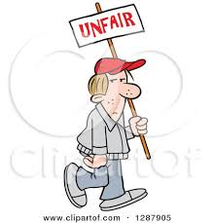
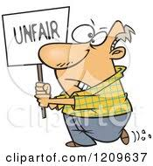
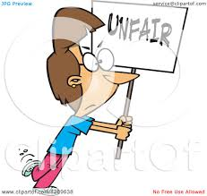
resentful
Talk with your partner about why someone
might feel resentful.

Slide 25
pleased or resentful?

Slide 26


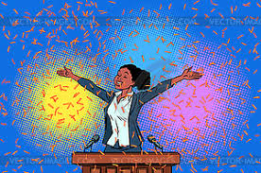
triumphant
Talk with your partner about a time when
you or your favorite team felt triumphant.

Slide 27
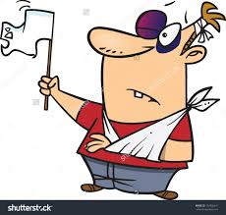
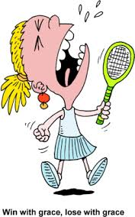
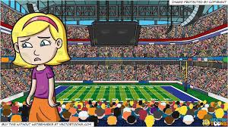
defeated
Talk with your partner about a time when
you or your favorite team felt defeated.

Slide 28
triumphant or defeated?

Slide 29
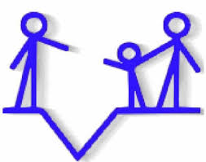
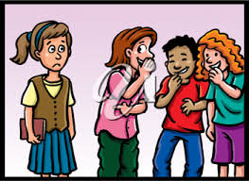
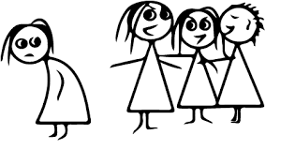
alienated
Talk with your partner about what you
might do to help someone who feels
alienated.

Slide 30
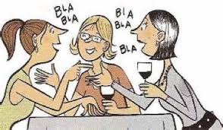


gregarious
Talk with your partner about why gregarious
people are happier than alienated people.

Slide 31
alienated or gregarious?

