Slide 1
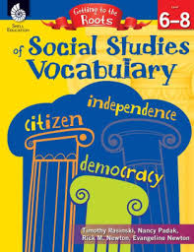

Slide 2
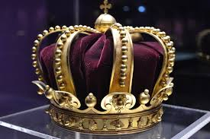
Rulers and Governments
Root: arch-,-archy
Means: government

Slide 3
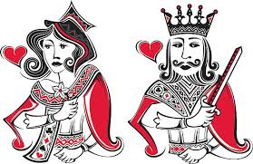
Rulers and Governments
Root: arch-,-archy
Means: government
monarch, monarchy, monarchist

Slide 4
Rulers and Governments
Root: -crat, -cracy
Means: government

Slide 5
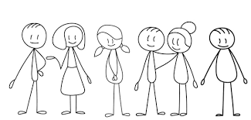
Rulers and Governments
Root: -crat, -cracy
Means: government
democracy, democracies
democratic/undemocratic
Democrat, Democratic Party
demo— people

Slide 6
Rulers and Governments
Root: -dic, dict-
Means: to speak with authority

Slide 7
Rulers and Governments
Root: -dic, dict-
Means: to speak with authority
dictator, dictatorship dictatorial,
(acting) dictatorially

Slide 8
Rulers and Governments
Root: pol-

Slide 9
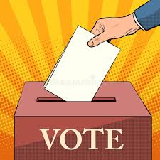
Rulers and Governments
Root: pol-
Means: power
politics, political, politician
policy

Slide 10
Rulers and Governments
Root:-col
Means: settle

Slide 11
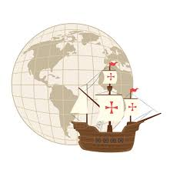
Rulers and Governments
Root: pol-
Means: settle
colony, colonial, colonize,
colonialism, colonization

Slide 12
Rulers and Governments
Root: pub
Means: of the people

Slide 13
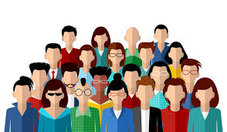
Rulers and Governments
Root: pub
Means: of the people
republic, Republican
public, publish, publication

Slide 14
Rulers and Governments
Root: -quer
Means: to win

Slide 15
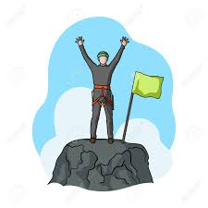
Rulers and Governments
Root: quer-
Means: to win
conquer, conqueror, conquest
reconquer, reconquest

