Slide 1
Welcome to “Decent Exposure” Volume IV
Countenance: slide 3
Profound: slide 4
Manifest: slide 5
Serene: slide 6
Sublime: slide 7
Prodigious: slide 8
Clamor : slide 9
Condescend : slide 10
Languor: slide 11
Allude : slide 12
Feeble : slide 13
Alight : slide 14
Apprehension : slide 15
Sabotage : slide 16
Liberal : slide 17
Acute : slide 18
Emphatic : slide 19
Reproach : slide 20
Contempt: slide 21
Ceremonious : slide 22
Morose : slide 23
Vapid : slide 24
Bereft : slide 25
Genial : slide 26
Nettles : slide 27

Slide 2
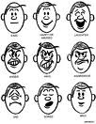
Countenance: facial expression
Synonym: visage
Sometimes used as a verb:
to approve of
to sanction
to endorse
“Our school does not
countenance bullying.”
A look of boding uneasiness took possession of every
The
countenance
of a stout old lady beamed
countenance.
The Adventures of Tom Sawyer
by Mark Twain
down into the room.
It was easy to see joy and courage in the fellow’s
countenance.
The Great Gatsby
by F. Scott Fitzgerald
Robinson Crusoe
by Daniel Defoe
The officers were impatient and snappy, their
countenances
clouded with the tales of misfortune.
The Red Badge of Courage
by Stephen Crane
Frequency: Forms of this
word appear once in every 127
pages of text.

Slide 3
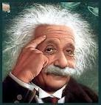
Profound: deep; deeply meaningful
Synonym: unfathomable
Antonyms: shallow; inane, superficial; facile; simple;
obvious; glib
There was a silence, prolonged and
unbroken.
My mother couldn’t have more
profound
profoundly
The stillness was so
profound
that he heard a little
disagreed with that.
animal twittering somewhere nearby under the snow.
The
profound
calm which only apparently precedes
The Adventures of Tom Sawyer by
Mark Twain
One Writer’s Beginnings by
Eudora Welty
Ethan Frome Edith Wharton
and prophesies of the storm is perhaps more awful
than the storm itself.
Forms:
N: profundity
V: OO
Adj: profound
Adv: profoundly
Moby Dick --Herman Melville
Frequency: Forms of this
word appear once in every 155
pages of text.

Slide 4

Forms:
N: the manifestation
Adj: manifest
V: manifest, manifests,
manifested, manifesting
Adv: OO
Manifest: to show; to reveal
Frequency: Forms of this
word appear once in every
126 pages of text.
The physician
manifested
a strong interest
The reason for its unpopularity was soon made
manifest.
in the young clergyman.
The Mayor of Casterbridge
Thomas Hardy
The squirrels
manifest
no concern whether the woods
The
it took was of great interest to them.
manifestation
The Scarlet Letter
by Nathaniel Hawthorne
will bear chestnuts this year or not.
Song of Solomon
by Toni Morrison
Walden by Henry David Thoreau
Historical References:
Manifest Destiny: The belief that God
intended for the United States to extend
its territory from coast to coast (Western
Expansion)
Communist Manifesto: The statement of the beliefs and goals of communism, written by Karl Marx and Fred Engels
Synonyms: (adj) obvious; overt;
demonstrable
(v): demonstrate; reveal
Antonyms: (adj) covert; hidden;
subtle; obscure

Slide 5

Synonym: tranquil
Forms:
N: serenity
Adj: serene
V: 00
Adv: serenely
Antonyms: turbulent; chaotic;
tumultuous; agitated
Serene: calm; peaceful
Forms:
N: serenity
Adj: serene
V: 00
Adv: serenely
Synonym: tranquil
Antonyms: turbulent; chaotic;
tumultuous; agitated
Frequency: Forms of this
word appear once in every
449 pages of text.
The
serene
sky and verdant fields filled me with ecstasy.
William Wordsworth
The moon seemed to gloat
serenely
over the spectacle.
Lord Jim by Joseph Conrad
My
serene
ity
is rippled but not ruffled.
Walden by Henry David Thoreau
The
serene
ocean rolled toward me in a thousand
hues of blue.
Moby Dick by Herman Melville

Slide 6
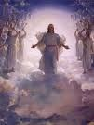
sublime: elevated; high-minded; spiritual
Synonyms: heavenly; celestial
Forms:
N: OO
Adj: sublime
V: 00
Adv: sublimely
Antonyms: mundane; vulgar;
earth-bound
The best cooking comes from the simplest but freshest ingredients and a sense of
combining them just right. Such dishes are
I cannot believe that I am the same creature
whose thoughts were once filled with
When I heard the choir sing in St. Patrick’s
Cathedral, I was overcome with a sense of
I dreamed of a
Seeing the Grand Canyon at sunrise was truly
sublime
vision that delivered peace to me in my time of grief.
and transcendent visions of the beauty and
majesty of goodness.
beauty and spirituality.
Frankenstein by
Mary Wollenscraft Shelley
Etymology: Sub: Under
Lime: Line
under the line that divides heaven and earth
Related word: subliminal (under the line of conscious awareness)
Frequency: Forms of this
word appear once in every
320 pages of text.

Slide 7
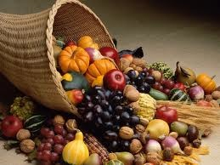
Prodigious: plentiful; productive; bountiful;
lavishly fruitful
Synonyms: abundant
Related Word:
prodigy
Antonyms: meager; puny; scarce
Each lad had an income now that was simply
I like them
the
prodigious
uproar of battle…
ly.
…a
prodigious--
blood-dripping mass
prodigious
a dollar for every weekday.
The Red Badge of Courage
-Stephen Crane
Pride and Prejudice
-Jane Austen
Moby Dick
-Herman Melville
The Adventures of Tom Sawyer
-Mark Twain
Frequency: Forms of this
word appear once in every
474 pages of text.

Slide 8
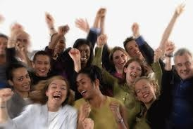
clamor: to create noise because of eagerness
or excitement
Synonym: uproar
Forms:
N: clamor
Adj: clamorous
V: 00
Adv: clamorously
Antonyms: tranquility; serenity
From the first, I was
ous
…an instant burst of
ed
to be allowed to
be let out.
The animals
The sailors
His feelings
ed
clamor
ed
to learn.
for pardon on the decks of the dock.
for an answer his mind could not give.
Hamlet
-William Shakespeare
Animal Farm
-George Orwell
One Writer’s Beginnings
-Eudora Welty
Moby Dick
-Herman Melville
Native Son
-Richard Wright
Frequency: Forms of this
word appear once in every
pages of text.

Slide 9
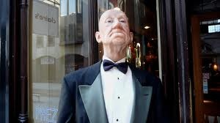
Condescend: to express a feeling of superiority
when interacting with others
Synonym: deign
Etymology:
con: with
descend: down
Antonyms: revere; respect
Men should speak to women in the language of truth
and soberness, and away with the lullaby strains of
Jem
condescended
These two great commanders did not
A sort of
He would answer
condescending
condescendingly.
concern and compassion…
condescend
condescending
endearments.
to take me to school on the first day.
Peter Pan - J.M. Barrie
to fight in person.
Moby Dick -Herman Melville
“Vindication of the Rights of Women
-Eudora Welty
To Kill A Mockingbird—
Harper Lee
The Adventures of Tom Sawyer—
Mark Twain
Frequency: Forms of this
word appear once in every
pages of text.

Slide 10
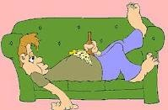
Languor: a state of laziness or inactivity
Synonyms: lassitude; torpor
Forms:
N: languor
Adj: languorous
V: 00
Adv: languorsly
Antonyms: energy; intensity;
industriousness
the
languor
of sleep
She opened her eyes in a state of dreamy, delicious
a
languid
weariness
languor.
…dreamy,
languorous
eyes…
languid
grace
Uncle Tom’s Cabin—
Harriet Beecher Stowe
Eustatia Vye drooped again into a
languor.
the
The Picture of Dorian Gray—
Oscar Wilde
languor
of afternoon music
Portrait of the Artist as a Young Man—
James Joyce
The Return of the Native—
Joseph Conrad
Frequency: Forms of this
1,762word appear once in every
pages of text.

Slide 11
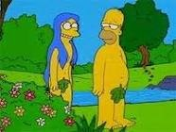
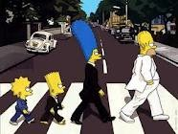
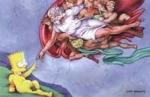
Allude: to refer to something
indirectly, expecting the
audience to understand
the true intended meaning
Synonyms: refer; imply; hint at
Forms:
N: allusion
Adj: 00
V: allude, alludes
alluded, alluding
Adv: 00
Antonyms: stipulate; indicate
They attacked one another with private
No new
The vast majority consisted of
was made to the subject over
which I brooded.
allusion
allusions
allusions.
He
alluded
to last night only by asking how Phineas was.
to prior communications that Major Major had
never even heard of.
A Separate Peace—
John Knowles
Jane Eyre—
Charlotte Bronte
A Passage to India—
E.M. Forester
Catch-22—
Joseph Heller
Frequency: Forms of this
word appear once in every
181 pages of text.

Slide 12
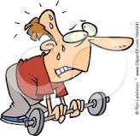
Feeble: weak, usually referring to the aged
body, but often applied to speech or
ideas
Frequency: Forms of this
word appear once in every
187 pages of text.
Three or four times I thought I would
feebly
He had only just reached middle age, and there was no
Up until that era, where you lived was at least where
start a conversation.
sign of
your parents lived, and you expected to live there
feebleness
in his muscles.
with your children when you became
enfeebled.
Mr. Wopsle cried out, “No!” with the malice
feeble
The Adventures of Tom Sawyer
Mark Twain
Great Expectations
Charles Dickens
of a tired man.
Homeless
Anna Quindlen
Synonyms: decrepit; debilitated
Forms:
N: feebleness
Adj: feeble
V: enfeeble; enfeebles
enfeebled; enfeebling
Adv: feebly
Great Expectations
Charles Dickens
Antonyms: robust; strong; healthy

Slide 13
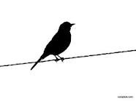
Alight: to land upon; to touch down;
to get down from a height; to arrive
Synonyms: descend upon; perch
Forms:
N: 00
Adj: 00
V: alight, alights
alit, alighting
Adv: 00
Antonyms: ascend from; embark
I had
alighted
from Joe’s back on the brink of the ditch when we came up, and
had not moved since.
Swooping down, they
alighted
at his feet.
I resolved to
We got a chair out, ready for Mrs. Joe’s
alight
as soon as we touched the town, and I took myself out of his hearing.
alighting,
Great Expectations
Charles Dickens
and stirred up the fire…
Great Expectations
Charles Dickens
Great Expectations
Charles Dickens
Frequency: Forms of this
word appear once in every
493 pages of text.
Great Expectations
Charles Dickens

Slide 14
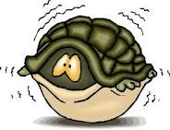
Apprehension: fear and nervousness about a
specific event in the future
Synonyms: uneasiness; trepidation; anxiety
Forms:
N: apprehension
Adj: apprehensive
V: 00
Adv: apprehensively
Antonyms: eagerness; assurance; confidence
As Mr. Kraler speaks, they all listen with
She gave the other two an
apprehensive
look; they
All these things I saw without knowing that I saw them,
all took deep breaths and then dived at the gnarled
As I walked on to the hotel, I felt that a dread,l much
apprehension.
because I was in an agony of
apprehension.
stump between them..
exceeding a mere
apprehension
Diary of Anne Frank
Frances Goodrich and Albert Hackett (play version)
Great Expectations
Charles Dickens
or disagreeable recognition, made me tremble.
Great Expectations
Charles Dickens
Great Expectations
Charles Dickens
Frequency: Forms of this
word appear once in every
157 pages of text.

Slide 15

Sabotage: to destroy a plan in a scheming manner
Forms:
N: sabotage; sabateur
Adj: 00
V: sabotage, sabotages
sabotaged, sabotaging
Adv: 00
Synonym: undermine
Antonyms: support; assist
“If you wish to leave with your students, we shall not
One good piece of news is that the Labor Exchange
A day never passed when spies and
saboteurs
stop you, but if any of you attempt to
was set on fire in an act of
sabotage.
sabotage
under his direction were unmasked by the
our resistance or take arms against us within this
All subsequent crimes against the Party, all
Thought Police.
sabotage,
castle, then Horace, we will duel.”
treacheries, acts of
deviations, heresies
1984 – George Orwell
sprang directly out of his teachings.
Diary of a Young Girl— Anne Frank
Harry Potter and the Deathly Hollows —J.K. Rowling
1984 – George Orwell
Frequency: Forms of this
word appear once in every
3,488 pages of text.

Slide 16
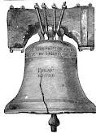
Liberal: free, generous, easygoing
Synonym: lenient; flexible; yielding
Antonyms: rigid; unyielding
Also, I was told what my allowance would be– it
Forms:
N: liberty; liberality
Adj: liberal
V: liberate, liberates
liberated, liberating
Adv: liberally
was a very
liberal
one…
Now, you understand, Mr. Pip, that the name of
your
liberal
benefactor is to be kept a secret.
Great Expectations
-- Charles Dickens
Great Expectations
-- Charles Dickens
And he was so very free of the wine that he
called for the other bottle and handed it out with the
Great Expectations
-- Charles Dickens
same
liberality
,when the first was gone.
Frequency: Forms of this
word appear once in every
111 pages of text.
Great Expectations
-- Charles Dickens
Related word:
library

Slide 17
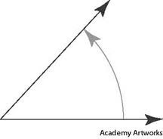
Acute: sharp; intense; knife-like;
Synonym: angular
Forms:
N: acuity; acuteness
Adj: acute
V: 00
Adv: acutely
Antonyms: obtuse; rounded; mild
Her head ached
acutely.
…a crisis of
…feeling
The longing to leave becomes
acutely
acutest
sorry…
pain…
acute.
Pride and Prejudice
-- Jane Austen
Song of Solomon
-- Toni Morrison
Native Son
-- Richard Wright
The Scarlet Letter
-- Nathaniel Hawthorne
Frequency: Forms of this
word appear once in every
339 pages of text.

Slide 18
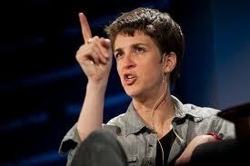
Emphatic: strongly stated; emphasized
At first I was very afraid of going to places where
H. and I had been happy—our favourite pub, our
favorite wood. But I decided to do it at once—like
sending a pilot up again as soon as possible after
he’s had a crash. Unexpectedly it makes no
difference. Her absence is no more in
those places than anywhere else. It’s not local
at all. I suppose if one were forbidden all salt, one
wouldn’t notice it more in any one food than another. Eating in general would be different, every
day, at every meal. It is like that. The act of living
is different in all through. Her absence is like the
sky, spread over everything.
Forms:
N: emphasis
Adj: emphatic
V: emphasize, emphatizes,
emphasized, emphasizing
Adv: emphatically
Synonym: vehement
Antonyms: mild; unsure; tentative
…he made an
swing at the ditch with his
The other lady, who had not spoken yet, said
emphatic
emphatic
I heard her say to Joe, in a most
emphatic
voice,
gravely and
emphatically
, “True, very true.”
manacled hands.
“The boy has been a good boy here, and that is his reward.”
Great Expectations —Charles Dickens
Great Expectations —Charles Dickens
Great Expectations —Charles Dickens
A Grief Observed
--C S. Lewis
Frequency: Forms of this
word appear once in every
485 pages of text.

Slide 19
Reproach: (v) scold, reprimand
(n) disapproval
Synonym: (n) berate
Forms:
N: reproach
Adj: reproachful
V: reproach, reproaches,
reproached, reproaching
Adv: reproachfully
Antonyms: laud; praise; support
endorse; compliment
I wanted to make Joe less ignorant and common
that he might be worthier of my society and less
open to Estella’s
But he eyed me severely—as if I had done
anything to him!—and departed with the words
delivered: “Boy! Let your behavior here be a credit unto them which brought you up by hand.”
reproachfully
reproach.
“No, Joseph,” said my sister, still in a
manner, while Joe apologetically drew back the
back of his hand from his nose.
reproachful
She made it a powerful merit in herself and also
a to Joe that she wore this apron
so much.
reproach
Great Expectations
--Charles Dickens
Great Expectations
--Charles Dickens
Great Expectations
--Charles Dickens
Great Expectations
--Charles Dickens
Frequency: Forms of this
word appear once in every
188 pages of text.

Slide 20
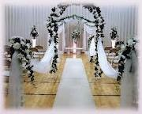


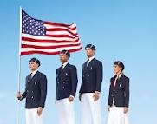
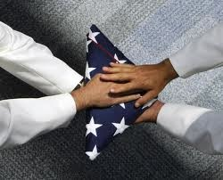
Ceremonial: related to
a formal ceremony
Forms:
N: ceremony
Adj: ceremonial,ceremonious
V: 00
Adv: ceremonially, ceremoniously
Synonym: ritualistic, solemn
Antonyms: casual, everyday
These extensive arrangements occasioned us to be
cut off
unceremoniously
“My dear Sybill,” said Dumbledore in a slightly
exasperated voice, “there is no question of throwing
in respect of breakfast.
This was not a very
ceremonious
way of rendering
As we neared home, Joe vaguely acknowledging
Great Expectations
--Charles Dickens
homage to a patron saint.
you
from anywhere, but Harry does
the occasion as an impressive and
unceremoniously
ceremonious
Great Expectations
--Charles Dickens
have an appointment…”
one and went on ahead to open the front door.
Great Expectations
--Charles Dickens
Frequency: Forms of this
word appear once in every
115 pages of text.
Harry Potter and the Half-Blood Prince
--J. K. Rowling

Slide 21

Contempt: open expression of
hatred and scorn; open violation
of authority
Synonym: disdain
Forms:
N: disdain
Adj: disdainful
V: disdain, disdains,
disdained, disdaining
Adv: disdainfully
Antonyms: admiration, regard
esteem
To punish me for my
for authority, fate
She laughed
contemptuously
contempt
,pushed me out, and
made me an authority myself.
locked the gate upon me.
There was an expression of
Her
for me was so strong, it was
contempt
contempt
on his face,
--Albert Einstein
and he bit the side of a great forefinger as he watched a sea of faces.
infectious, and I caught it.
Great Expectations
--Charles Dickens
Great Expectations
--Charles Dickens
Great Expectations
--Charles Dickens
Frequency: Forms of this
word appear once in every
155 pages of text.

Slide 22
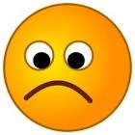
Morose: gloomy; sad
Synonym: melancholy, sullen
Forms:
N: moroseness
Adj: morose
V: 00
Adv: morosely
Antonyms: cheerful, sanguine
Only old Benjamin was just the same as ever,
The clay of White Fang had been molded until he
He fell
morosely
silent.
Those around him had never seen the Count so
except for being a little greyer around the muzzle,
became what he was,
morose
and lonely, unloving
Of Mice and Men
--John Steinbeck
morose
and irritable.
and, since Boxer’s death, more
and ferocious, the enemy of all his kind.
morose
and
War and Peace
--Leo Tolstoy
taciturn than ever.
Animal Farm
--George Orwell
White Fang
--Jack London
Frequency: Forms of this
word appear once in every
2,157 pages of text.

Slide 23
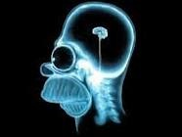
Vapid: Empty-headed; mindless; meaningless
mentally blank; without thoughts
Synonym: inane, superficial
Forms:
N: vapidity, vapidness
Adj: vapid
V: 00
Adv: vapidly
Antonyms: profound, sophisticated, intriguing
The man looked
Your eyes are as
She was a
A large
doll with gold curls
as the glass eyes
little thing, vacantly
vapid
across the street,
ly
and a violet dress sat on the glass top
of a cabinet.
frowning a little.
of your stuffed fox.
pretty, curvy, perhaps fourteen.
Call it Sleep
--Henry Roth
Atlas Shrugged
--Ayn Rand
The Moon is a Harsh Mistress
--Robert Heinlein
Ulysses
--James Joyce
Frequency: Forms of this
word appear once in every
6,238 pages of text.

Slide 24
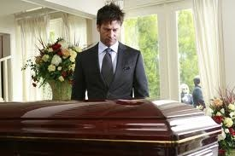
Bereft: grief-stricken; in mourning
Synonym: grieving
Forms:
N: bereavement
Adj: bereft, bereaved
V: 00
Adv: 00
Antonyms: celebratory, joyful
I judged him to be a bachelor from the frayed
“Good Lord,” said he, “Camilla, what can it signify
If he were doomed to be
bereft
of her, so it must be.
Madam, you have
bereaved
me of all words.
bereft
condition of his linen, and he appeared to have
as long as the poor
little things are
The Mayor of Casterbridge
--Thomas Hardy
sustained a good many
Only my blood speaks to you in my veins.
in black?”
bereavements
;for he wore
The Merchant of Venice
--Wm Shakespeare
Great Expectations
--Charles Dickens
at leas four mourning rings…
Great Expectations
--Charles Dickens
Frequency: Forms of this
word appear once in every
2,122 pages of text.

Slide 25
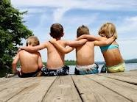
Genial: friendly, sociable; favorable to
Synonym: gregarious; amiable
Forms:
N: congeniality
Adj: genial, congenial
V: 00
Adv: genially, congenially
Antonyms: aloof; sullen
They would doubtless be
congenial
with the
So soft was her step, it failed to make even a sound,
“Harry, that’s three of my little suppers you’ve missed
generality of female minds.
but for the magical thrill imparted by her
genial
The course terminated, and Mr. Pumblechook
now!” said Slughorn, poking him
genially
in the chest.
touch.
Pride and Prejudice
--Jane Austen
genial
had begun to beam under the
The Adventures of Tom Sawyer
--Mark Twain
influence of
gin-and-water.
Harry Potter and the Half-Blood Prince
--J. K. Rowling
Great Expectations
--Charles Dickens
Frequency: Forms of this
word appear once in every
499 pages of text.

Slide 26
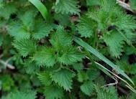
Forms:
N: nettles
Adj: nettlesome
V: 00
Adv: 00
Nettles: thickets of weeds, usually
with thorns
Nettles
grew all around it, their tips reaching
As I saw him go, picking his way among the
nettles,
the windows, which were tiny and thick with
grime.
and among the brambles that bound the green
Great Expectations
--Charles Dickens
At such time I found out for certain that this
bleak place overgrown with
nettles
Frequency: Forms of this
word appear once in every
1,725 pages of text.
was the churchyard.
Great Expectations
--Charles Dickens

