Slide 1
Welcome to “Decent Exposure” : Middle School Volume I
“Decent Exposure” will help you teach words explicitly and thoroughly, so that students
will remember and use them. The words have been chosen on the basis
of their frequency in serious literature, the kind of books that students read in school.
Also, these words have synonyms, antonyms, associations, components,
and forms that extend beyond just the single word that might appear on a vocabulary
list.
By showing how these words are used in several contexts, students derive a 360°
perspective as well as model sentences from great literature.

Slide 2
Welcome to “Decent Exposure” Volume I
Refugee (Slide 3)
Apparent (Slide 4)
Elaborate (Slide 5)
Bewildered (Slide 6)
Congregate (Slide 7)
Haughty (Slide 8)
Persist (Slide 9)
Precipice (Slide 10)
Culprit (Slide 11)
Comprehend (Slide 12)
Emerge (Slide 13)
Stationary (Slide 14)
Dwelling (Slide 15)
Descend (Slide 16)
Despair (Slide 17)
Ominous (Slide 18)
Ravine (Slide 19)
Valor (Slide 20)
Arid (Slide 21)
Cease(Slide 22)
Beckon (Slide 23)
Recite (Slide 24)
Tranquil (Slides25)
Jubilant (Slide 26)
Chaos (Slide 27)

Slide 3
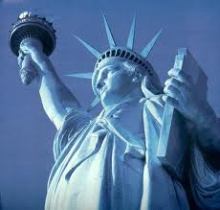
refugee: person who is forced to
seek safety in another country,
usually because of war or poverty
Any form of refugee will appear once in every 527 pages of text.
One million Afghans fled the country as
Rowan welcomes
He took them to a school in a nearby
Maybe she saw me as a needy
refugees
and new arrivals
refugees.
refugee
every day.
camp.
from the war.
After the First Death by
Robert Cormier
Milkweed by
Jerry Spinelli
Lone Survivor by Marcus Luttrell
Maelstrom by
Harry H. Neff
Related words:
refuge: a place of safety
fugitive: person who runs away from the law
immigrant: person who moves to a new country
to seek asylum: to go to another country in order
to be safe from a law that is considered
cruel or unfair

Slide 4
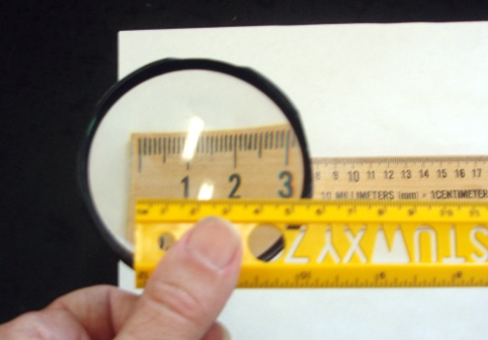
Apparent: clear to see Related word: appear
Syn: obvious, overt
Ant: obscure, covert
Forms:
Noun: 00 Verb: 00
Adjective: apparent
Adverb: apparently
Incredible as it seemed, he
Apparently
I hoped my disappointment wasn’t too
The anesthetic was
satisfied, he pressed a button and
apparently
apparent
intended going toe to toe with the troll.
losing its effectiveness.
in my voice.
rolled down the window.
The Hound of Rowan by Harry H. Neff
Twilight by
Stephanie Meyer
Artemis Fowl by
Eoin Colfer
New Moon by
Stepenie Meyer
Any form of the word apparent will appear
once in every 56 pages of text.

Slide 5
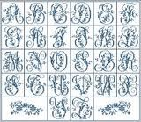
Elaborate (adjective): detailed; fancy
elaborate (verb): to provide many details when
describing something
Related word: labor
Syn: ornate, fancy, fanciful, decked out, complex
Ant: simple, elegant, bare; simplify
Forms: Noun: elaboration Verb: elaborate
elaborates
Adjective: elaborate elaborating
Adverb: elaborately elaborated
Have you ever noticed that the more you try not to
think, the more
elaborate
your thoughts become?
The Secret Life of Bees
by Sue Monk Kidd
A fire was crackling under an
elaborate
carved mantlepiece.
HP and the Chamber of Secrets by JK Rowling
Only when I swallowed did I realize they were looking
He was mad, as if I’d
elaborately
planned getting sick.
at me, waiting for me to
elaborate.
Any form of the word elaborate will appear
once in every 246 pages of text.
The Truth About Forever by Sarah Dessen
Some Like You by Sarah Dessen

Slide 6
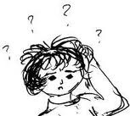
Bewildered: completely confused; in a fog
Related word: wild
Syn: befuddled, bemused, dumbfounded
Ant: certain, sure, confident, poised, prepared
Lou Ann had forgotten it was Halloween, and
Jason returned with a
bewildered
look on his face
He was
bewildered,
not thinking in that direction
was completely
bewildered
and said, “I don’t know what you’re talking about.”
when a mob of children
The man was still there, trying to smile, looking
at all.
Twilight by
Stephenie Meyer
bewildered.
came to the door.
The Ultimate Gift by
Jim Stovall
The Bean Trees by
Barbara Kingsolver
The Martian Chronicles by Ray Bradbury
Any form of the word bewildered will appear once in every 264 pages of text.

Slide 7
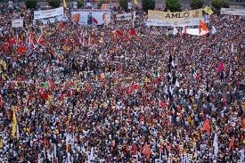
Congregate: form a group (of people or animals)
Syn: cluster, flock together
Ant: segregate, disperse
The girls had
congregated
in her room.
It’s just that it’s very difficult for a large number of
In front of the truck, workers
congregated
Julia Alverez,
How the Garcia Girls Lost
Their Accent
He and his groupmates
wizards to
in groups of five or six.
congregate
congregated
without attracting attention.
by the tables in front of the auditorium and took their
The Giver by
Lois Lowry
HP and the Goblet of Fire
J.K. Rowling
packaged food.
The Wedding
Nicholas Sparks
Any form of the word congregate will appear once in every 306 pages of text.

Slide 8
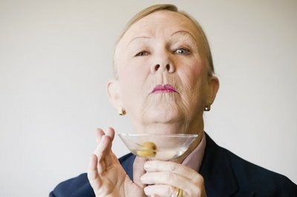
Haughty: acting with a superior attitude
Syn: snobby, snobbish, supercilious,
condescending
Ant: humble, modest, unassuming, demure
Forms: noun: haughtiness verb: 00
adjective: haughty adverb: haughtily
Harry supposed that she was beautiful, with her
Girls responded with pointed whispers,
“Fine,” said Hermione
They were also
haughty,
haughtily,
brutal, and selfish.
and she marched off.
haughty
waist-length hair and floor-length cloak, but she also
laughter, and, as I myself have often done, with evil
looked
eyes.
haughty
and proud.
HP and the Deathly Hollows
--J.K. Rowling
HP and the Prisoner of Azkaban
--J.K. Rowling
Crank
--Ellen Clark
The Maelstrom
--Henry H. Neff
Any form of the word haughty will appear once in every 399 pages of text.

Slide 9
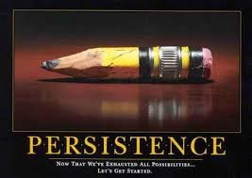
Persist: to keep going, despite hardships
Syn: continue, stick with
Ant: resign, give up, surrender
Forms: Noun: persistence Verb: persist, persists
persisting
persisted
Adjective: persistent
Adverb: persistently
“No, I mean, really,” she
persisted.
…he had tried in every way to keep the Indian from
And yet I
persist
like a stubborn mule in my efforts.
Tuck Everlasting
--Natalie Babbitt
But the old man
him, but the Indian
persisted
persisted.
in his attempts to strike
up a conversation.
The Alchemist
--Paul Coelho
The History of Love
--Nicholas Krauss
Bless Me Ultimia
--Rudolfo Anaya
Any form of the word persist will appear once in every 154 pages of text.

Slide 10
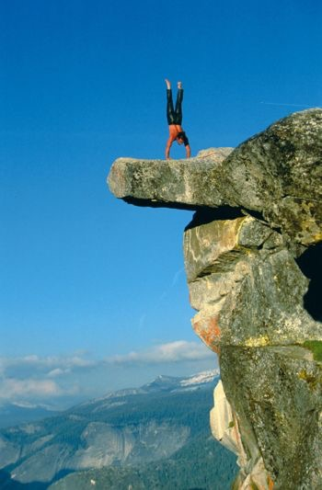
Precipice: a cliff
Related words: precipitate, precipitation
Forms: Noun: precipice Verb: precipitate, precipitates
precipitated, precipating
I gripped the chain-link fence and edged down the
That was when I noticed four figures standing on a
Then suddenly, as though it had come to the top of the
Finally I stopped on the edge of yet another
precipice,
mountain until I stood on the
precipice
hill and gone over a
which I sensed rather than saw.
precipice,
it dropped like a stone.
rocky ledge, much too close to the
precipice.
October Sky
--Homer Hickham
New Moon
--Stephenie Meyer
Charlie and the Chocolate Factory
--Roald Dahl
of the ditch.
Lone Survivor
--Marcus Luttrell
Any form of the word precipice will appear once in every 481 pages of text.

Slide 11

Culprit: guilty person
Syn: criminal, perpetrator
Forms:
Noun: culprit, culprits, culpability Verb: 00
Adjective: culpable
He stood over the empty box, head swiveling around
Who are the
culprits
?
the room, looking for the
I will hunt out the
Have you caught the
culprit
culprit.
culprits
and bring him to you.
?
Charlie and the Chocolate Factory
--Roald Dahl
The Looking Glass Wars
--Frank Beddor
HP and the Chamber of Secrets
--JK Rowling
The Host
--Stephenie Meyer
Any form of the word culprit will appear once in every 1,160 pages of text.

Slide 12

Comprehend: Understand
Forms: Noun: comprehension, comprehensiveness
Verb: comprehend, comprehends
comprehended, comprehending
Adjective: comprehensive, comprehensible
incomprehensible
Adverb: comprehensively
For her part, Winnie, now that the running was over,
Jonas listened, trying hard to
comprehend.
This would take some time to
comprehend.
began to
comprehend
what was happening.
I couldn’t
comprehend
Lois Lowry, The Giver
what this human woman was
William P. Young, The Shack
doing here, totally at ease, surrounded by vampires.
Natalie Babbit, Tuck Everlasting
Stephenie Meyer, New Moon
Any form of the word comprehend will appear once in every 128 pages of text.

Slide 13

Emerge: to slowly be revealed; to develop from an
early stage; to come out of hiding or to move from
one stage to another
Forms: Noun: emergence, emergency, emergencies
Verb: emerge, emerges, emerging, emerged
Adjective: emergent
Adverb: 00
Synonyms: appear, materialize, transpire
Antonyms: fade, evaporate, disappear
It
emerged
in her dreams like a dark moon with
I think there’s a pattern
emerging.
Tally pulled her shirt and jacket on before daring to
figures leaping from its mouth.
And then one day you
emerged
from the coma.
Suzanne Collins, The Hunger Games #3
emerge
from the sleeping bag.
Cornelia Funke, Inkheart
Robert Cormier, After the First Death
Scott Westerfield, Uglies
Any form of the word emerge will appear once in every 98 pages of text.

Slide 14
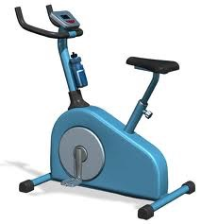
Stationary: not moving
Related Words: station, status, state
Synonyms: immobilized, immobile, inactivated
Antonyms: moving, in motion, activated
The acceleration was so smooth it seemed they were
A faint rattling noise was coming from them, even
While I waited for him, I stared up at the two stars I
Harry did not like being
stationary;
walking had
stationary
, and the wall was racing toward them.
could see and let my head slowly become
stationary.
though they were completely
stationary.
given the illusion that they had a goal.
Henry H. Neff, The Second Siege
Stephenie Meyer, The Host
J.K. Rowling, HP and the Deathly Hollows
J.K. Rowling, HP and the Order of the Phoenix
Any form of the word stationary will appear once in every 1,485 pages of text.

Slide 15
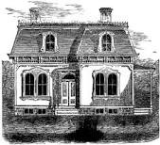
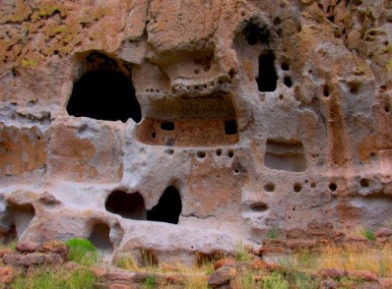
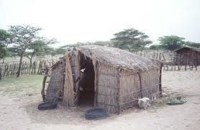
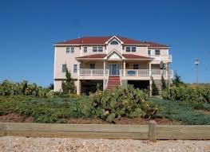
Dwelling: (noun): a home
(verb): to live inside a home
Synonym: residence
Near synonym: shelter, habitat
In any case, most Wizarding
dwellings
Go immediately to your
dwelling
at the conclusion of
There, great fires engulfed clusters of
One of the
dwellings
was a small shop.
dwellings.
are magically protected from unwanted Apparators.
Training Hours each day.
Henry H. Neff, The Fiend and the Forge
Lois Lowry, The Giver
Yann Martel, Life of Pi
J.K. Rowling, HP and the Half-Blood Prince
Any form of the word dwelling will appear once in every 80 pages of text.

Slide 16
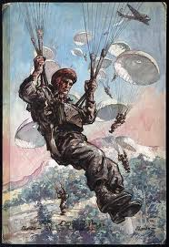
Descend: to lower; to move downward
Forms: Noun: descent
Verb: descend, descends, descended, descending
Adjective: 00 Adverb: 00
Synonyms: drop, fall, precipitate, de-escalate
Antonyms: ascend, climb, elevate, escalate
…a great bird like an eagle high in the air,
descending
The following day experts
descended
like buzzards,
They had
descended
two or more floors when
She bent her knees, and her board started to
descending slowly in wide circles down toward the
descend.
recovering Missy’s remains and bagging the sheet
another set of quiet joined theirs.
earth.
Scott Westerfield, Uglies
J.R.R. Tolkien, The Two Towers
J.K. Rowling, HP and the Deathly Hollows
along with whatever else they could.
Any form of the word descend will appear once in every 82 pages of text.
William P. Young, The Shack

Slide 17
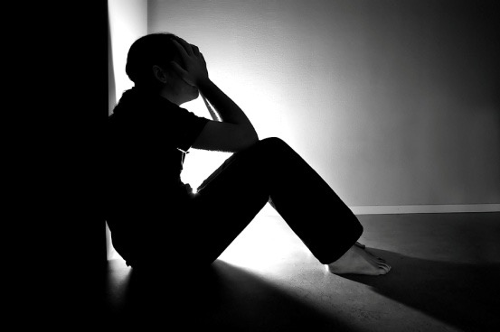
Despair: hopelessness
Synonyms: dejectedness, sadness, depression, misery,
wretchedness, pessimism
Antonyms: optimism, exuberance, joy, exhilaration,
hopefulness
For yet another weapon, swifter than hunger, the Lord
But when he entered, misery and
She cried so
despairingly
that Jo was frightened.
despair
alone welcomed him.
of the Dark Tower had dread and
despair.
Louisa May Alcott, Little Women
At last my mother gave up, in
despair.
Mary Shelley, Frankenstein
J.R.R. Tolkien, The Two Towers
Harriet Beecher Stow, Uncle Tom’s Cabin
Any form of the word despair will appear once in every 177 pages of text.

Slide 18
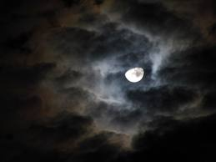
Ominous: threatening; foreshadowing bad
things to come
Forms: Noun: omen, omens Verb: 00
Adjective: ominous Adverb: ominously
Near Synonyms: menacing, looming, foreboding,
scary
Near Antonyms: promising, hopeful
They looked seldom at it, for it was
ominous
All was
ominously
quiet.
The sharp sound as the gloves snapped into place
…the ruins of the towers: they had an
ominous
look.
but dreary even in the light of morning.
J. R. R. Tolkien, The Return of the King
against his wrist seemed
ominous
to me.
J.R.R. Tolkien, The Fellowship of the Ring
J. R. R. Tolkien, The Hobbit
Stephenie Meyer, Twilight
Any form of the word ominous will appear once in every 357 pages of text.

Slide 19
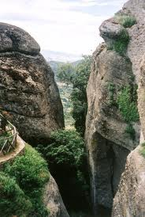
Ravine: a deep narrow valley formed by running water
Near Synonyms: chasm, abyss, crevasse
Twilight came mercifully early in the deep
Barefoot, she scrambles down the
ravine
ravine
Long valleys and
ravines
opened beneath them.
The valley opened out into a great plain dotted with
of the streambed.
after her mother.
Megan Whalen Turner, The Thief
Sonia Nazario, Enrique’s Journey
Christopher Paolini, Eragon
rocks and cut up by
ravines.
Any form of the word ravine will appear once in every 576 pages of text.
Rudyard Kipling, The Jungle Book

Slide 20

Valor: Bravery, courage, nobility
Forms: Noun: valor Verb: 00 Adjective: valorous Adverb: valorously
Then you cry in a loud voice, so that she knows
everyone in the valley can hear your statement of
The stories they tell of comradeship and
valor
The shadows closed on men again, and their hearts
valor.
Ted Dekker, Black: The Birth of Evil
are all to make up for what they lacked.
The girl stood huddled with her
went cold, and the
valor
of Gondor withered
mother and sister, as he presented her, the oldest
Mark Helprin, Soldiers of the Great War
into ash.
J.R.R. Tolkien, The Return of the King
child, with a medal of
valor.
Suzanne Collins, The Hunger Games
Any form of the word “valor” will appear once in every
1,030 pages of text.

Slide 21
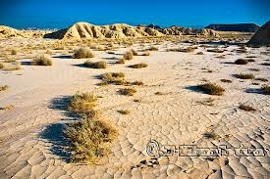
Arid: lacking sufficient rainfall for growth
Synonyms: sere, parched, desert-like
Antonyms: moist, lush, soggy
Sol spent three days and nights in the
August and September were
arid
months, when
arid
Atticus’s voice had lost its comfortableness; he was
hardly anything grew, and one ate mostly beans
mountains, eating only the thick-crusted bread
The
arid,
imposing mountains sat along deep
speaking in his
arid,
detached professional voice.
gorges and soared to jagged peaks.
that had been dried and stored.
he had brought and drinking from his condenser
Harper Lee, To Kill a Mockingbird
Khaled Hosseini, The Kite Runner
therm.
Dan Simmons, Hyperion
Tracy Kidder, Strength in What Remains
Any form of the word arid will appear once in every 1,424 pages of text.

Slide 22
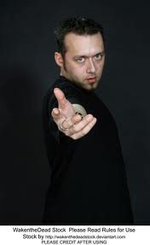
Beckon: to make an inviting gesture; to call forth
Near synonyms: summon, invite, ignore
Near antonyms: reject, dismiss
Related word: beacon (guiding light)
At that moment, the door opened, and Snape
“Gather round,” he said,
beckoning.
beckoned
them all inside.
The woman
April is upon us; May
beckoned
beckons.
again, this time
Henry H. Neff, The Fiend and the Forge
more vigorously.
Libba Bray, Sweet Far Thing
J.K. Rowling, HP and the Goblet of Fire
J.K. Rowling, HP and the Deathly Hollows
Any form of the word beckon will appear once in every 617 pages of text.

Slide 23

Cease: to stop doing something
Forms:
Noun: cessation
Verb: cease, ceases
ceased, ceasing
Adj: 00 Adv: 00
Synonym: discontinue, desist
Antonym: continue, proceed
Related word: deceased
As we drew near, the firing
ceased,
Chains
cease
White Fang had quieted down and
At the age of eleven or twelve, they had
to be necessary after the spirit has
ceased
ceased
snarling.
being children.
gone out of a prisoner.
and we saw that the fight was over.
Cormac McCarthy, All the Pretty Horses
Jack London, White Fang
Jack London, Sea Wolf
Mark Twain, A Connecticut Yankee in King Arthur’s Court
Any form of the word cease will appear once in every 64 pages of text.

Slide 24

Recite: to perform or say a memorized
or partially memorized
text, pledge, or prayer
Forms:
Noun: recitation, recital
Verb: recite, recites,
recited, reciting
Adj: 00 Adv: 00
It was hard to relax with Hermione next to you
You mean we might draw a circle on the ground and
“Four score and once upon a time ago,” she began
He
recited
the alphabet for Zero, then Zero repeated
reciting
reciting.
it without a single mistake.
the twelve uses of dragon’s blood or practicing wand
stand inside it and
recite
charms and spells?
Julia Alverez, How the Garcia Girls Lost Their Accent
Louis Sacher, Holes
movements.
J.K. Rowling, HP and the Sorcerer’s Stone
CS Lewis The Silver Chair
Any form of the word recite will appear once in every 303 pages of text.

Slide 25
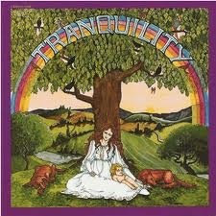
Tranquil: calm and peaceful
Synonyms: serene, gentle
Antonyms: turbulent, tumultuous, riotous, stormy
Forms: Noun: tranquility
Verb: tranquilize, tranquilizes
tranquilized, tranquilizing
Adjective: tranquil Adverb: tranquilly
I stood up and stretched and looked across the highway
She notices that she is in a
tranquil
mood for the
The air at two thousand meters was so thin and
Go to bed and sleep
tranquilly.
across the river, so
tranquil,
its water as blue
first time in quite a while.
tranquil
that it seemed to be only a gloss of light.
Victor Hugo, Les Miserables
as the sky.
Hakuri Murikami, After Dark
Mark Helprin, Soldier of the Great War
Ernest Gaines, A Lesson Before Dying
Any form of the word tranquil will appear once in every 321 pages of text.

Slide 26

Jubilant: joyful
Synonyms: exuberant
Antonyms: morose, sullen
Forms: Noun: jubilance
Verb: OO
Adjective: jubilant Adverb: jubilantly
He had expected to hear the cheer of triumph and
I would fall back, exhausted but
The city was in the midst of a
jubilant
jubilant.
gala.
jubilation
at his death.
It was a wild,
jubilant
scene, one that I would
Frank Beddor, The Looking Glass War
Yan Martel, Life of Pi
never be able to forget.
J.K. Rowling, HP and the Deathly Hollows
James Patterson, Kiss the Girls
Any form of the word jubilant will appear once in every 2,232 pages of text.

Slide 27
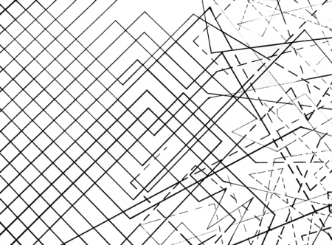
Chaos: disorder; state of confusion
Synonyms: disorganization, disarray, pandemonium,
anarchy, lawlessness
Antonyms: order, orderliness, organization
Forms: Noun: chaos
Verb: OO
Adjective: chaotic Adverb: OO
Compared with the
But I wasn’t sure anyone could hear her over the
Without her, our lives would dissolve into
You have to rise above the squabbling and
chaos
of Cherry Hill, Northwood
chaos.
chaos,
was a paradise of neat houses and fastidiously
screeching of birds and the general
and keep believing.
chaos.
Rick Riordan, The Battle of the Labyrinth
Rick Riordan, The Titan’s Curse
Nicole Krauss, History of Love
maintained lawns.
Wes Moore, The Other Wes Moore
Any form of the word chaos will appear once in every 698 pages of text.

