Slide 1
Words High School Volume II:
Scrutiny: Slide 2
Acquiesce: Slide 3
Exonerate: Slide 4
Plaintive: Slide 5
Perfidy: Slide 6
Formidable: Slide 7
Redress: Slide 8
Kindred: Slide 9
Plunder: Slide 10
Dissipate: Slide 11
Portend: Slide 12
Periphery: Slide 13
Animosity: Slide 14
Contrite: Slide 15
Depravity: Slide 16
Attrition: Slide 17
Indifference: Slide 18
Intuitive: Slide 19
Rapt: Slide 20
Malicious: Slide 21
Oscillate: Slide 22
Augment: Slide 23
Cacophony: Slide 24
Herald: Slide 25
Emulate: Slide 26

Slide 2
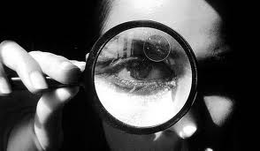
Scrutiny: close examination
Syn: perusal, investigation
Forms:
N: scrutiny
V: scrutinize, scrutinizes
scrutinized, scrutinizing
Adj: 00 Adv: 00
Ant: glimpse
On closer
scrutiny
it was evident that she was fourteen.
Every arrival on this campus will be
scrutinized,
the grounds
Les Miserables
--Victor Hugo
checked hourly.
The Bourne Supremacy
--Robert Ludlum
Because of their relationship, he came under close
scrutiny.
The Girl with the Dragon Tatoo
--Stieg Larsson
I returned to
scrutinizing
the horizon, my hopes high.
The Life of Pi
--Yann Martel
Any form of the word “scrutiny” will appear once
in every 477 pages of text.

Slide 3

Acquiesce: surrender
Syn: capitulate
Forms:
N: acquiescence
V: acquiesce, asquiesces
acquiesced, acquiescing
Adj: acquiescent
Adv: acquiescently
Ant: refuse
Related: quiet
Hector McQueen
acquiesced
willingly in the search.
She had a sense of
acquiescing
in the plan with the
Murder on the Orient Express
--Agatha Christie
I could not but
passiveness of a sufferer resigned to the surgeon’s touch.
acquiesce
, for I was dog tired, and could not
The House of Mirth
--Edith Wharton
have sat up had I tried.
Dracula
--Bram Stoker
He’d flattered me--he understood me well enough to know I
craved flattery—and in gratitude, I
acquiesced.
Any form of the word “acquiesce” will appear once
in every 656 pages of text.
Girl Interrupted
--Susanna Kaysen

Slide 4

Exonerate: undo a conviction; prove that
an accused or convicted person is
not guilty
Any form of the word “exonerate” will appear once
in every 4,359 pages of text.
So before you read what’s in that thing, tell me a story that
I can think of no answer that
exonerates
squares with its details and
exonerates
me.
yourself in my eyes.
Snow Falling on Cedars
--David Guterson
The Poisonwood Bible
--Barbara Kingsolver
She knew that even if she was
exonerated
of the murder,
she could not return to her previous existence.
No one of us can be completely
exonerated
from
suspicion.
The Eldest
--Christopher Paolini
And Then There Were None
--Agatha Christie
Forms: N: exoneration
V: exonerate, exonerates,
exonerated, exonerating
Adj: 00 Adv: 00
syn: vindicate, pardon
ant: condemn
related: onus (burden)

Slide 5
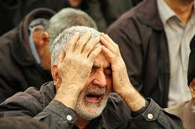
Plaintive: mournful; expressing sadness
through a sound
Forms: N: 00
V: 00
Adj: plaintive
Adj: plaintively
syn: sorrowful
ant: cheerful
relative: complain
“I don’t want no trouble,” he said
plaintively.
She made a sound I had not heard them make before, a
Of Mice and Men
--John Steinbeck
plaintive
shriek.
Airborn
--Kenneth Oppel
The
plaintive
melody, sung in low tones, spoke beyond
its notes.
Black: The Birth of Evil
--Ted Dekker
“I don’t want to talk to you,” she said, hating her
plaintive
tone.
The Guardian
--Nicholas Sparks
Any form of the word “plaintive” will appear once
in every 1,021 pages of text.

Slide 6

Perfidy: betrayal
Forms:
N: perfidy
V: 00
Adj: perfidious
Adv: perfidiously
syn: treachery; infidelity;
untrustworthiness;
faithlessness
ant: fidelity, loyalty
So, she discovered my
perfidy
and I had her lured to a
dangerous neighborhood and ordered her throat cut.
In spite of my
It is ingratitude,
perfidy,
perfidy
she was desperate to see me
treachery!
Glory in Death
--J.D. Robb
one more time.
HP and the Deathly Hollows
--J.K. Rowling
The Once and Future King
--T.H. White
He says you’ll see the bullet holes all over the front and they
should be left there to remind the Irish of English
perfidy.
Angela’s Ashes
--Frank McCourt
Any form of the word “perfidy” will appear once
in every 1,587 pages of text.

Slide 7
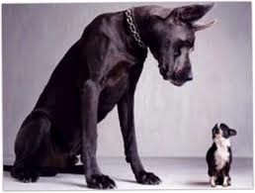
Formidable: intimidating in size and power
syn: imposing; enormous;
intimidating; impressive
ant: diminutive; meek;
insignificant
Forms: N: 00
V: 00
Adj: formidable
Adv: formidable
You would make a
formidable
opponent, I’m sure.
Brisingr
--Chrisopher Paolini
For a moment, the girl seemed to lose her
formidable
self-control.
Eldest
--Christopher Paolini
Eragon eyed her
formidable
claws and said, “Wait!”
Eragon
--Christopher Paolini
That will of iron is
formidable,
and I am quite exhausted
by it all.
A Great and Terrible Beauty
--Libba Bray
Any form of the word “formidable” will appear once
in every 331 pages of text.

Slide 8
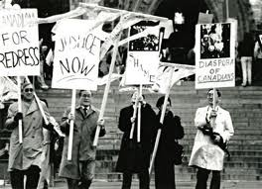
Redress: the process of seeing justice
for denial of rights
syn: recompense;
amends; reparations
Forms: N: redress
V: redress, redresses, redressed, redressing
Adj: 00 Adv: 00
Wrongs have to be
redressed
by reason, not by force.
What is now amiss that Caesar and his Senate must
redress?
The Once and Future King
--T.H. White
Could anything be done to
redress
these inequities?
Julius Caesar
--Wm Shakespeare
“But the question must be asked, “If this boy thought that he
Strength in What Remains
--Tracy Kidder
was somehow wronged, why did he not go into a court of law
and seek a
redress
of grievances?
Native Son
--Richard Wright
Any form of the word “redress” will appear once
in every 1,165 pages of text.

Slide 9
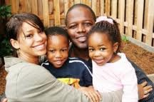
Kindred: related by blood,
or seeming to be related
by blood; compatible
Forms:
N: kin, kinship, kinfolk
V: 00
Adj: kindred
Adv: 00
Relatives: kind
His mother and I were
In her he recognized a
spirits.
kindred
spirit.
Then he smiled a familiar smile, the smile of a
kindred
The Other Wes Moore,
Wes Moore
Matthew and I are such
kindred
spirits I can read his
spirit, and then I knew out friendship was intact.
thoughts without any words at all.
Stephenie Meyer,
Breaking Dawn
Anne of Green Gables
--Lucy Maud Montgomery
We are somehow
kindred
spirits just beyond our family ties.
The Ultimate Gift,
Jim Stovall

Slide 10
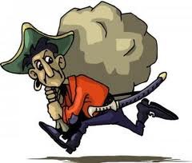
Plunder: V: raid for the purpose of stealing
N: stolen goods
Forms: N: plunder
V: plunder, plunders,
plundered, plundering
Adj: plunderous
Adv: 00
syn: loot, pillage
Dragons steal gold and jewels, you know, from men and elves
Everything now hinged on the assent of Heafstaag, a brutal
and dwarves, wherever they can find them; and they guard
king interested only in personal glory and triumphant
plunder.
their
plunder
as long as they live.
The Hobbit
--J.R.R. Tolkien
The Crystal Shard
--R.A. Salvatore
Force is all they know, force, fraud and
plunder.
Atlas Shrugged
--Ayn Rand
He was arrested for
plundering.
Slaughterhouse 5
--Kurt Vonnegut
Any form of the word “plunder” will appear once in every 380 pages of text.

Slide 11
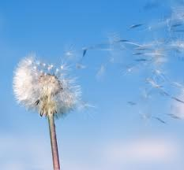
Dissipate: scatter widely until gone;
lose intensity
Forms:
N: dissipation
V: dissipate, dissipates, dissipated,
dissipating
syn: dispel; attenuate
ant: intensify; amplify; fortify
Slowly the voices outside
dissipate
down the road.
The mist
dissipated
swiftly, but I held my shield in place.
The Help
--Kathryn Stockett
In the wake of the adreneline rush that was slowly
Breaking Dawn
--Stephanie Meyer
dissipating,
A Bend in the Road
--Nicholas Sparks
Miles felt tired.
They were both half-dressed and growing colder as their
heat began to
dissipate.
The Lovely Bones
--Alice Sebold
Any form of the word “dissipate” will appear once
in every 623 pages of text.

Slide 12
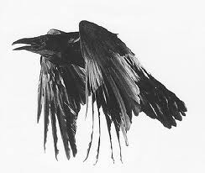
Portent: sign that evil is on its way
Syn: omen, harbinger
Root: port: to carry
Relatives: important,
import, export, portable,
deport
Forms:
N: portent, portents
V: portend, portends,
portended, portending
Adj: 00 Adv: 00
Three dead trees on the moor below, burned up alive
“It has been guessed already,” said Ingold;” for there have
There had been no signs or
by lightning, are ominous
portents
portents.
, no secret signals.
been strange
portents
here of late.
The Devil’s Arithmetic
--Jane Yolen
Grendel
--John Gardner
Would anyone like me to help them interpret the shadowy
The Fellowship of the Ring
--J.R.R. Tolkien
portents
within their Orb?
HP and the Prisoner of Azkaban
--J.K. Rowling
Any form of the word “portent” will appear once
in every 3,748 pages of text.

Slide 13
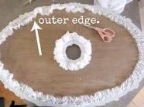
Periphery: edge
Forms:
N: periphery
V: 00
Adj: peripheral Adv: 00
Syn: margin
Root: peri: around
Relatives: perimeter
Ari hung back on the
periphery.
Saving the World and Other
Extreme Sports
--James Patterson
Hassan milled about the
periphery
of my life after that.
The Kite Runner
--Khaled Hosseini
Langdon felt like a ship on the
periphery
of a storm…
tossed but detached.
Angels and Demons
--Dan Brown
Leila and I tended to dwell around the corners, along the
Any form of the word “periphery” will appear once
in every 3,023 pages of text.
periphery.
Native Speaker
--Chang-Rae Lee

Slide 14
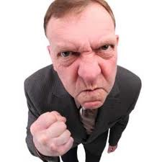
Animosity: hatred; resentment
Syn: animus, hatred,
bad blood, ill will
Ant: alliance, friendship,
camaraderie, congeniality
Forms:
N: animosity
V:00
Adj: 00 Adv: 00
Jacob didn’ like the reminder; the pain in his eyes hardened
into
animosity.
Eclipse
--Stephenie Meyer
Its eyes glared at then with steady, sunken
animosity.
Cujo
--Stephen King
There was an unfriendly feel in the air an
animosity
that resisted intruders.
Eragon
--Christopher Paolini
His one eye met hers with an impersonal
animosity.
Any form of the word “animosity” will appear once
in every 1,351 pages of text.
Gone with the Wind
--Margaret Mitchell

Slide 15
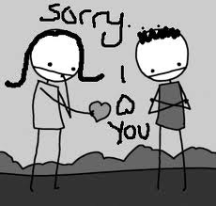
Contrite: sorry
Syn: repentant, rueful
Forms: N: contrition
V: 00
Adj: contrite Adv: contritely
She didn’t feel he was sufficiently
contrite.
Outcasts United
--Warren St. John
“I’m sorry you lost your rocket stuff,” he told me, truly
contrite.
October Sky
--Homer Hickam
Now say an Act of
Contrition
and remember Our Lord
watches you every minute.
Angela’s Ashes
--Frank McCourt
I shall feel
contrition
and be forgiven.
Any form of the word “contrite” will appear once
in every 3,636 pages of text.
The Power and the Glory
--Graham Greene

Slide 16

Depravity: evil; outside the boundaries of
human decency
Forms: N: depravity
V: 00
Adj: depraved Adv: 00
Syn: degeneracy
Ant: normalcy
To me, religion is about our dignity, not our
depravity.
Was there no end to their
Life of Pi
--Yann Martel
depravity?
Artemis Fowl
--Aoin Colfer
You’re dangerous and
depraved
and you ought to be
taken out and shot.
Catch-22
--Joseph Heller
I have prayed—to both sides– to release me from this
depravity
of thought.
Rose Red
--Stephen King
Any form of the word “depravity” will appear once
in every 1,112 pages of text.

Slide 17
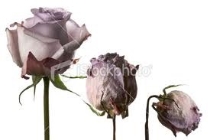
Attrition: fade-away; drop-off
Forms:
N: attrition
V: 00
Adj: 00 Adv: 00
Syn: lessening;decline
Ant: fortification
He hopes to drag out this fight, to bleed us dry through
attrition.
Brisingr
--Christopher Paolini
Eruption, earthquake, avalanche,
attrition
of glaciers,
He’d had good experiences with almost all of them, though
the erosion of water, the cracking of frost, the weathering of
Several times the enemy was able to trick him into exposing
in his business there was an above average rate of
rain and wind and snow—these it had eternally fought and
more weaknesses than he meant to; other times the enemy
attrition
and turnover.
Ender’s Game
--Orson Scott Card
was able to wear them down by
attrition
until his victory was
resisted in vain, yet it stood magnificent, frowning, battle-
as much a matter of luck as strategy.
Zeitoun
--Dave Eggers
scarred and undefeated.
The Call of of the Canyon
--Zane Grey
Any form of the word “attrition” will appear once
in every 7,113 pages of text.

Slide 18

Indifferent: not caring, having no opinion
Syn: apathetic, neutral, blase
Ant: passionate, ardent,
fervent
Forms:
N: indifference
V: 00
Adj: indifferent Adv: indifferently
They were both
The pure, colorless vastness of the sky stretched over him,
indifferent
to what people might think
indifferent
to him and his suffering.
of them.
Love in the Time of Cholera
--Gabriel Garcia Marquez
HP and the Deathly Hollows
--J. K. Rowling
I try to sound
indifferent,
but my voice cracks.
The government obviously is guided by abstract considerations,
Suzanne Collins
--The Hunger Games
and remains
indifferent
to the influence its measures
may exercise.
Anna Karenina
--Leo Tolstoy
Any form of the word “indifferent” will appear once
in every 295 pages of text.

Slide 19
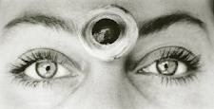
Intuitive: having unexplainable powers of
knowing and understanding
Syn: perceptive
Ant: dense, obtuse
Relatives: tuition,
tutor
Forms: N: intuition
V: intuit, intuits, intuited, intuiting
Adj: intuitive Adv: intuitively
The boy was beginning to understand that
intuition
is really
Bella, for a fairly
intuitive
person, you can be so obtuse!
a sudden immersion of the soul into the universal current of life.
Eclipse
--Stephanie Meyer
She was far more
intuitive
The Alchemist
--Paolo Coelho
than I. Her gift for understanding
people was much greater.
The Color Purple
--Alice Walker
Intuitively,
I knew how easily distances could harden and
become permanent.
Drown
--Junot Diaz
Any form of the word “intuitive” will appear once
in every 596 pages of text.

Slide 20
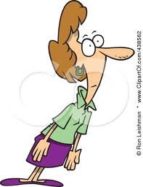
Rapt: stunned with amazement
syn: mezmerized
ant: bored, distracted
Relatives: rapture,
enrapture
He was too busy staring at Isabelle,
rapt
and open-mouthed.
City of Bones
--Cassandra Clare
I filled her in on the progress, watching her
rapt
I was filled with a mix of
rapt
admiration and abject fear.
attention as she tried to imagine it.
The Wedding
--Nicholas Sparks
Life of Pi
--Yann Martel
Our six hundred faces gazed up at the little man in
rapt
attention.
October Sky
--Homer Hickam
Any form of the word “rapt” will appear once
in every 430 pages of text.

Slide 21
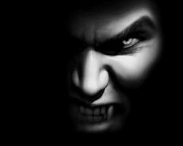
Malicious: intending to do harm to a person or
animal
With
malice
Forms: N: malice,
maliciousness
V:00
Adj: malicious
Adv: maliciously
toward none,with charity for all…
Syn: evil, toxic, spiteful, vindictive,
venomous, malevolent
Ant: benign, benevolent
Origin: mal: bad
Second Inaugural Address
--Abraham Lincoln
His eyes glittered. Such
malice
was in them that men
Three of four faces looked at him in
malicious
amusement.
stepped back from him.
The Two Towers
--J.R.R. Tolkien
The Power and the Glory
--Graham Greene
Malfoy elbowed past Hermione to block Harry’s way up
the stone steps to the castle, his face gleeful and his pale
eyes glinting
maliciously.
Any form of the word “malicious” will appear once
in every 307 pages of text.
HP and the Prisoner of Azkaban
--J. K. Rowling

Slide 22
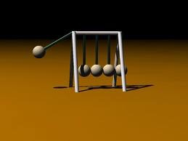
Oscillate: Move or change in a steady,
back-and-forth pattern
Forms:
N: oscillation
V: oscillate, oscillates,
oscillated, oscillating
Adj: 00 Adv: 00
Syn: vacillate; waffle
Ant: stagnate
They spent that summer
oscillating
between childhood, which
still held them in its clasp, and their awakening as man and woman.
A small fan sat
oscillating
in the corner.
House of Spirits
--Isabelle Allende
A needle within her wavered for a moment , burning between
A Walk to Remember
--Nicholas Sparks
its
way between two courses.
As I turned away to continue walking up the trail, my emotions
oscillating
oscillated
between nervous anticipation and a nearly
Atlas Shrugged
--Ayn Rand
overwhelming sense of dread.
Into Thin Air
--Jon Krakauer
Any form of the word “oscillate” will appear once
in every 2,326 pages of text.

Slide 23
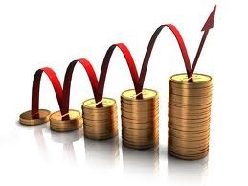
Augment: to increase
Forms:
N: augmentation
V: augment, augments,
augmented, augmenting
Adj: 00
Adv: 00
Synonyms:
Antonyms:
The libraries were
augmented
by donations.
The Autobiography of Benjamin Franklin
When you inspect your little kingdom, you will find in it some
little improvement, your flocks increased, and your subjects
augmented.
Robinson Crusoe
--Daniel Defoe
The procession moved on, and still on, through ever
They
augmented
their diets with fish caught from the
augmenting
splendors of welcome.
river, and Tally roasted a rabbit on a fire she’d built herself.
The Prince and the Pauper
--Mark Twain
Uglies
--Scott Westerfield
Any form of the word “augment” will appear once
in every 803 pages of text.

Slide 24
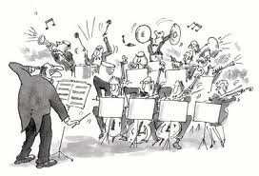
Cacophony: loud, unpleasant
noise
Forms:
N: cacophony
V: 00
Adj: cacophonous
Adv: 00
Syn: racket
Relatives: phon (sound):
symphony, telephone,
phonics,
His harsh words cut through the
cacophony
of the attack.
Uglies
--Scott Westerfield
He was suddenly assailed by a great
cacophony
of voices.
There was a discharge of bullets and a
cacophony
The Hound of Rowan
--Henry H. Neff
of bullets.
cacophony
It created a
of hacking coughs, bronchial
Nineteen Minutes
--Jodi Picoult
rattles, asthmatic wheezes, consumptive croaks.
Any form of the word “cacophony” will appear once
in ever 12,548 pages of text.
Angela’s Ashes
--Frank McCourt

Slide 25
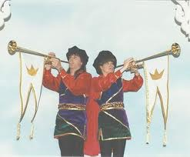
Forms:
N: herald, heralds
V: herald, heralds,
heralded, heralding
Adj: 00 Adv: 00
Herald: N: Announcer;
V: Announce
Syn: vacillate; waffle
Ant: conceal; withhold
Tonight
heralds
a new era.
Water for Elephants
--Sara Gruen
Then Aragon set trumpeters at each of the four roads that
ran into the ring of trees, and they blew a great fanfare, and
Any break in the routine may
herald
for them unbearable
the
heralds
I Know Why the Caged Bird Sings
--Maya Angelou
news.
cried aloud.
The Return of the King
--J. R. R. Tolkien
“Herald,
read the accusation!” said the King.
Alice’s Adventures in Wonderland
--Lewis Caroll
Any form of the word “herald” will appear once
in every 381 pages of text.

Slide 26

Emulate: try to be like someone
you admire
Forms:
N: emulation
V: emulate, emulates,
emulated, emulating
Adj: emulatory
Adv: 00
Syn: racket
Relatives: phon (sound):
symphony, telephone,
phonics,
Max was looking to
emulate
his moment of glory.
I believe in the way he lives his life and I try to
emulate
him.
The Book Thief
--Markus Zusak
Jay Allison, et. al.
--This I Believe II
That suggested that they had decided to stop having
children,
emulating
the soap opera characters
they admired.
Half the Sky
--Nicholas Kristof
I’d like to appeal to all our listeners to
emulate
their example,
perhaps by casting a protective charm over any Muggle dwellings
in your street.
HP and the Deathly Hollows
--J.K. Rowling
Any form of the word “emulate” will appear once
in every 1,143 pages of text.

