Slide 1
Welcome to Decent Exposure High School Volume III:
covet (Slide 13)
entreat (Slide 14)
chastise (Slide 15)
discreet (Slide 16)
lucid (Slide 17)
obstinate (Slide 18)
vacuous (Slide 19)
enigma (Slide 20)
aversion (Slide 21)
avert (Slide 22)
nonchalant (Slide 23)
frugal (Slide 24)
zeal (Slide 25)
pious (Slide 26)
astute (Slide 27)
opulent (Slide 28)
indignant (Slide 2)
usurp (Slide 3)
tremulous (Slide 4)
deride (Slide 5)
insolent (Slide 6)
revere (Slide 7)
petulant (Slide 8)
complacent (Slide 9)
amiable (Slide 10)
buttress (Slide 11)
knell (Slide 12)

Slide 2
Indignant: defensively angry because of
an insult
Forms:
N: indignation
V: 00
Adj: indignant
Adv: indignantly
Syn: insulted, defensive
Ant: flattered
Related: dignity, indignity
“We weren’t trying to hear him! said Ron
indignantly.
Rage, astonishment,
indignation
, and a storm of
She only felt a furious surge of
indignation
passions rushed through the listener’s heart, as the plot was laid bare.
that he should think her such a fool.
Harry Potter and the Goblet of Fire
--J.K. Rowling
Gone with the Wind
--Margaret Mitchell
Nicholas Nickleby
--Charles Dickens
Any form of this word will appear once in every 299 pages of text.

Slide 3
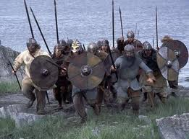
Usurp: seize political power undeservedly
Syn: commandeer,
appropriate
Forms:
N: usurper, usurpation
V: usurp, usurps
usurped, usurping
Adj: 00 Adv: 00
Ant: yield, surrender
William the Conqueror, whose cause was favoured by
The history of the present King of Great Britain is
the pope, was soon submitted to by the English, who
The ghosts were returning; they filled Italy, they
a history of repeated injuries and
usurpations.
wanted leaders, and had been of late much accustomed
This was a shocking thing; that the slime of the pit
were even
usurping
the places she had known
to
usurpation
and conquest
seemed to utter cries and voices; that the amorphous
The Declaration of Independence
--Thomas Jefferson, et. al.
as a child.
A Room with a View
--E.M. Forster
dust gesticulated and sinned; that what was dead,
Alice’s Adventures in Wonderland
--Lewis Carroll
and had no shape, should
usurp
the offices of life.
Any form of this word will appear once
in every 658 pages of text.
Dr. Jeckyll and Mr. Hyde
--Robert Louis Stevenson

Slide 4
Tremulous: shaky, usually because of fear
Forms:
N: tremor
V: tremble, trembles,
trembled, trembling
Adj: tremulous
Adv: tremulously
Syn: undulating
Ant: rigid
Related: tremor
In the grass, the daisies were
Dumbledore’s smile was
tremulous.
…with every successive Sabbath, his cheek was
Now,
tremulously,
experimentally, daring to test,
H.P. and the Deathly Hollows
--J. K. Rowling
The Picture of Dorian Gray
--Oscar Wilde
the Witch inhaled.
tremulous.
paler and thinner, and his voice more
Something Wicked This Way Comes
--Ray Bradbury
Something Wicked This Way Comes
--Ray Bradbury
Any form of this word will appear once in every 873 pages of text.

Slide 5
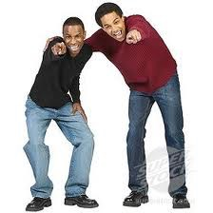
Deride: to express scorn with cruel laughter
Forms:
N: derision
V: deride, derides,
derided, deriding
Adj: derisive
Adv: derisively
Syn: mock; jeer
Ant: compliment, support
Related: ridiculous
Putting all the
He gave a short,
derision
derisive
he could in his voice, he jeered,
laugh.
There was a stirring in the crowd, a few hoots of
derision,
“How did you like getting shot?”
but Kennedy smiled.
H.P. and the Chamber of Secrets
--J. K. Rowling
Usually, she could will herself to absorb Mariam’s
Eragon
--Christopher Paolini
October Sky
--Homer Hickam
and finger-pointing
derision.
A Thousand Splendid Suns
--Khaled Hosseini
Any form of this word will appear once in every 650 pages of text.

Slide 6
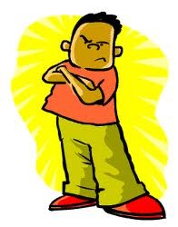
insolent: disrespectful; fresh; bratty
Forms:
N: insolence
V: 00
Adj: insolent
Adv: insolently
Syn: impudent; disrespectful;
audacious; brazen; impertinent
Ant: deferential; respectful; humble; obedient; docile
“I will not suffer,” said the Baron, “such meanness on your
Remember that I am not Dumbledore, who forgave your
He stared back
You’re
part, or such
insolent,
insolence
,insolent,
woman.
on yours.”
his eyes seemingly huge
insolence
and insubordination.
behind his glasses.
Angela’s Ashes
--Frank McCourt
Candide
--Voltaire
Lock and Key
--Sarah Dessen
H.P. and the Deathly Hollows
--J.K. Rowling
Any form of this word will appear once in every 419 pages of text.

Slide 7
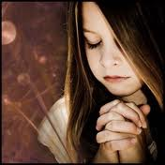
Revere: respect deeply, almost to the point of worship
Forms:
N: reverence
V: revere, reveres, revered,
revering
Adj: reverent, irreverent
Adv: reverently, irreverently
Syn: pay homage to
Ant: desecrate; insult
Related: Reverend
My hands naturally came together in
reverent
worship.
The Life of Pi
--Yan Martel
The woman eyed her with a
reverent
,almost awestruck,
They
revere
those old soldiers.
A Thousand Splendid Suns
--Khaled Hosseini
expression.
The Bourne Identify
--Robert Ludlum
The noble soul has
reverence
for itself.
Friedrich Nietzsche, in The Fountainhead
--Ayn Rand
Any form of this word will appear once in every 167 pages of text.

Slide 8
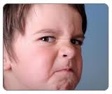
Petulant: cranky, grouchy
Forms:
N: petulance
V: 00
Adj: petulant
Adv: petulantly
Syn: irritable, peevish,
cantankerous, fractious,
testy, pouty,
Ant: agreeable, docile, benign, easygoing
His manner varies from genial bullying when he is in a good
You can be as
humor to stormy
petulant
petulance
as you want, tomorrow.
when anything goes wrong.
Pygmalion
--George Bernard Shaw
Ender’s Game
--Orson Scott Card
“I’m angry with you, Emil,” she broke out with
“But we’re just sitting here,” he said, sounding
petulance.
petulant
and tired and cross.
O Pioneers!
--Willa Cather
Cujo
--Stephen King
Any form of this word will appear once in every 1,613 pages of text.

Slide 9
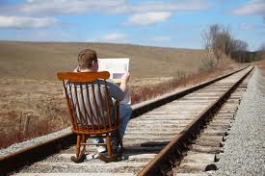
Complacent: blissfully unaware; undeservedly
confident
Forms:
N: complacency
V: 00
Adj: complacent
Adv: complacently
Syn: smug
Ant: cautious, wary
Related: placid
But he’d let himself become too
complacent
Milo nodded serenely with
complacent
gratification.
Summer Pleasures
--Nora Roberts
with what he’d been doing.
Catch-22
--Joseph Heller
That would have wiped that
complacent
smile off his face.
“Don’t let that make you
complacent
though,” he warned me.
Naked in Death
--J.D. Robb
Twilight
--Stephanie Meyer
Any form of this word will appear once in every 656 pages of text.

Slide 10
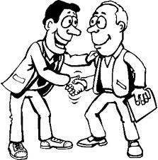
Amiable: friendly; sociably pleasant
Syn: gregarious, affable
Forms:
N: amiability
V: 00
Adj: amiable
Adv: amiably
Ant: hostile, aloof
Related: amor
I am playful; playfulness is part of my
amiable
character.
Varia did not try to look
The spy chatted
amiably.
amiable
and kept her gloomy
Little Dorrit
--Charles Dickens
expression.
The Idiot
--Fyodor Dostoevsky
The Killer Angels
--Michael Shaara
I can be
amiable.
Agreeable. Affable. And that’s only the A’s.
The Book Thief
--Markus Zusak
Any form of this word will appear once in every 920 pages of text.

Slide 11
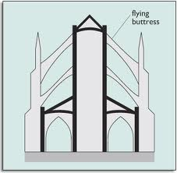
Buttress: (n. or v.) support, as in an architectural
structure that supports a building
Forms:
N: buttress, buttresses
V: buttress, buttresses
buttressed, buttressing
Adj: 00 Adv: 00
Syn: reinforce, fortify
Ant: undermine
There was a soldier standing with his girl in the shadow
There was a soldier standing with his girl in the shadow
of one of the stone
He could see the arched
buttresses
buttresses
ahead of us.
of the cathedral dome.
It’s got all these turrets and flying
buttresses
and stuff.
They behaved like people who do not want to be seen;
A Farewell to Arms
--Ernest Hemingway
All the Pretty Horses
--Cormac McCarthy
lurking in shadow behind
buttresses
The Princess Diaries
--Meg Cabot
or in doorways.
The Silver Chair
--C.S. Lewis
Any form of this word will appear once in every 1,929 pages of text.

Slide 12
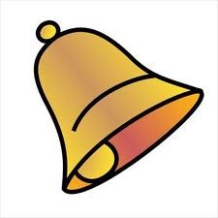
Knell: the sound of a bell, esp. a bell that informs
of a death
Any form of this word will appear once in every 4,220 pages of text.
There seemed to be an ominous
It could just as well have been himself for whom the death
His manner was so casual when he was sounding the
knell
of some evil to come.
knell
was tolling.
death
knell
of Tara.
The Idiot
--Fyodor Dostoevsky
The bell clanged and
knelled.
Love in the Time of Cholera
--Gabriel Garcia Marquez
Sea Wolf
--Jack London
Gone with the Wind
--Margaret Mitchell
Forms:
N: knell, knells
V: knell, knells, knelled,
knelling
Adj: 00 Adv: 00
Syn: toll, peal
Expression: death knell

Slide 13
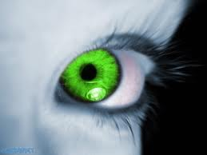
Covet: to want something that you have no right to want
Syn: begrudge, envy
Forms:
N: 00
V: covet, covets, coveted
coveting
Adj: covetous
Adv: covetously
Ant: bestow, bequeath
“Thou shalt not covet thy neighbor’s wife.”
When someone
covets
He decided to end the life of another man who stood
He’s
coveted
that for a long time, and now he has it.
something, they desire and lust after it.
He put on his hat and the dark cordovan gloves I
coveted.
between him and the land he
coveted.
The Alchemist
--Michael Scott
The Lovely Bones
--Alice Sebold
Snow Falling on Cedars
--David Guterson
Sara Shepherd, Pretty Little Liars
Any form of this word will appear once in every 816 pages of text.

Slide 14
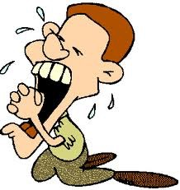
Entreat: plead with
Syn: beseech
Ant: reject
Any form of this word will appear once in every 1,094 pages of text.
I
entreat
you not to suppose that I moved this way
You—poor and obscure, and small and plain as you are--
in order to beg for a partner.
Let me
entreat
you, for your own sake and for hers,
I
entreat
you to accept me as a husband.
Say no more against it, I
entreat
you.
to be more quiet.
Pride and Prejudice
--Jane Austen
Hard Times
--Charles Dickens
Mansfield Park
--Jane Austen
Jane Eyre
--Charlotte Bronte
Forms:
N: entreaty, entreaties
V: entreat, entreats,
entreated, entreating
Adj: 00 Adv: 00

Slide 15
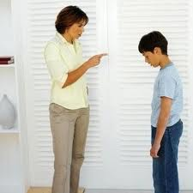
Chastise: punish
Syn: castigate; reproach; reprove; rebuke;
censure; reprimand; penalize
Ant: reward; laud; praise; extol; fawn over
Forms:
N: chastisement
V: chastise, chastises,
chastised, chastising
Adj: 00 Adv: 00
Now I didn’t bring you in here just to
How could I, of all people,
He would
chastise
chastise
someone for their past?
them both, harshly.
you.
It was a minor rule, rather like rudeness, punishable by gentle
chastisement.
Eldest
--Christopher Paolini
The Kite Runner
--Khaled Hosseini
The Shining
--Stephen King
The Giver
--Lois Lowry
Any form of this word will appear once in every 1,031 pages of text.

Slide 16
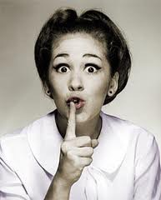
Syn: subtle, covert, modest
Ant: overt, immodest, obvious, indiscreet
Discreet: kept secret or private
Forms:
N: discretion, indiscretion
V: 00
Adj: discreet, indiscreet
Adv: discreetly, indiscretely
I daresay you know, like everybody else, that once, many
Old folks, you know, have
He discovered Isabelle to be
discretion
discreetly
and know the world.
and aggravatingly
I think I impressed upon him how important it is to handle
years ago, I was guilty of an
unsentimental in letters.
indiscretion.
this thing
discreetly.
This Side of Paradise
--F. Scott Fitzgerald
The Doll’s House
--Henrik Ibsen
The Merry Wives of Windsor
--William Shakespeare
A Streetcar Named Desire
--Tennessee Williams
Any form of this word will appear once in every 530 pages of text.

Slide 17
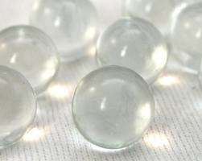
Lucid: clear
Syn: comprehensible, coherent, limpid
Ant: incomprehensible, incoherent, muddy
Forms:
N: lucidity
V: 00
Adj: lucid
Adv: 00
I was
lucid--
things were clear– but my tongue wouldn’t
Though drunk, Alessandro was
My mind made a final attempt at being
She was perfectly
lucid
,you could even say controlled,
lucid.
lucid.
despite her anxiety.
fit around the words.
The Things They Carried
--Tim O’Brien
The Bourne Identity
--Robert Ludlum
A Soldier of the Great War
--Mark Helprin
The Life of Pi
--Yan Martel
Any form of this word will appear once in every 867 pages of text.

Slide 18
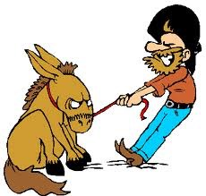
Syn: mulish, cantankerous
Obstinate: stubborn
Ant: agreeable, negotiable, flexible, conciliatory
ob: against or reverse:
obstruct, obnoxious,
obvious, object
“I’ll do as I choose and I go as I please,”
And I’ve had enough of you too—you beastly,
“I want the gum!” Violet said
obstinately.
said Bilbo
stuck-up
obstinately.
obstinate
Charlie and the Chocolate Factory
--Rahl Dahl
You know how
pig.
obstinate
men get when they get their
backs up.
Forms:
N: obstinacy
V: 00
Adj: obstinate
Adv: obstinately
The Hobbit
--J.R.R. Tolkien
The Magician’s Nephew
--C.S. Lewis
Gone With the Wind
--Margaret Mitchell
Any form of this word will appear once in every 338 pages of text.

Slide 19
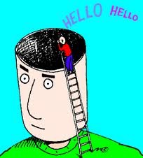
Vacuous: empty-headed, lacking substance
Ant: profound, intellectual, erudite, sophisticated
Syn: shallow, inane, superficial
Relatives: vacuum; evacuate, vaccinate
His eyes seemed wandering,
vacuous
again.
People noticed the
vacuousness
of my face and the
He opened the medicine cabinet. He stared rather
vacuously
The veiled,
vacuous
look passed and Bourne reached for
into it for a few seconds, as though he had forgotten why he
aimlessness of my conversation.
the phone.
The Bourne Identity
—Robert Ludlum
opened it.
Cujo
--Stephen King
The Waves
--Virginia Woolf
Forms:
N: vacuous, vacuity
V: 00
Adj: vacuous
Adv: vacuously
Franny and Zooey
--J.D. Salinger

Slide 20
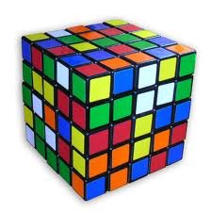
Forms:
N: enigma
V: 00
Adj: enigmatic
Adv: 00
Enigma: puzzle, mystery
Syn: conundrum
It was just another of the
He found himself fascinated by the
She got up very early, intrigued by the
enigmas
enigma
he never solved.
enigma
of the girl’s disappearance
of the dream.
Childhood’s End
--Arthur C. Clarke
Love in the Time of Cholera
--Gabriel Garcia Marquez
I watched curiously as an
enigmatic
Childhood’s End
--Arthur C. Clarke
range of emotions
flitted across her face.
New Moon
--Stephanie Meyer
Any form of this word will appear once in every 5,511 pages of text.

Slide 21
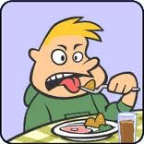
Syn: revulsion, loathing
Ant: attraction, magnetism, proclivity, addiction
Aversion: strong, automatic dislike, esp. one causing a negative physical
reaction
Forms:
N: aversion
V: avert, averts, averted,
averting
Adj: averse
Adv: aversely
She had an unreasoning
“We have an
aversion
aversion
to it,” she said, choosing the
to her stepmother.
word carefully.
The Adventures of Sherlock Holmes
--Arthur Conan Doyle
The Alchemist
--Michael Scott
She had avoided Emily Brent with a shuddering
aversion
Others called them Mujahideen, but, when they did, they
And Then There Were None
--Agatha Christie
made a face—a sneering, distasteful face—the word reeking
of deep
aversion.
A Thousand Splendid Suns
--Khaled Hosseini
Any form of this word will appear once
in every 338 pages of text.

Slide 22
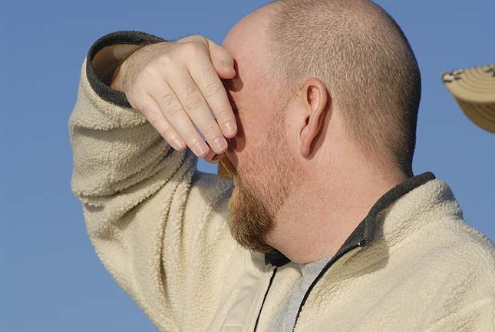
Syn: evade, reject
Avert: turn away from
Ant: seek out, approach
Root: vert, verse
to turn: divert,
diverse; convert,
converse; subvert,
subversive; traverse
Forms:
N: aversion
V: avert, averts, averted,
averting
Adj: averse
Adv: 00
Tally
They shrug, mumble, and
averted
her eyes from Shay’s beauty, trying
He merely turned red and
avert
their gazes.
averted
his eyes.
to focus her thoughts.
Uglies
--Scott Westerfeld
Water for Elephants
--Sara Gruen
Listening for Lions
--Gloria Whelan
A potential crisis had been
averted.
Any form of this word will appear once
in every 338 pages of text.
The Shack
--William P. Young

Slide 23
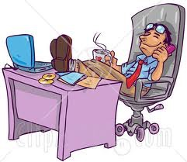
Nonchalant: having a free,casual, informal attitude
Syn: insouciant; blithe
Ant: tense, intense
I just got very cool and
Forms: N: nonchalance
V: 00
Adj: nonchalant
Adv: nonchalantly
nonchalant.
Catcher in the Rye
--J. D. Salinger
My driver drove
And he said
nonchalantly
and recklessly, averting
, “I can waltz.”
“Don’t rush, act
nonchalant”
, Amy cautioned.
collisions by the thinnest of margins, all without so much as a
I Am the Cheese
--Robert Cormier
pause in the incessant stream of words spewing from his mouth.
The Grapes of Wrath —John Steinbeck
The Kite Runner —Khaled Hosseini
Any form of this word will appear once
in every 2,269 pages of text.

Slide 24
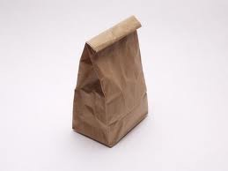
Frugal: thrifty; reluctant to spend money
Syn: miserly, parsimonious
Forms: N: frugality
Verb: 00
Adj: frugal
Adv: frugally
Ant: extravagant, lavish
Any form of this word will appear once
in every 1,326 pages of text.
They’re so
frugal
with things here, waste is practically
a criminal activity.
In order to secure my credit and character as a tradesman,
Susanne Collins
--The Hunger Games
I took care not only to be in reality industrious and
frugal,
The truest happiness, he said, lay in working hard and
And I reckon I deserve a treat today, after being so
frugal
but to avoid all appearances to the contrary.
living
frugally.
Animal Farm
--George Orwell
for the last few days.
Confessions of a Shopoholic
--Sophie Kinsella
The Autobiography of Benjamin Franklin
--Benjamin Franklin

Slide 25
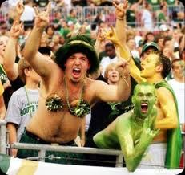
Zeal: excessive commitment or enthusiasm
Syn: exuberance, ardor, fervor, elan, fanaticism
Forms: N: zeal, zealot
Verb: 00
Adj: zealous
Adv: zealously
Ant: apathy, lethargy, nonchalance,
indifference, ennui
They flung themselves into their work with savage
I didn’t have that patriotic
zeal.
Above 26,000 feet, moreover, the line between appropriate
One Day in the Life of Ivan Denisovich
--Alexander Solzhenitsyn
The Things They Carried
--Tim O’Brien
zeal
and reckless summit fever becomes grievously thin.
Into Thin Air
--Jon Krakauer
If something captured my undisciplined imagination, I pursued
it with a
zeal
bordering on obsession.
Into Thin Air
--Jon Krakauer
Any form of this word will appear once
in every 202 pages of text.

Slide 26
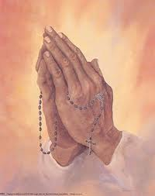
Pious: observing religious laws and customs
Ant: profane, blasphemous
Forms: N: piety
Verb: 00
Adj: pious
Adv: piously
Why do you turn away from your
pious
practices and good works?
A Portrait of the Artist as a
Young Man
--James Joyce
Pious
people have always gotten on my nerves.
Most were
pious
Christians or Muslims.
The Secret Life of Bees
--Sue Monk Kidd
Outcasts United
--Warren St. John
He really seemed somehow to other to fancy that his wife
had
piety
and benevolence enough for two.
Uncle Tom’s Cabin
--Harriet Beecher Stowe
Any form of this word will appear once
in every 274 pages of text.

Slide 27
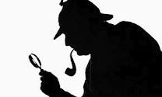
Astute: sharply observant
Forms: N: asuteness
Verb: 00
Adj: astute
Adv: astutely
Syn: shrewd
Ant: obtuse, naïve, gullible
I’d say that’s a remarkably
astute
analysis.
Chrysler may not like Toyota, but the
astute
The Shining
--Stephen King
Mr. Iacocca does not call for an air strike against Tokyo.
“You’ve completely changed, you used to be so
astute,
are you losing it now?
The Bourne Ultimatum
--Robert Ludlum
The Trial
--Franz Kafka
For all his sagacity, for all his caution and
astuteness,
the old judge had gone the way of the rest.
And Then There Were None
--Agatha Christie
Any form of this word will appear once
in every 1,835 pages of text.

Slide 28
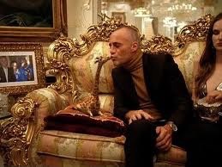
Opulent: observably wealthy, showy
Forms: N: opulence
Verb: 00
Adj: opulent
Adv: opulently
Syn: ostentatious, lavish
Ant: humble, modest, understated
Related: optical, optician
An
opulent
priest is a contradiction.
The
opulence
Les Miserables
--Victor Hugo
of having a teacher for each grade made an
Nowhere in all America will you find parks and gardens
impression on him.
East of Eden
--John Steinbeck
more
opulent
than in New Bedford.
“How grand you look, Randolph,” he continued in a thin
Moby Dick
--Herman Melville
voice while studying his host and glancing around at the
opulent
suite.
Any form of this word will appear once
in every 1,590 pages of text.
The Bourne Ultimatum
--Robert Ludlum

