Slide 1
Welcome to Decent Exposure : High School, Volume I:
magistrate: Slide 2
jubilant: Slide 3
chattel: Slide 4
timbre: Slide 5
meander: Slide 6
resilient: Slide 7
embellish: Slide 8
denounce: Slide 9
mystic: Slide 10
dubious: Slide 11
ruminate: Slide 12
sever: Slide 13
resplendent: Slide 14
discord: Slide 15
invective: Slide 16
wistful: Slide 17
didactic: Slide 18
undulate: Slide 19
guileless: Slide 20
blight: Slide 21
ethereal: Slide 22
ascetic: Slide 23
notorious: Slide 24
chasm: Slide 25
reticent: Slide 26

Slide 2
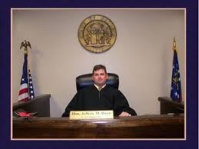
Magistrate: judge
Relatives: mag: big, great in size
majestic, magnificent, magnitude
You told us that when you said you did not care to go before
the
magistrate,
to “press charges,” as you put it.
Before the war I was a
magistrate,
and I used to work on this
kind of problem.
A Soldier of the Great War
--Mark Helprin
The Bourne Supremacy
--Robert Ludlum
His mother was a federal
magistrate,
his father, a law professor.
Outcasts United
-- Warren St. John
I have been named
magistrate
of this town.
One Hundred Years of Solitude
--Gabriel Garcia Marquez
Any form of the word “magistrate” will appear once in every 235 pages of text.

Slide 3

Jubilant: overjoyed
Forms:
N: jubilation
V: 00
Adj: jubilant
Adv: jubilantly
syn: elated, ecstatic
ant: morose, sullen, depressed,
indifferent, apathetic
The city was in the midst of a
jubilant
gala.
The Looking Glass Wars
--Frank Beddor
But although Tom’s ear tingled, his heart was
jubilant.
I felt their arms around my neck, their hugs and the marvelous
The Adventures of Tom Sawyer
--Mark Twain
May the halls echo with the
jubilation
of our race.
jubilation
of reunion.
Black Like Me
--John Howard Griffin
Eldest
--Christopher Paolini
Any form of the word “jubilant” will appear once in every 2,232 pages of text.

Slide 4
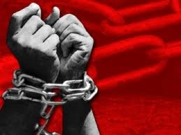
Chattel: slave; livestock; a burdensome
possession
On the way we meet the inhabitants trundling
their goods and
chattels
along with them in wheelbarrows,
in perambulators, and on their backs.
You then stood without a
All Quiet on the Western Front
--Erich Maria Remarque
chattel
to your name, and I was the
master of the house in Corn Street.
The Mayor of Casterbridge
--Thomas Hardy
Yet that intelligent, enterprising, noble-hearted man was a
chattel.
Incidents in the Life of a Slave Girl
--Harriet Jacobs
She is a valuable industrial possession—
chattel
to the man, or
who may profit by her labor; never a luxury—a bill of
expense.
The Power and the Glory
--Grace MacGowan Cooke
Any form of the word “chattel” will appear once in every 2,611 pages of text.

Slide 5

Timbre: one of the properties of sound; often used to describe a tone, loudness, or
pitch of voice.
Only the
timbre
of his voice showed his passion; he was as
slow and easy as Pruitt.
The Thundering Herd
--Zane Grey
So we watch their faces, their hands, their feet, and listen for truth in
timbre.
She stood listening to the alternating
timbres
and resonances
The Bluest Eye
--Toni Morrison
of the men’s voices.
The Looking Glass War
--Frank Beddor
The voice had its very own
timbre,
with a heavy, weary rasp.
Life of Pi
--Yann Martel
Any form of the word “timbre” will appear once in every 10, 563 pages of text.

Slide 6
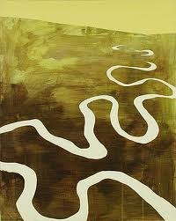
Meander: wind, wander, travel in an indirect path
Forms: N:00; V: meander, meanders, meandered, meandering; Adj: 00; Adv: 00
I watched the currents
meander,
the lazy ripples that once
in a while broke the surface.
For the next few minutes, they chatted as they
It was one of several
meandering
meandered
among the shelves.
True Believer
--Nicholas Sparks
cottages lined up along a stream bank.
The Secret Life of Bees
--Sue Monk Kidd
The Bean Trees
--Barbara Kingsolver
They watched Hagrid
meander
tipsily up to the castle.
HP and the Prisoner of Azkaban
--J.K. Rowling
Any form of the word “meander” will appear once in every 3,045 pages of text.

Slide 7
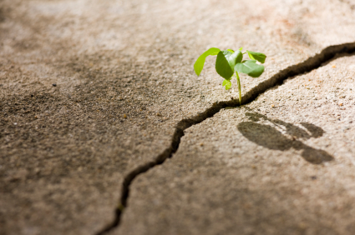
Resilient: the ability to bounce back after a setback
syn: hardy
ant: fragile
Forms: N: resilience
V: 00
Adj: resilient Adv: resiliently
We were both more
resilient
than I gave us credit for.
She was, he thought, capable, strong, and
It takes a special strength and
resilience.
resilient.
The Host
--Stephanie Meyer
Immortal in Death
--J.D. Robb
But my dad’s a
man, tough and determined.
resilient
City of Bones
--Cassandra Clare
Lone Survivor
--Marcus Luttrell
Any form of the word “resilient” will appear once in every 3,359 pages of text.

Slide 8
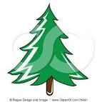
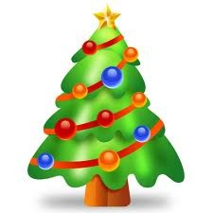
Embellish: decorate
Forms: N: embellishment,embellishments
V: embellish, embellishes, embellished,
embellishing Adj: 00 Adv: 00
He began
embellishing
--a teaspoon of blood became
syn: adorn
ant: denude
Related:
bella: beauty
a cup…
We discussed John’s and my year abroad, and me carefully
Nineteen Minutes
--Jodi Picoult
embellishing
the journey to sound like the ideal honeymoon.
He wore a helm
embellished
with gold, silver and rubies and,
Rose Red
--Stephen King
on his fingers, five large rings.
When she saw the teacher looking so interested, she
embellished
Brisingr
--Christopher Paolini
the story.
A Tree Grows in Brooklyn
--Betty Smith
Any form of the word “embellish” will appear once in every 1,259 pages of text.

Slide 9

Denounce: publicly reject or accuse
Forms: N: denunciation, denunciations
V: denounce, denounces, denounced,
denouncing Adj: 00 Adv: 00
syn: repudiate
ant: praise, laud
Related:
noun: name
announce, noun,
pronounce
Mr. Rearden, the law which you are
denouncing
is based on the highest
Chris would fixate on his father’s own less-than-sterling
principle—the principle of the public good.
Martin hastened to Terry, declaring that he would resign--
behavior many years earlier and would silently
denounce
him.
They published a scathing
Atlas Shrugged
--Ayn Rand
denunciation
of the population
would
denounce
--would expose—Yes!
limitation laws.
Ender’s Game
--Orson Scott Card
Into the Wild
--Jon Krakauer
Arrowsmith
--Sinclair Lewis
Any form of the word “denounce” will appear once in every 386 pages of text.

Slide 10
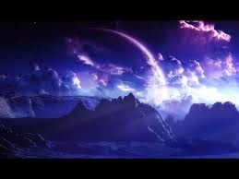
Mystic: related to the heavens or religious beliefs; a person thought to be able to communicate with God, angels, or other spiritual forces
Forms: N: mystic; mysticism
V: 00 Adj: mystical Adv: mystically
syn: divine; otherworldly; ethereal;
celestial
ant: mundane; earthly
Once he surrendered reason,
She was a practicing Sufi
mystic.
he was left at the mercy of…
Red: The Heroic Rescue
--Ted Dekker
a body moved by unaccountable
He hypnotized me with his
mystical
vampire powers.
instincts and a soul moved by
mystic
revelations.
Breaking Down
--Stephanie Meyer
Atlas Shrugged
--Ayn Rand
Now we’re resorting to
mystics?
Black: The Birth of Evil
--Ted Dekker
Any form of the word “mystic” will appear once in every 340 pages of text.

Slide 11
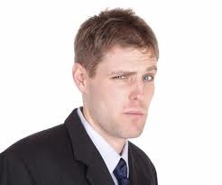
Dubious: full of doubt; uncertain; unsteady; unlikely;
questionable
Forms: N: doubt
V: doubt, doubts, doubted, doubting
Adj: dubious Adv: dubiously
“Oh come on,” I said
dubiously.
Twilight
--Stephanie Meyer
syn: skeptical; cynical
ant: certain; cocky; gullible; inevitable
The only
dubious
ray of hope has come from my sister.
The Hunger Games
--Suzanne Collins
She scanned the menu and settled
dubiously
on the stuffed shells supreme.
Immortal in Death
--J.D. Robb
His writing ability was
dubious
to say the least, but he
considered himself lucky.
The Book Thief
--Markus Zusak
Any form of the word “dubious” will appear once in every 922 pages of text.

Slide 12
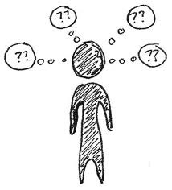
Ruminate: think about something over and over
What I know is
Forms: N: rumination
V: ruminate, ruminates, ruminated,
ruminating
Adj: ruminative Adv: 00
ruminated,
plotted,
and set down.
Henry V
--WS
syn: contemplate, perseverate, mull
ant: ignore, forget
I was afraid I’d
ruminate,
agonize, rationalize and talk
Relatives: ruminant (cud-chewing
animal); rumor
myself into not going.
The Kite-Runner
--Khaled Hosseini
He remained in a state of empty and peaceful
rumination
until he heard the clock tower strike three in the morning.
Metamorphosis
--Franz Kafka
He rested a while in critical
rumination.
Catch-22
--Joseph Heller
Any form of the word “ruminate” will appear once in every 2,617 pages of text.

Slide 13

Sever: to cut
Forms: N: severance
V: sever, severs, severed, severing
Adj: 00 Adv: 00
syn: truncate, terminate, amputate
ant: extend, unite, splice
The
severed
ropes fell away.
HP and the Deathly Hollows
--J.K. Rowling
Angela
severed
the connection.
Brisingr
--Christopher Paolini
Now Palmgren was gone, and another tie to established society
had been
severed.
The Girl with the Dragon Tattoo
--Stieg Larsson
The bullet had hit him in the shoulder,
severing
tendons and
ligaments, shattering bone.
The Looking-Glass War
--Frank Beddor
Any form of the word “sever” will appear once in every 626 pages of text.

Slide 14
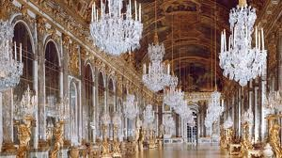
Resplendent : luxuriously decorated
Forms: N: resplendence
V: 00
Adj: resplendent Adv: resplendently
He wore a
resplendent
syn: opulent, ostentatious, lavish
ant: modest, spare, austere, sparse
dressing gown and embroidered slippers.
The Early Cases of Hercule Poirot
--Agatha Christie
Relatives: splendid; splendor
Razor creases on his pants and
resplendent
Drown
--Junot Diaz
white shirts were his trademarks.
in the sun; she heard the
He was
She saw the leaves
resplendent
resplendent
in new clothes and a greatcoat with a
dashing cape thrown back from his heavy shoulders.
sounds of the city, faint and sweet, like thousands of distant
violins.
The Incredible Lightness of Being
--Milan Kundera
Gone With the Wind
--Margaret Mitchell
Any form of the word “resplendent” will appear once in every 1,864 pages of text.

Slide 15
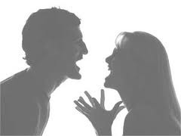
Discord: quarrelsome atmosphere; tension between people
He had seen some minor
discord
and name-calling.
We have remained close, however, and have glimpsed islands of
agreement while navigating the rapids of
The Crystal Shard
--R.A. Salvatore
But then
discord
crept among us.
discord.
This was the cause of constant
discord.
This I Believe II
--Jay Allison, et. al.
HP and the Order of the Phoenix
--J.K. Rowling
Love in the Time of Cholera
--Gabriel Garcia Marquez
Forms: N: discord
V: 00
Adj: discordant Adv: discordantly
Any form of the word “discord” will appear once in every 625 pages of text.
syn: dispute, disagreement
ant: harmony, accord

Slide 16
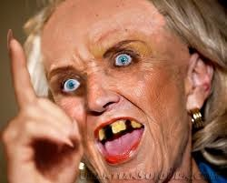
invective: a scolding with harsh words
Forms: N: invective
V: 00
Adj: 00 Adv: 00
syn: diatribe, vituperation, tirade
ant: praise, adoration, adulation
He occasionally broke forth into sentences composed of
Then she burst into intolerable
invective.
invectives
He began to hate them vehemently, and to assail them with every
He was divided between the impulse to laugh aloud and the equally
joined together in a long string.
invective
kind of
he could think of.
unseasonable impulse to burst into scornful
invective.
Of Human Bondage
--Somerset Maugham
Maggie: A Girl of the Streets
--Stephen Crane
Zen and the Art of Motorcycle Maintenance
--Robert Pirsig
Middlemarch
--George Elliot
Any form of the word “invective” will appear once in every 2,300 pages of text.

Slide 17

Wistful: in a day-dreaming state of mind
syn: dreamy, nostalgic
Forms: N: wistfulness; V:00; Adj: wistful
Adv: wistfully
I could see them smiling
wistfully
at us.
A Walk to Remember
--Nicholas Sparks
Any form of the word “wistful “will appear once in every 533 pages of text.
He looked so
wistful
as he went away, hearing the frolic
and evidently having none of his own.
Little Women
--Louisa May Alcott
And all the while the dog sat and watched him, a certain yearning
wistfulness
in his eyes, for it looked upon him as a fire-provider,
He thought
wistfully
of the guys out on the football field
in the sweet, fresh wind, tossing the ball around before
and the fire was slow in coming.
To Build a Fire
--Jack London
practice began.
The Chocolate Wars
--Robert Cormier

Slide 18
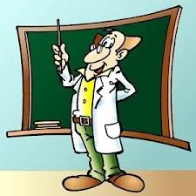
Didactic: teacher-ish, in a condescending way
syn: pedantic; professorial
Forms: N: didacticism; autodidact V: 00; Adj: didactic
Adv: didactically
Any form of the word “didactic” will appear once in every 3,784 pages of text.
His tone was becoming a little bit
didactic,
and this both amused
and irritated her.
Doctor Zhivago
--Boris Pasternak
Always
didactic,
he went into a learned exposition of the
diabolical purposes of cinnabar.
One Hundred Years of Solitude
--Gabriel Garcia Marquez
Monsieur the Principal thinks my thesis aught to be dogmatic
and
didactic.
The Three Musketeers
--Alexander Dumas
He could think of no possible way he could tell them what they
should work toward without falling back into the trap of
authoritarian,
didactic
thinking.
Zen and the Art of Motorcycle Maintenance –Robert M. Pirsig

Slide 19

Undulate: to move in a slow, waving motion
syn: unstable, unpredictable, combative
ant: placid, stable, predictable, docile
Forms: N: undulation;
V: undulate, undulates, undulated, undulating
Adj: Adv:00
Below, the surface of the water was an
undulating
mirror
of brightness.
The Pearl
--John Steinbeck
A silver ring fish floated by them,
undulating,
and closing
like an iris, instantly, around food particles, to assimilate them.
Ripples of cold
undulated
over Harry’s skin.
The Martian Chronicles
--Ray Bradbury
HP and the Deathly Hollows
--J.K. Rowling
Fighting exhaustion, the two climbers continued up the
undulating
ridge above.
Into Thin Air
--Jon Krakauer
Any form of the word “undulating will appear once in every 1,051 pages of text.

Slide 20

Guileless: without trickery
syn: sincere, ingenuous, innocent
ant: insincere, disingenuous, sly, crafty
Forms: N: guile; V: beguile, beguiles, beguiled,
beguiling; Adj: 00; Adv: 00
Relatives: gullible, disguise, guise
His eyes were wide and
guileless
as those of a boy.
His look was one of conviction, of
guileless
yet ironclad
Airborn
--Kenneth Oppel
A Thousand Splendid Suns
--Khaled Hosseini
earnestness.
With her smooth face, she looked like a young girl, frail,
guileless,
and innocent.
The Joy Luck Club
--Amy Tan
Calm,
guileless,
and sometimes childishly animated, they
looked like fat fifty-year-olds pretending to be fourteen.
The Unbearable Lightness of Being
--Kundera Milan
Any form of the word “guileless” will appear once in every 1,399 pages of text.

Slide 21
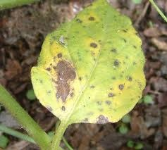
Blight: disease, visible marks of decay
syn: degeneration,
affliction
ant: robustness
Forms: N: blight, blights
V: blight, blights, blighted,
blighting Adj: 00 Adv: 00
Five figures wandered slowly over the
blighted
lands.
She says ‘twould break your heart to think what the English did
to us, but if they didn’t put the
A Hitchhiker’s Guide to the Galaxy
--Douglass Adams
blight
on the potato, they didn’t
do anything to take it off.
This sort of person is a
blight
on good professionalism.
Angela’s Ashes
--Frank McCourt
Remains of the Day
--Kazuo Ishiguro
Like a
blighted
tree, Reich fell to the ground.
The Demolished Man
--Alfred Bester
Any form of the word “blight” will appear once in every 825 pages of text.

Slide 22
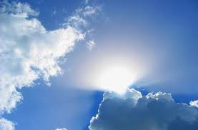
Ethereal: of the air or heavens
syn: celestial, insubstantial, airy, otherworldly
ant: earthly, earthbound, quotidian, mundane
Forms: N: ether; V: 00; Adj: ethereal; Adv: ethereally
Relative: Ethernet
Mist floated just above the ground ,
ethereal
and ghostlike.
You have to kill them in their physical and
A Bend in the Road
--Nicholas Sparks
ethereal
forms before they die.
Surrounded by a streetlight halo, she looked almost
ethereal.
City of Bones
--Cassandra Clare
The Wedding
--Nicholas Sparks
The wrought-iron fence added a spooky touch to an
ethereal
setting.
True Believer
--Nicholas Sparks
Any form of the word “ethereal will appear once in every 1,941 pages of text.

Slide 23
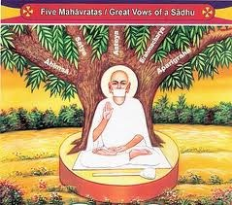
ascetic: N: a person who is 100% dedicated to
religious pursuits; Adj: severely devoted
to religion at the sacrifice of worldly
matters
ant: libertine, hedonist
Forms: N: ascetic, ascetics,
asceticism V: 00
Any form of the word “ascetic” will appear once in every 1,113 pages of text.
A gluttonous
ascetic
? Such a contradiction!
Ender’s Game
--Orson Scott Card
His suits fitted him as though he had borrowed them from a stout z
friend, and his face, seldom suggestive of his profession, was now
But I am no longer the one I was, I am no
ascetic
anymore,
not at all so; it could have been than of an
ascetic
absorbed in
I am not a priest any more, I am no Brahmin any more.
occult pursuits.
In Cold Blood
--Truman Capote
Siddhartha
--Herman Hesse
Hester sought not to acquire anything beyond a subsistence, of
the plainest and most
ascetic
simple abundance for her child.
The Scarlet Letter
--Nathaniel Hawthorne

Slide 24
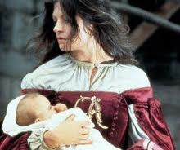
Notorious: well-known for a negative quality or
behavior
Forms: N: notoriety
V: 00 Adj: notorious
Adv: notoriously
syn: scandalous
The men were jailed in one of Central Africa’s most
notorious
prisons.
Outcasts United
--Warren St. John
Chinese officials are
notoriously
late.
The Bourne Supremacy
--Robert Ludlum
He’s
notorious
for saying no to everything.
Angela’s Ashes
--Frank McCourt
Secluded five miles up a rutted dirt track, the played-out mine
was a
notorious
party spot.
Crank
--Ellen Hopkins
Any form of the word “notorious” will appear once in every 505 pages of text.

Slide 25
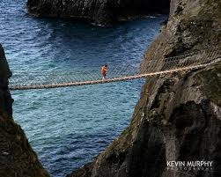
Chasm: a deep empty space
Forms:
N: chasm, chasms
V: 00; Adj: 00
Adv: 00
syn: abyss, gulf, gorge
ant: mountain
Cold laughter echoed from the
chasm.
The Lighting Thief
--Rick Riordan
But her first problem was getting across the
chasm.
Uglies
--Scott Westerfield
There was nothing between us but a dark
chasm.
October Sky
--Homer Hickham
A cliff was on their left and a
chasm
on their right.
The Two Towers
--J.R.R. Tolkien
Any form of the word “chasm” will appear once in every 1,078 pages of text.

Slide 26
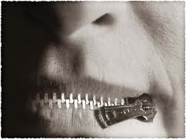
Reticent: reluctant to speak
Forms:
N: reticence
V: 00
Adj: reticent
Adv: reticently
syn: taciturn, diffident
ant: garrulous, loquacious
Nassar,
reticent
by nature, withdrew almost completely.
A
reticent
fellow, he made no reply.
Zeitoun
--Dave Eggers
Howard’s End
--E.M. Forster
He took my hand as we walked to the river, which surprised me
because he was normally
reticent
to show affection in public.
The Poisonwood Bible
--Barbara Kingsolver
Pour your heart out to me, Bessie. Don’t be
reticent.
Franny and Zooey
--J.D. Salinger
Any form of the word “reticent” will appear once in every 1,374 pages of text.

