Slide 1
Welcome to Decent Exposure, Middle School Volume III
altitude: Slide 2
chasm: Slide 3
miscreant: Slide 4
proprietor: Slide 5
waylay: Slide 6
dismember: Slide 7
pallet: Slide 8
sentry: Slide 9
recede: Slide 10
plunder: Slide 11
hew: Slide 12
lament: Slide 13
circuitous: Slide 14
mirth: Slide 15
fluster: Slide 16
wield: Slide 17
prosperous: Slide 18
nimble: Slide 19
inquisitive: Slide 20
flexible: Slide 21
siege: Slide 22
infuriate: Slide 23
amble: Slide 24
glower: Slide 25

Slide 2
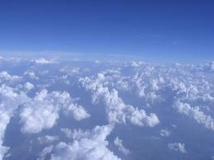
Altitude: height, usually measured in
great distances from sea level
It had been designed to reach an
altitude
As we got closer to Washington, Blackjack started
Unfortunately,
altitude
sickness kept me from
The balloon was losing
altitude.
of five miles.
slowing down and dropping
altitude.
the top.
Henry H. Neff, The Maelstrom
Homer Hickham, October Sky
Rick Riordan, The Titan’s Curse
Wes Moore, The Other Wes Moore
Any form of the word altitude will appear once in every 937 pages of text.

Slide 3
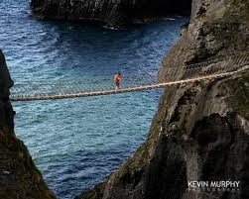
Chasm: deep gap
Synonyms: abyss, ravine, crevasse
She found herself to her horror sliding down into a
A glorious rainbow emerged from the mist over the
There was nothing beneath us but a dark
It had a rope bridge across a
chasm.
chasm.
dark, narrow
whirling
chasm.
chasm.
C. S. Lewis, The Silver Chair
Christopher Paolini , Eldest
Homer Hickham, October Sky
Rick Riordan, Sea of Monsters
Any form of the word chasm will appear once in every 1,078 pages of text.

Slide 4
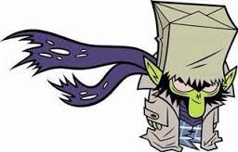
Miscreant- evildoer
Any form of miscreant will appear once in every 2,945 pages of text
What
miscreants
lurked in them, presently to be
detected by the activities of the law?
We must attack now, before yonder
miscreants
We have arrested the
E. M. Forster, A Passage to India
miscreant.
are strengthened by their friends.
Henry H Neff, The Last Battle
F. Scott Fitzgerald, Tender is the Night
You tell those fidgeting
miscreants
that they will
stand in place all morning until it pleases me to
acknowledge them.
Henry H Neff, The Maelstrom

Slide 5
Proprietor: owner of a business,
usually a store, inn, or restaurant
Related words: property, proprietary
The Willow House is a fine inn, and Mr. Barsed, its
The
The
proprietor
proprietor
of the bodega laid out an
came over to take their order.
The
proprietors
had kindly offered them a
proprietor,
sets out an excellent meal for its guests.
assortment of peppers on the counter for Cesar
complimentary room, and as he moved a few of his
to make his selection.
Alexc Pate, Amistad
Cormac McCarthy, All the Pretty Horses
W. William Winoker, The Perfect Game
things into it,his exhaustion began to get the better
of him.
William P. Young, The Shack
Any form of the word proprietors will appear once in every 308 pages of text.

Slide 6
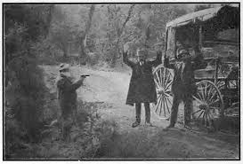
Waylay: to intercept someone by ambush and
hold them against their will, usually for a
criminal purpose
Forms: noun: 00 Verb: waylay, waylays,
waylaying, waylaid
They were not
As Roran hurried from one chore to another, Katrina
waylaid
by pirates or enemies of
waylaid
him in an alley.
state.
Just outside the double doors of the courtroom, he
Alexc Pate, Amistad
was
waylaid
by the Houghtons.
Christopher Paolini, Eldest
Thief indeed! What of our claim for
waylaying,
Jodi Picoult, Nineteen Minutes
wounding, and orc-dragging us through Rohan?
Any form of the word waylay will appear once in every 3,728 pages of text.
J.R.R. Tolkien, The Return of the King

Slide 7
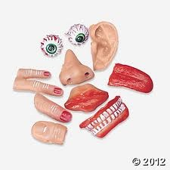
Dismember: to take apart, usually referring to
a human or animal
Synonym: disassemble
Antonym: assemble
Forms: noun: dismemberment
verb: dismember, dismembers
dismembered, dismembering
As I approached the barn, I heard the most unholy
His butchered,
dismembered
body lay on the floor of
It’s a violent
dismemberment.
sounds– like cats being
dismembered,
calves being
the boat.
Yan Martel, Life of Pi
One of the hawks had a partially
dismembered
slaughtered.
gopher in its mouth.
Sara Gruen, Water for Elephants
Jodi Picoult, Change of Heart
Any form of the word dismember will appear once in every 8,347 pages of text.
James Patterson, The Angel Experiment

Slide 8
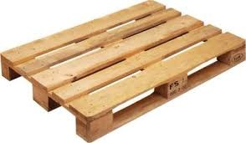
Pallet: a small, low, portable platform,
usually used for transporting items
Thompson’s gavel slammed down on the wooden
Finally Lieutenant Pennel was loaded with some
The ailing woman turned restlessly on her
pallet.
She’s having difficulty balancing on the
pallet.
other wounded boys onto a long
pallet.
pallet.
Christopher Paollini, Brisingr
Grace MacGowan Cooke, The Power and the Glory
James Bradley, Flags of our Fathers
Alexs Pate, Amistad
Any form of the word pallet will appear once in every 3,091 pages of text.

Slide 9
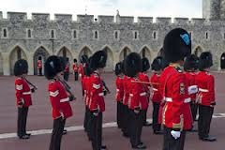
Sentry: soldier who guards an entrance
Synonym: sentinel
He mostly slept in the van during the day and then sat
The headed through the hills, avoiding the tops for
I want one
The
sentry
sentry
was standing, his back toward them, at
at the gate and one on the ramparts.
up at night, acting as
of being spotted by
the far end of the bridge.
sentries.
sentry.
Mark Helprin, A Soldier in the Great War
Christopher Paolini, Eragon
Stephenie Meyer, The Host
Ernest Hemingway, For Whom the Bell Tolls
Any form of the word sentry will appear once in every 710 pages of text.

Slide 10
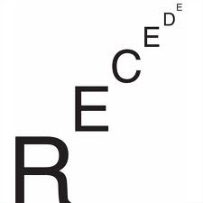
Recede: to move to a more distant point;
to withdraw; to lessen
Synonyms: retire, retreat
Antonyms: intensify, aggress, approach
Forms: noun: recession verb: recede, recedes,
receded, receding
adjective: recessive adverb: 00
He could smell the sharp odor of exposed kelp from
Owen began to turn down the volume, and the static
Her mother’s voice, the feel of home,
receded
Their voices
receded
down the corridor.
above us
receded
us bit by bit.
for a moment, and her thoughts turned forward.
the
receding
tide.
John Steinbeck, The Pearl
Natalie Babbitt, Tuck Everlasting
Sara Dessen, Just Listen
Rick Riordan, The Sea of Monsters
Any form of the word recede will appear once in every 303 pages of text.

Slide 11
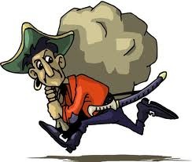
Plunder: raid and steal, esp. from a village
Synonyms: pillage, sack, ravage
Antonyms: restore, rehabilitate
Forms: Noun: plunder Verb: plunder, plunders,
plundered, plundering
Adjective: 00 Adverb: 00
They’ll dream about vicious children
plundering
After weeks of marches and raids, he’s escaped into
Others curse him as the
plunderer
the nest.
the wild with child slaves and
plunder
of their fleets.
He was arrested for
plundering.
Kurt Vonnegut, Slaughterhouse-Five
Henry H. Neff, The Fiend and the Forge
David Almond, Skellig
far from even the nearest safari camp.
Allan Stratton, Chandra’s Wars
Any form of the word “plunder” will appear once in every 380 pages of text.

Slide 12
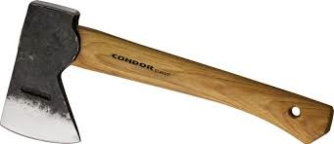
Hew: to strike forcibly with an axe or sword;
to conform (to)
Synonyms: hack, chop
Forms: Noun: 00 Verb: hew, hews, hewn, hewed
hewing
Adjective: hewn Adverb: 00
At least his hand still clasped the Red Arrow, but his
In a fury he
A rough
-hewn
hewed
maypole has been erected on
at them with his sword.
As for fish, they were
hewn
a gentle slope further on.
head was
hewn
off.
to pieces practically while they were still flopping about.
Libba Bray, Sweet Far Thing
J. R. R. Tolkien, The Return of the King
J. R. R. Tolkien, The Two Towers
Yann Martel, Life of Pi
Any form of the word “hew” will appear once in every 1,257 pages of text.

Slide 13
lament: to feel or express sorrow or regret
Synonyms: mourn, grieve
Antonyms: rejoice, congratulate,
celebrate
Forms: Noun: lament, lamentation
Verb: lament, laments, lamented, lamenting
Adjective: lamentable Adv: lamentably
She, being the nearest woman relative, raised a
“You could’ve told me,” Schwartzie
lamented.
“We’ll never bet anywhere,” he
lamented
A cry of
lamentation
went up.
formal
lament
for the dead of the family.
I could’ve been ready.
to Ursula.
George Orwell, Animal Farm
Chaim Potok, The Chosen
John Steinbeck, The Pearl
Gabriel Garcia Marquez, One Hundred Years of Solitude
Any form of the word “lament” will appear once in every 265 pages of text.

Slide 14
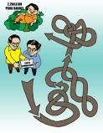
Circuitous: in a circular or indirect pattern
Synonym: indirect, roundabout
Antonym: direct
Forms: Noun: circuit, circuitry Verb: 00
Adjective: circuitous Adverb: circuitously
I wasn’t used to having to go to such
Wherever he was being taken, he was being driven
circuitous
I’ll be coming by a rather
circuitous
I’ve just decided to try and loop back around, although
measures, listening to your words in Jessica’s mind…
there by an extremely
circuitous
route.
it will require miles of travel away from the inferno
route, so I don’t know
how long it will take me.
her mind isn’t very original, and it was annoying to
and then a very
circuitous
Roger Zelazny, Nine Princes in Amber
Robert Ludlum, The Bourne Ultimatum
route back, when the first
have to stoop to that.
Stephenie Meyer, Twilight
fireball blasts into the rock about two feet from my head.
Suzanne Collins, The Hunger Games
Any form of the word “circuitous” will appear once in every 3,708 pages of text.

Slide 15
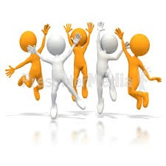
Mirth: joy
Synonyms: merriment, revelry, celebration
Antonyms: mournfulness, grief, lamentation
Forms: Noun: mirth Verb: 00
Adjective: mirthful Adverb: mirthfully
…but a smile without
mirth
without depth, just an arrangement of flesh.
I would entreat you rather to put on your
boldest suit of
The sound of her
mirth,
Robert Cormier, After the First Death
mirth,
Trying valiantly to laugh along with everyone else, he
William Shakespeare, The Merchant of Venice
for we have friends that purpose merriment.
was like water falling on crystal.
got up, his feet numb from the weight of the dwarf,
Christopher Paolini, Brisingr
William Shakespeare, The Merchant of Venice
as Percy Weasley did his best to disperse the crowd,
some of whom were crying with
mirth.
J.K. Rowling, HP and the Chamber of Secrets

Slide 16
Fluster: confuse, throw off-guard
Synonyms: discombobulate, bewilder,
disconcert, agitate
Antonyms: soothe, reassure, calm
Forms: Noun: 00 Verb: fluster, flusters, flustered,
flustering
Adjective: 00 Adverb: 00
He looked at her until she was baffled and
flustered
She saw me, and I got all
again.
flustered.
flustered,
His questions left Laila
and I just kept walking.
Nora Roberts, Summer Pleasures
Khaled Hosseini, A Thousand Spendid Suns
Sara Dessen , Just Listen
“Er…what?” said Daphne,
flustered.
Any form of the word “fluster” will appear once in every 4,805 pages of text.
Terry Pratchett, Nation

Slide 17
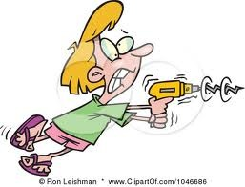
Wield: to exercise power over something or
someone; to use an instrument skillfully
Forms: Noun: 00 Verb: wield, wields, wielded
wielding
Adjective: unwieldy (awkward)
Adverb: 00
Suddenly, they burst into the creek,
No broken blade will harm me, not even one
He jumps up, kicking his chair ten feet behind him and
I can ride and
wield
blade, and I do not fear either
wielding
wielding
wielded
a knife.
sticks like swords.
by you.
pain or death.
Henry H. Neff, The Second Siege
J. R. R. Tolkien, The Return of the King
Sara Shepard, Pretty Little Liars
Suzanne Collins, The Hunger Games
Any form of the word “wield” will appear once in every 798 pages of text.

Slide 18
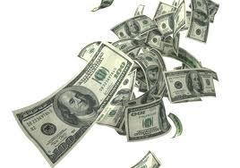
Prosperous: successful and/or fortunate, esp.
financially
Synonyms: affluent, wealthy
Antonyms: impoverished, unfortunate
Forms: Noun: prosperity Verb: prosper, prospers,
prospered, prospering
Adjective: prosperous Adverb: prosperously
The man saluted and said: “A New Year to you, sir.”
prosperous
May God grant you a long and
prosperous
life, my daughter.
It was a nice little town, very
prosperous,
“This here’s California, and she don’t look so
prosperous.”
James Joyce,
Dubliners
with neat houses and all the sanitary conveniences.
Khaled Hosseini, A Thousand Splendid Suns
John Steinbeck,
The Grapes of Wrath
Tim O’Brien, The Things They Carried
Any form of the word “prosperous” will appear once in every 159 pages of text.

Slide 19
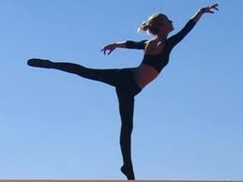
Nimble: flexible, adaptable, quick
Synonyms: lithe, agile
Antonyms: stiff, inflexible, rigid
Forms: Noun: nimbleness Verb: 00
Adjective: nimble Adverb: nimbly
She was sitting at a loom, weaving cream-colored
Fingers, though blunt, were far more
nimble
A Metaverse vehicle can be fast and
nimble
I don’t have such
nimble
cloth with fast,
nimble
movements.
than a hook.
as a quark.
hands as our light-fingered friend.
Yann Martel , Life of Pi
Neal Stephenson, Snow Crash
Henry H. Neff, The Second Siege
Cornelis Funke, Inkheart
Any form of the word “nimble” will appear once in every 956 pages of text.

Slide 20
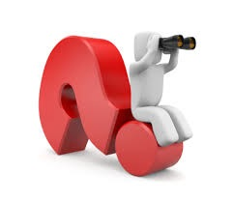
Inquisitive:
tending to ask questions; tending to explore and find
answers
Synonyms: curious, questioning, interested
Antonyms: uninterested, uncurious, apathetic
Forms: Noun: inquisitiveness Verb: inquire, inquires,
inquired, inquiring
Adjective: inquisitive Adverb: inquisitively
“Stay here, I vote,” said Jill. “I’d much rather not see it.
“What?” came the
inquisitive
response.
But she felt a little
inquisitive.
William Winokur, The Perfect Game
To explain would have only left his classmate more
Lucy felt a little frightened, but she felt very
inquisitive
C. S. Lewis, The Silver Chair
and excited as well.
confused and more
inquisitive.
Tracy Kidder, Strength in What Remains
C.S. Lewis, The Lion, The Witch and the Wardrobe
Any form of the word “inquire” will appear once in every 52 pages of text.

Slide 21
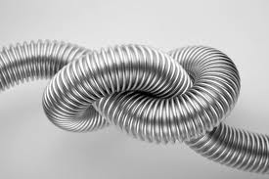
Flexible: bendable
Synonyms: agile, lithe, nimble, easygoing,
adaptable
Antonyms: rigid, inflexible
Forms: Noun: flexibility Verb: flex, flexes,
flexed, flexing
Adjective: flexible Adverb: flexibly:
Related words: besieged
Horn isn’t
flexible
or springy enough to make a bow.
Christopher Paolilni, Eldest
These have a narrow
flexible
rubber sole
with threads though.
I touched the baby’s shoulder blades, felt how tiny and
We Shadowhunters live by a code, and that code isn’t
Suzanne Collins, The Hunger Games
flexible
they were.
David Almond, Skellig
flexible.
Cassandra Clare, City of Bones
Any form of the word “flexible” will appear once in every 447 pages of text.

Slide 22
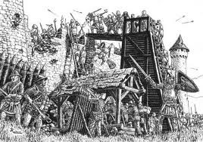
Siege: attack and takeover of a specific
city or town
Related word: besieged (to feel attacked) :
Others were on guard, as if expecting a
siege
Vicksburg had fallen, fallen after a long and bitter
I have been home less than a minute, and already I
“It was frazzled and puffed out,” under
siege,”
at any moment.
siege.
am under
David Eggers, Zeitoun
as Jim so kindly used to put it.
siege.
Margaret Mitchell, Gone with the Wind
Libba Bray, Sweet Far Thing
Any form of the word “siege” will appear once in every 305 pages of text.
Nicholas Sparks, The Guardian

Slide 23
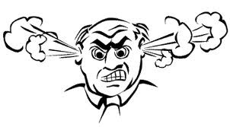
:
Infuriate: to cause extreme anger; to make furious
Synonyms: enrage
Antonyms: sedate, please, calm, satisfy
Forms: Noun: 00 Verb: infuriate, infuriates,
infuriated, infuriating
Adjective: 00 Adverb: infuriatingly
Related words: fury, furious
I jab at him with my elbow, but this only
infuriates
The color is hideous enough, and unreliable enough,
him.
infuriating,
The gesture was
but in his condition,
It
and
infuriating
enough, but the wallpaper was
infuriated
me to think that not too long ago, I, like
Suzanne Collins, The Hunger Games, Book #3
there was little Max could do.
torturous.
this boy, had foolishly played the clown.
Henry H. Neff, The Fiend and the Forge
Charlotte Perkins Gillman, The Yellow Wallpaper
Daniel Keyes, Flowers for Algernon
Any form of the word “infuriate” will appear once in every 1,544 pages of text.

Slide 24
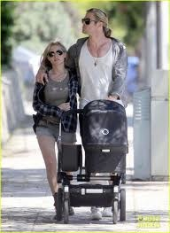
Amble: to walk at a leisurely pace
Synonyms: stroll, saunter
Antonyms: march, stride
Forms: Noun:00 Verb: amble, ambles,
ambled, ambling
Adjective: 00 Adverb: 00
Related words: perambulator, ambulance,
ambulate
I walked back to the door, stepping aside as Monica
Toby was
ambling
toward it on weary legs.
We both laughed,
A toothless old man came
ambling
on towards the house.
ambling
ambled
past me, yawning widely.
up to them.
Olive Ann Burns, Cold Sassy Tree
Henry H. Neff, The Maelstrom
Sarah Dessen, The Truth About Forever
J.K. Rowling, HP and the Sorcerer’s Stone
Any form of the word “amble” will appear once in every 1,731 pages of text.

Slide 25
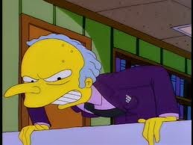
Glower: frown menacingly, make a mean and
threatening face
Synonyms: frown, sneer
Antonyms: smile, grin, beam
Forms: Noun:00 Verb:glower, glowers,
glowered, glowering
Adjective: 00 Adverb: 00
And Ares, well, he sat on his chrome-and-leather
throne,
glowering
at me while he sharpened his
…shouted his sister,
glowering
at him and
The adults stoop as well, some
glowering,
knife.
shaking her fist.
and the tension rises.
Franz Kafka, Metamorphosis
Jacob’s eyes sparked with hate as he
glowered
Rick Riordan, The Titan’s Curse
at Edward again.
Nicholas Kristof, Half the Sky
Stephenie Meyer, New Moon
The word “glower” will appear once in every 3,404 pages of text.

