Slide 1
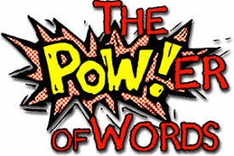
Vocabulary Instruction for Durable Learning
A workshop with Amy Benjamin
www.amybenjamin.com
Agenda:
I. How Words Get Learned and Stay Learned
II. Types of vocabulary/Types of Instruction
A. Literary words
B. Generic academic words
C. Latin roots
D. Glossary words

Slide 2
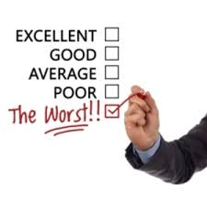
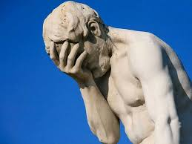

Slide 3
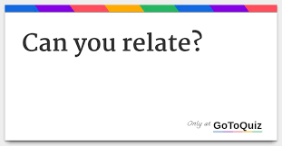
“In the 20 years I spent as a language arts teacher, I always accepted that
teaching vocabulary was my responsibility—and yet, whenever I used a
vocabulary workbook, I didn’t teach vocabulary so much as I assigned it.
This isn’t something I’m proud of, but it was so easy just to say, ‘Look at the
words in Chapter 2 of your vocab book and fill in the activities.’ Later in the
week, when I could find the time, I would go over the students’ work,
administer a test, grade it, and move on to the next chapter. My students
never really “knew” the words. I know I’m not the only teacher who has let
vocabulary fall by the wayside to focus on other things.”
Marilee Sprenger
Vocabulary Rehab
ASCD

Slide 4
key comprehension the knowledge is reading predictor vocabulary of
Vocabulary knowledge is the key predictor of reading comprehension.

Slide 5
Reading is the key builder of vocabulary.

Slide 6
Knowing the meaning of
individual words
Understanding the
world of words
Having fun with words

Slide 7
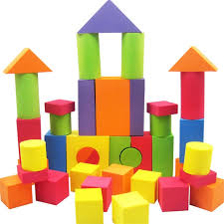
Build Semantic Networks
Etymology
Forms
Connotation
Word
Visuals
Prefix, Root,
Suffix
Context
Collocation
Synonyms/Near Synonyms
Antonyms/Near Antonyms
Personal connections
and associations

Slide 8
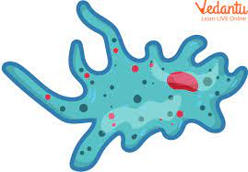
Draw an Amoeba
How would you
describe the shape
of an amoeba?
blobby
blob-like
New Words:
atypical
atheist
anarchy
anonymous
asymmetrical
shapeless
amorphous

Slide 9
“Teachers will often attempt to relate to students
by conversing with them on their level, adopting
many of their expressions and colloquialisms.
However, research suggests that this approach is
not particularly conducive to vocabulary growth.
We need to “teach up” by using academic
language rather than kid language”
(Himmele & Himmele, 2009).

Slide 10
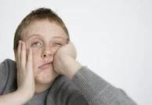
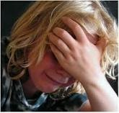

Slide 11
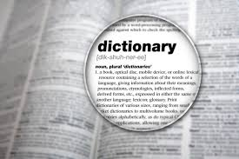
Teacher: Your vocabulary words are emerge, ensue, and profound.
Look them up in the dictionary, write the definitions, and use them in a sentence.
emerge: v. to become known
ensue: v: to follow
profound: adj.: deep
My dog ensued
me to school.
My grade on the
test emerged.
I swam in the
profound end
of the pool.

Slide 12
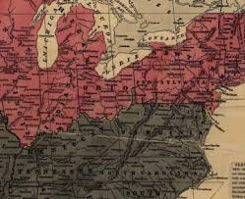
A Classroom Snapshot:
Context: After having viewed selected parts of the Ken Burns Documentary
about the Civil War
Teacher:
Maria:
James
Keenan:
Student:

Slide 13
A Classroom Snapshot:
Context: After having viewed selected parts of the Ken Burns Documentary
about the Civil War
Teacher: I want to keep talking about the Civil War. Who remembers the year the
Civil War began. Maria?
Maria: 1861. There were really gross pictures in the show of guys
with blood all over them.
Teacher: 1861. Yes.
James (calling out): They were cool.
Teacher: James, did those gross pictures give you any ideas about the war?
Student:
James: Yeah, they were stupid.
Teacher: Who remembers who was the president for the South?
His name waazzzz…..
Keenan? You think you know?
Keenan: Can I go to the bathroom?

Slide 14
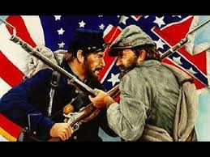
Another Classroom Snapshot:
Context: After having viewed selected parts of the Ken Burns Documentary
about the Civil War
Teacher: Let’s continue our discussion of the Civil War. First, what year marked
the beginning of the Civil War. Maria?
Maria: 1861. There were really gross pictures in the show of guys
with blood all over them.
Teacher: 1861. Yes. Some of the photographs were gruesome.
James (calling out): They were cool.
Teacher: James, how did those graphic images of combat injuries help you understand
how the Civil War affected young soldiers?
James: It showed how they got hurt. It showed what happened
to them.
Student:
Teacher: Dismemberment of body parts. Fatal infections.
Amputations with no anesthesia. Pretty hideous.
Now let’s talk about leadership.
What role did Jefferson Davis play for the Confederacy?
Keenan? You think you know?
Keenan: Are we gonna have a snow day tomorrow?

Slide 16
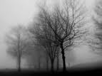

Slide 17
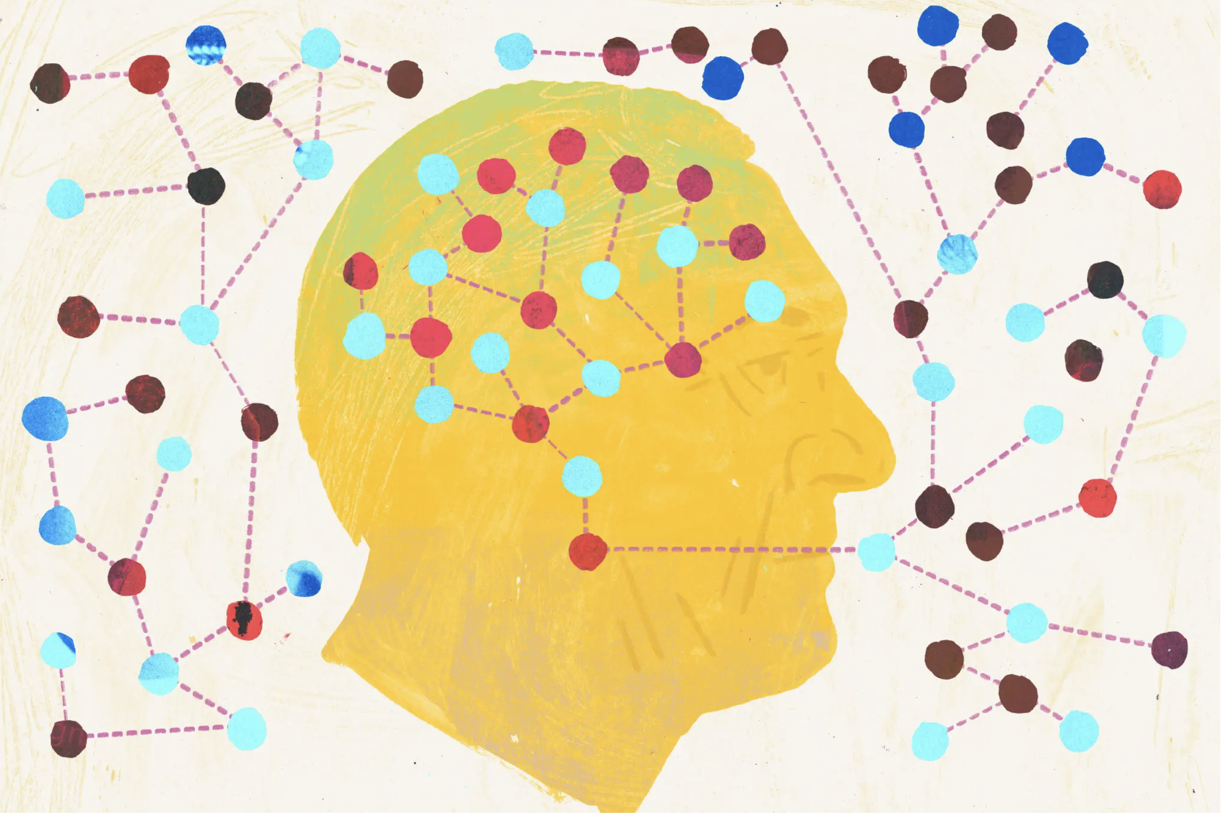

Slide 18
More Numbers:
6;30
Number of exposures to a new word during the initial lesson;
Number of exposures during the ensuing month
10-15%
Your chances of learning a word after a single exposure in context
2-3
Realistic number of words learned in a school day through explicit instruction
90-95%
Percentage of words that need to be known for the text to be
considered “instructional level” for that reader
20
Number of paragraphs of instructional level text that need to be read to
add one word to your vocabulary
8-3000
Number of words that schoolchildren need to learn every day
(3000 words per year)
25-1-1000
A fifth grader who spends 25 minutes a day reading will grow
her vocabulary by 1,000 words in a year.

Slide 19
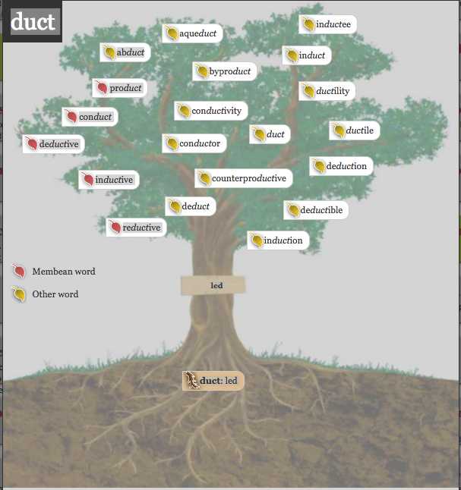
Latin Word Roots
Literary Words
Explicit Instruction
Teacher Selected
Implicit and Explicit Instruction
Student and Teacher Selected
His eyes narrowed imperceptibly as he
took in Dumbledore’s eccentric appearance.
HP and the Half-Blood Prince, J.K. Rowling
Generic Academic Words (AWL)
Glossary Words
Implicit Instruction
Teacher Selected
Explicit Instruction
Teacher Selected
analyze, approach, area, assess, assume, authority,
context, constitute, contract, data, define, derive,
distribute, economy, environment, establish,
estimate, evident, factor, finance, formula,
Meteorology: ionosphere, mesosphere,
exosphere, stratosphere,
precipitation, saturate, cumulous,
stratus, cumulo-nimbus, nimbus

Slide 20
Literary Words
Implicit and Explicit Instruction
Student and Teacher Selected
His eyes narrowed imperceptibly as he
took in Dumbledore’s eccentric appearance.
HP and the Half-Blood Prince, J.K. Rowling

Slide 21
for Learning Words We Meet in Reading

Slide 22
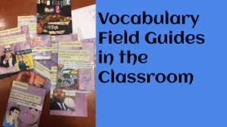

Slide 23
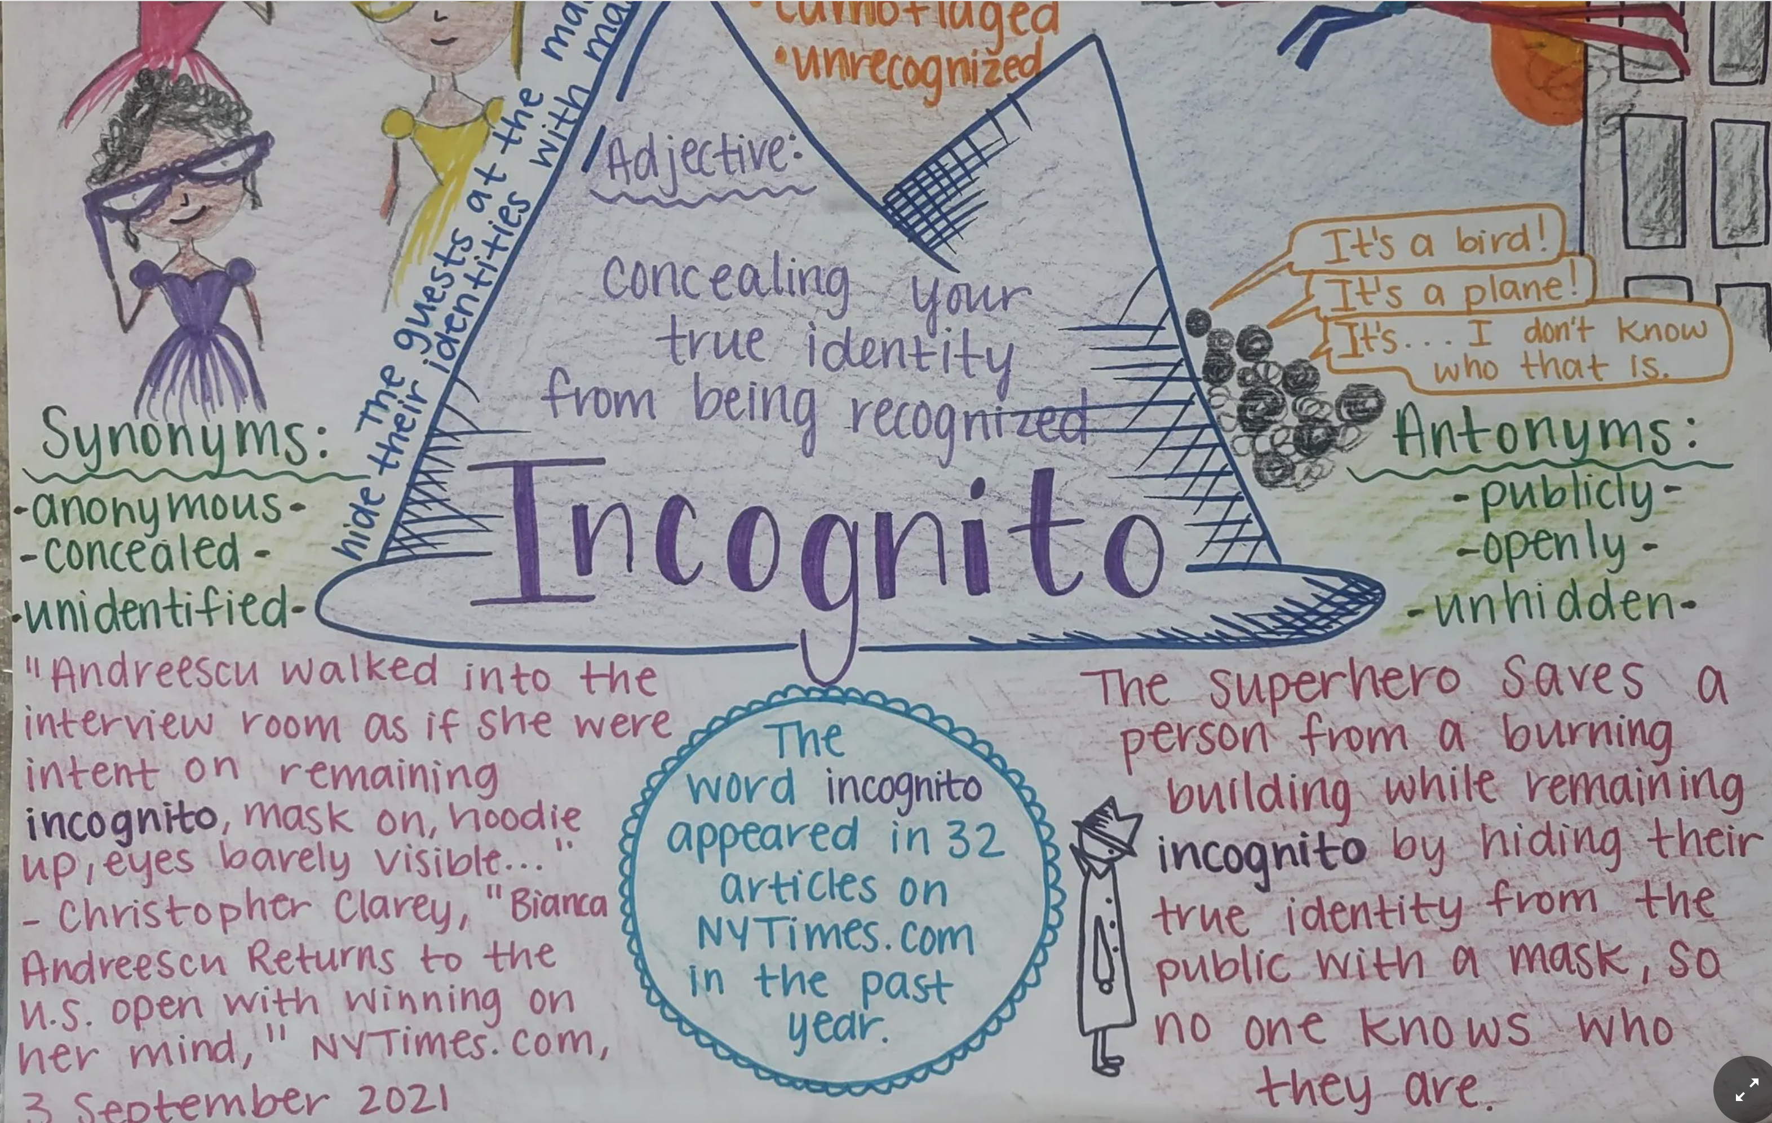
This field guide includes: hand-drawn pics; NYT frequency; professional sentence;
student-friendly definition; description of a situation that uses the word;
synonyms; antonyms

Slide 24
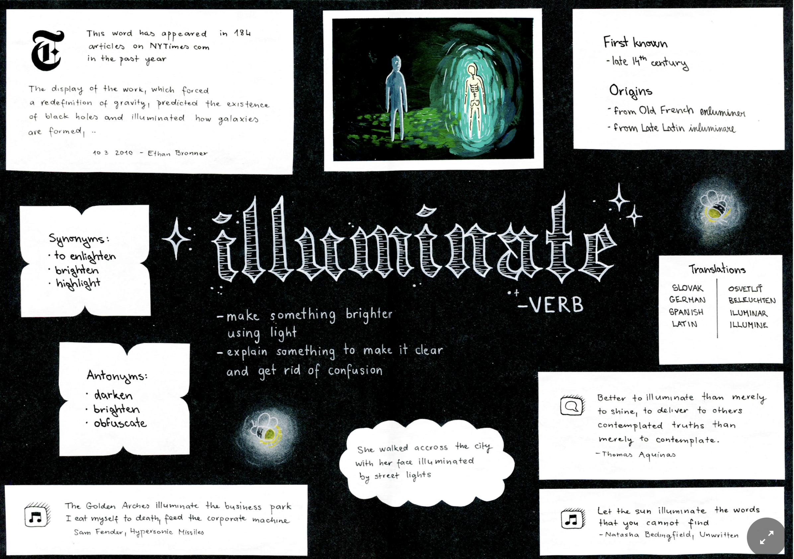
This field guide includes: stylized presentation of the word; student-friendly definition;
antonyms; synonyms; pic; origins and first appearance; other languages;
frequency; professional sentence

Slide 25
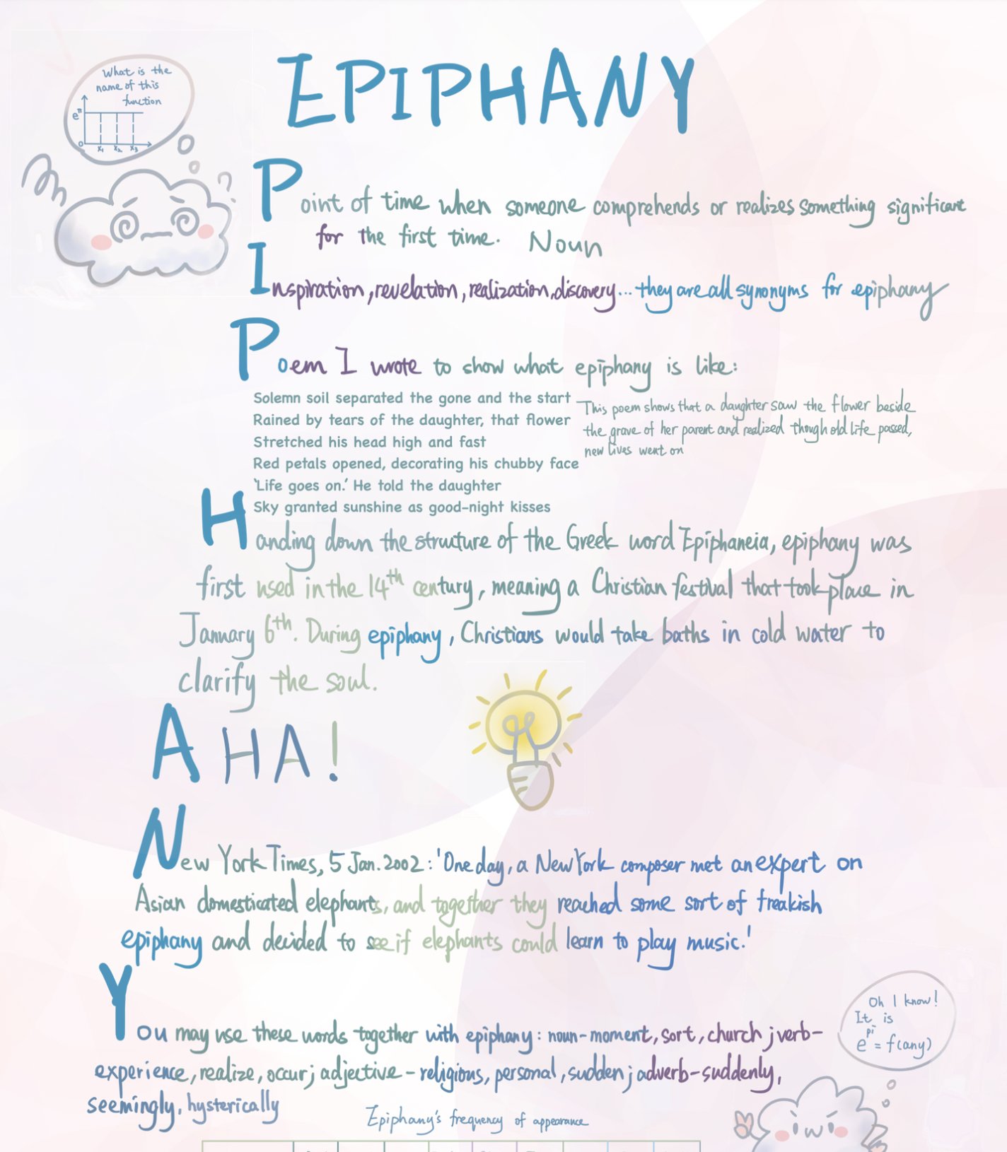
This field guide includes:
student-friendly definition
synonyms
original poem
origin
pic that represents the
concept
something you’d say
related to the concept
professional sentence
situation when you might
use the word

Slide 26
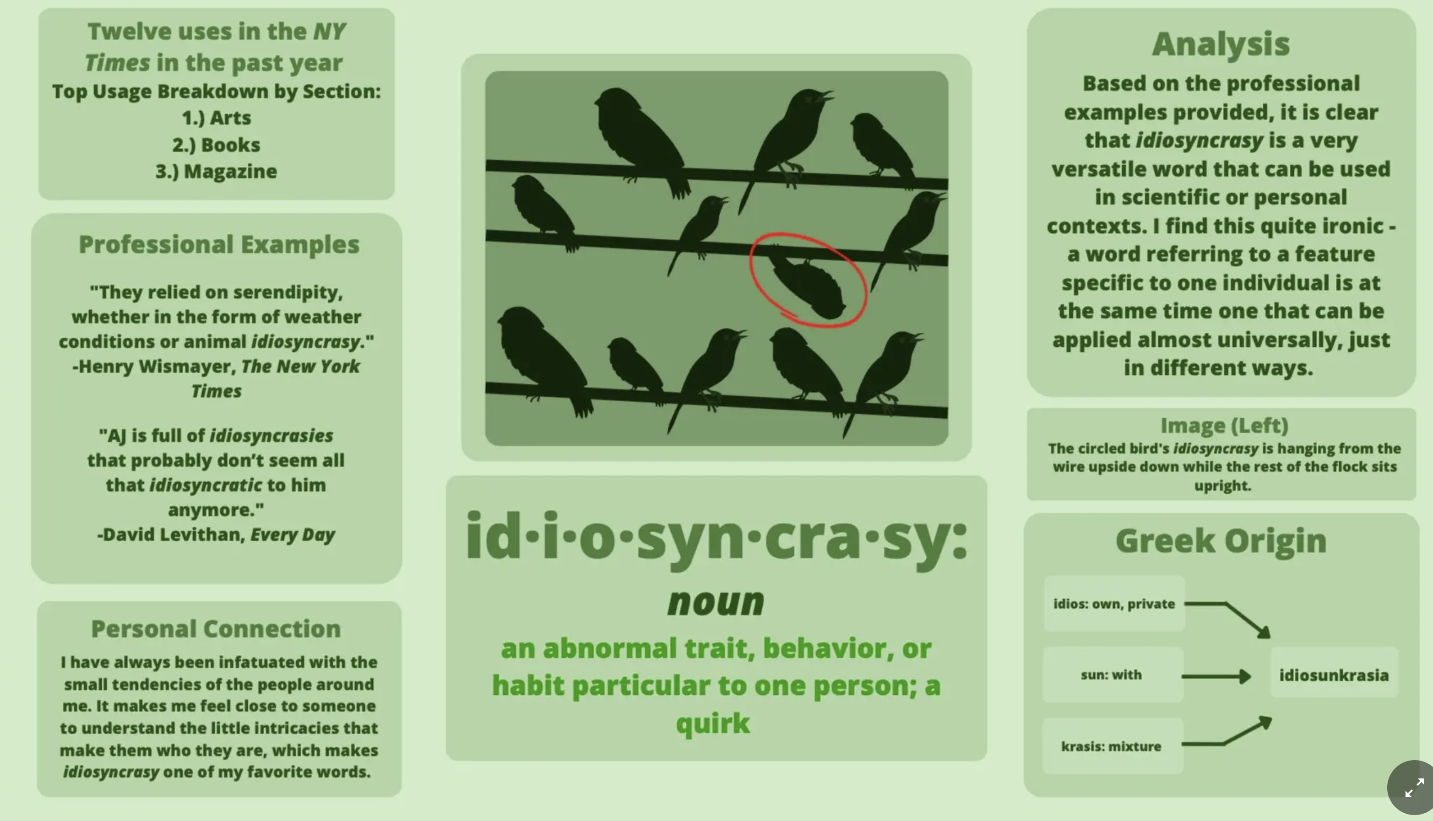
This field guide includes: pic that illustrates the word; part of speech;
student-friendly definition; professional sentences; frequency; personal connection
origin; analysis; explanation of how the image represents the word

Slide 28
name
nominate, number,
polynomial, misnomer,
nomenclature, denomination,
denominator
Sp: nombre
bad
ignore, ignorant,
ignoramus, ignoble
ignominy
shame
disgrace
humiliation
approbation
dishonor
infamy
Senator Joseph McCarthy’s life
ended ignominiously, and his name
is forever associated with malicious
accusations that run amok in society.

Slide 30
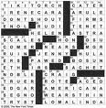
Of Limited Value…
Lists alone
Context alone
Definitions alone
Dictionaries and Glossaries alone
Of Durable Value…
Words in clusters
Leisure reading
Multiple exposures in various contexts
Chances to speak, hear, write
Manipulation of forms of words
Classify and categorize word lists
Word games, puzzles

Slide 31
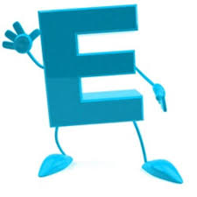
All words are learned because we
hear and read them repeatedly
in various forms and contexts.
Exposure

Slide 32
Giving a brief definition of a word
is not sufficient for durable learning.
Don’t just give a brief dictionary-type
definition. Give examples. Tell
stories. Show visuals. Give synonyms
and antonyms.
Elaboration

Slide 33
Learning happens as a result of
problem-solving. When we do
games and puzzles, when we
expend mental energy by having to
think about how a word is used, that
is when we come to own a new word.
.
Engagement

Slide 34
Humans love to learn through stories.
The history of a word illuminates its
meaning, making the word more
likely to be understood and
remembered.
.
.
Etymology

Slide 35
Your positive attitude and joy in
teaching words and language is
contagious and makes the words
memorable.
Enthusiasm

Slide 36
Getting to Know the Words We Meet in Reading:
The word I would like to get to know is:
My guess:
Dictionary Definition:
(Use vocabulary.com, preferably)
Visual:
Draw a very quick picture:
Definition in my own words:
Complete sentence of at least 10 words:
Must contain an action verb and a visual image.

Slide 37
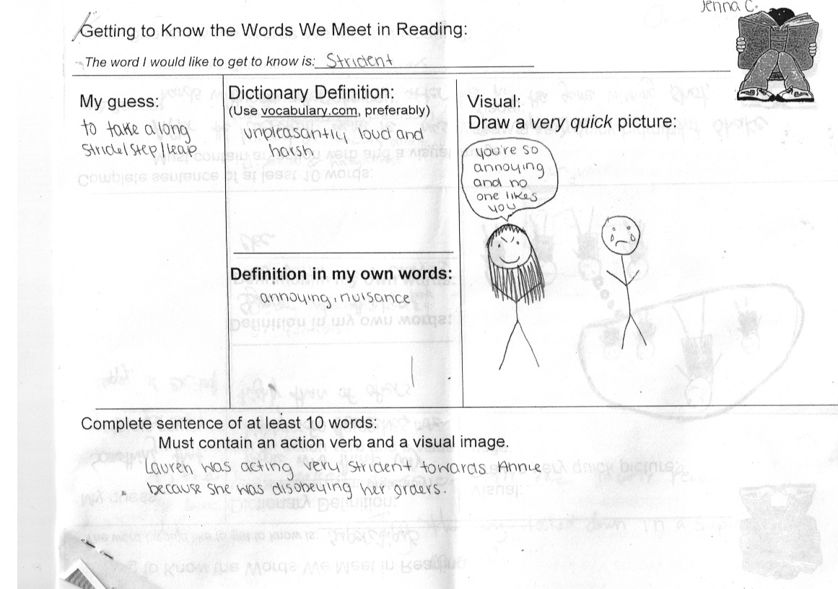

Slide 38
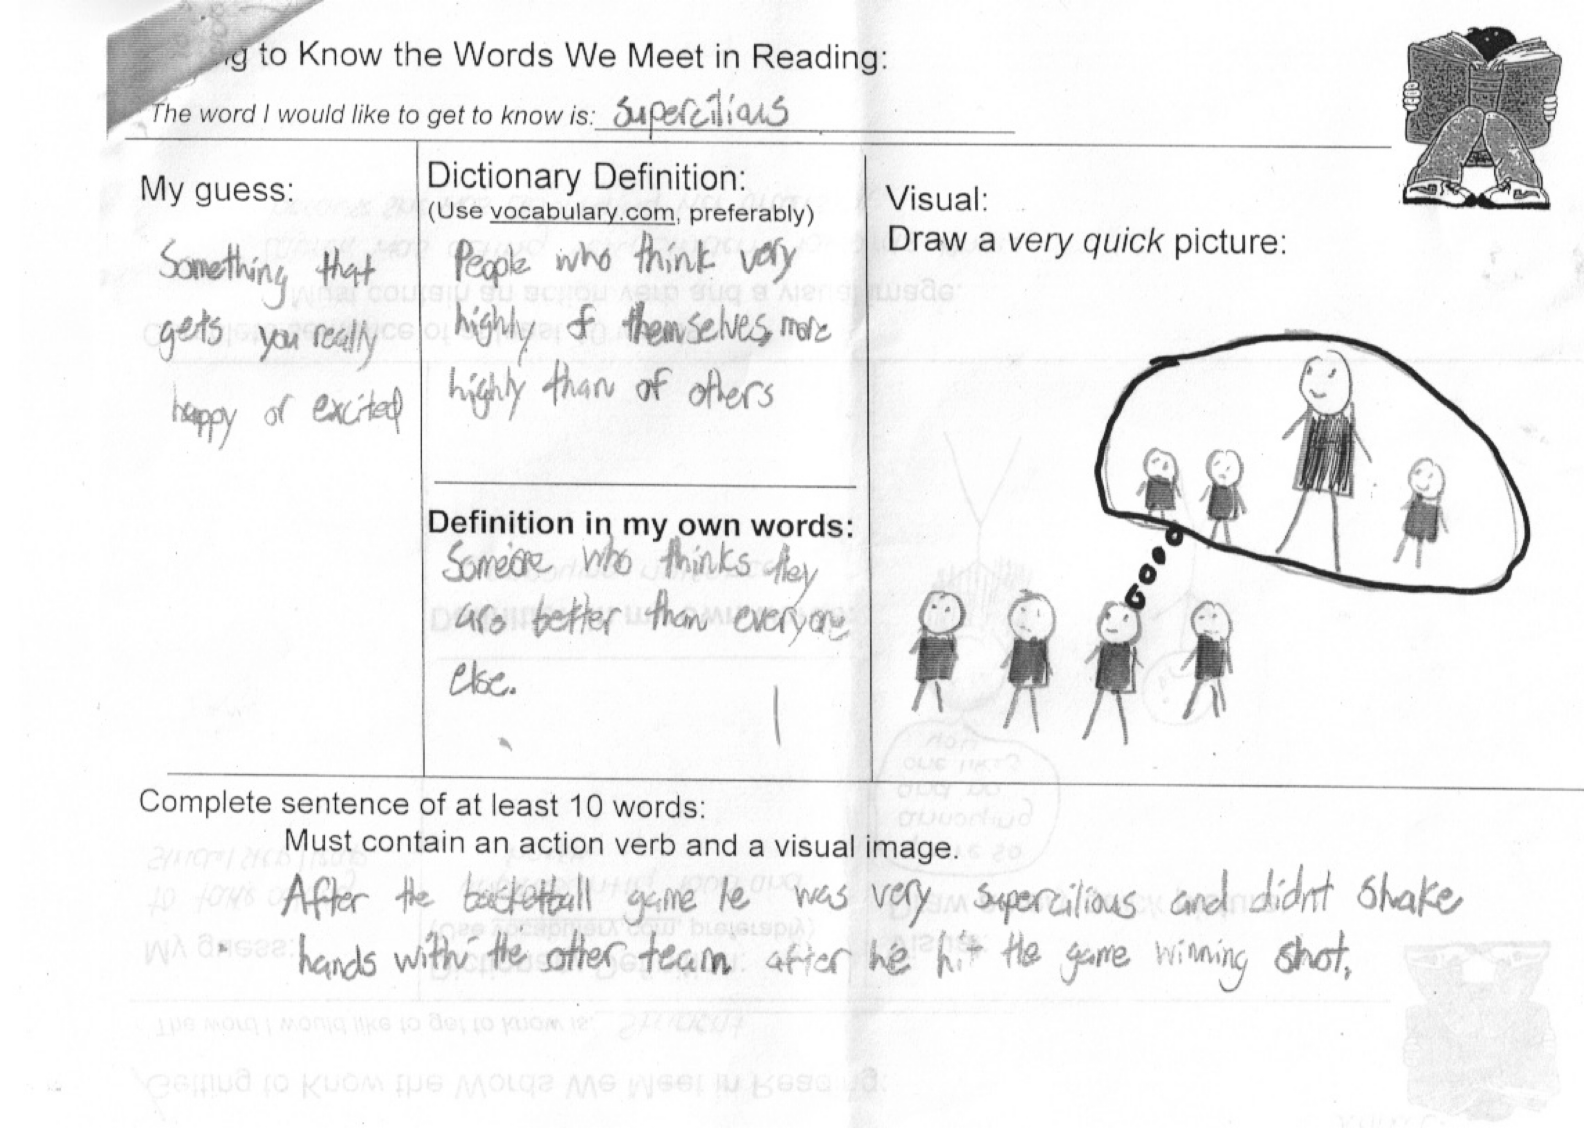

Slide 39
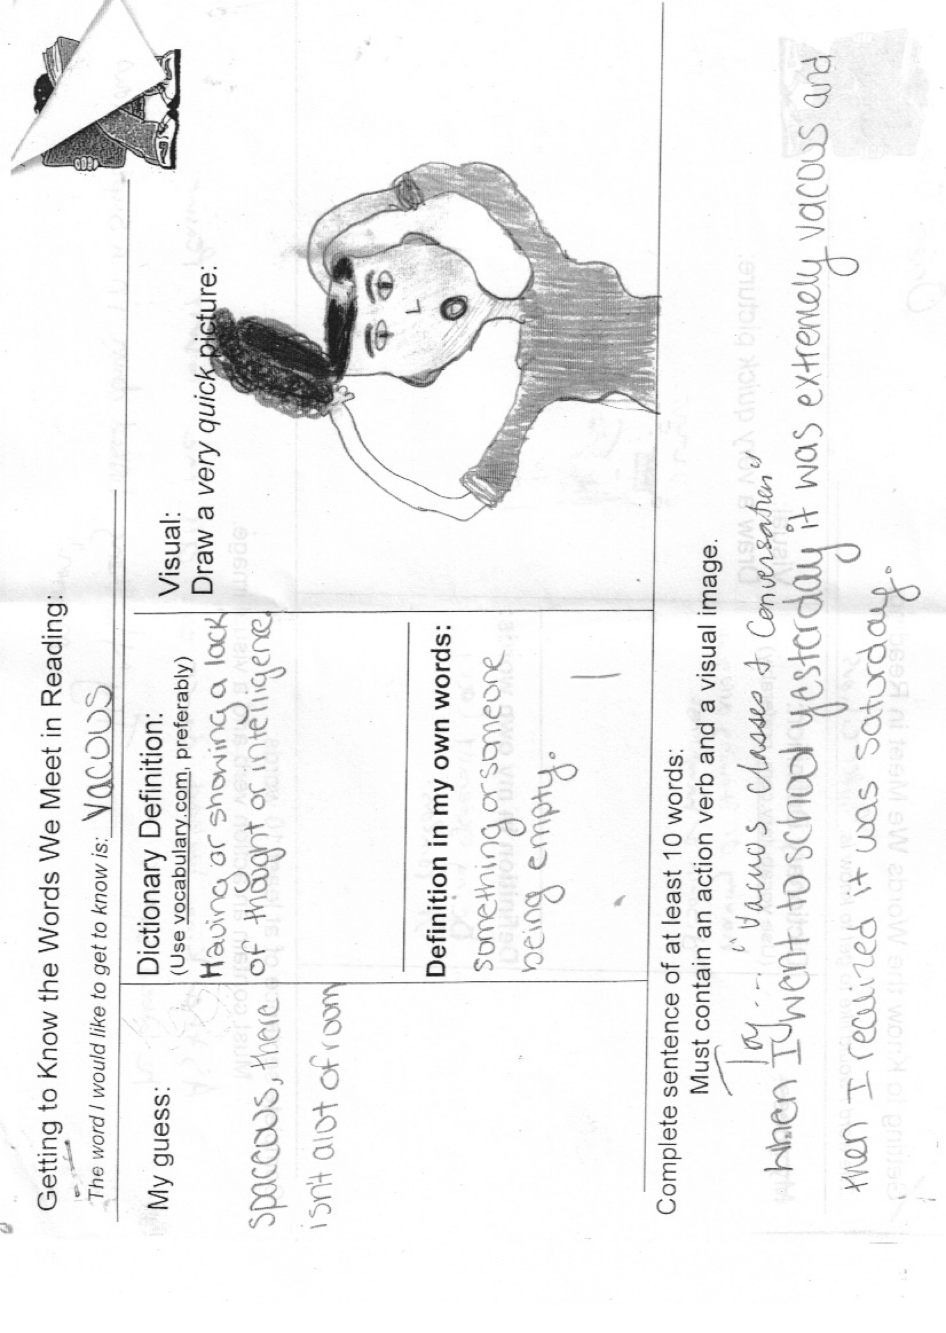

Slide 40
jubilant
tedious
precaution
conceited
philanthropy
empathetic
preposterous
disoriented
fastidious
haphazard
umbrage

Slide 41
After familiarizing protocol (e.g., vocabulary.com):
Strategies for Processing New Words:
I. Yes/No Questions
If the Yankees win, will you be jubilant?
II. Situational Questions
Henry is a Baltimore Ravens fan. Why would he feel jubilant if the
Ravens go to the Super Bowl?
I. Personal Connections
What is a time when you felt jubilant?

Slide 42
After familiarizing protocol (e.g., vocabulary.com):
Strategies for Processing New Words:
I. Yes/No Questions
Was Romeo jubilant when we first meet him?
II. Situational Questions
Why is Lord Capulet jubilant as he hosts the masked ball?
II. Personal Connections
Have your parents ever expected you to be jubilant about
something you were not jubilant about?

Slide 43
After familiarizing protocol (e.g., vocabulary.com):
Strategies for Processing New Words:
IV Match the word to the situation: tedious, precaution, conceited
“You guys are so lucky to have me on your team.”
a 1,000 piece jigsaw puzzle
hand sanitizer

Slide 44
After familiarizing protocol (e.g., vocabulary.com):
Strategies for Processing New Words:
IV Match the word to the situation: tedious, precaution, conceited
Lady Macbeth gets the King’s guards intoxicated before
the murder and smears them with the King’s blood after it.
Polonius is a man of too many words, and listening to him
give advice grows tiresome.
Nick Bottom brags that he would be perfect playing all the roles
in “Pyramus and Thisbe.”

Slide 45
After familiarizing protocol (e.g., vocabulary.com):
Strategies for Processing New Words:
V Generate situations:
3 things that a philanthropist would do
3 preposterous things that did not happen on your way to
school today
3 things that would disorient you

Slide 46
After familiarizing protocol (e.g., vocabulary.com):
Strategies for Processing New Words:
V Generate situations:
Are there any characters in The Harry Potter series
who are empathetic?
Harry Potter aspires to be a “normal wizard” and
attend Hogwart’s Academy free of danger. Is this
aspiration preposterous or realistic?
Would you say that Harry is disoriented when he
discovers his connection to Voldemort?

Slide 47
After familiarizing protocol (e.g., vocabulary.com):
Strategies for Processing New Words:
V Generate “happenings and non-happenings”
What is one thing that a fastidious person would not do in the
workplace?
What is one thing that a haphazard cook might not do?
When a person takes umbrage, what is something that
they would probably not say?

Slide 48
20 paragraphs = 1 word gained
25 minutes of free reading every day = 1,000 words
per school year

Slide 49
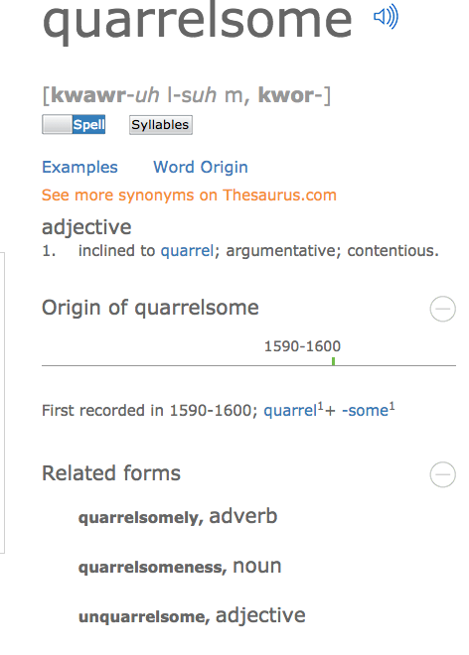

Slide 50
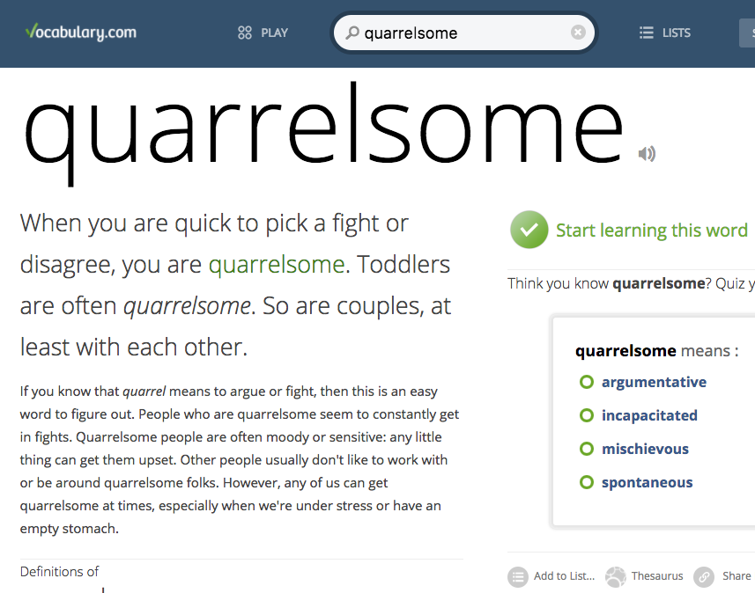

Slide 51
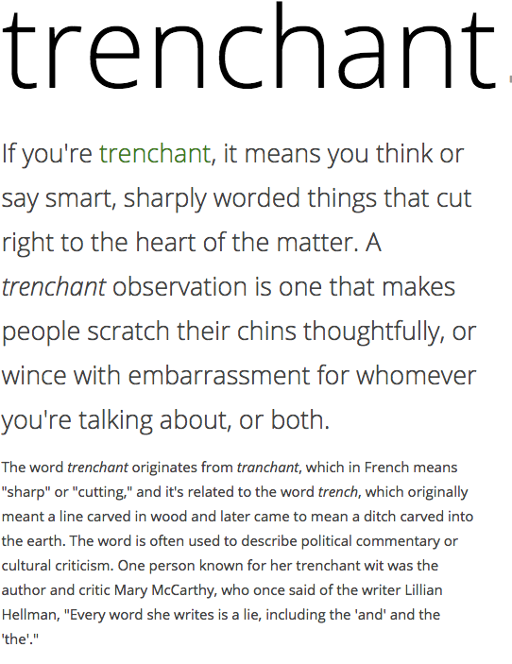

Slide 52
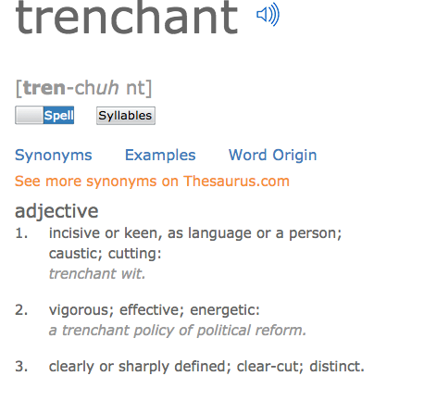

Slide 53
Find the word (or phrase) that means:
(These are not in order.)
leaves greeted blocked moon not easily understood differentiate
manner covered unrefined shining
…”Several changes of day and night passed, and the orb of night had greatly lessened when I began to
distinguish my sensations from each other. I gradually saw plainly the clear stream that supplied me with
drink, and the trees that shaded me with their foliage. I was delighted when I first discovered that a pleasant
sound, which often saluted my ears, proceeded from the throats of the little winged animals who had often
intercepted the light from my eyes. I began also to observe, with greater accuracy, the forms that surrounded me,
and to perceive the boundaries of the radiant roof of light which canopied me. Sometimes I tried to imitate
then pleasant songs of the birds, but was unable. Sometimes I wished to express my sensations in my own
mode, but the uncouth and inarticulate sounds which broke from me frightened me into silence again.”

Slide 54
Should I spend time teaching this word explicitly?
Three Questions:
How useful is this word? Will students be likely to encounter it again
soon? Is it necessary for comprehension?
Will teaching this word explicitly equip the students with word-learning
skills that can be applied to other words?
3. Am I enthusiastic about this word? Can I make it interesting?
Notes:
To comprehend text, the reader needs to know 95% of the words.
Next, we’re going to look at two models for explicit instruction that results in durable learning of the target word.

Slide 55
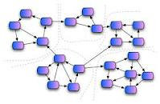
1. Does our instruction generate conversation about words?
2. Does our instruction
connect the target word to other words?

Slide 56
Generic Academic Words (AWL)
Implicit Instruction
Teacher Selected
analyze, approach, area, assess, assume, authority,
context, constitute, contract, data, define, derive,
distribute, economy, environment, establish,
estimate, evident, factor, finance, formula,

Slide 57
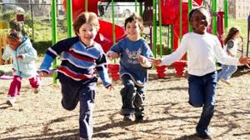
The English Language is Two Languages
“BICS”
“CALPS”

Slide 58
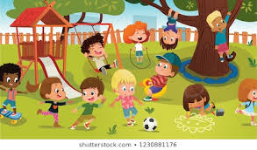
BICS and CALP
Basic Interpersonal Communication Skills
The language necessary for day-to-day living, conversations with friends and family, informal interactions
Cognitive Academic Proficiency Skills
The language necessary to understand and discuss content in school

Slide 59
Social English: BICS

Slide 60
Academc/Business English: CALPS
Your Unembellished Attributes
Don’t proceed to transform yourself
In an effort to garner my approval.
Up to this point, you have underperformed.
Disabuse yourself of the notion that you
Have lost your novel qualities, to the point
Where I no longer acknowledge you.

Slide 61
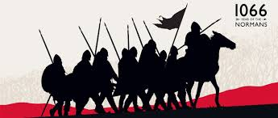
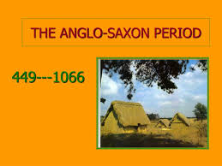
Tier 3: glossary word:
Multisyllabic
Specific to a subject area
Latin or Greek-based
topography, photosynthesis, isoceles triangle,
sedimentary, oxygenated, cartographer
Tier 2: Words of education, business,
government, religion:
Components: Prefix, root, suffix
Latin-based
elevation, formation, protrude, expansive,
isolated, remote
Tier 1: Basic conversational words: Friends & family
1 or 2 syllables
Learned naturally, through exposure
hills, grass, rocks, land, sky, clouds, fly, climb,
green, high…

Slide 62
Two Types of Tier Two Words:
Generic Academic
Words:
acquire, benefit, clarify, develop, evolve, grant, hierarchy, internal…
Literary Words:
allude, beneficient,
clamorous, deride,
effulgent, frugal, guile, happenstance,
insipid

Slide 63
Generic Academic Words (AWL)
Implicit Instruction
Teacher Selected
analyze, approach, area, assess, assume, authority,
context, constitute, contract, data, define, derive,
distribute, economy, environment, establish,
estimate, evident, factor, finance, formula,

Slide 64
The Academic Word List (AWL):
Background:
Welcome to the Academic Word List (also known as the AWL or the All-Star List).
This list was developed by Dr. Averil Coxhead, Professor of Linguistics in New Zealand. For her
M.A. in Teaching English to Speakers of Other Languages (TESOL), Dr. Coxhead went into a
college library and pulled out some 200 books, representing 38 different subject areas. She then
extracted the set of academic words (as opposed to basic conversational words) that appeared
most frequently across all of the 38 subject areas. Hence, these words comprise the All-Star Team
of academic discourse.
The list is broken down into 10 groupings (subsets) in order of their frequency in academic texts.
Each of the subsets has the words in it arranged alphabetically. You will find that your students are
more familiar with the words in the first few subsets than they are in subsequent ones, but all of
these words earned their way on the list by being frequent in academic texts.
The AWL is not restricted to a specific field of study. That means that the words are useful for learners
studying in disciplines as varied as literature, science, health, business, and law.
This high-utility academic word list does not contain technical words likely to appear in one,
specific field of study such as amortization, carburetor, semicolon, or cartilage.
Two-thirds of all academic English derive from Latin or Greek.
Understandably, knowledge of the most high-incidence academic words in English can significantly
boost a student’s comprehension level of school-based reading material. Students who are taught
these high-utility academic words and routinely placed in contexts requiring their usage are likely
to be able to master academic material with more confidence and efficiency, wasting less time and
energy in guessing words or consulting dictionaries than those who are only equipped with the most
basic 2000-3000 words that characterize ordinary conversation.

Slide 65
Academic Word List: Subset 1
analyze, approach, area, assess, assume, authority, available, benefit, concept, consist, context, constitute, contract, data, define, derive, distribute, economy, environment, establish, estimate, evident, factor, finance, formula, function, income, indicate, individual, interpret, involve, issue, labor, legal, legislate, major, method, percent, period, principle, proceed, process, policy, require, research, respond, role, section, sector, significant, similar, source, specific, structure, theory, vary
Spanish Cognates:
analizar, el área, asumir, la autoridad, el beneficio/beneficiar, concepto, consistir, contexto, constituir, datos, definir, derivar, distribuir, la economía, establecer, estimar/estimado, evidente, la función, las finanzas, la fórmula, el indice, el individuo, interpretar, envolver, laborar, legal, legislar, el método, ocurrir, el por ciento, el período, principio, proceder, el proceso, requerir, responder, rol, sección, sector, significativo/significante, específica, estructura, la teoría, variar

Slide 66
Academic Word List: Subset 2
achieve, acquire, administrate, affect, appropriate, aspect, assist, category, chapter, commission, community, complex, compute, conclude, conduct, consequence, construct, consume, credit, culture, design, distinct, equate, element, evaluate, feature, final, focus, impact, injure, institute, invest, item, journal, maintain, normal, obtain, participate, perceive, positive, potential, previous, primary, purchase, range, region, regulate, relevant, reside, resource, restrict, secure, seek, select, site, strategy, survey, tradition, transfer
Spanish Cognates:
adquirir, administrar, afectar, apropiado, el aspecto, la categoría, la comisión, complejo, conducta, la consecuencia, construir, consumir, el crédito, la cultura, diseñar, distinto, el elemento, evaluar, el impacto, instituto, invertir, mantener, obtener, percibir, positivo, potencial, previo, primero, región, regular, relevante, residir, restringir, seguro, selecto, sitio, la estrategia, la tradición, transferir

Slide 67
Academic Word List: Subset 3
alternative, circumstance, comment, compensate, component, consent, considerable, constant, constrain, contribute, convene, coordinate, core, corporate, correspond, criteria, deduce, demonstrate, document, dominate, emphasis, ensure, exclude, fund, framework, illustrate, immigrate, imply, initial, instance, interact, justify, layer, link, maximize, negate, outcome, philosophy, physical, proportion, publish, react, register, rely, scheme, sequence, shift, specify, sufficient, technical, technique, valid, volume
Spanish Cognates:
el alternativo, la circunstancia, el comentario, compensar consentimiento, constante, considerable, contribuir, la coordenada, corporativo, corresponder, los criterios, deducir, demonstrar, el document, dominar, el énfasis, el fondo, ilustrar, inmigrar, la instancia, inicial, interactuar, justificar, maximizar, la filosofía, la proporción, registrar, especificar, volumen

Slide 68
Academic Word List: Subset 4
access, adequacy, annual, apparent, approximate, attitude, attribute, civil, code, commit, concentrate, confer, contrast, cycle, debate, despite, dimension, domestic, emerge, ethnic, grant, hence, hypothesis, implement, implicate, impose, integrate, internal, investigate, mechanism, occupy, option, output, overall, parallel, parameter, phrase, prior, principal, professional, project, promote, regime, resolve, retain, series, statistic, status, stress, subsequent, undertake
Spanish Cognates:
acceso, la adecuación, la actitud, aparente, anual, aproximado,
atributo, civil, cometer, concentrarse, conferir, el contraste, el ciclo,
debatir, la dimensión, étnico, la hipótesis, implementar, imponer,
integrar, interno, investigar, el mecanismo, ocupar, la opción,
paralelo, el parámetro, la frase, el profesional, el proyecto,
promover, resolver, retener, la serie, la estadística, el estrado, subsecuente, emprender

Slide 69
Academic Word List: Subset 5
academy, adjust, alter, amend, capacity, clause, compound, consult, decline, discrete, enable, energy, enforce, entity, equivalent, evolve, expand, expose, external, facilitate, fundamental, generate, liberal, license, logic, margin, modify, monitor, network, notion, objective, orient, perspective, precise, prime, psychology, pursue, ratio, reject, revenue, stable, style, substitute, sustain, symbol, target, transit, trend, version, welfare, whereas
Spanish Cognates:
la academia, ajustar, alterar, enmendar, la capacidad, la clásula, compuesto, consultar, la energía, la entidad, equivalente, evolucionar, exponer, externo, facilitar, fundamental, generar, liberal, la licencia, la lógica, el margen, modificar, el monitor, la noción, el objectivo, orientar, la perspectiva, preciso, principal, la psicología, perseguir, el estable, el estilo, el sustituto, el símbolo, el tránsito, la versión

Slide 70
Academic Word List: Subset 6
abstract, acknowledge, accuracy, aggregate, allocate, assign, bond, capable, cite, cooperate, discriminate, display, diverse, domain, edit, enhance, estate, exceed, explicit, federal, fee, flexible, furthermore, gender, incentive, incorporate, incidence, index, inhibit, initiate, input, interval, mitigate, minimum, ministry, motive, neutral, nevertheless, overseas, precede, presume, rational, recover, reveal, scope, subsidy, trace, transform, underlie, utilize
Spanish Cognates:
abstracto, el agregado, asignar, capaz, citar, cooperar, discriminar, diverso, el dominio, editar, la estancia, exceder, explícito, federal, flexible, el género, el incentive, incorporar, la incidencia, el índice, inhibir, iniciar, el intervalo, el mínima, el ministerio, el motivo, neutral, preceder, presumir, racional, recuperar, revelar, transformar, utilizar

Slide 71
Academic Word List: Subset 7
adapt, advocate, channel, classic, comprehensive, comprise, confirm, contrary, convert, decade, deny, differentiate, dispose, dynamic, equip, eliminate, empirical, extract finite, foundation, gradient, guarantee, hierarchy, identical, ideology, infer, innovate, insert, intervene, isolate, media, mode, paradigm, phenomenon, priority, prohibit, publication, quote, release, reverse, simulate, sole, somewhat, submit, successor, thesis, transmit, ultimate, unique, voluntary
Spanish Cognates:
adaptarse, abogado, el canal, clásico, comprehender, confirmar, contrario, convertir, la década, diferenciar, disponer, dinámico, equipar, eliminar, empírico, extraer, finito, la fundación, el gradiente, garantizar, idéntico, la ideología, inferir, insertar, intervenir, los medios de comunicación, el modo/la modalidad, el paradigma, fenómeno, la prioridad, prohibir, la publicación, el revés, simular, el sucesor, la tesis, transmitir, último, único, voluntario

Slide 72
Academic Word List: Subset 8
abandon, accompany, accumulate, ambiguous, appendix, appreciate, arbitrary, automate, bias, chart, clarify, commodity, complement, conform, contemporary, contradict, crucial, currency, denote, detect, deviate, displace, eventual, exhibit, exploit, fluctuate, guideline, implicit, induce, inevitable, infrastructure, inspect, intense, manipulate, minimize, nuclear, offset, predominant, prospect, radical, reinforce, restore, revise, tension, terminate, theme, thereby, uniform, vehicle, via, virtual, widespread
Spanish Cognates:
abandonar, acompañar, acumular, ambiguo, el apéndice, arbitrario, aclarar, el complemento, contemporaneo, contradecir, crucial, denotar, detectar, desplazar, la exposición, explotar, fluctuar, implicito, inducir, inevitable, la infraestrutura, inspeccionar, intenso, manipular, minimiza, nuclear, el prospecto, radial, reforzar, revisar, la tensión, terminar, la tema, el uniforme, el vehículo, vía, virtual

Slide 73
Academic Word List: Subset 9
accommodate, analogy, anticipate, assure, attain, behalf, cease, coherent, coincide, commence, compatible, concurrent, confine, controversy, converse, device, devote diminish, distort, duration, erode, ethic, found, format, inherent, insight, integral, intermediate, manual, mature, mediate, medium, military, minimal, mutual, norm, overlap, passive, portion, preliminary, protocol, qualitative, refine, restrain, revolution, rigid, route, scenario, sphere, subordinate, supplement, suspend, trigger, unify, violate
Spanish Cognates:
acomodar, analogia, asegurar, cesar, coherente, coincidir, comenzar, compatible, concurrente, confinar, la controversia, conversar, dedicar, disminuir, distorsionar, la duración, erosionar, fundar, el formato, inherente, la percepción, integrante, intermedio, manual, mediar, medio, mínimo, mutuo, la norma, pasivo, la porción, preliminar, el protocolo, refinar, la revolusion, rigido, la ruta, el escenario, la esfera, subordinar, el suplemento, suspender, unificar, violar

Slide 74
Academic Word List: Subset 10
adjacent, albeit, assemble, collapse, colleague, compile, conceive, convince, depress, encounter, forthcoming, incline, integrity, intrinsic, invoke, levy, likewise, nonetheless, notwithstanding, ongoing, panel, persist, pose, reluctance, so-called, straightforward, undergo, whereby
Spanish Cognates:
adyacente, el colapso, el colega, compliar, convencer, el encuentro, inclinarse, la integridad, intrinsic, invocar, el panel, persistir, posar

Slide 75
June 2023
Caption

Slide 76
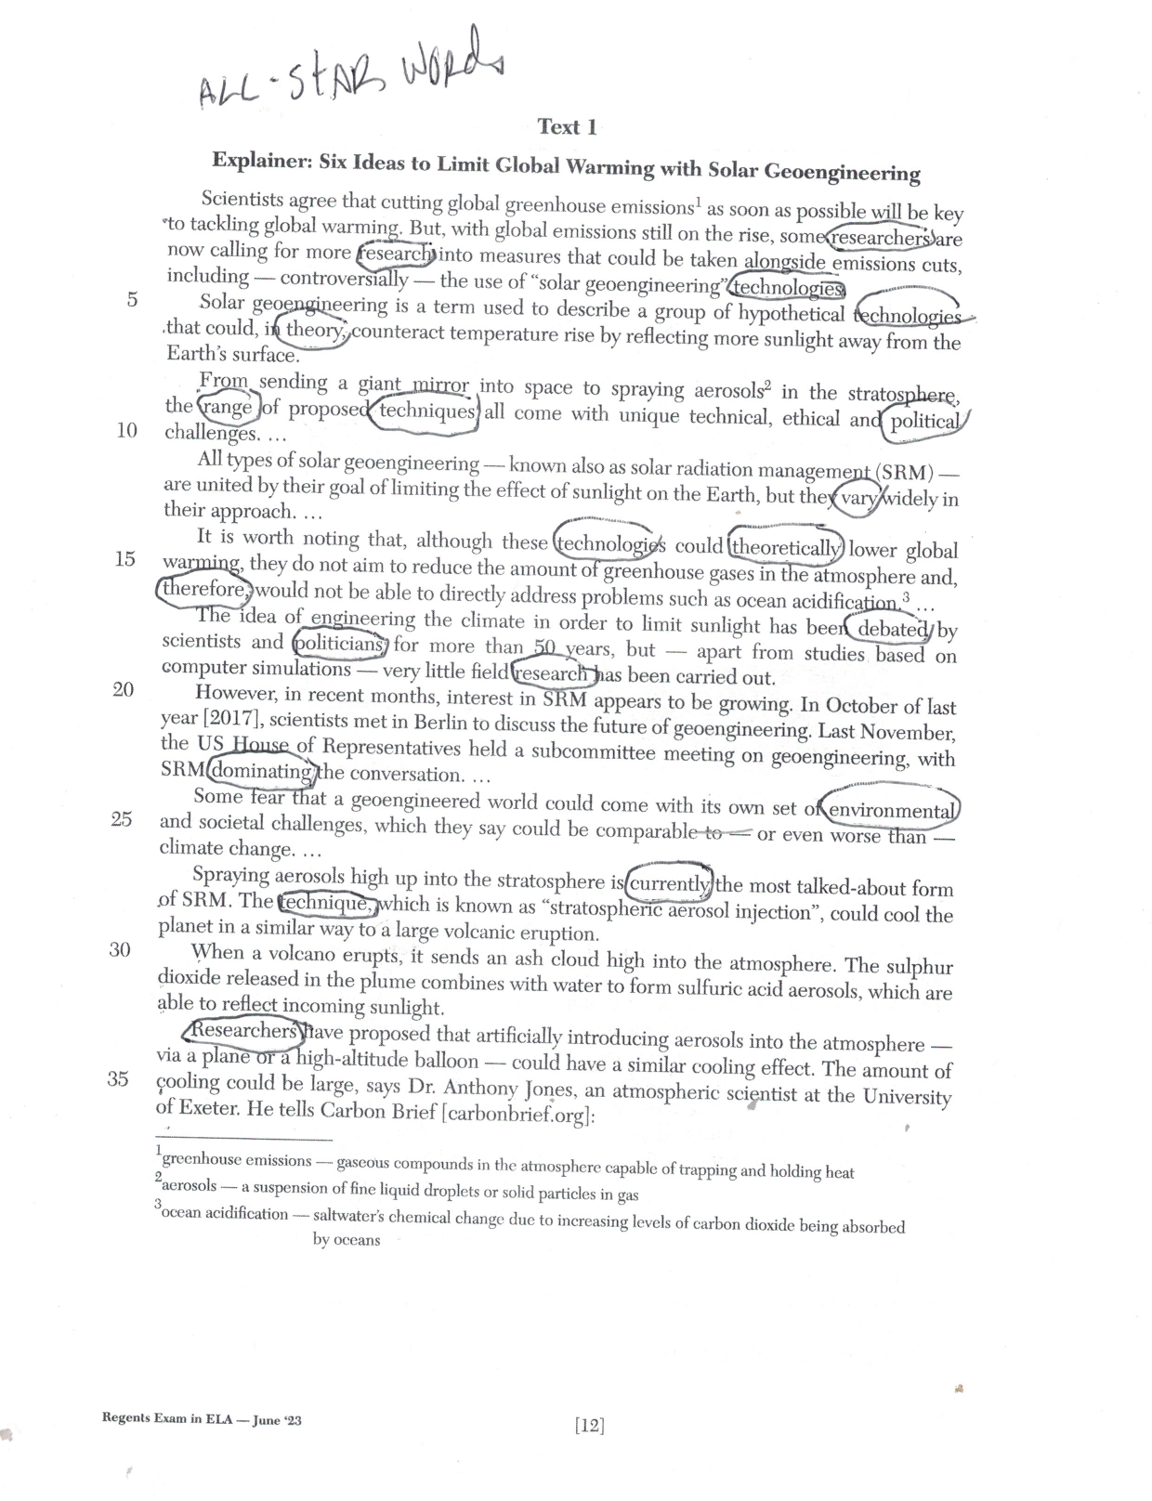
…and on the student-written essay question
(Part II, Argumentation)
research (2), researchers (2)
technologies (2)
theory, theoretically
range
technique, techniques
political, politicians
vary
therefore
environmental
dominating
currently

Slide 77
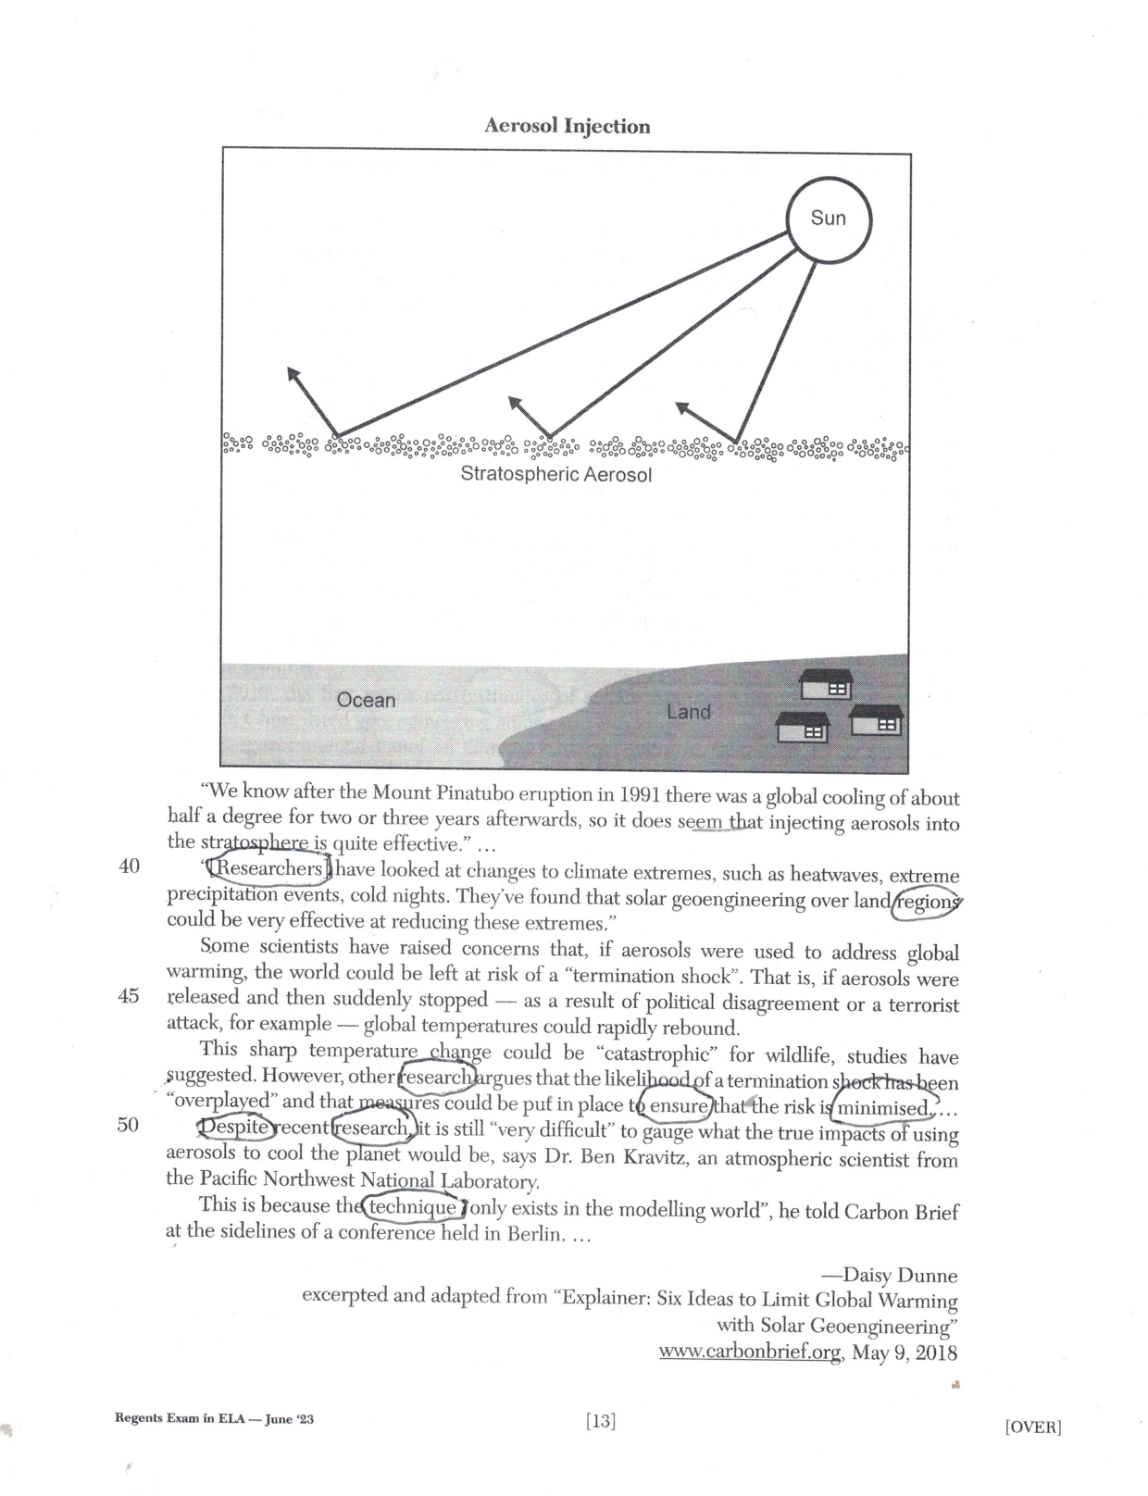
research (3), researches
regions
ensure
minimized
despite

Slide 78
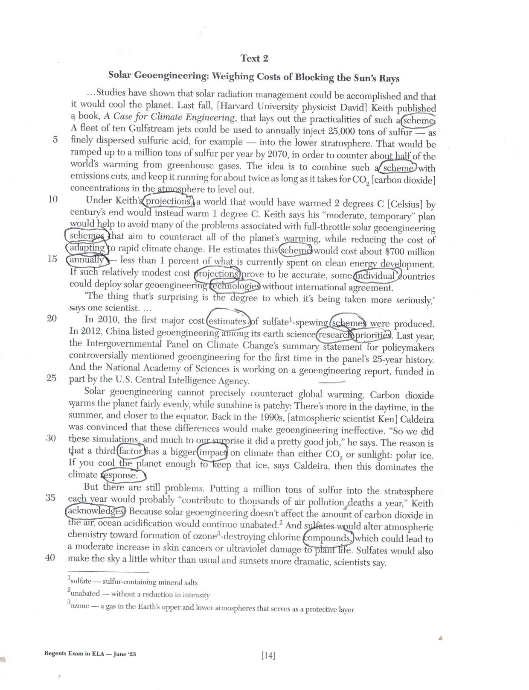
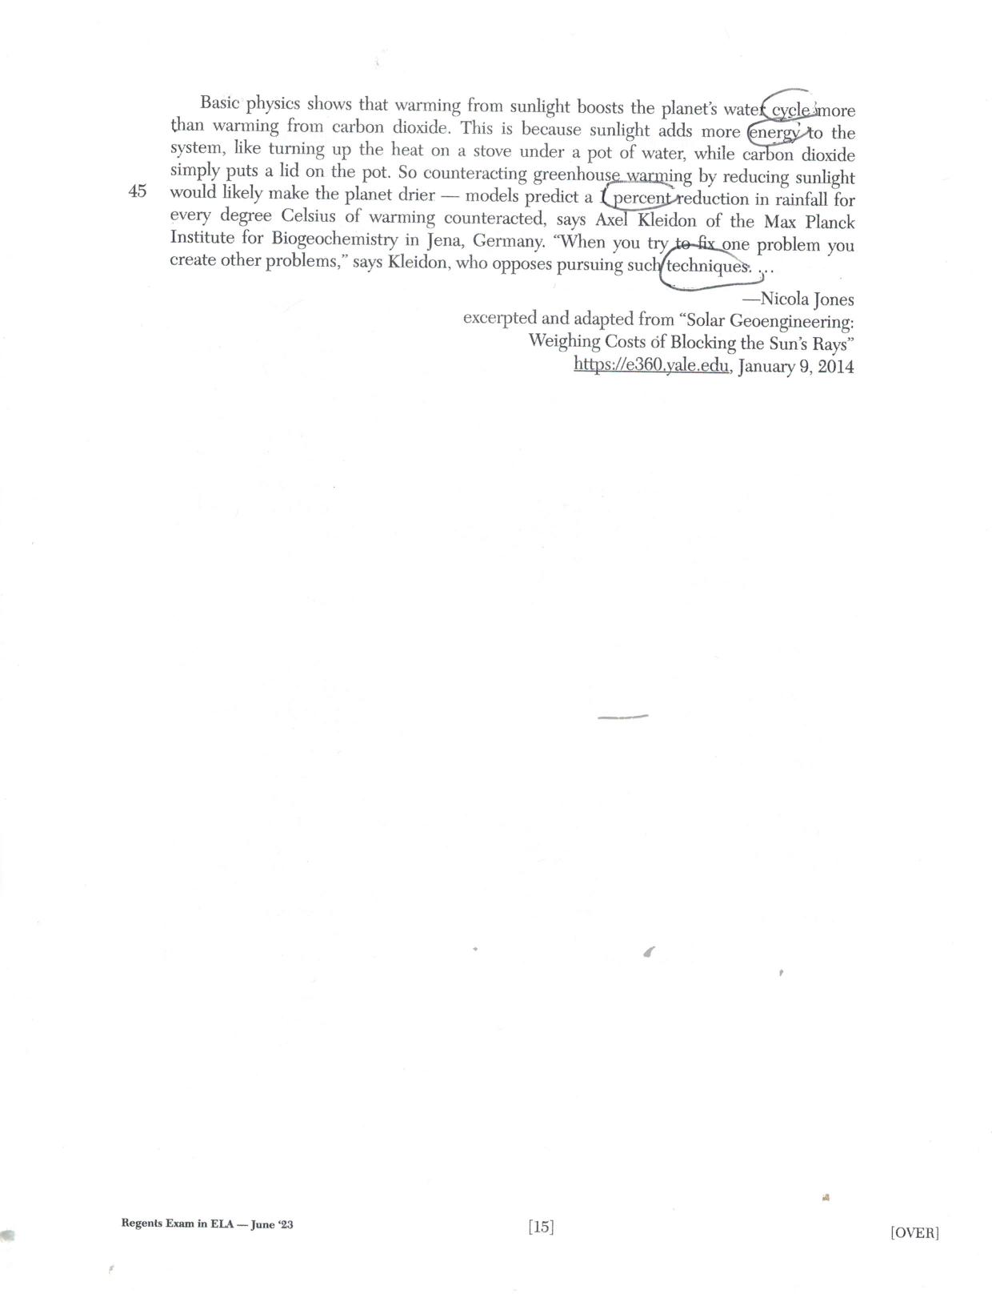
scheme (4)
projections (2)
compounds
acknowledged
response
factor
impact
research
priorities
estimates
adapting
annually
individual
cycle
energy
percent
techniques

Slide 79
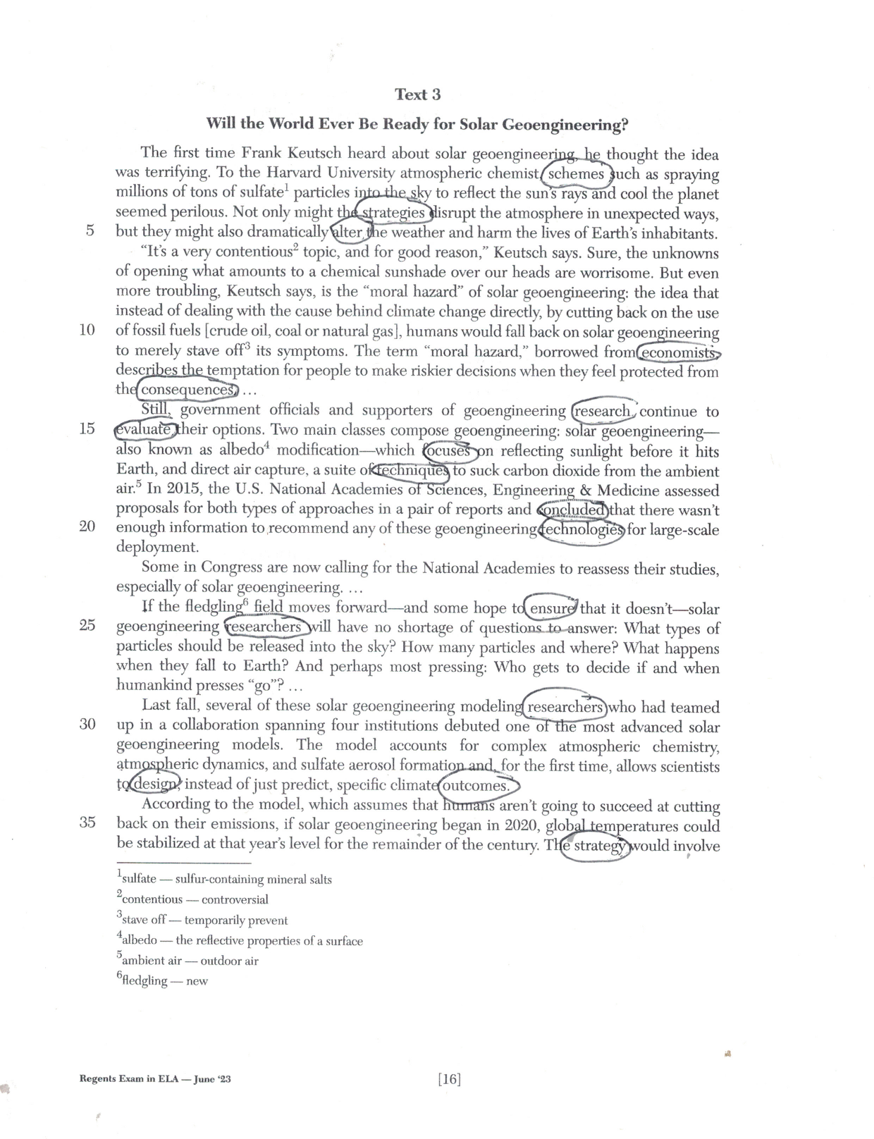
schemes
alter
strategy, strategies
economists
consequences
research, researchers (2)
focuses
techniques
concluded
technologies
evaluate
ensure
outcomes
design

Slide 80
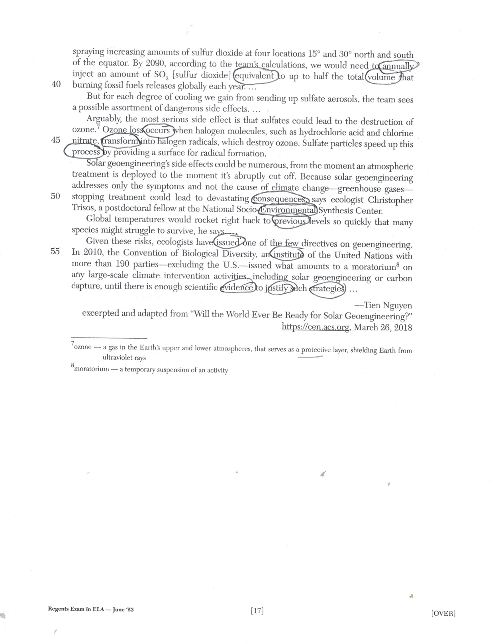
annually
volume
equivalent
occurs
transform
process
consequences
environmental
previous
issued
institute
evidence
justify
strategies

Slide 81
eliminate, eliminating, elimination
achieved(2)
potential
benefits
estimated
economic (2)
research
technological
research
decades
assumption
individual
policy
dynamic
impact
environmental
oppose, opponents
area
evidence

Slide 82
LIVING ENVIRONMENT June 2023
Pages 2 and 5: Multiple Choice
energy
contribute
maintain
physical
environmental
structures
specific
function
processes
regulate
input
responding
factor
occurs
sequence
period

Slide 83
PHYSICAL SETTING
EARTH SCIENCE
June 2023
Pages 2 and 6: Multiple Choice
layer
energy
revolution
shifted
approximately
evidence
core
inferred
region
period
primarily
atmosphere

Slide 84
Algebra I
June 2023
Pages 3, 5
sequence
process
percent
initial
periods
function
formula

Slide 85
GLOBAL HISTORY AND GEOGRAPHY
June 2023
Pages 2 and 5: Multiple Choice
maintain
shifted
authority
areas
individuals
strategies
economic
policies
implemented
significant
consequences
approximately
conclusion
appropriate
response
economy, economic
consisting
prior
politicians
authorities

Slide 86
U.S. HISTORY AND GEOGRAPHY
June 2023
Pages 3 and 5: Multiple Choice
primary
principle
military
policy
individual
distribution
economic
revenue
r

Slide 87
2015-16: 11% State Gap
NYS Assessment Median
State Gap in 2021: 3%
NYS Assessment Median
Grades 3-8 State ELA Assessment from 2016-21: + 14% points

Slide 88
Academic Word List: Subset 1
analyze, approach, area, assess, assume, authority, available, benefit, concept, consist, context, constitute, contract, data, define, derive, distribute, economy, environment, establish, estimate, evident, factor, finance, formula, function, income, indicate, individual, interpret, involve, issue, labor, legal, legislate, major, method, percent, period, principle, proceed, process, policy, require, research, respond, role, section, sector, significant, similar, source, specific, structure, theory, vary
Academic Word List: Subset 3
alternative, circumstance, comment, compensate, component, consent, considerable, constant, constrain, contribute, convene, coordinate, core, corporate, correspond, criteria, deduce, demonstrate, document, dominate, emphasis, ensure, exclude, fund, framework, illustrate, immigrate, imply, initial, instance, interact, justify, layer, link, maximize, negate, outcome, philosophy, physical, proportion, publish, react, register, rely, scheme, sequence, shift, specify, sufficient, technical, technique, valid, volume
Academic Word List: Subset 2
achieve, acquire, administrate, affect, appropriate, aspect, assist, category, chapter, commission, community, complex, compute, conclude, conduct, consequence, construct, consume, credit, culture, design, distinct, equate, element, evaluate, feature, final, focus, impact, injure, institute, invest, item, journal, maintain, normal, obtain, participate, perceive, positive, potential, previous, primary, purchase, range, region, regulate, relevant, reside, resource, restrict, secure, seek, select, site, strategy, survey, tradition, transfer

Slide 89
Academic Word List: Subset 4
access, adequacy, annual, apparent, approximate, attitude, attribute, civil, code, commit, concentrate, confer, contrast, cycle, debate, despite, dimension, domestic, emerge, ethnic, grant, hence, hypothesis, implement, implicate, impose, integrate, internal, investigate, mechanism, occupy, option, output, overall, parallel, parameter, phrase, prior, principal, professional, project, promote, regime, resolve, retain, series, statistic, status, stress, subsequent, undertake
Academic Word List: Subset 5
academy, adjust, alter, amend, capacity, clause, compound, consult, decline, discrete, enable, energy, enforce, entity, equivalent, evolve, expand, expose, external, facilitate, fundamental, generate, liberal, license, logic, margin, modify, monitor, network, notion, objective, orient, perspective, precise, prime, psychology, pursue, ratio, reject, revenue, stable, style, substitute, sustain, symbol, target, transit, trend, version, welfare, whereas
Academic Word List: Subset 6
abstract, acknowledge, accuracy, aggregate, allocate, assign, bond, capable, cite, cooperate, discriminate, display, diverse, domain, edit, enhance, estate, exceed, explicit, federal, fee, flexible, furthermore, gender, incentive, incorporate, incidence, index, inhibit, initiate, input, interval, mitigate, minimum, ministry, motive, neutral, nevertheless, overseas, precede, presume, rational, recover, reveal, scope, subsidy, trace, transform, underlie, utilize

Slide 90
Academic Word List: Subset 7
adapt, advocate, channel, classic, comprehensive, comprise, confirm, contrary, convert, decade, deny, differentiate, dispose, dynamic, equip, eliminate, empirical, extract finite, foundation, gradient, guarantee, hierarchy, identical, ideology, infer, innovate, insert, intervene, isolate, media, mode, paradigm, phenomenon, priority, prohibit, publication, quote, release, reverse, simulate, sole, somewhat, submit, successor, thesis, transmit, ultimate, unique, voluntary
Academic Word List: Subset 8
abandon, accompany, accumulate, ambiguous, appendix, appreciate, arbitrary, automate, bias, chart, clarify, commodity, complement, conform, contemporary, contradict, crucial, currency, denote, detect, deviate, displace, eventual, exhibit, exploit, fluctuate, guideline, implicit, induce, inevitable, infrastructure, inspect, intense, manipulate, minimize, nuclear, offset, predominant, prospect, radical, reinforce, restore, revise, tension, terminate, theme, thereby, uniform, vehicle, via, virtual, widespread
Academic Word List: Subset 9
accommodate, analogy, anticipate, assure, attain, behalf, cease, coherent, coincide, commence, compatible, concurrent, confine, controversy, converse, device, devote diminish, distort, duration, erode, ethic, found, format, inherent, insight, integral, intermediate, manual, mature, mediate, medium, military, minimal, mutual, norm, overlap, passive, portion, preliminary, protocol, qualitative, refine, restrain, revolution, rigid, route, scenario, sphere, subordinate, supplement, suspend, trigger, unify, violate
Academic Word List: Subset 10
adjacent, albeit, assemble, collapse, colleague, compile, conceive, convince, depress, encounter, forthcoming, incline, integrity, intrinsic, invoke, levy, likewise, nonetheless, notwithstanding, ongoing, panel, persist, pose, reluctance, so-called, straightforward, undergo, whereby

Slide 91
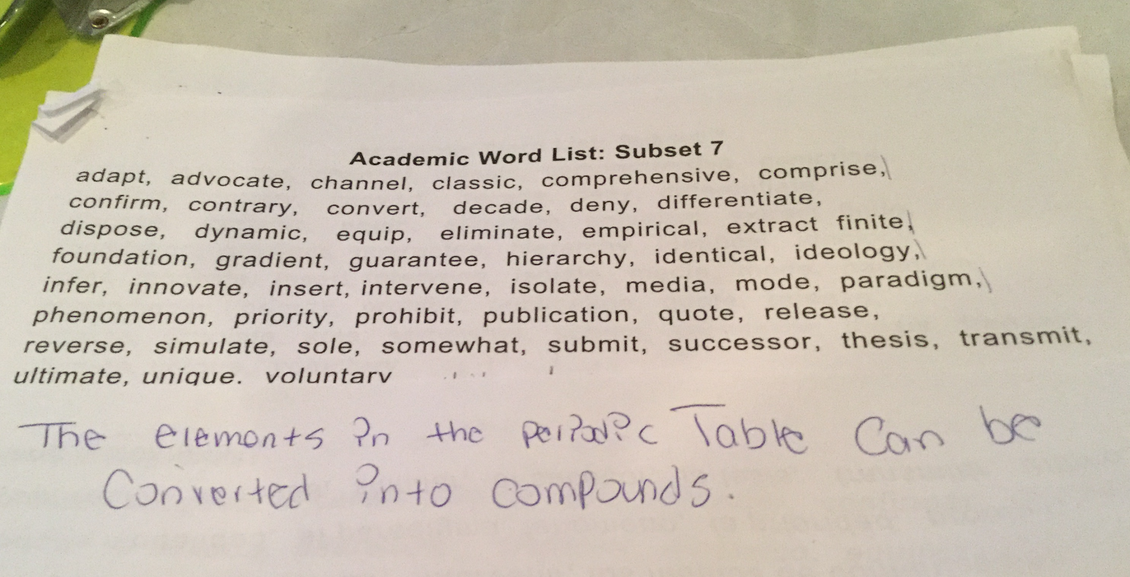

Slide 92
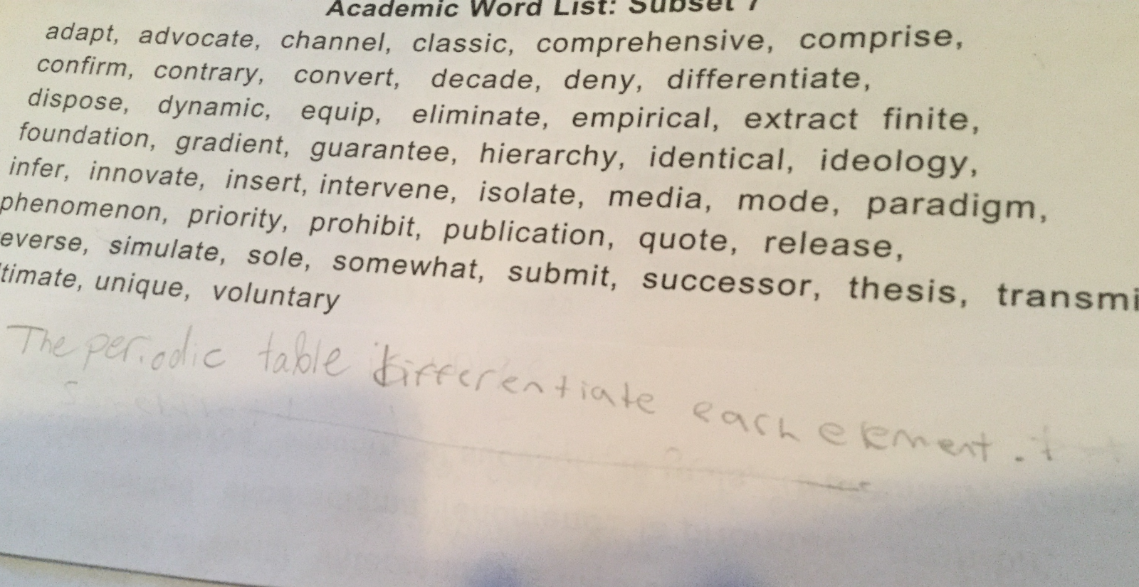

Slide 93
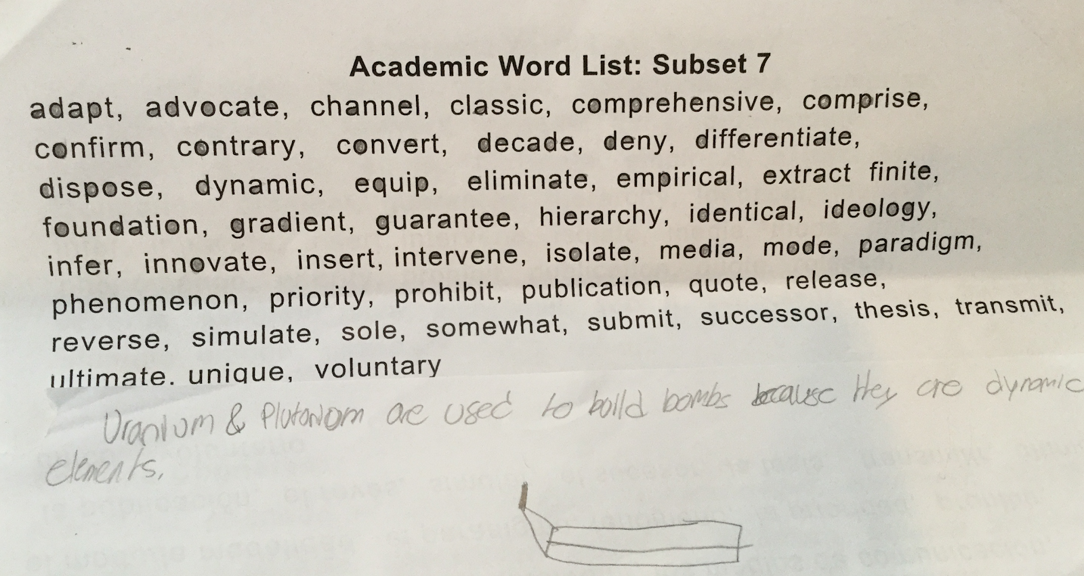

Slide 94
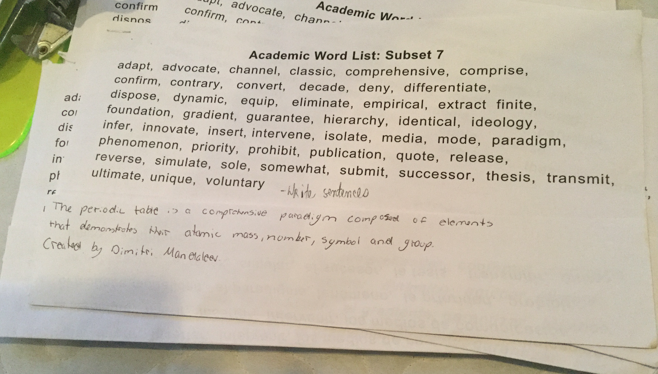

Slide 95
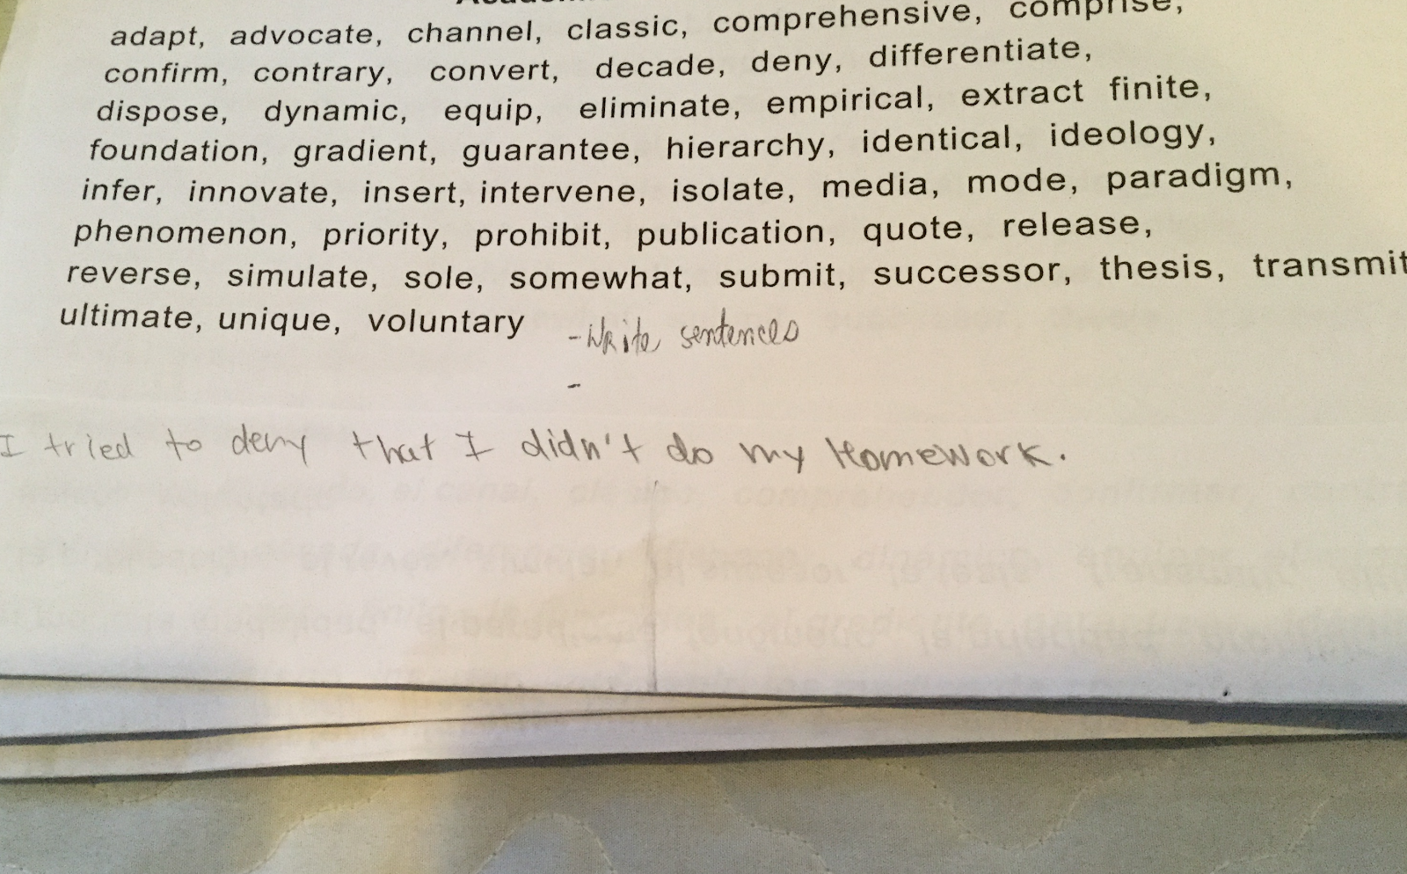

Slide 96
Morphology Chart
NOUNS: They will fit into this frame: The_____. | VERBS: They will fit into this frame: To____ or Can____or Is____ing | ADJECTIVES: They will fit into this frame: The ________truck | ADVERBS: They will fit into this frame: Do it ___________.
Nouns answer the question: What? or Who?
Verbs answer the question: What is it doing, having, feeling, or being?
Adjectives answer the question: What kind? (They may also answer the questions Which one? and
How many? but those kinds of adjectives do not fit into
the frame of The______truck.
Adverbs answer any of these questions: Where? When? Why? To what extent? How?

Slide 97
Boys and girls, today we are compiling—we are putting together— a list of
rhyming words. So first—listen carefully—I need you to take the cap off
your markers. Put it on the end, to ensure it does not fall off. If you do lose
your cap, I want you to seek it out—or look for it.
I need everyone to focus, and the strategy we are going to use is tapping out.
So, the first word—and we’ll take it right out of our Dr. Seuss book—is FOX.
Elbows up, tappers ready: F—O—X. What’s the firs sound you hear? AAAH.
Tap it with me: AAAH.

Slide 98
All right—again— I need everyone to focus and really listen. We’re using the
strategy of tapping out.
A word that would rhyme with FOX? (child responds: BOX)
Awesome. Elbows up, tappers ready: B—AAAH—X: BOX

Slide 99
(She calls on a child to come to
the board to write).
And, notice, we are compiling,
we are putting together, a list
of rhyming words.
(She guides the child as he writes on the board.)
OK—put the marker back in the appropriate place—in the right spot—where it belongs.
Another word that rhymes, so we can add it to the list that we are compiling?
(She gestures toward the list.)

Slide 100
Prior Knowledge: How well do I know these words?
Strangers
Acquaintances
Friends

Slide 102
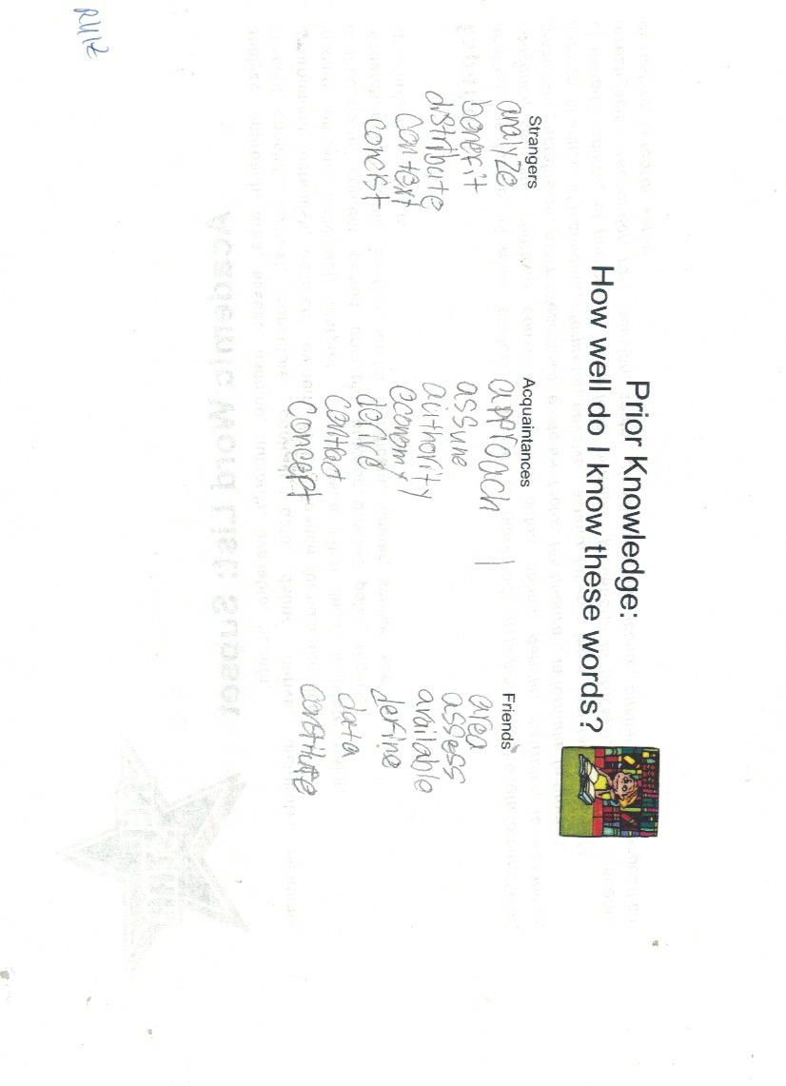

Slide 103
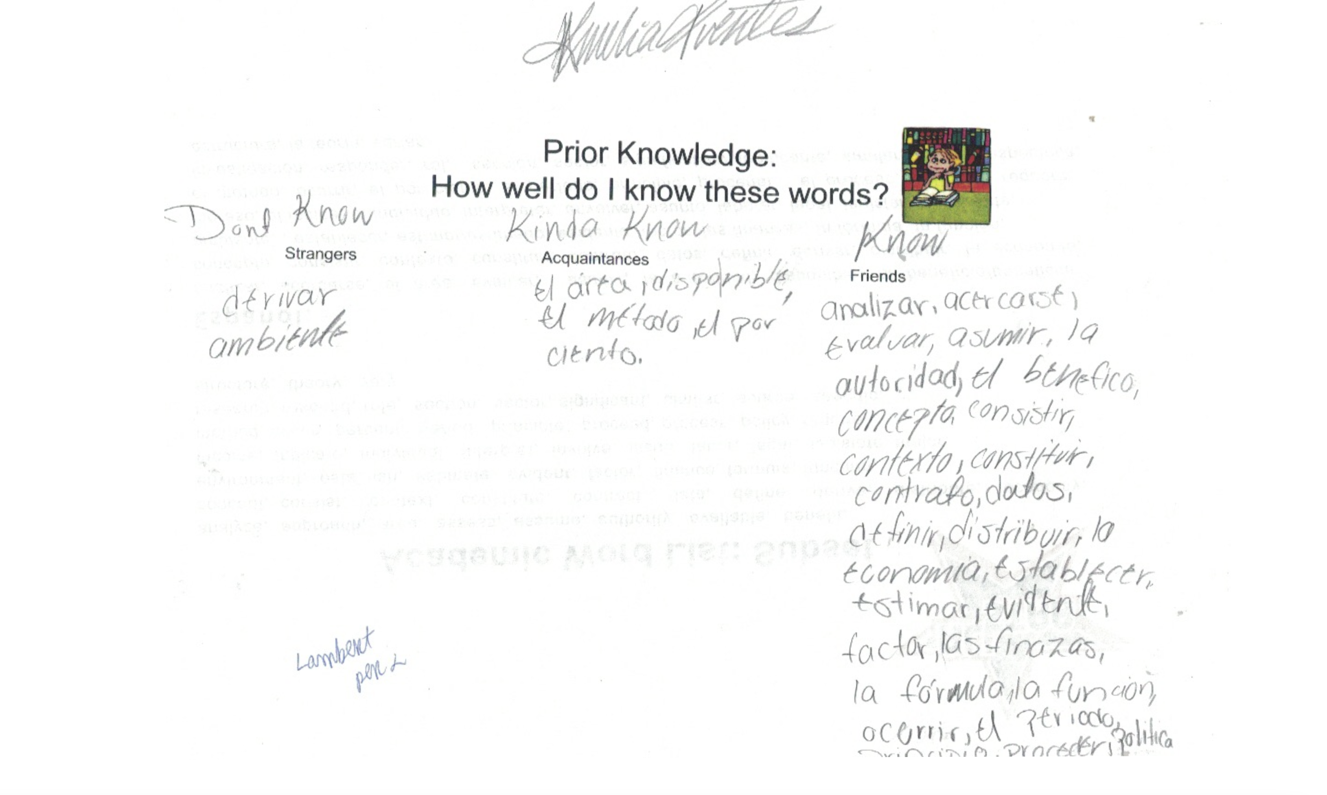

Slide 104
Latin Word Roots
Explicit Instruction
Teacher Selected

Slide 105
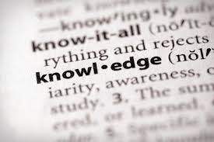
Etymology Illuminates Meaning
cordial
instruct/ educate

Slide 106
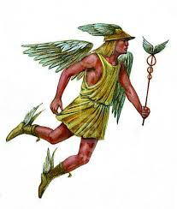
Etymology Illuminates Meaning
mercantilism
merchant
market
commerce
commercial
mercenary
merchandise
Mercury:
Roman god of financial gain

Slide 107
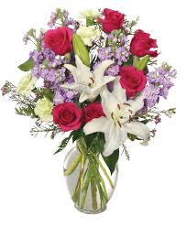
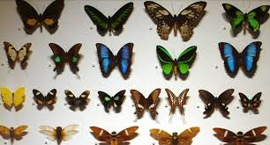
Etymology Illuminates Meaning
anthos (flower)
logein (collection)
anthology

Slide 108
Etymology Illuminates Meaning
algia (pain)
nostalgia
nostos (home)

Slide 109
Etymology Illuminates Meaning
dis (bad)
aster (star)
disaster

Slide 110
Google Forms
Word Learning Point 9:
The following words have interesting etymologies. Use etymonline.com to match them.
Etymology:
river horse
hiding place
testicle
whale-horse
salt
from cows
to run in small steps
small water
small mouse
spiral wing
muscle
salary
avocado
vaccination
vodka
hippopotamus
cache
walrus
curriculum
helicopter

Slide 111
Go to “Latin Roots Visuals”

Slide 112
Glossary Words
Explicit Instruction
Teacher Selected
First, explain the concept; show
a visual; give examples
Then: Present the word
Then: Break it down; give its
etymology

Slide 113
1 of 5
VOCABULARY PRIOR TO AN IN-CLASS READING
For Informational Text:
cranium
Talk with your neighbor about how
bicycle riders can protect their craniums.

Slide 114
2 of 5
vertebra
vertebrae
Talk with your partner.
All of the pictures to the
right show vertical lines.
How would you describe
vertical lines?

Slide 115
3 of 5
imprint
Talk with your neighbor about why
your shoes make an imprint on sand
and not on the street.

Slide 116
4 of 5
fossil
Talk with you neighbor about what you
might do if you found a fossil on the
beach.

Slide 117
5 of 5
carnivore
Talk to your neighbor about animals that
you know are carnivores.

