Slide 1
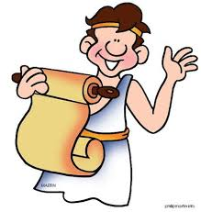

Slide 2
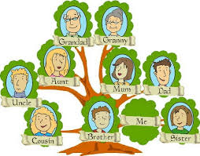

Slide 3
What percentage of English
words derive from Latin/Greek?
1%
10%
35%
50%
Words derived from Latin/Greek
are most likely to be used in which context?
1. casual conversation
2. academics, business, religion, government
3. emotionally charged situations
4. the early stages of learning English

Slide 4
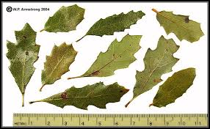
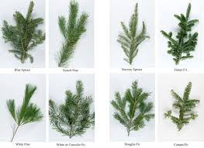

Slide 5
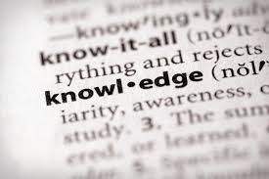
Etymology Illuminates Meaning
cordial
instruct/ educate

Slide 7
attract
tractor
detract
subtract
traction
extract
distract
intractable
traction
Sp. Cognates:
atraer, extraer
tract: to pull or drag

Slide 8
credit
credible
incredible
credulous
discredit
credentials
creditor
creed
accredited
Sp. Cognates:
creditor, increible
cred: to believe; to trust

Slide 9
complex
complicate
duplicate
explicate
explicit
implicit
perplex
implicate
duplex
duplicity
Sp. Cognates:
complicar, implicar,
duplicar
plex;plic: to weave; to fold; double

Slide 10
fluid
affluent
fluent
influence
influenza
fluctuate
confluence
superfluous
effluence
flux
Sp. Cognates:
fluido, influencia
flu: to flow; to glide

Slide 11
eject
reject
trajectory
inject
projectile
interject
adjective
object
abject
subject
conjecture
Sp. Cognates:
inyectar, sujeto
ject: to throw

Slide 12
ligature
ligament
obligation
religion
allegiance
legal
legislate
league
legion
Sp. Cognates:
legal, liga, religioso
lig/leg: to tie; to bind together

Slide 13
formulate
reform
deform
formal
informal
conform
information
formula
format
Sp. Cognates:
forma, formular
form: shape

Slide 14
progress, progressive, progression
regress, regressive, regression
congress
aggressive, aggression
transgress, transgression
digress, digression
egress
Sp. Cognates:
progreso
gress: step

Slide 15
grade
gradient
graduate, graduation
gradual
degrade
upgrade
Sp. Cognates:
el grado, graduarse,
el graduado,
la graduada gradual,
gradualmente, degradar,
el gradiente,
el grado
grad: step

Slide 16
propel, propeller
impel, impulsive
repel, repulsive
compel, compulsive
expel, expulsion
pulse
pulsate
Sp. Cognates:
el pulso, repeler,
inpulsar, expulsar,
pel: to drive

Slide 17
emit, emission
remit, remission
submit, submission
permit, permission
admit, admission
omit, omission
transmit, transmission
Sp. Cognates:
admitir, admision, el permiso,
permitir, cometir, encomendar,
comite, transmitir, la transmision,
la sumision, la mision,
el misionero, la misionara,
omitir, omsion
mit, miss: to send

Slide 18
script
manuscript
scribble
subscribe, subscription
transcribe, transcription
describe, description
inscribe, inscription
Sp. Cognates:
escribir, describir,
prescribir
scrip, scribe: to write

Slide 19
spectator
spectacular
spectacle
prospect, prospective
inspect, inspection
respect, respectable
perspective
expect, expectation
Sp. Cognates:
espectador,
inspeccionar,
respeto
spec: to look at

Slide 20
construct, construction, constructive
destroy, destruction
instruct, instruction
infrastructure
obstruct, obstruction
instrument
structure
Sp. Cognates: estructura, instruir, destruir, construir,
la construccion,
el instrumento
struct, stroy: to build

Slide 21
science
conscience
conscious, unconscious subconscious
omniscient
Sp. Cognate:
ciencia, consciente,
omnisciente,
inconsciente
sci: to know

Slide 22
value, valuable
evaluate
valid, invalid
validate, invalidate
prevalent
equivalent
valiant
valor, valorous
Sp. Cognate: evaluar, equivalente, valor
val: weight, worth, measure

Slide 23
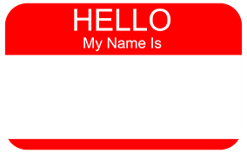
nominate
denomination
synonym
antonym
homonym
anonymous
number
numeral
numerous
Sp. Cognate:
nombre, nombrar,
numero, anonimo
nom, num: to name

Slide 24
respire, respiration
perspire, perspiration
inspire, inspiration
expire, expiration
aspire, aspiration
conspire, conspiracy
spirit
Sp. Cognate:
conspirar, inspirar,
expirar
spir: breathe

Slide 25
voice
vocal
vocabulary
provoke, provocation
evoke
invoke, invocation
advocate
vociferous
Sp. Cognate: vocabulario
voc, vok: to speak

Slide 26
sequence
consequence, consequential inconsequential
subsequently
prosecute
segue
second
Sp. Cognate: secuencia,
consecuencia, consecutivo
seq, sec, see: to follow

Slide 27
catapult
catastrophe
accident
coincide, coincidence
incident
cascade
casualty
homicide, suicide, insecticide
Sp. Cognates:accidente,
incidente, la catapulta,
catapultar, categoria
cata, cad, cas, cide: to fall

Slide 28
portable
import, export
important
portal
deport, deportation
porter
report
support
Sp. Cognates: importar,
importante, exportar
port: to carry, doorway

Slide 29
revert, reversion
invert, inversion
convert, conversion
divert, diversion
averse
adversary
converse, conversation
anniversary
introvert, extrovert
Sp. Cognate: diverso, convertir,
invertir
vert, vers: to turn

Slide 30
literature
literate, illiterate
literary
obliterate
lit: letter
Sp. Cognate: literatura

