Slide 1
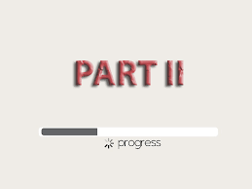
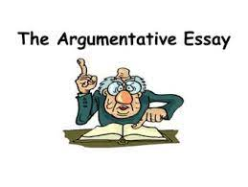

Slide 2
Test Breakdown:
40%: Multiple Choice Reading Comprehension:
Fiction
Poem
Literary non-fiction
40%: Argumentation essay, based on a social issue;
4 articles (pro/con/information)
20%: Rhetorical analysis of a literary excerpt

Slide 3
Topic Archive
January 2024: Should English curriculum focus on the classics?
August 2023: Should cities ban single-use Styrofoam products?
June 2023: Should solar geoengineering be used to reduce global warming?
January 2023: Should elementary-age children receive participation awards in sports?
August, 2022: Should U.S. Congressional lawmakers have term limits?
June, 2021: Should protective headgear be mandatory in soccer?
January, 2020: Does the Internet have a negative effect on our thinking process?
August, 2019: Should plastic shopping bags be banned?
June, 2019: Should pets be allowed in the workplace?
January, 2019: Should cash currency be eliminated?
August, 2018: Should shark netting be used on coastal beaches?
June, 2018: Is graffiti vandalism?
January, 2018: Could algae be the solution to our energy problems?
August, 2017: Should self-driving cars replace human drivers?

Slide 4
Evaluate: Do these topics meet the criteria for Part II (Argumentation):
Who, if anyone other than themselves, bears responsibility for the deaths of
Romeo and Juliet?
1a. Should there be a legal age for marriage? If so, what should it be?
2. Is Atticus Finch justified in his parenting decision when Jem destroys
Mrs. Dubose’s camellias?
2a. Does race play a role in America’s criminal justice system?
3. Is George in any way responsible for Lennie’s death?
3a. Public Law 111-256 (“Rosa’s Law”) replaced the term “mental retardation”
with “intellectual disability.” Do you agree that this change serves a
purpose?
4. Select a main character in A Raisin in the Sun. Could that character
achieve his or her dreams today?
4a. Should the government intervene in real estate sales practices?

Slide 5
Test Blueprint
Test Part | Suggested Time | Standards Addressed | Text Description | Student Task
Part II: Argumentation Writing from Sources | 80 minutes | RL 1-10 W 1,4,9 L 1-6 | 4 information- based texts, probably inc. graphics up to 2,600 words, total | Write an argumentative essay, referring to the sources given
Reading time:
Text 1: 3 minutes
Text 2: 3 minutes
Text 3: 4 ½ minutes
Text 4: 2 minutes
Text 5: 5 minutes
Total: 18 minutes
Writing Time:
3 minutes: Read the Directions
5 minutes: Written plan
50 minutes: Write the essay
Total: Approx. 80 minutes
(Combined with the 6 minutes left over
from Part 1, I now have 16 extra minutes.)

Slide 6
Writing Rubric: Common Core Standards, Grades 6-12:
Type: Argumentation
Pro
Semi-Pro
Novice
Pre-Novice
Effectively does ALL of the
following:
States importance of issue
Makes a claim
Acknowledges opposing claim(s)
Effectively does TWO of the
following:
States importance of issue
Makes a claim
Acknowledges
opposing claim(s)
Effectively does ONE of the
following:
States importance of issue
Makes a claim
Acknowledges opposing claim(s)
Effectively does NONE of the
following:
States importance of issue
Makes a claim
Acknowledges opposing claim
Writing an
introduction
Developing
an argument
Develops claims and opposing
claims thoroughly and fairly
with evidence: facts, stats,
reasons, examples, anecdotes
Good start toward
developing claims and
opposing claims; Includes
some substantial evidence
Mentions, but does not
develop, sufficient evidence;
Does not attend to opposing
claim(s)
No relevant facts, statistics,
reasons, or evidence.
Expressing
relationships
between ideas
Establishes clear and effective
organization through:
paragraphing, sectioning,
complex sentences, transitions
and other linking devices
Transitions from paragraph
to paragraph, but needs
more internal transition and
linkage within paragraphs
A few organizational
structures and transitional
words
All or mostly simple
sentences with no or
very few transition words
and conjunctions used
No paragraphing
Using Tier
II and III
Vocabulary
Sufficient, appropriate
use of Tier II
and III language throughout
Tier II and III vocabulary are
evident, but there are
several instances where
Tier II vocabulary should be
used instead of Tier I
A few Tier II and II vocabulary
used
No Tier II or III vocabulary
used
Using formal writing
tone
Formal writing tone used
throughout; Few or no glaring
errors in spelling, grammar,
punctuation, capitalization;
obvious care in presentation
Good attempt at formal
writing style and
proofreading, but a few
glaring errors indicate that
more careful proofreading
is needed
Attempt at formal
writing style, but needs
more proofreading and/or
care in presentation
Overall tone is too informal,
including some or all of:
“texting” abbreviations, slang,
messiness, errors in spelling,
punctuation, grammar
Writing a
conclusion
Strong conclusion that
follows from the evidence
presented and makes an
impact on the reader
Good start toward a
strong conclusion that
follows from the evidence
and makes an impact on
the reader
Sketchy conclusion that
just restates the claim
and/or the issue; does not
make an impact on the reader
no conclusion
Developed by Amy Benjamin in accordance with the Common Core State Standards for Literacy in English Language Arts and Social Studies, Science, Technical Subjects, www.amybenjamin.com

Slide 7
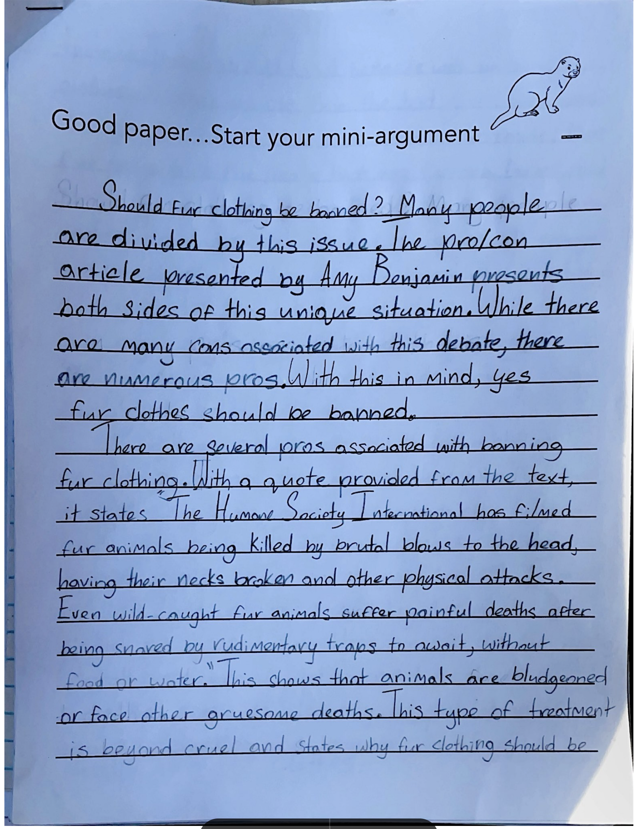
“Christopher” used
a heavily scaffolded
structure to write
a well-organized
argument.

Slide 8
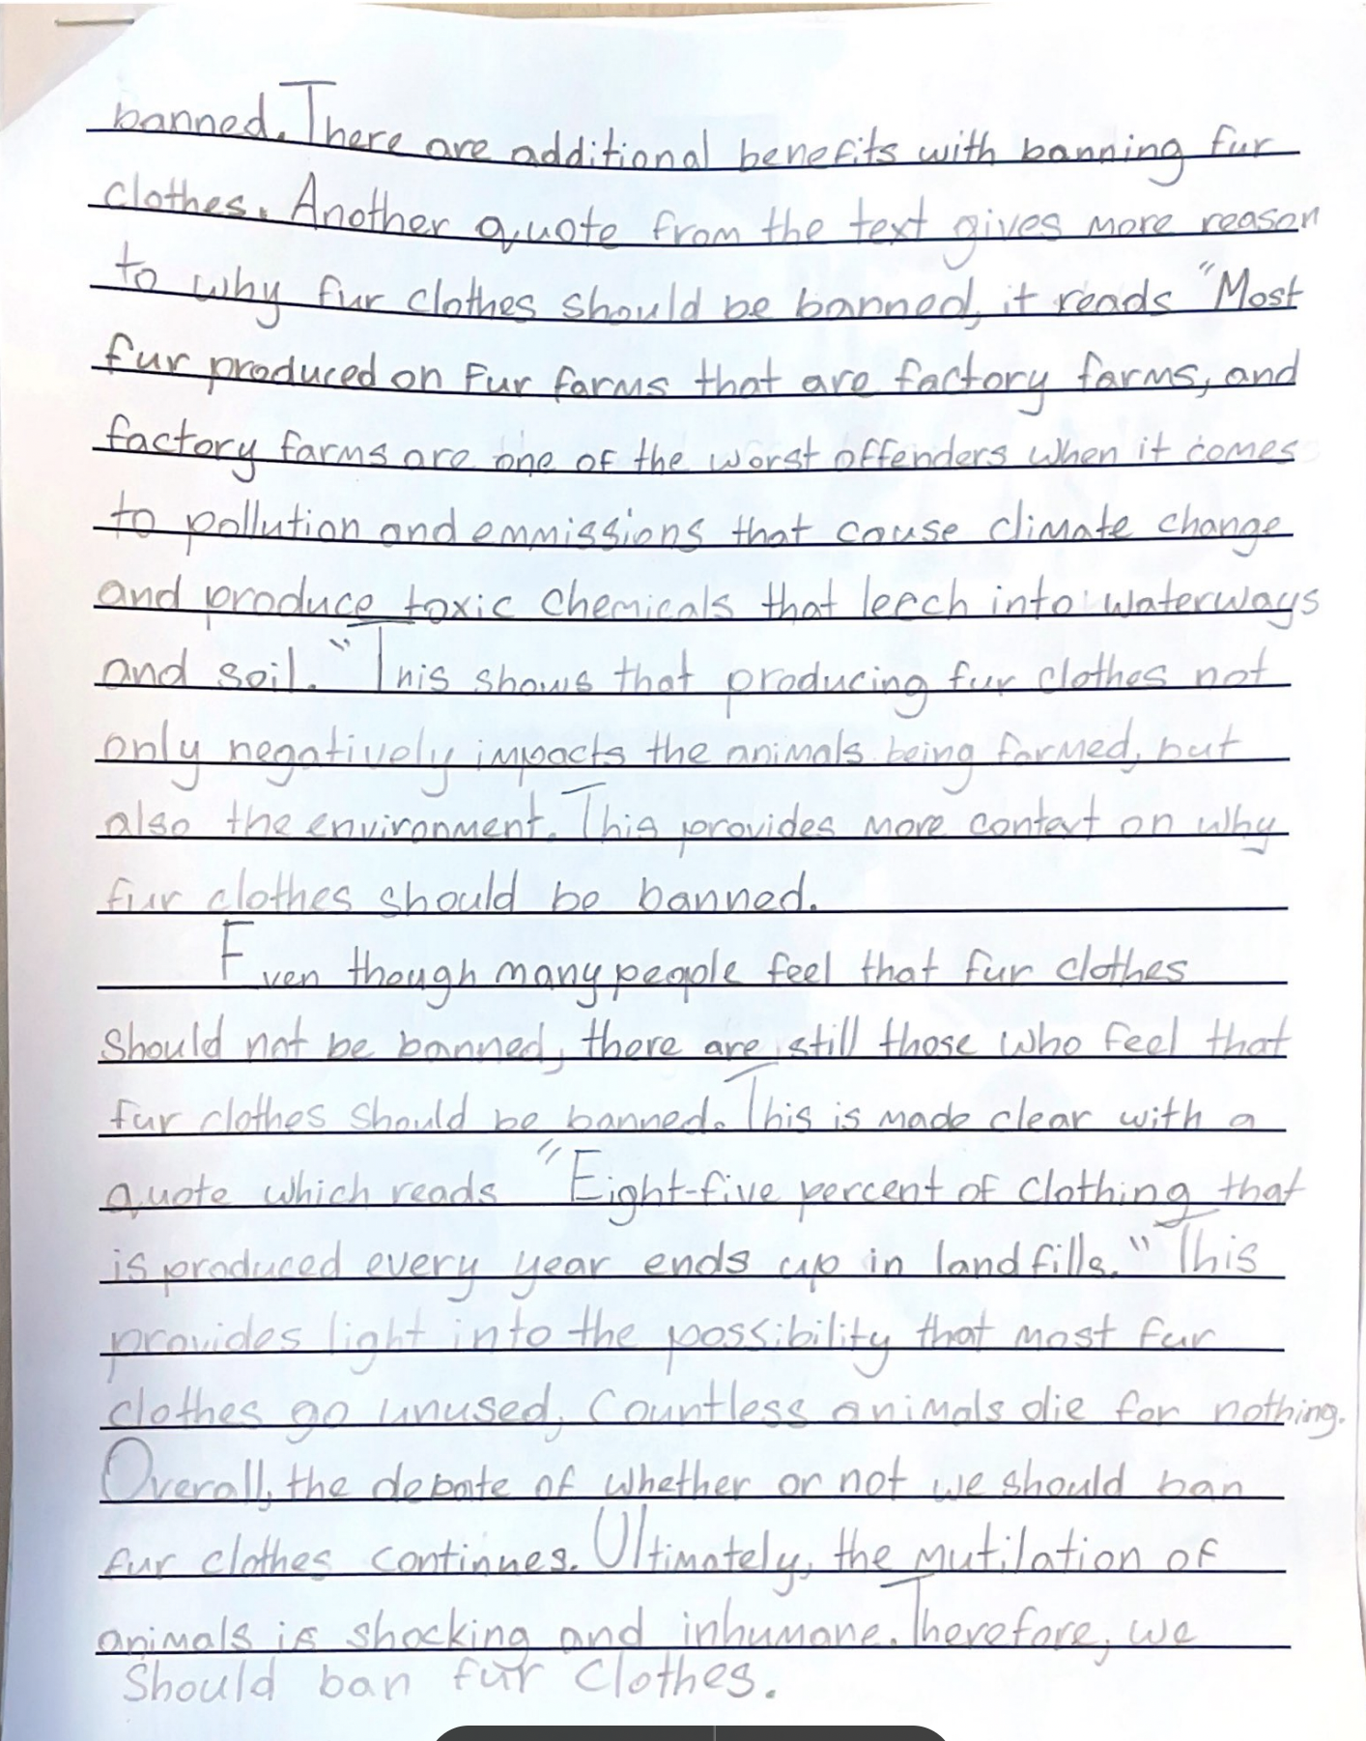

Slide 9
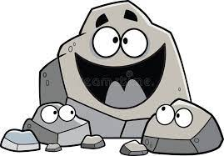
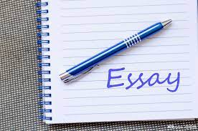
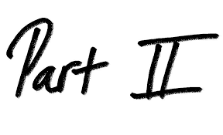
Paragraph 1: Introduction
Sentence 1: Rewrite the topic question:
Should……?
Sentence 2:
Many people are divided on this controversial issue.
The authors of Text #______, Text #_________, and Text #___________present both sides of this
complicated situation.
Sentence 3:
Sentence 4:
While both sides make valid claims, the benefits of ____________ outweigh the drawbacks.

Slide 10
Paragraph 2: Reasoning and
Support
Sentence 1:
There are several factors to be considered: First, as ______________asserts in Text 1, “quote___________.”
Sentence 2:
This fact is significant because____________________________________
Sentence 3:
The numbers tell the story: <Quote a statistic from one of the texts, and insert a parenthetical citation after it.>
Sentence 4:
What if……? The results of such an action could seriously impact___________________ in a __________way.
positive or negative
OR
Suppose__________
OR
Imagine if_________

Slide 11
Paragraph 3: Reasoning and
Support
Sentence 1:
Not only that, but ____________ would improve __________ .
OR
not improve
OR
endanger
Sentence 2:
Paraphrase a quote from another text. When you paraphrase, you do not need quotation marks,
but you do need the parenthetical citation.
Sentence 3:
This fact is relevant because__________________________________________________________.
Sentence 4:
What if……? Wouldn’t that lead to___________________?
OR
Suppose__________
OR
Imagine if_________

Slide 12
Paragraph 4: Develop the Counterclaim
Sentence 1:
But there are those who believe otherwise, claiming that__________________
is a better way to go.
OR OR
claim hold
OR OR
insist assert
OR OR
claiming holding
OR OR
insisting asserting
Sentence 2:
In Text #____, <author of text> says: <“Quote.”
Sentence 3:
This might be convincing if_________________________________,
but ________________________is more practical and advantageous.
Sentence 4:
After all, who would want________________________________?

Slide 13
Paragraph 5: Conclusion:
Sentence 1: O
Overall, the debate about_____________continues.
Sentence 2: U
Ultimately, what is at stake here is__________________________.
Sentence 3: T
Therefore, let’s ________-ing_______________so that we can all rest easy, knowing that___________________________________.
stop
OR
start
OR
continue

Slide 14
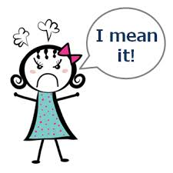
Should TikTok be banned in the U.S.?
Should schools set aside time during the day dedicated to social-emotional learning?
Should LBGT issues be discussed in high school classrooms?
Should transgender athletes be permitted to play on the team of their choice?
In sports, women’s track uniforms become tighter and skimpier from high school, to college,
to professional level. Men’s track uniforms remain loose-fitting throughout their years.
Is this sexist?

Slide 15
How would you like it if…
How would you feel if…
What if…
Imagine a world where…
This is an urgent matter of…
This issue threatens to…
In a world where…, it is imperative that we…
It is deeply troubling that…
We must all do our utmost to see that…

Slide 16
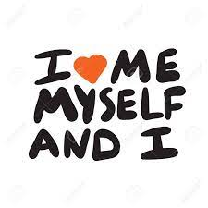
As a fervent advocate for…, I strongly believe that…
As someone who feels a personal connection to…
because of my experience with…, I am a strong
advocate of…
Ever since…, I have been committed to…
This issue weighs heavily on my heart, compelling
me to speak out against the practice of…

Slide 17
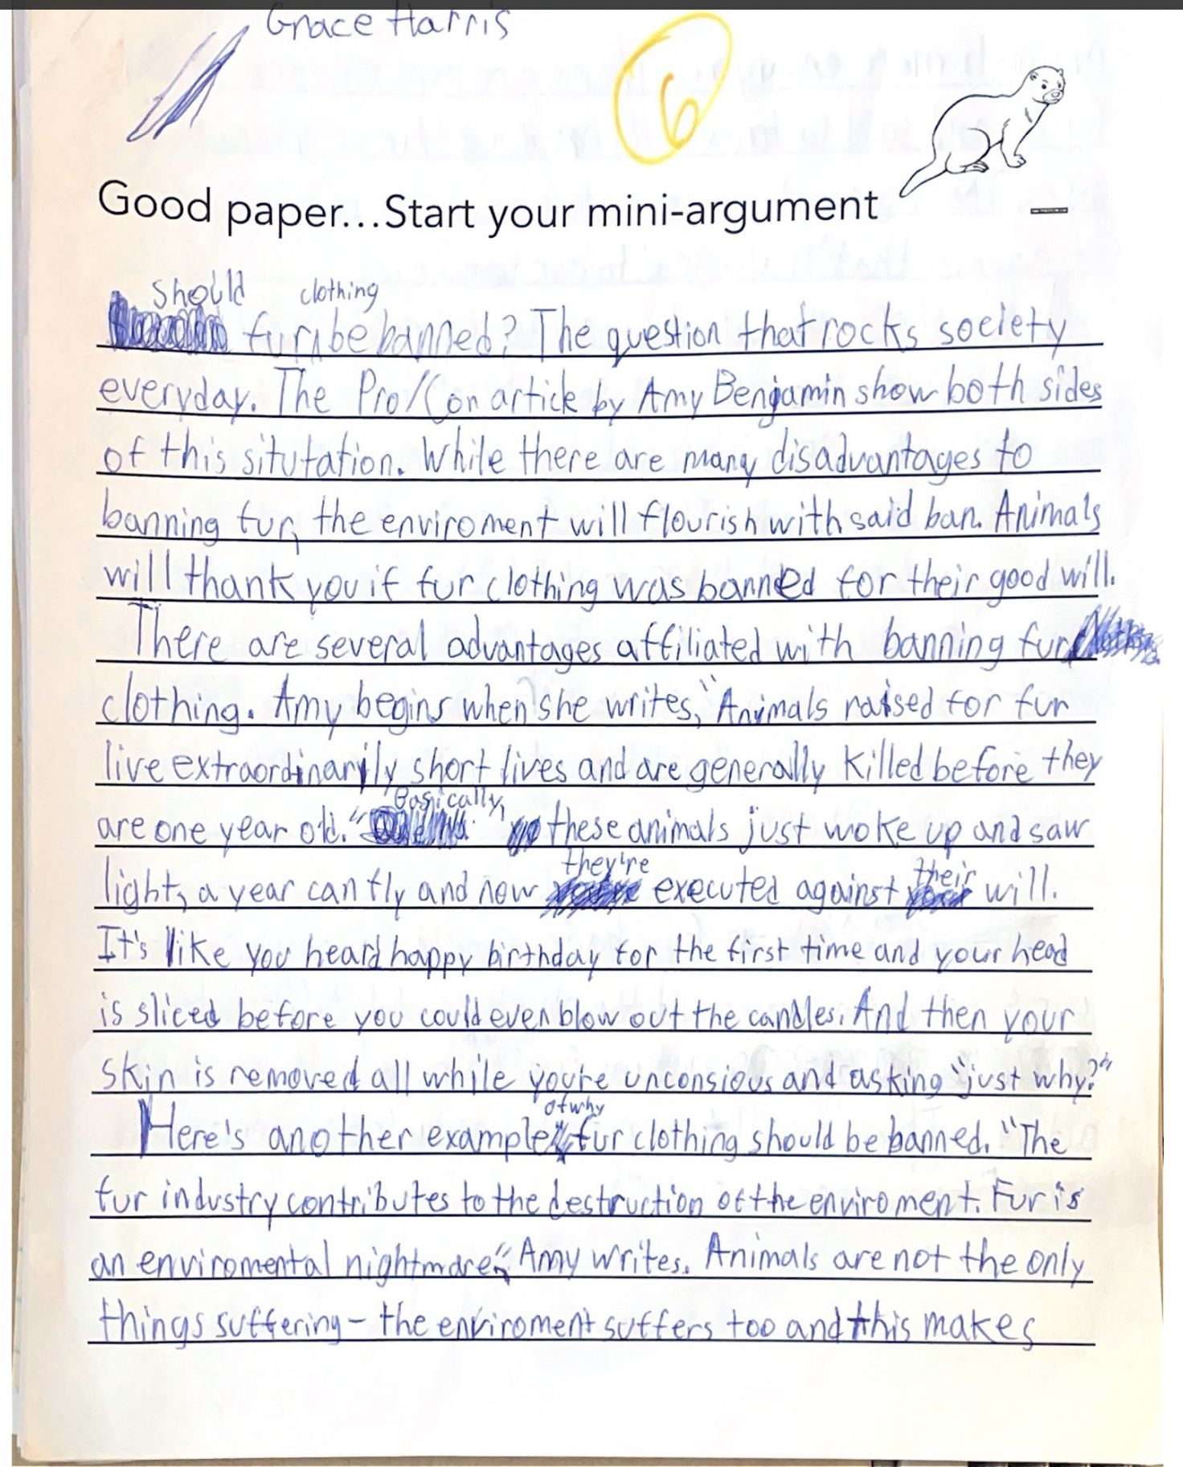
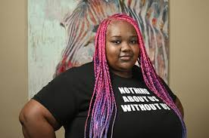
Grace took the scaffold
to the next level, expressing
her passion for the issue.

Slide 18
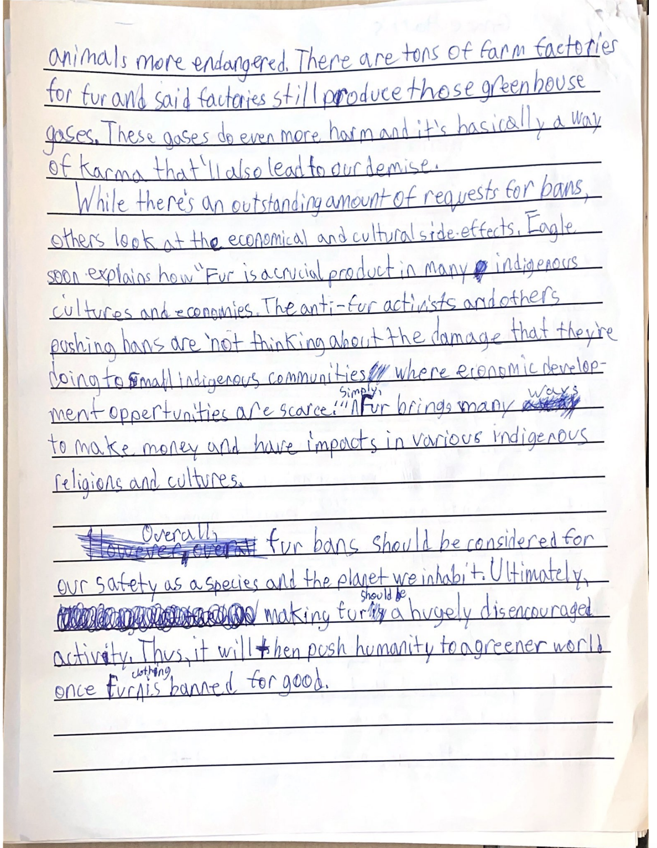

Slide 19
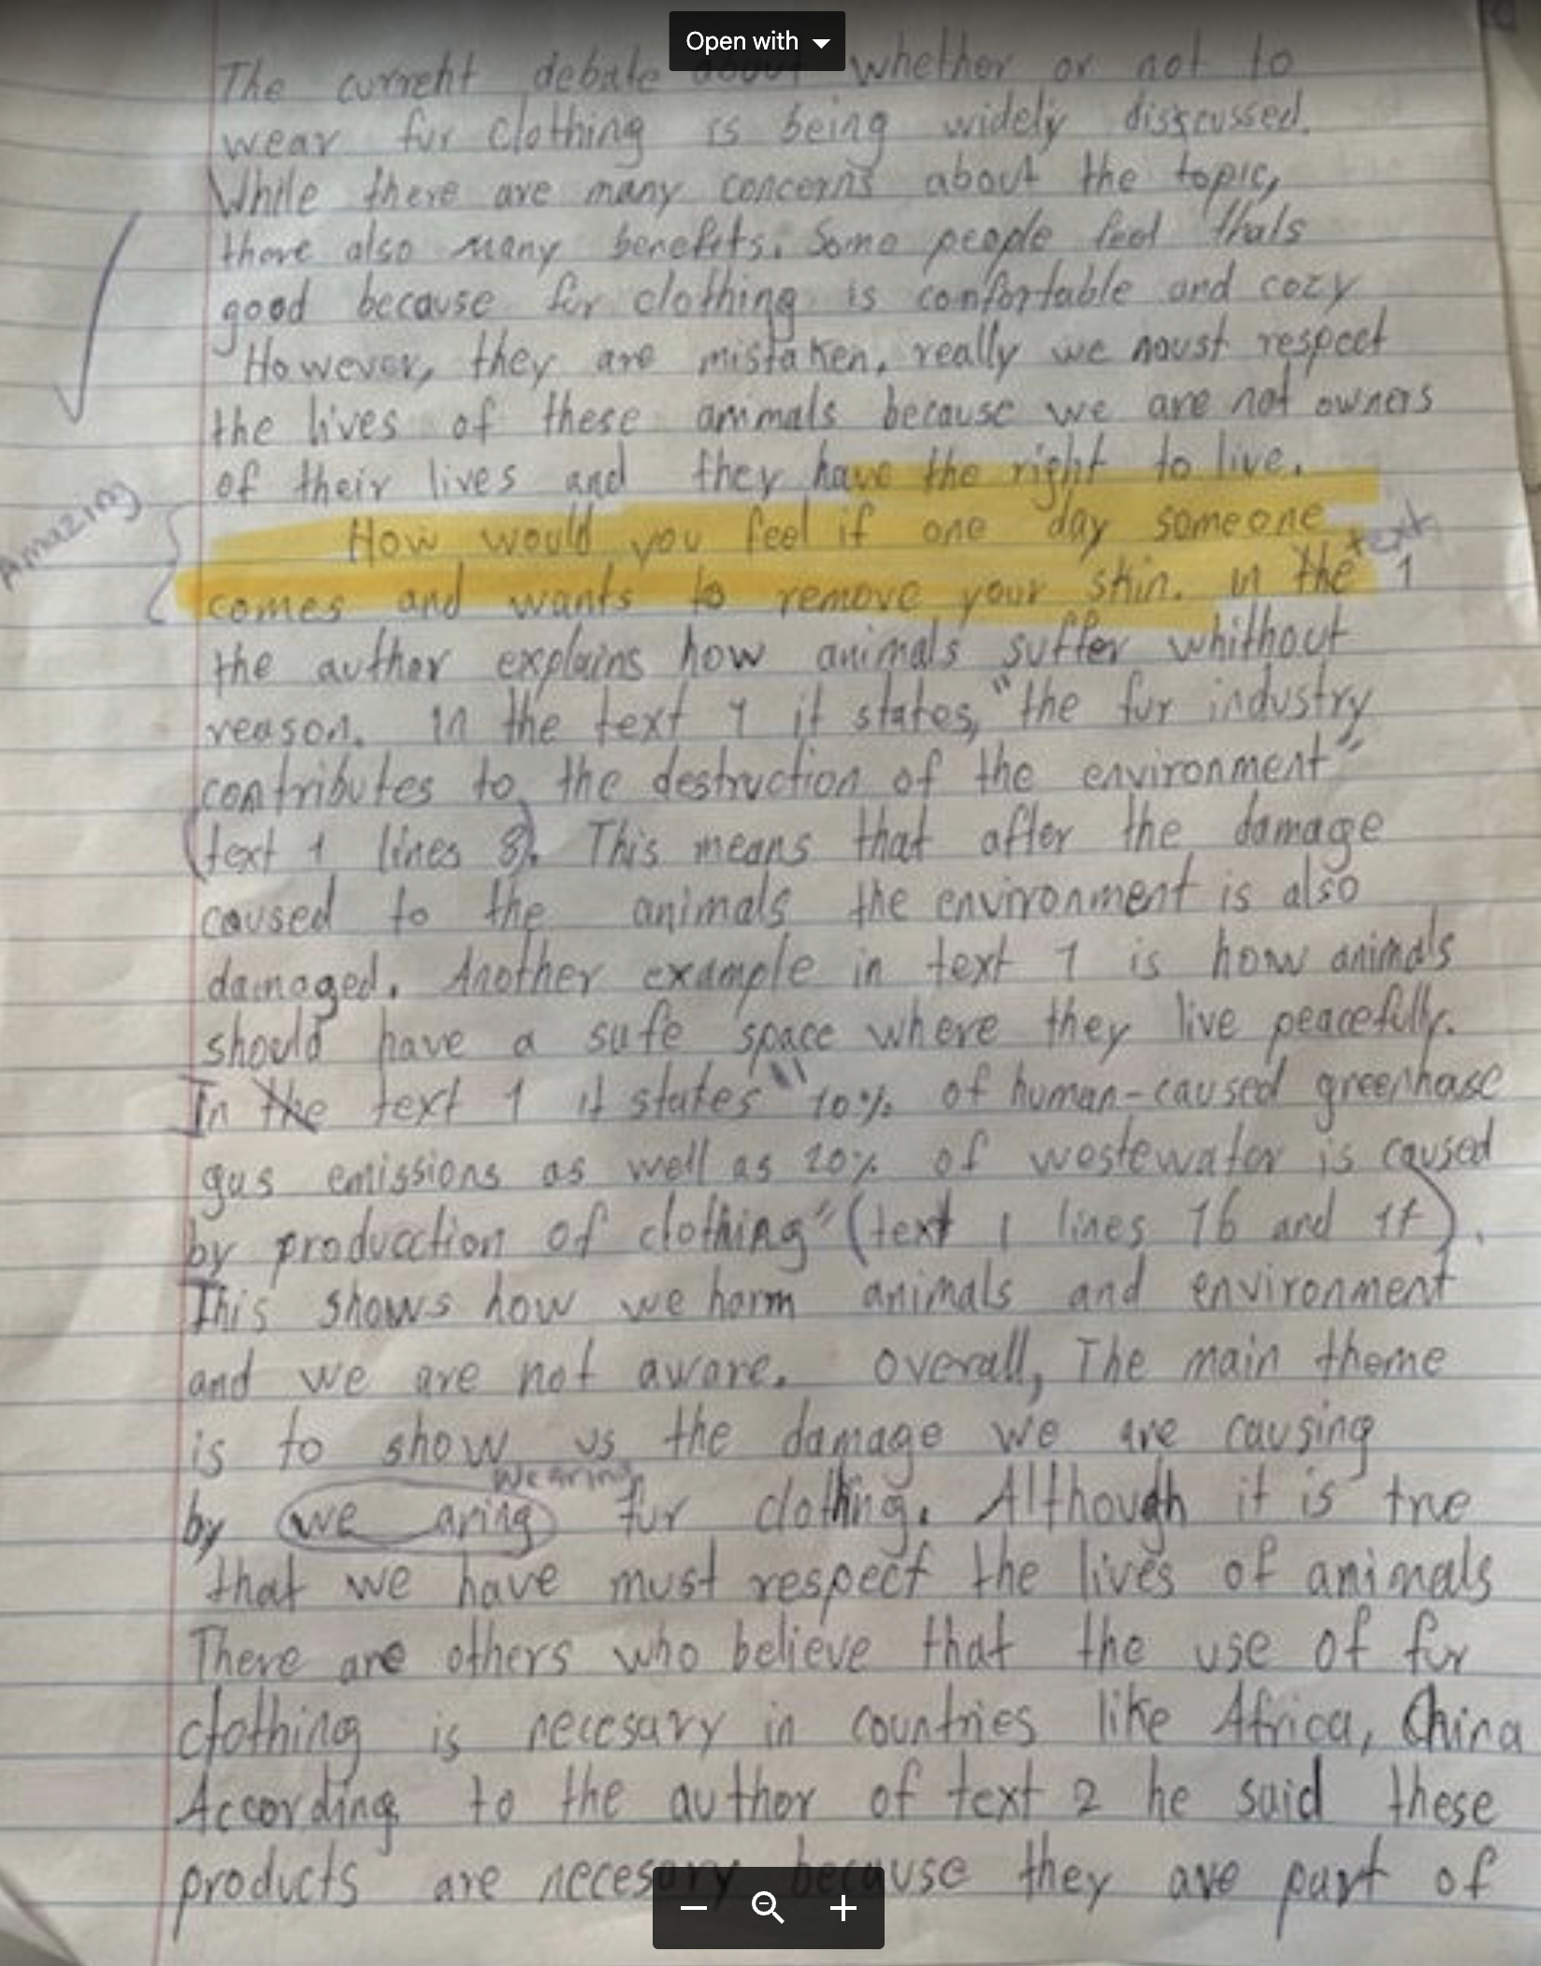

Slide 20
5 Minute Plan
What is the question?
What is my viewpoint? (claim)
Why is this issue important?
What is the counterclaim?
What valid points does the counterclaim have?
But why am I still right?
What are my parting words of warning? (If…then…)
Connectives: but, however
although, even though, nevertheless
therefore, so
Use your sentence frames.
Use your academic word list.

Slide 21
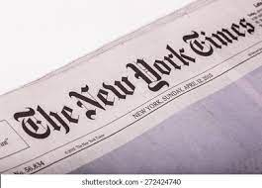

Slide 22
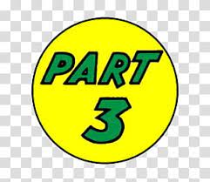
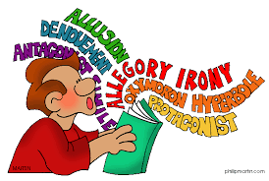
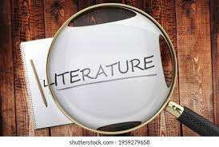

Slide 24
Using an abstract noun to name a central idea (which you will later develop).
-acy
-al
-ance,ence
-dom
-ism
-ity, -ty
-ment
-ness
-ship
-tion, -sion
Theme Town
Abstract Noun-Making
Suffixes
rebellion, exploitation, education, redemption, determination, materialism,
maturation, kinship, friendship, abandonment, betrayal, reversal, deception,
bravery, compassion, uncertainty, ambiguity, unexpectedness, loyalty, denial,
perseverance, patriotism, adventurousness, communication, miscommunication,
disappointment, renaissance, forgiveness, homelessness, wisdom, foolishness,
responsibility, disillusionment, opportunism, comeuppance, obsession, romance,
resentment, acceptance, alienation, individuality, innocence (loss of), integrity,
self-deception, parenthood, childhood, mistaken identity, disconnectedness,
gratitude, illness, brutality…

Slide 25
Other writing strategies
that will probably work are:
figurative language
imagery
multi-sensory detail
contrast
Paragraph 1:
Sentence 1:
In <name of passage>, the author <name of author> uses the writing strategy of imagery* to
develop the central idea of ____________.
Insert a word that ends with -ment, -ness, -ity, -hood, -ity, -ism, -ship,
-tion, -sion, -al, -ty, -dom, -ance, -ence, -acy
Sentence 2:
In literature, as in life, ______________ is a common experience.
or…problem, condition, issue, frustration, pursuit,
goal, etc.
Sentence 3:
When <name of author> writes, <quote>, he/she uses the words “_______”, “______”. and “______”.
Sentence 4:
The impact of this word choice is to stimulate the reader’s emotional response.
or…imagination, understanding, interest, etc.
Sentence 5:
The reader feels a sense of_____________, which is heightened because of the diction.

Slide 26
Paragraph 2:
Sentence 6:
Further into the passage, in lines __ through __,
<name of author>, uses the phrase “_____ “.
Sentence 7:
This word choice dramatically strengthens the central idea of_______________
by emphasizing ___________.
(insert word that names the central idea in Sentences 1 and 2)
Sentence 8:
The effect of the contrast between ____ and _____ (lines __through__) creates tension that
makes the passage interesting and memorable .
Sentence 9:
Words have power, and <name of author> carefully uses words that unify the passage around
a clear, single idea.
That single idea is _______________, a universal human experience that will always be
compelling to read and write about.
Sentence 10:
(insert word that names the central idea in Sentences 1 and 2)
Sentence 11:
After all, who has never, at one time or another in their lives, thought about_______________?.
(insert word that names the central idea in Sentences 1 and 2)

Slide 27
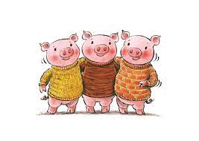
In The Three Little Pigs, the author uses the
writing strategy of contrast to express a
central idea: If you work hard now, it will
pay off later.
The Three Little Pigs is about how three brothers
went off into the world. Each little pig built his own
house. The house of straw and the house of twigs
were inexpensive and easy to build, but were not
strong enough to resist the depredations of the
big bad wolf. The only house that remained intact
was the one that was made of bricks and was the
most difficult and expensive to construct. In the
end, the wolf was defeated because he could
not huff and puff hard enough to blow down
the house made of bricks.
In The Three Little Pigs, the author uses the
writing strategy of conflict to express a
central idea: The best offense is a good defense.
In The Three Little Pigs, the author uses the
writing strategy of characterization to express a
central idea: brotherhood.

Slide 28
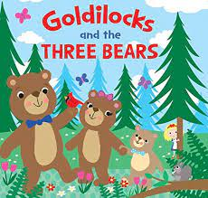
In Goldilocks and the Three Bears, the author
uses the writing strategy of repetition
to express central idea: Inconsiderate people
do not care how their actions
affect others.
Goldilocks and the Three Bears is about how a girl
named Goldilocks breaks into the home of a bear
family and selfishly eats their food, breaks their
furniture, and falls asleep in one of their beds. In
the end, the bears return home, survey the damage,
and Goldilocks runs off without suffering any
consequences for her destructive acts.
In Goldilocks and the Three Bears, the author
uses the writing strategy of contrast to
express a central idea: Innocent creatures
can suffer at the hands of opportunists.
In Goldilocks and the Three Bears, the author
uses the writing strategy of characterization
to express a central idea: entitlement.

Slide 29
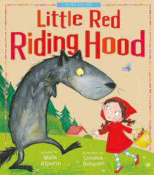
Little Red Riding Hood is about a girl who is traveling
along in the woods, on her way to deliver a food
basket to her ailing grandmother. On her way,
she disregards her mother’s warning and strays
from the path. The Big Bad Wolf approaches her
and sweet-talks her into picking some flowers
while he steals her basket, proceeds to the
grandmother’s house, enters on a false pretext,
and devours her. Later, when the little girl arrives,
the wolf has assumed the identity of the
grandmother. Little Red Riding Hood almost
falls for the ruse, but is rescued at the last minute
by a hunter, who slays the wolf in a grand gesture of
heroism.
In Little Red Riding Hood, the author uses the
writing strategy of imagery to express
central idea: Danger lurks in the woods.
In Little Red Riding Hood, the author uses the
writing strategy of dramatic irony to express a
central idea: The reader knows something that
the character does not know.
In Little Red Riding Hood, the author uses the
writing strategy of symbolism to express a
central idea: deception.

