Slide 1
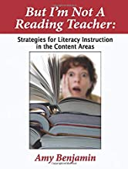
January 17, 2024
Nassau BOCES

Slide 2
Topic I:
Elements of Reading Instruction
Pre-K—12

Slide 3
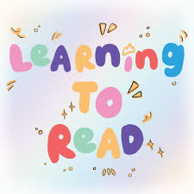
Elements of Reading Instruction
Word Level: Decoding
Comprehension: Understanding
Author’s Intent
Phonics: Letters represent sounds
Automaticity: All words are
sight words
Discerning central ideas and
supportive information
Sight words: Letters do not
necessarily represent sounds
Accuracy: Correctly reading
what is on the page, including
punctuation
Ability to summarize
Ability to discern tone
Basic spelling
Expressiveness: Activating an
inner voice that hears language
the way the author intended it
to sound
Ability to answer questions
Basic vocabulary
Ability to read between the lines
Focus: Being in a reading mindset
Basic understanding of
what punctuation and
capitalization are
meant to do
Knowing 90-95% of the vocabulary
Sufficient background knowledge

Slide 4
“Words mean more than what is set down
on the page. It takes the human voice to
infuse words with meaning.”—Maya Angelou
Why these strategies work:
Fluency is not the same as speed.
They all model and reinforce pace,
accuracy, and expressiveness in a
low-anxiety structure.
Deficit indicators:
Strategies for improvement:
I. Wide reading: When reading something we
are interested in, we know a lot of the words.
This familiarity allows us to use context to learn
unfamiliar words; builds confidence
Robotic (word-by-word,
expressionless) reading
aloud
I. Choral Reading:
1. Whole class
2. Teacher reads every other sentence
3. “Just the boys”; “Just the girls” alternating
4. Cumulative: First one reader, then add a few
more, then a few more
II. Deep reading: Fluency develops as a
result of repeated readings; practice increases
speed
Inaccuracies, especially
in mistaking words spelled
similarly in the first few
letters
II. After teacher reads aloud, with students’
eyes on text, students talk about what the
teacher did to make the words on the page
come alive
III. Multiple re-reads: What did you notice on consecutive readings?
Skim, Scan, Read
Reading too slowly to
maintain comprehension:
The effort that it takes to
consciously decode words
takes away from the focus
on meaning
III. Learn to “ear read”: activate the inner voice
For fluent readers, all words are
sight words. The purpose of phonics
instruction is so you don’t have to
consciously use it anymore.
IV. Focus on how the punctuation enhances
meaning by grouping words together and
directing expression: ex.: How does your
voice and pacing change when you see a
comma? What does a semicolon indicate?
V. Poor readers read words. Skillful readers
read phrases. Teacher marks off phrases.
Then, read it again, with increasingly
fewer mark-offs.

Slide 5
Fluency is not the same as speed.
“Words mean more than what is set down
on the page. It takes the human voice to
infuse words with meaning.”—Maya Angelou
Why these strategies work:
More Strategies for Improvement:
VIII. Students transform a chapter into a script or screenplay
VIII. Requires deep reading for meaning
IX. Learn spelling patterns: learn words in clusters based
on how they are spelled (same letter patterns)
IX: Improving spelling means improving the reader’s ability to
recognize words
X. Shakespeare: monologues, soliloquies, dialogues
X. Requires deep reading for meaning
XI. Self-Understanding: What environment do you need
for comprehension?
XI. Readers need to give themselves an environment that
promotes concentration

Slide 7
Academic Vocabulary: Pages 15-29
Generic Academic
Words
Glossary
Words
Literary Words
“Geneticists turned a
specialized stomach
cell from a mouse into
a skin cell by activating
a specific gene responsible
for the production of epidermal
cells.”
“Geneticists turned a
specialized stomach
cell from a mouse into
a skin cell by activating
a specific gene responsible
for the production of epidermal
cells.”
tawny, chortle,
exasperated,
falter, muffled,
gingerly, snivel

Slide 8
9:00

Slide 9
Article: “The High Price of Multitasking”
NYT: July 14, 2019
By: Daniel T. Willingham, psychologist at the University of Virginia and author of
“Outsmart Your Brain: Why Learning is Hard and How You Can Make It Easy”
Surprises
Questions
Affirmations
Words
(Hmmmm….I never knew this or thought about it
this way.)
(I already knew this, but it’s good to have
it expressed and/or
expanded on by an expert.)
(3 words in the text that I would like
to know more about.)
(I wonder about; I’m not sure about; I disagree with)

Slide 10
Topic II:
Building Vocabulary

Slide 11
key comprehension the knowledge is reading predictor vocabulary of
Vocabulary knowledge is the key predictor of reading comprehension.

Slide 12
Reading is the key builder of vocabulary.

Slide 13
Knowing the meaning of
individual words
Understanding the
world of words
Having fun with words

Slide 14
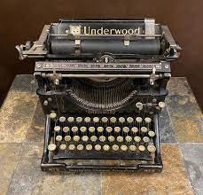
literary
generic academic
glossary
of words
…and ways to teach them:

Slide 15
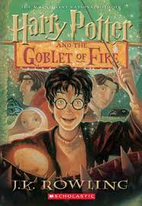
Find the word that means:
In Paragraph 1: called in____________________
boiled over________________________
obvious___________________________
bothered (3 words)________________________
obviously___________________________
seemingly___________________________
In Paragraph 2: bar___________________
lively business (2 words)___________________
shown up (2 words)_______________________
emotionally_______________________________
In Paragraph 3: shabby_____________________
The police were summoned, and the whole of Little
Hangleton had seethed with shocked curiosity and
ill-disguised excitement. Nobody wasted their breath
pretending to feel very sad about the riddles, for they had
been most unpopular. Elderly Mr. ad Mrs. Ridddle had been
rich, snobbish, and rude, and their grown-up son, Tom,
had been, if anything, worse. All the villagers cared about
was the identity of their murderer for plainly, three
apparently healthy people did not all drop dead of natural
causes on the same night.
(2) The Hanged Man, the village pub, did a roaring trade
that night; the whole village seemed to have turned out to discus the murders.
They were rewarded for leaving their firesides when the Riddles’ cook arrived
dramatically in their midst and announced to the suddenly silent pub that a man
called Frank Bryce had just been arrested.
“Frank!” cried several people. “Never!”
(3) Frank Bryce was the Riddles’ gardener. He lived alone in a rundown
cottage on the grounds of the Riddle House. Frank had come back from the
war with a very stiff leg and a great dislike for crowds and loud noises, and
had been working for the Riddles ever since.

Slide 16
Getting to Know the Words We Meet in Reading:
The word I would like to get to know is:
My guess:
Dictionary Definition:
(Use vocabulary.com, preferably)
Visual:
Draw a very quick picture:
Definition in my own words:
Complete sentence of at least 10 words:
Must contain an action verb and a visual image.

Slide 17
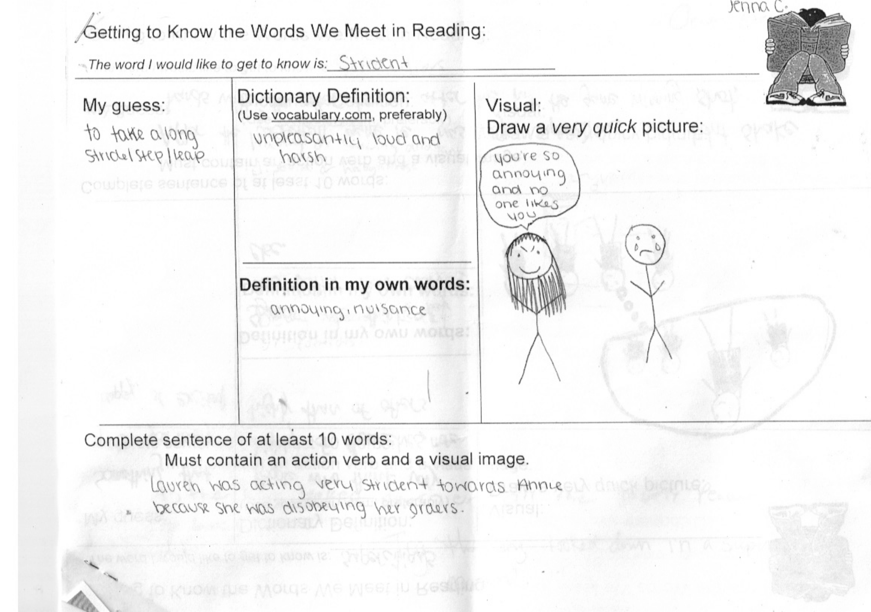
Dictionary Definition:
(Use vocabulary.com, preferably)
Visual:
Draw a very quick picture:
Definition in my own words:

Slide 18
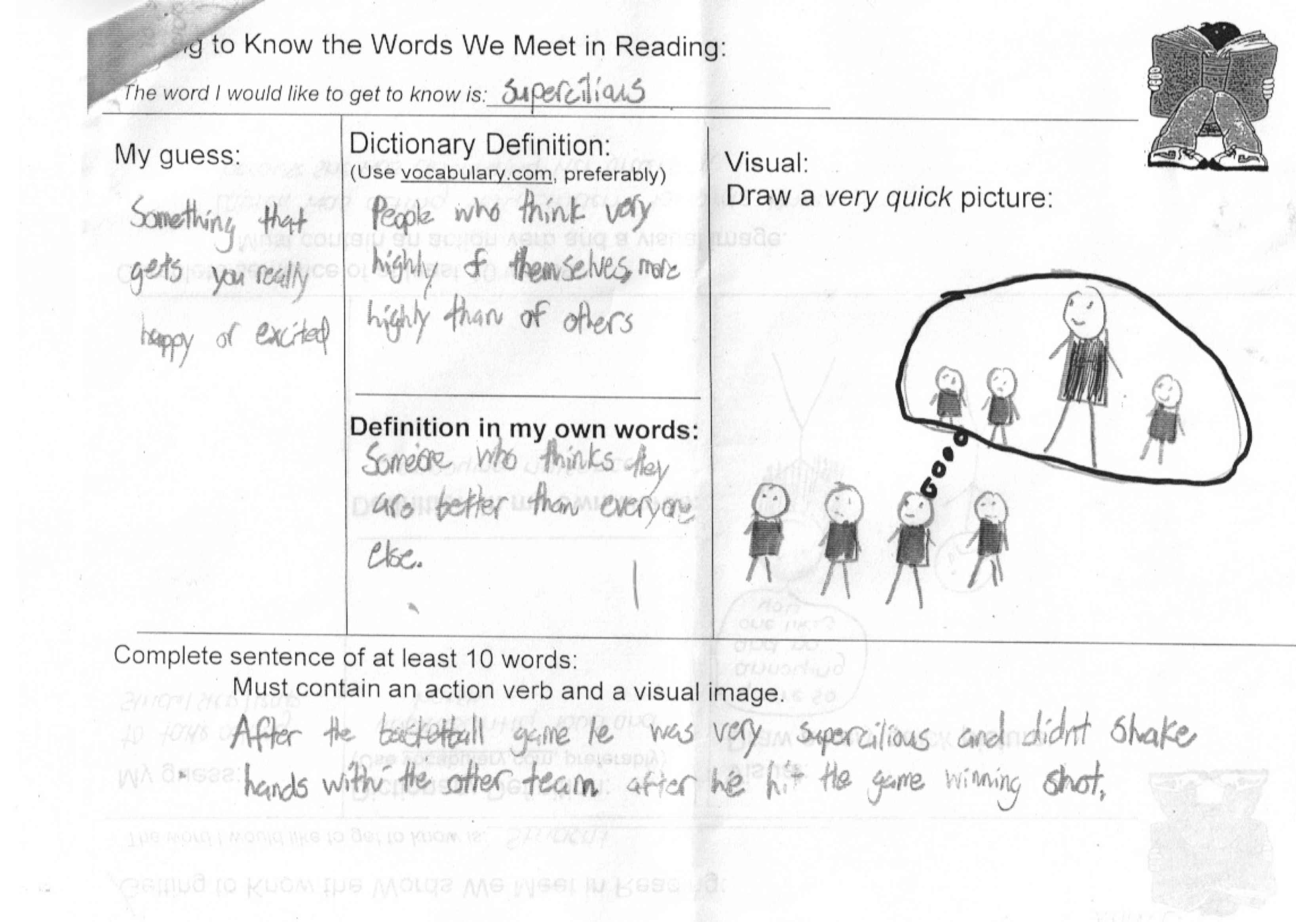

Slide 19
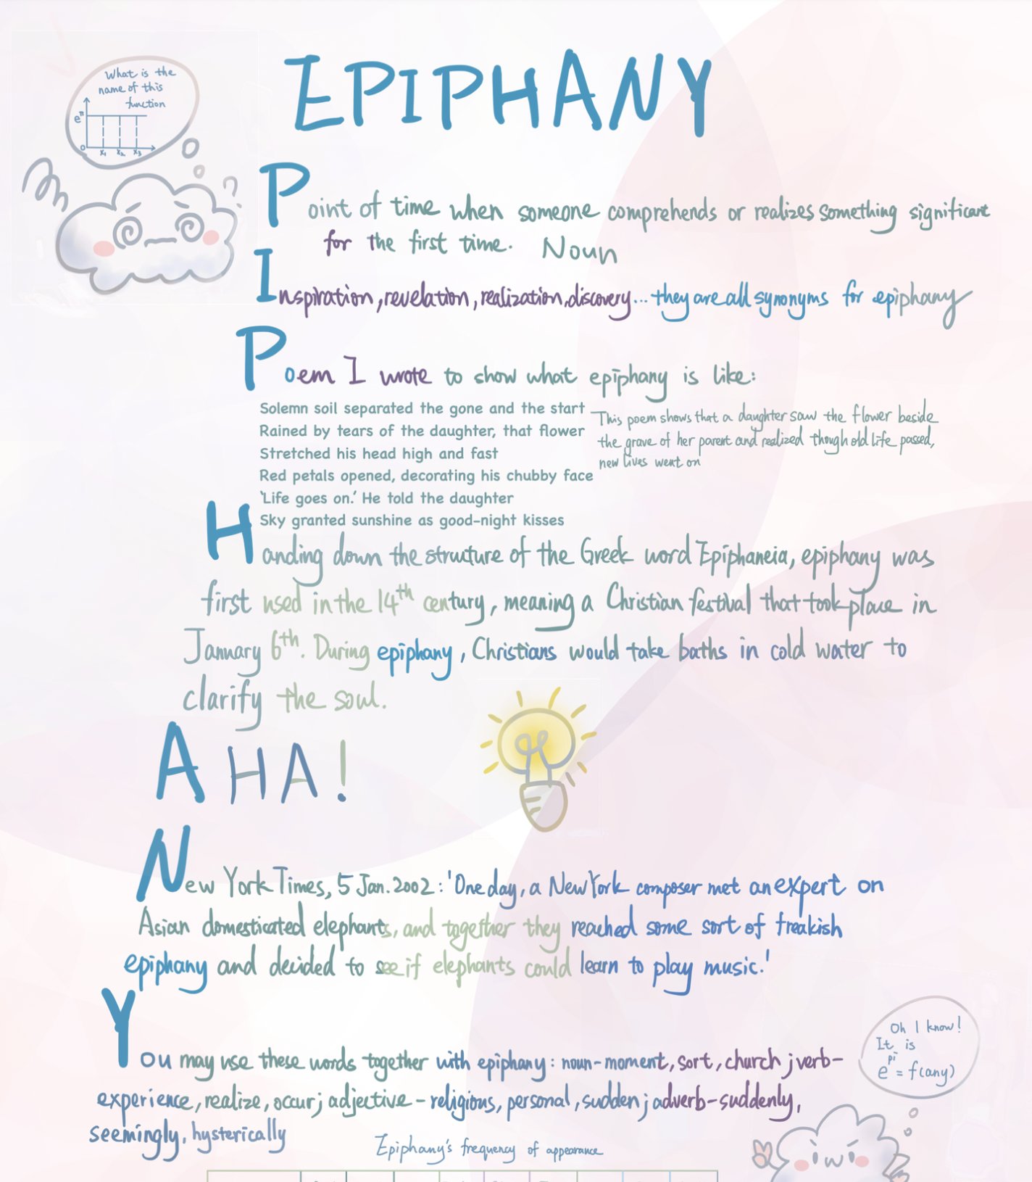
This field guide includes:
student-friendly definition
synonyms
original poem
origin
pic that represents the
concept
something you’d say
related to the concept
professional sentence
situation when you might
use the word

Slide 20
name
nominate, number,
polynomial, misnomer,
nomenclature, denomination,
denominator
Sp: nombre
bad
ignore, ignorant,
ignoramus, ignoble
ignominy
shame
disgrace
humiliation
approbation
dishonor
infamy
Senator Joseph McCarthy’s life
ended ignominiously, and his name
is forever associated with malicious
accusations that run amok in society.

Slide 22
The Academic Word List (AWL):
Background: The Academic Word List consists of 570 word families that are not in the most
frequent 2,000 words of English but which occur frequently over a very wide range of academic texts.
These 570 word families are grouped into ten subsets that reflect word frequency.
A word like analyze falls into Subset 1, which contains the most frequent words, while the word
adjacent falls into Subset 10 which includes the least frequent (among this list of high incidence words).
The AWL is not restricted to a specific field of study. That means that the words are useful for learners
studying in disciplines as varied as literature, science, health, business, and law.
This high-utility academic word list does not contain technical words likely to appear in one,
specific field of study such as amortization, petroglyph, onomatopoeia, or cartilage.
Two-thirds of all academic English derive from Latin or Greek.
Understandably, knowledge of the most high-incidence academic words in English can significantly
boost a student’s comprehension level of school-based reading material. Students who are taught
these high-utility academic words and routinely placed in contexts requiring their usage are likely
to be able to master academic material with more confidence and efficiency, wasting less time and
energy in guessing words or consulting dictionaries than those who are only equipped with the most
basic 2000-3000 words that characterize ordinary conversation.
The following link gives you a two-page version of the list:
http://www.doe.in.gov/TitleI/pdf/Word_List_Feldman.pdf
Source: Coxhead, Averil. (2000). A new academic word list. TESOL Quarterly, 34, 213-238.

Slide 23
Academic Word List: Subset 1
analyze, approach, area, assess, assume, authority, available, benefit, concept, consist, context, constitute, contract, data, define, derive, distribute, economy, environment, establish, estimate, evident, factor, finance, formula, function, income, indicate, individual, interpret, involve, issue, labor, legal, legislate, major, method, percent, period, principle, proceed, process, policy, require, research, respond, role, section, sector, significant, similar, source, specific, structure, theory, vary
Spanish Cognates:
analizar, el área, asumir, la autoridad, el beneficio/beneficiar, concepto, consistir, contexto, constituir, datos, definir, derivar, distribuir, la economía, establecer, estimar/estimado, evidente, la función, las finanzas, la fórmula, el indice, el individuo, interpretar, envolver, laborar, legal, legislar, el método, ocurrir, el por ciento, el período, principio, proceder, el proceso, requerir, responder, rol, sección, sector, significativo/significante, específica, estructura, la teoría, variar

Slide 24
Academic Word List: Subset 1
analyze, approach, area, assess, assume, authority, available, benefit, concept, consist, context, constitute, contract, data, define, derive, distribute, economy, environment, establish, estimate, evident, factor, finance, formula, function, income, indicate, individual, interpret, involve, issue, labor, legal, legislate, major, method, percent, period, principle, proceed, process, policy, require, research, respond, role, section, sector, significant, similar, source, specific, structure, theory, vary
Academic Word List: Subset 3
alternative, circumstance, comment, compensate, component, consent, considerable, constant, constrain, contribute, convene, coordinate, core, corporate, correspond, criteria, deduce, demonstrate, document, dominate, emphasis, ensure, exclude, fund, framework, illustrate, immigrate, imply, initial, instance, interact, justify, layer, link, maximize, negate, outcome, philosophy, physical, proportion, publish, react, register, rely, scheme, sequence, shift, specify, sufficient, technical, technique, valid, volume
Academic Word List: Subset 2
achieve, acquire, administrate, affect, appropriate, aspect, assist, category, chapter, commission, community, complex, compute, conclude, conduct, consequence, construct, consume, credit, culture, design, distinct, equate, element, evaluate, feature, final, focus, impact, injure, institute, invest, item, journal, maintain, normal, obtain, participate, perceive, positive, potential, previous, primary, purchase, range, region, regulate, relevant, reside, resource, restrict, secure, seek, select, site, strategy, survey, tradition, transfer

Slide 25
Academic Word List: Subset 4
access, adequacy, annual, apparent, approximate, attitude, attribute, civil, code, commit, concentrate, confer, contrast, cycle, debate, despite, dimension, domestic, emerge, ethnic, grant, hence, hypothesis, implement, implicate, impose, integrate, internal, investigate, mechanism, occupy, option, output, overall, parallel, parameter, phrase, prior, principal, professional, project, promote, regime, resolve, retain, series, statistic, status, stress, subsequent, undertake
Academic Word List: Subset 5
academy, adjust, alter, amend, capacity, clause, compound, consult, decline, discrete, enable, energy, enforce, entity, equivalent, evolve, expand, expose, external, facilitate, fundamental, generate, liberal, license, logic, margin, modify, monitor, network, notion, objective, orient, perspective, precise, prime, psychology, pursue, ratio, reject, revenue, stable, style, substitute, sustain, symbol, target, transit, trend, version, welfare, whereas
Academic Word List: Subset 6
abstract, acknowledge, accuracy, aggregate, allocate, assign, bond, capable, cite, cooperate, discriminate, display, diverse, domain, edit, enhance, estate, exceed, explicit, federal, fee, flexible, furthermore, gender, incentive, incorporate, incidence, index, inhibit, initiate, input, interval, mitigate, minimum, ministry, motive, neutral, nevertheless, overseas, precede, presume, rational, recover, reveal, scope, subsidy, trace, transform, underlie, utilize

Slide 26
Academic Word List: Subset 7
adapt, advocate, channel, classic, comprehensive, comprise, confirm, contrary, convert, decade, deny, differentiate, dispose, dynamic, equip, eliminate, empirical, extract finite, foundation, gradient, guarantee, hierarchy, identical, ideology, infer, innovate, insert, intervene, isolate, media, mode, paradigm, phenomenon, priority, prohibit, publication, quote, release, reverse, simulate, sole, somewhat, submit, successor, thesis, transmit, ultimate, unique, voluntary
Academic Word List: Subset 8
abandon, accompany, accumulate, ambiguous, appendix, appreciate, arbitrary, automate, bias, chart, clarify, commodity, complement, conform, contemporary, contradict, crucial, currency, denote, detect, deviate, displace, eventual, exhibit, exploit, fluctuate, guideline, implicit, induce, inevitable, infrastructure, inspect, intense, manipulate, minimize, nuclear, offset, predominant, prospect, radical, reinforce, restore, revise, tension, terminate, theme, thereby, uniform, vehicle, via, virtual, widespread
Academic Word List: Subset 9
accommodate, analogy, anticipate, assure, attain, behalf, cease, coherent, coincide, commence, compatible, concurrent, confine, controversy, converse, device, devote diminish, distort, duration, erode, ethic, found, format, inherent, insight, integral, intermediate, manual, mature, mediate, medium, military, minimal, mutual, norm, overlap, passive, portion, preliminary, protocol, qualitative, refine, restrain, revolution, rigid, route, scenario, sphere, subordinate, supplement, suspend, trigger, unify, violate
Academic Word List: Subset 10
adjacent, albeit, assemble, collapse, colleague, compile, conceive, convince, depress, encounter, forthcoming, incline, integrity, intrinsic, invoke, levy, likewise, nonetheless, notwithstanding, ongoing, panel, persist, pose, reluctance, so-called, straightforward, undergo, whereby

Slide 28
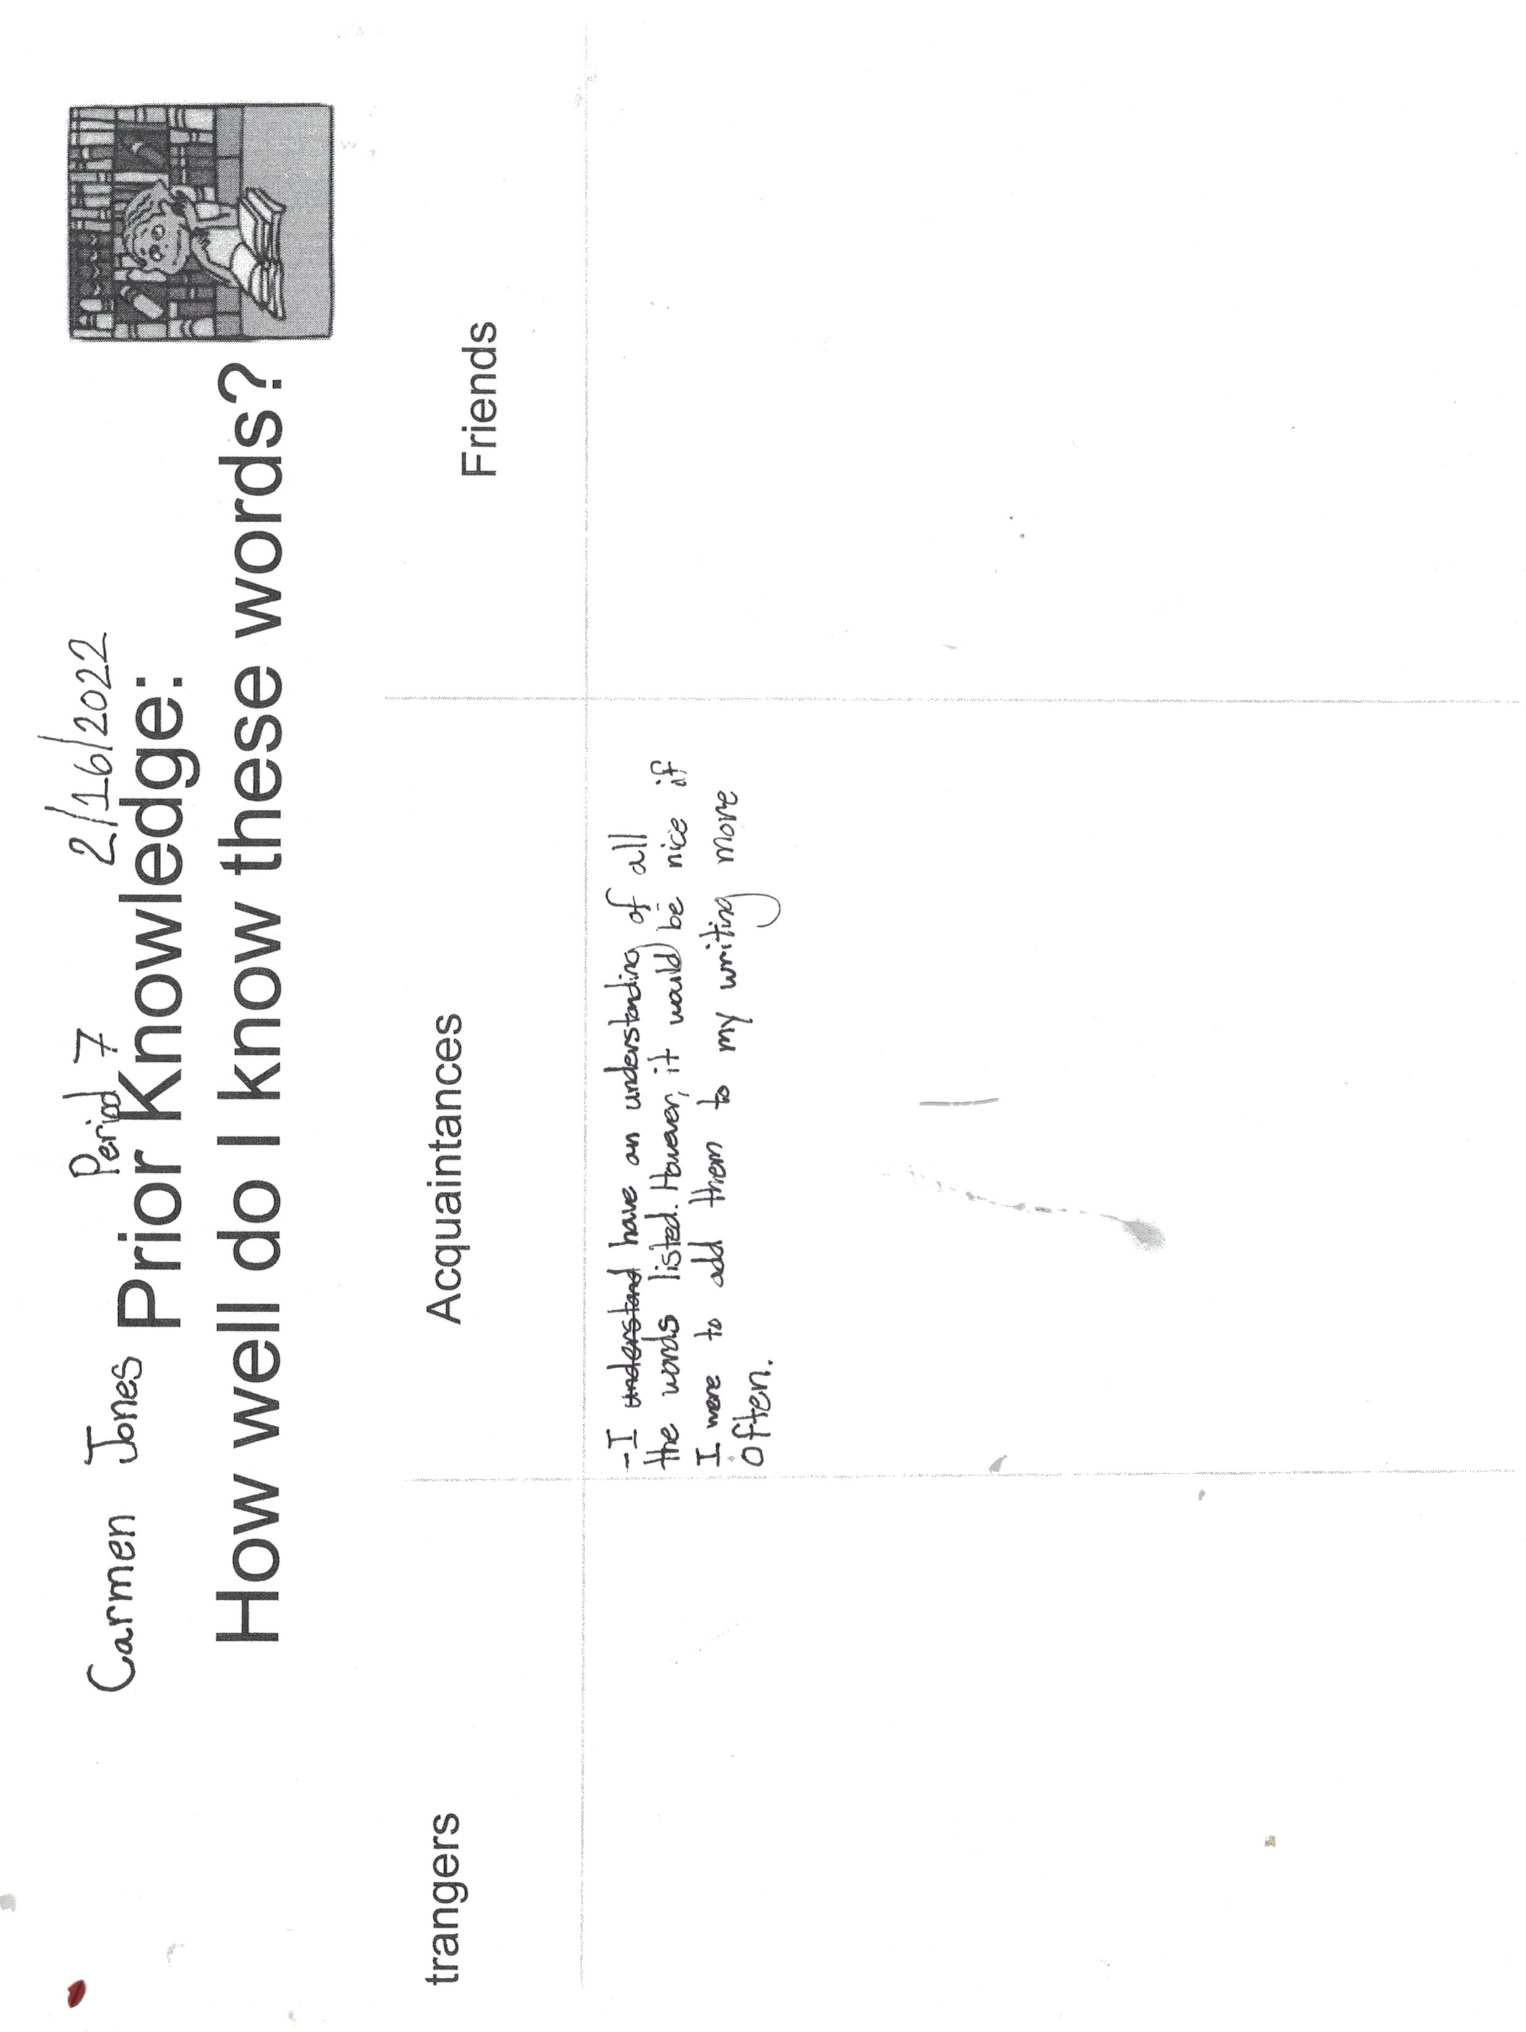

Slide 30
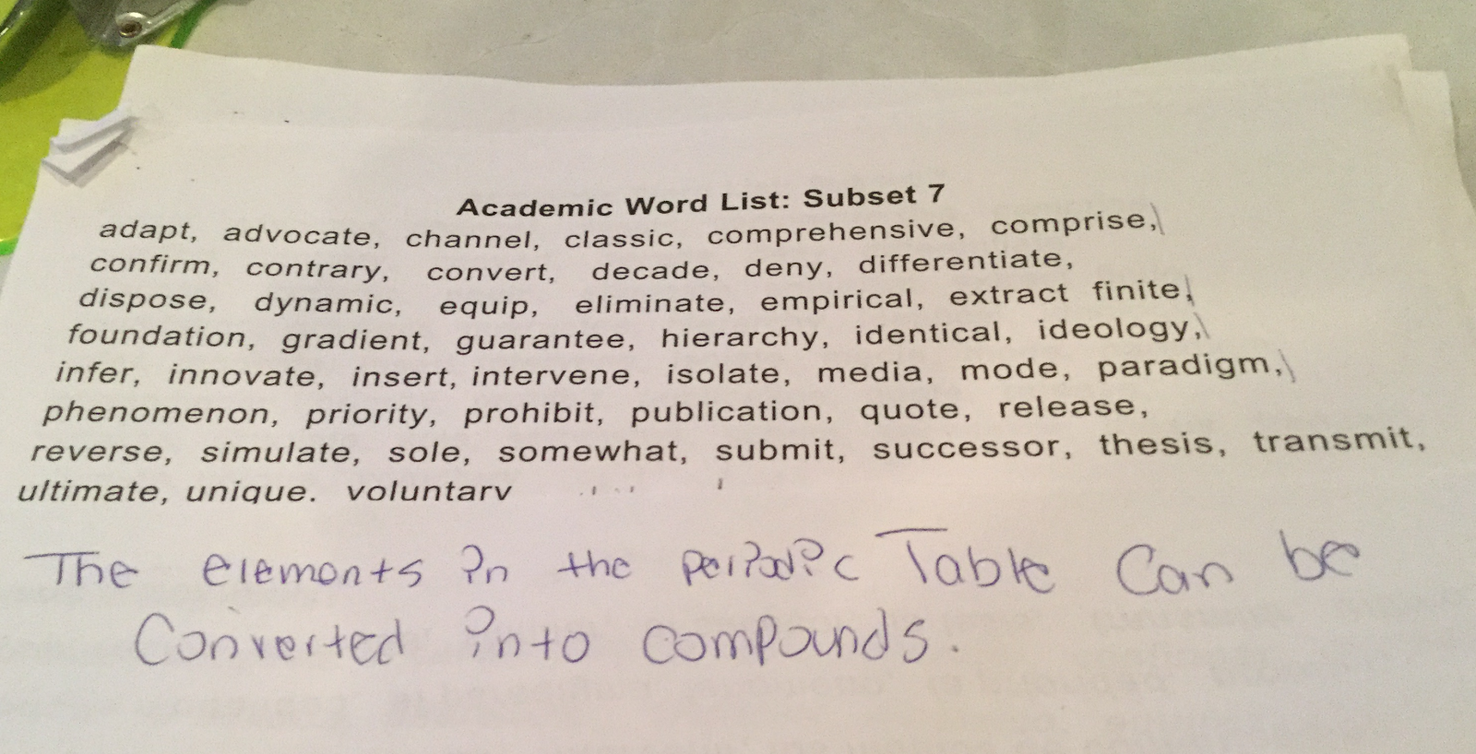

Slide 31
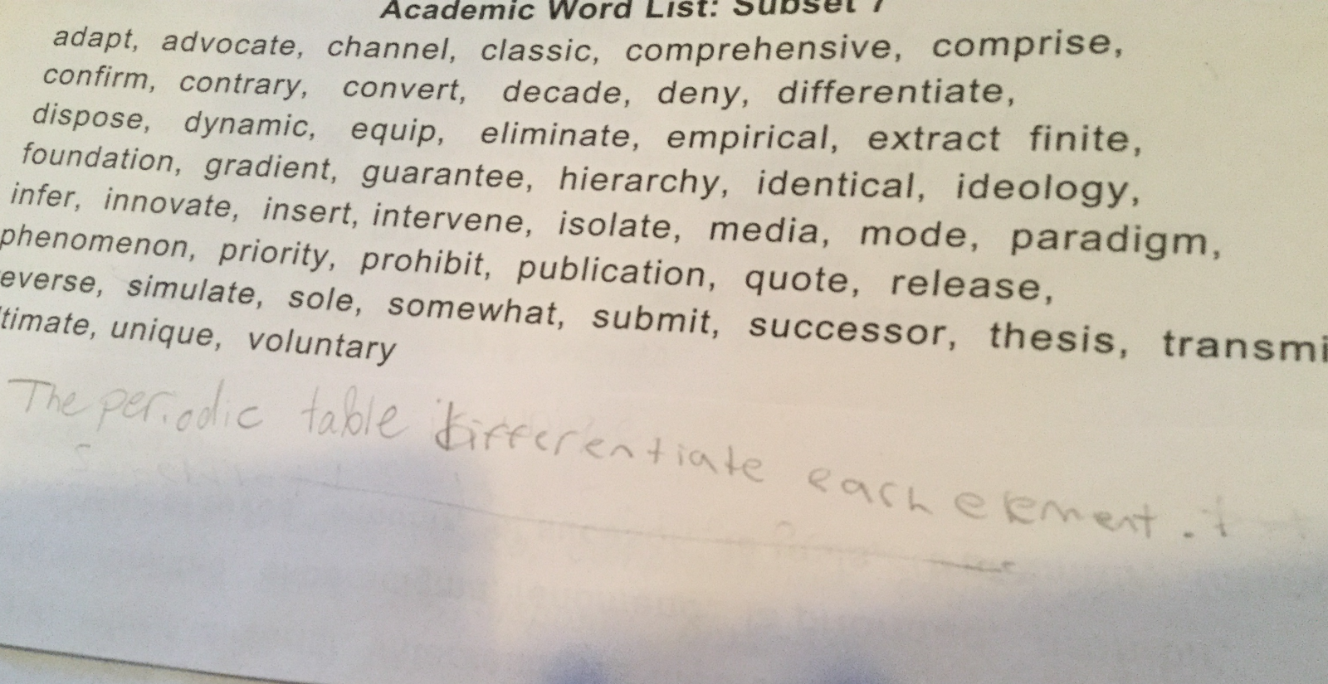

Slide 32
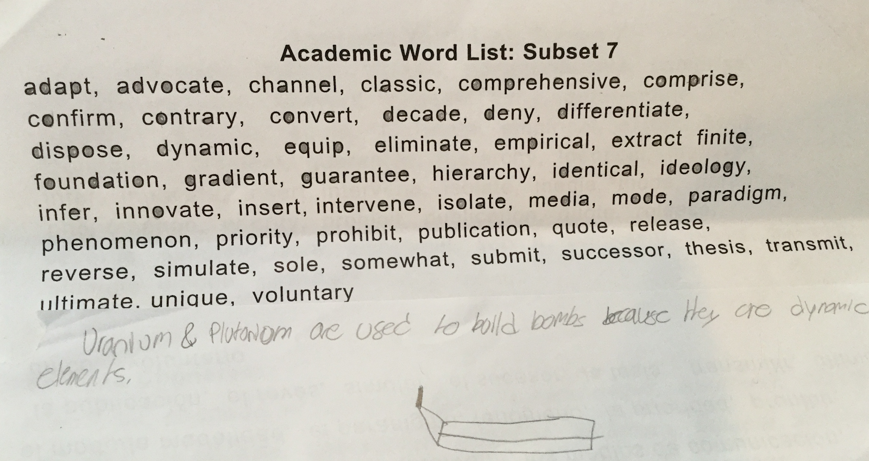

Slide 33
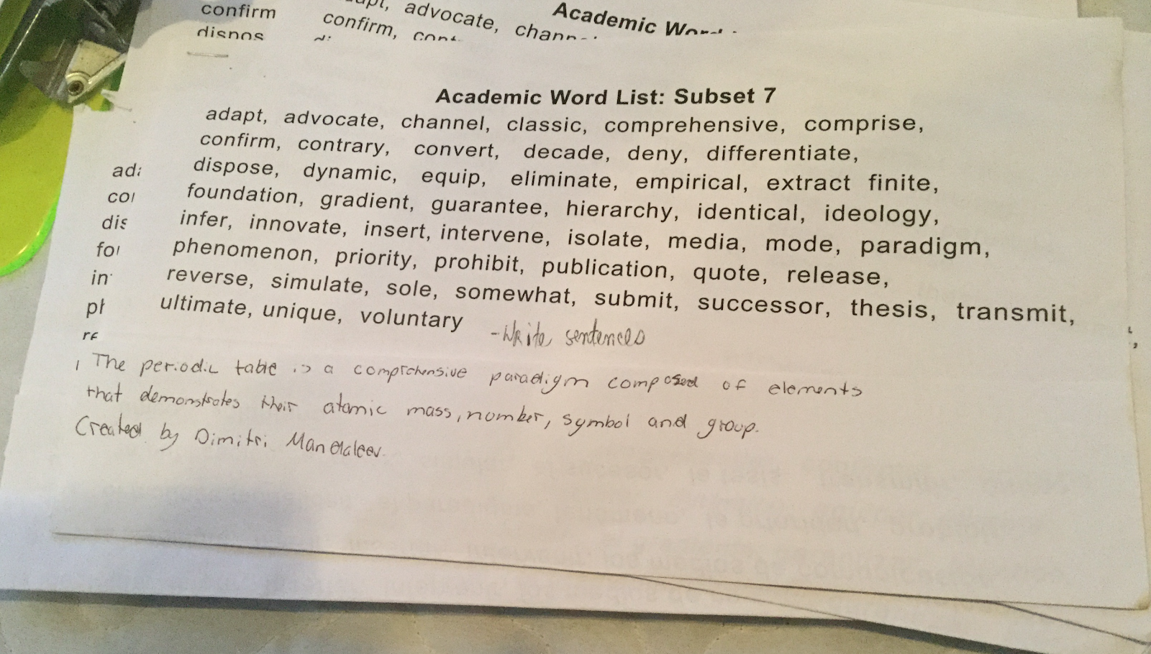

Slide 34
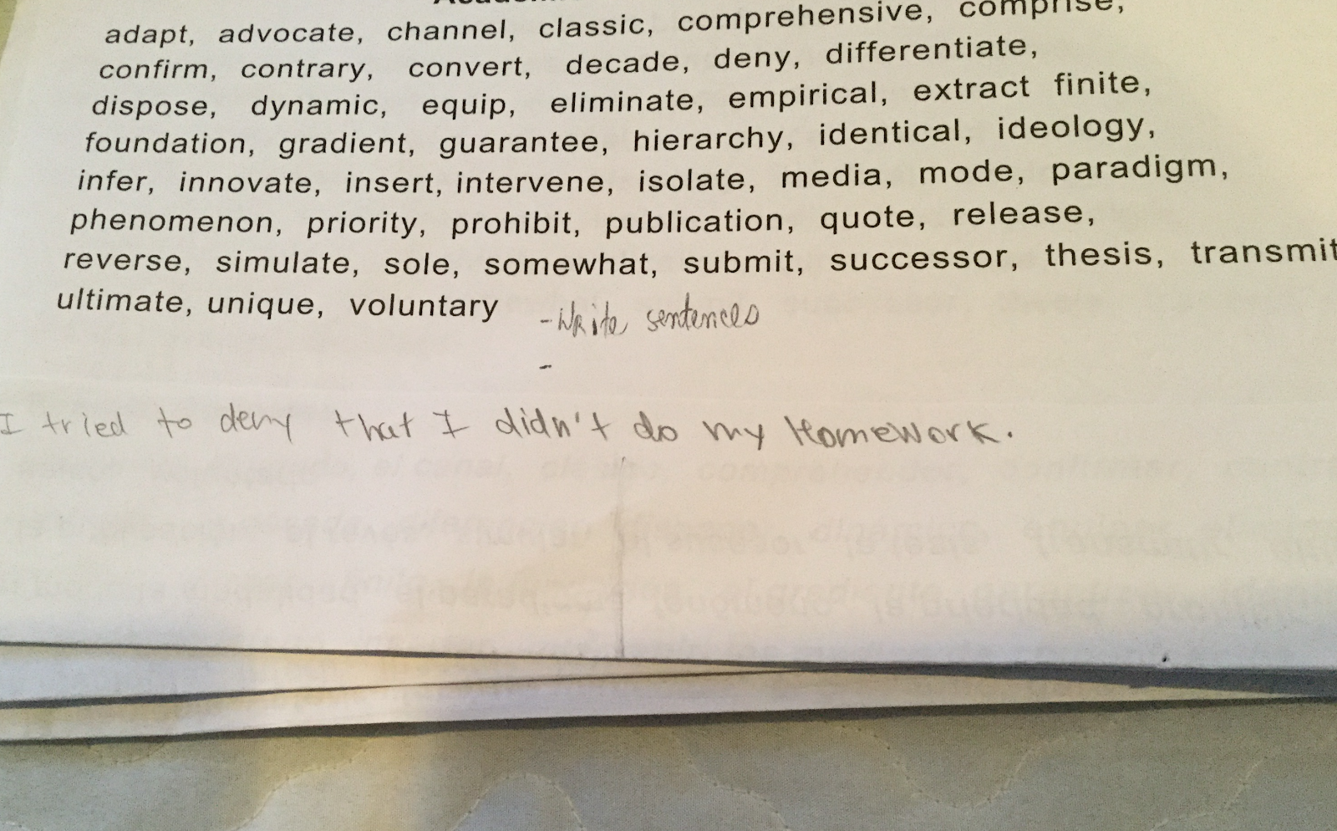
10:00

Slide 35
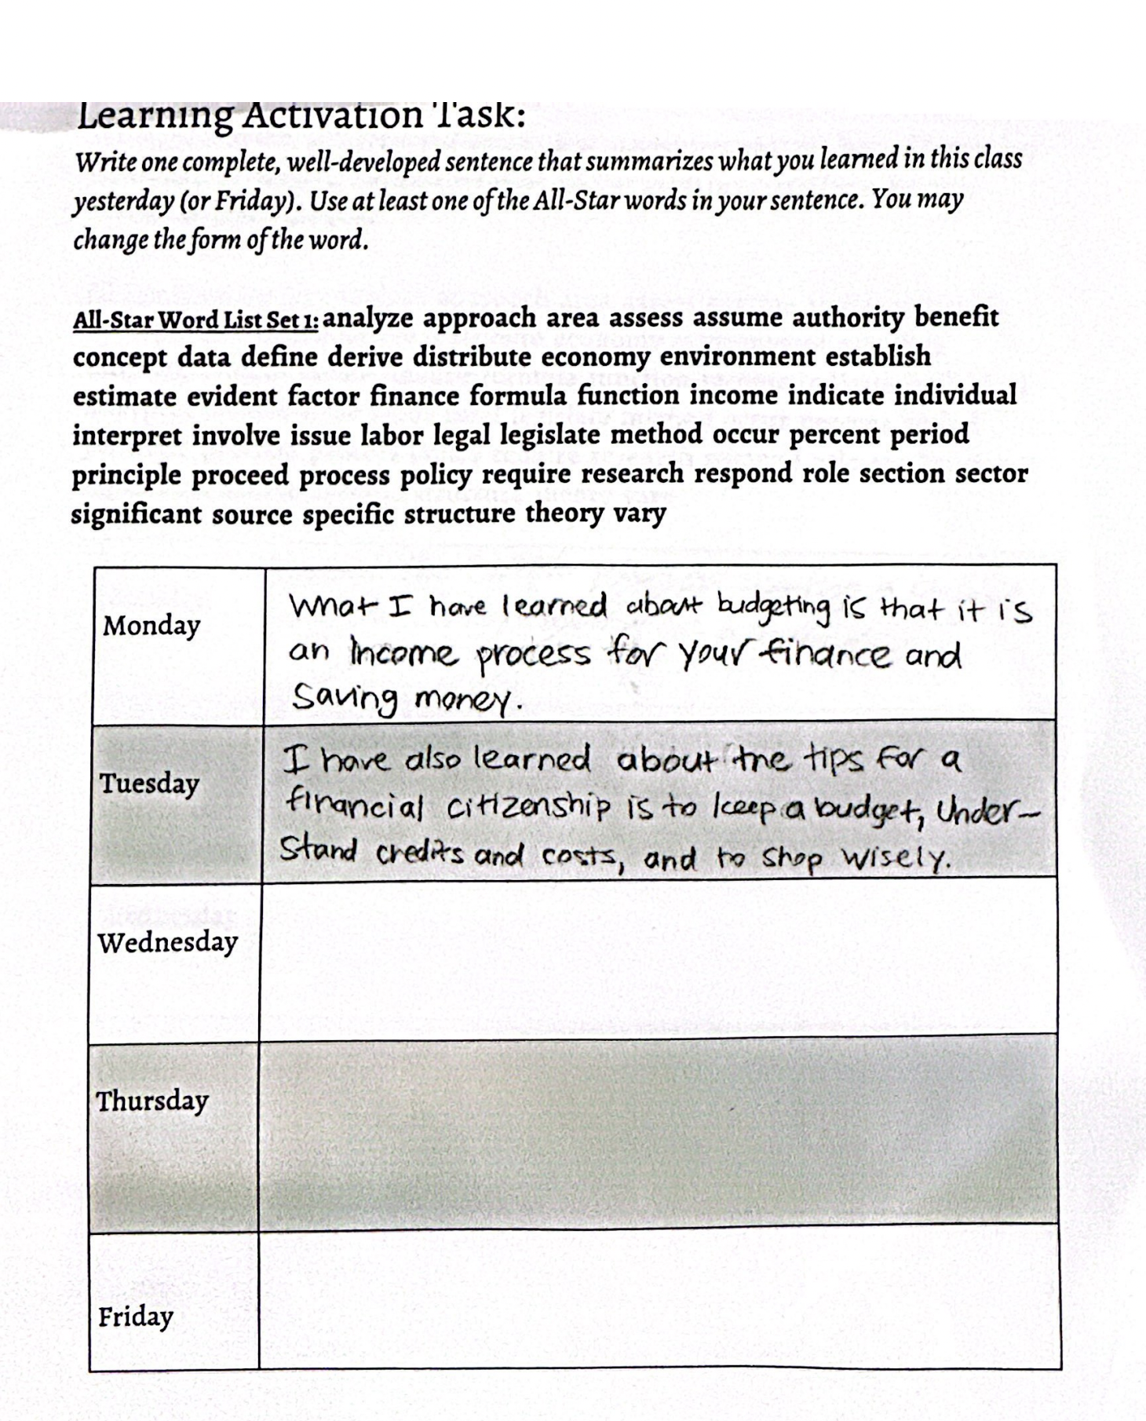
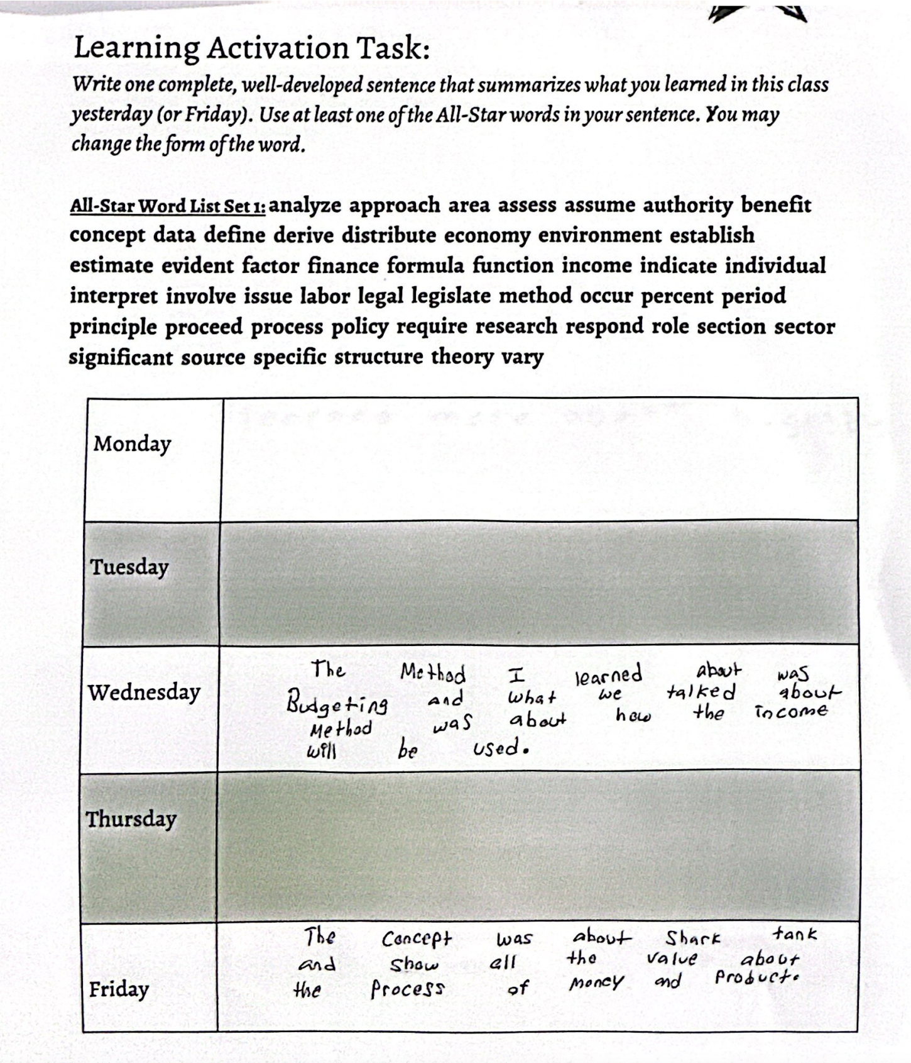

Slide 36
Core Strategies for English Language Learners (and everyone else)
Develop academic
vocabulary with the
All-Stars List:
Provide
comprehensible
input
Provide opportunities
for meaningful use of
English.
Ensure a
low affective filter
Front-load
vocabulary prior
to a read-aloud
Implementation:
Use selected words from
the list naturally, in the
course of speaking to the
children. Repeat the words
as much as possible, in
various contexts and forms.
Implementation:
Provide sufficient and
helpful visuals, including
gestures, facial expressions,
expressive voice, slow
speech.
Toggle between the new
word and a familiar
definition of it.
Implementation:
Frequent turn-and-talks
with clear prompts. Model
turn-and-talks (I do it,
we do it, you do it)
Implementation:
Be a “warm demander”;
Prevent stress and
anxiety by using positive
classroom management
techniques; have a
consistent attitude of
friendliness, enthusiasm,
and patience
Implementation:
Select 3-5 key words
that will appear in the
text. Teach these words
using visuals. Present
the concept before naming
the word. (You: “There’s a
name for this.”
Students: “We call it…”
You: (show and say the word)
Spanish Cognates
Implementation:
Where possible, point
out the Spanish sound-
alike (cognate).
Amy Benjamin Educational Services, Inc. 2023

Slide 37
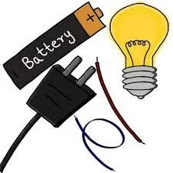
Morphology Chart
electricity
NOUNS: They will fit into this frame: The_____. | VERBS: They will fit into this frame: To____ or Can____or Is____ing | ADJECTIVES: They will fit into this frame: The ________truck | ADVERBS: They will fit into this frame: Do it ___________.
electricity electrician, s | electrify electrifies electrified electrifying | electrical | electrically
Nouns answer the question: What? or Who?
Verbs answer the question: What is it doing, having, feeling, or being?
Adjectives answer the question: What kind? (They may also answer the questions Which one? and
How many? but those kinds of adjectives do not fit into
the frame of The______truck.
Adverbs answer any of these questions: Where? When? Why? To what extent? How?

Slide 38
Morphology Chart
neutral
NOUNS: They will fit into this frame: The_____. | VERBS: They will fit into this frame: To____ or Can____or Is____ing | ADJECTIVES: They will fit into this frame: The ________truck | ADVERBS: They will fit into this frame: Do it ___________.
neutrality neutralizer | neutralize neutralizes neutralized neutralizing | neutral | neutrally
Nouns answer the question: What? or Who?
Verbs answer the question: What is it doing, having, feeling, or being?
Adjectives answer the question: What kind? (They may also answer the questions Which one? and
How many? but those kinds of adjectives do not fit into
the frame of The______truck.
Adverbs answer any of these questions: Where? When? Why? To what extent? How?

Slide 39
Morphology Chart
accurate
NOUNS: They will fit into this frame: The_____. | VERBS: They will fit into this frame: To____ or Can____or Is____ing | ADJECTIVES: They will fit into this frame: The ________truck | ADVERBS: They will fit into this frame: Do it ___________.
 |  | accurate inaccurate | accurately inaccurately
accuracy
inaccuracy,
inaccuracies
Nouns answer the question: What? or Who?
Verbs answer the question: What is it doing, having, feeling, or being?
Adjectives answer the question: What kind? (They may also answer the questions Which one? and
How many? but those kinds of adjectives do not fit into
the frame of The______truck.
Adverbs answer any of these questions: Where? When? Why? To what extent? How?

Slide 40
Morphology Kit
This “Morphology Kit”
is a great way to
expand vocabulary
because most
of the words
created by
these suffixes
express abstract
ideas.
Noun-Making Suffixes | Verb-Making Suffixes | Adjective-making suffixes
-ment -ness -ation, sion -ity -ism -hood -itude -ence -ance -ide | -ate -ify -ize | -acious,icious -y -ous, ious -ant -able, ible -er; est
Adverb-making suffix:
-ly
5

Slide 41
“The Real Magic of Spelling: Improving Reading and Writing”
From: American Educator, Winter, 2008-2009
Surprises
Questions
Affirmations
Words
(Hmmmm….I never knew this or thought about it
this way.)
(I already knew this, but it’s good to have
it expressed and/or
expanded on by an expert.)
(3 words in the text that I would like
to know more about.)
(I wonder about; I’m not sure about; I disagree with)

Slide 42
Etymology Illuminates Meaning

Slide 43
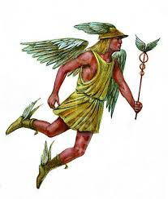
Etymology Illuminates Meaning
mercantilism
merchant
market
commerce
commercial
mercenary
merchandise
Mercury:
Roman god of financial gain

Slide 44
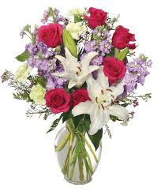
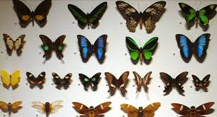
Etymology Illuminates Meaning
anthos (flower)
logein (collection)
anthology

Slide 45
Etymology Illuminates Meaning
bureau (desk)
-cracy (power)
bureaucracy

Slide 46
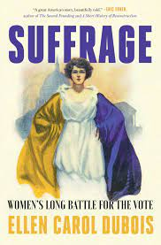
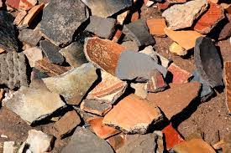
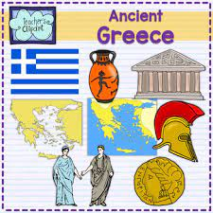
Etymology Illuminates Meaning
ballots

Slide 47
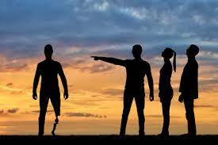
Etymology Illuminates Meaning
To banish by popular vote
ostracize
ossify
osteoporosis
osteopath
ossuary
oyster
oss-, ost- = bone

Slide 48
Etymology Illuminates Meaning
con (against)
con (together)
gress (step)
Congress
contradict
contrary
controversy
pros and cons
construct
convene
confluence
convocation
congeal
consecutive
con (to know)
progress
regressive
egress
aggressive
digress
transgress
connote
confide
concept
conscience
conscious

Slide 49
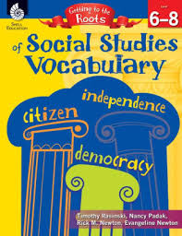

Slide 50
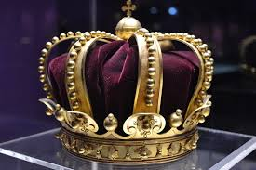
Root: arch-,-archy
Rulers and Governments
Means: first, leader, oldest
architecture, architect
archival
hierarchy, hierarchical
matriarch, matriarchy
monarch, monarchy
oligarch, oligarchy
patriarch, patriarchy
anarchy, anarchist
archaeology, archaeologist
archaic, archaism
archangel
archbishop
archduke
archenemy

Slide 51
Root: -crat, -cracy
Rulers and Governments
democracy, democrat, democratic
gerontocracy
gynecocracy
kakistocracy
plutocracy, plutocrat, plutocratic
theocracy, theocrat, theocratic
aristocracy, aristocrat, aristocratic
autocracy, autocrat
bureaucracy, bureaucrat
Means: rule, ruler

Slide 52
Root: -dic, dict-
Rulers and Governments
dictum
edict
indicate, indicator, indication
indict, indictment
jurisdiction
malediction
predict, prediction, predictive
verdict
valedictorian
abdicate, abdication
addict, addiction, addictive
benediction
contradict, contradiction, contradictory
dedicate, dedication
dictate
dictator, dictatorial, dictatorship
diction, dictionary
Means: say, speak, tell

Slide 53
Root: -judg-,judic-
Rulers and Governments
adjudicate
injudicious
judge
judgment
judgmental
judicial, judiciary
judicious
misjudge, misjudgment
nonjudgmental
prejudge
prejudice, prejudiced, prejudicial
Means: judge, decide

Slide 54
Roots: popl-; dem(o)-
populism
populous
populate
unpopular
demagogue, demagoguery
demographics, demography
popular, populist
population, depopulation
popularity, populate
populace
epidemic
pandemic
undemocratic
Means: the people
Rulers and Governments

Slide 55
Topic IV:
Free Vocabulary Reading

Slide 56
20 paragraphs = 1 word gained
25 minutes of free reading every day = 1,000 words
per school year

Slide 58
Article: “Is Listening to a Book the Same Thing as Reading It?”
NYT: December 8, 2018
By: Daniel T. Willingham, psychologist at the University of Virginia and author of
“Outsmart Your Brain: Why Learning is Hard and How You Can Make It Easy”
Surprises
Questions
Affirmations
Words
(Hmmmm….I never knew this or thought about it
this way.)
(I already knew this, but it’s good to have
it expressed and/or
expanded on by an expert.)
(3 words in the text that I would like
to know more about.)
(I wonder about; I’m not sure about; I disagree with)

Slide 59
Topic V:
Textbook Reading and Studying

Slide 60
Comprehend in Layers

Slide 61
Information is constructed incrementally, not all at once.
Then, as you read the chapter itself,
the information will have something
to stick to.
Note the end-of-chapter questions
Read the end-of-chapter summary
Read the headings; note special (glossary) terms
Picture-Walk through the chapter: Read
the captions

Slide 62
Information is constructed incrementally, not all at once.
Then, as you read the chapter itself,
the information will have something
to stick to.
Note the end-of-chapter questions
Read the end-of-chapter summary
Read the headings; note special (glossary) terms
?

Slide 63
Information is constructed incrementally, not all at once.
Then, as you read the chapter itself,
the information will have something
to stick to.
Note the end-of-chapter questions
Read the end-of-chapter summary
?
Picture-Walk through the chapter: Read
the captions

Slide 64
Information is constructed incrementally, not all at once.
Then, as you read the chapter itself,
the information will have something
to stick to.
Note the end-of-chapter questions
?
Read the headings; note special (glossary) terms
Picture-Walk through the chapter: Read
the captions

Slide 65
Information is constructed incrementally, not all at once.
Then, as you read the chapter itself,
the information will have something
to stick to.
?
Read the end-of-chapter summary
Read the headings; note special (glossary) terms
Picture-Walk through the chapter: Read
the captions

Slide 66
Information is constructed incrementally, not all at once.
?
Note the end-of-chapter questions
Read the end-of-chapter summary
Read the headings; note special (glossary) terms
Picture-Walk through the chapter: Read
the captions

Slide 67
Article: “There Are Better Ways to Study That Will Last You a Lifetime”
NYT: April 20, 2023
By: Daniel T. Willingham, psychologist at the University of Virginia and author of
“Outsmart Your Brain: Why Learning is Hard and How You Can Make It Easy”
Surprises
Questions
Affirmations
Words
(Hmmmm….I never knew this or thought about it
this way.)
(I already knew this, but it’s good to have
it expressed and/or
expanded on by an expert.)
(3 words in the text that I would like
to know more about.)
(I wonder about; I’m not sure about; I disagree with)

Slide 68
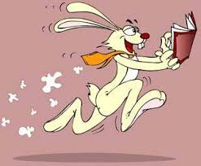
“How To Read Faster”
NYT March 20, 2020
By Malia Wollon
Surprises
Questions
Affirmations
Words
(Hmmmm….I never knew this or thought about it
this way.)
(I already knew this, but it’s good to have
it expressed and/or
expanded on by an expert.)
(3 words in the text that I would like
to know more about.)
(I wonder about; I’m not sure about; I disagree with)

Slide 69
Surprises
Questions
Affirmations
Words
(Hmmmm….I never knew this or thought about it
this way.)
(I already knew this, but it’s good to have
it expressed and/or
expanded on by an expert.)
(3 words in the text that I would like
to know more about.)
(I wonder about; I’m not sure about; I disagree with)

Slide 70
Topic VI:
Chat GPT as a Reading Assistant

Slide 71
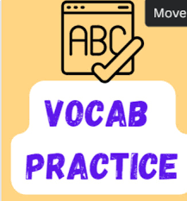

Slide 72
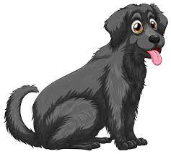
Prompt 1 (ELA): Write a sweet story of no more than 150 words about a big black dog
and a rubber duckie. Integrate any two of the following words,
changing their form to fit the context: potential, obtain, sequence,
valid, regulate, ensure. Boldface any words that a seventh grader
might not know.
In a quaint town, a big black dog named Shadow discovered an extraordinary
sequence of events. One day, he found a mysterious package containing a vibrant
yellow rubber duckie. Intrigued, Shadow sensed the potential for a remarkable
friendship. The duo embarked on adventures, from rolling down grassy hills to
splashing in puddles. However, the rubber duckie's erratic behavior posed
a challenge. Determined to regulate their play, Shadow struggled to ensure
the safety of their escapades.
As days passed, the dog and duck found a valid balance. Shadow's loyalty and
the rubber duckie's buoyant spirit created an unbreakable bond. They even managed
to obtain the title of the town's most beloved pair, teaching everyone that friendship
could be found in the most unexpected places.

Slide 73
Prompt 2 (ELA): Write a scary story of no more than 150 words about bubbles
and jelly beans. Integrate and boldface only these words:
subsequent, undertake, modify, mitigate. Change the form of
the words to fit the context.
One eerie night, a group of friends decided to undertake a daring adventure in the abandoned candy factory. As they entered, the air filled with an unnatural stillness.
Suddenly, mysterious bubbles emerged, floating eerily around them. The friends
hesitated but continued further, unable to resist the eerie allure.
In the subsequent silence, the group stumbled upon a room filled with oversized,
glowing jelly beans. Curiosity overwhelmed them, and they decided to taste the
glowing treats. Little did they know, each bite seemed to modify their senses, distorting reality. Shadows danced, and the once familiar factory twisted into a nightmarish
labyrinth.
Panicking, the friends tried to escape, but the jelly beans' effects only intensified.
Desperate to mitigate the nightmare, they raced through the haunted factory,
haunted by the malevolent bubbles and the spectral glow of the jelly beans.

Slide 74
Prompt 3 (ELA-ELL): Rewrite the story, using a combination of English and
Spanish words throughout.
.
En una noche tenebrosa, un grupo de amigos decided to undertake una aventura
audaz en la fábrica de dulces abandonada. Al entrar, el aire se llenó de una quietud sobrenatural. De repente, misteriosas bubbles aparecieron, flotando de manera
inquietante a su alrededor. Los amigos dudaron, pero continuaron más adelante,
incapaces de resistir la atracción escalofriante.
En el silencio subsequent, el grupo tropezó con una habitación llena de jelly beans gigantes y brillantes. La curiosidad los abrumó, y decidieron probar las golosinas luminosas. Sin saberlo, cada mordisco parecía modify sus sentidos, distorsionando la realidad. Las sombras bailaban y la fábrica, una vez familiar, se retorcía en un laberinto de pesadilla.
En medio del pánico, los amigos intentaron escapar, pero los efectos de los jelly beans solo se intensificaron. Desesperados por mitigate la pesadilla, corrieron por la fábrica embrujada, perseguidos por las burbujas malévolas y el resplandor espectral de los jelly beans.

Slide 75
Prompt 4 (ELA-ELL): More English please
.
On a spooky night, a group of amigos decided to undertake an audacious adventure in the abandoned candy factory. As they entered, the air se llenó de una quietud sobrenatural. Suddenly, mysterious bubbles appeared, floating de manera inquietante around them. The friends hesitated, but continued más adelante, unable to resist the chilling atracción.
In the subsequent silence, the group stumbled upon a room filled with oversized, glowing jelly beans. La curiosidad los abrumó, and they decided to taste the glowing treats. Little did they know, each bite seemed to modify their senses, distorting la realidad. Shadows danced, and the once familiar factory twisted into un laberinto de pesadilla.
Panicking, los amigos tried to escape, but the jelly beans' effects solo se intensificaron. Desperate to mitigate the nightmare, they raced through la fábrica embrujada, perseguidos por las burbujas malévolas and the spectral glow de los jelly beans.

Slide 76
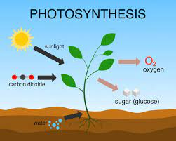
Prompt 5: (Science) Write a dialog between two seventh grade students,
Claudia and Ramon, who are trying to understand the process of photosynthesis.
They are explaining it to each other. No more than 150 words. Include and boldface
the words mechanism and cycle.
Claudia: Hey Ramon, do you get this whole photosynthesis thing?
Ramon: Not really, Claudia. It's like a mystery.
Claudia: I know, right? But I think it involves plants making their own food.
There's this cool mechanism where they use sunlight, carbon dioxide, and water.
Ramon: Sunlight? Seriously?
Claudia: Yeah! It's like a magic trick. They trap the sunlight and convert it
into energy. And, get this, they release oxygen as a byproduct.
It's like a plant superpower.

Slide 77
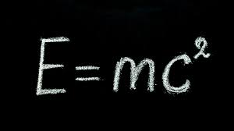
Prompt 6 (Science): Can you do the same thing about Einstein’s Theory of Relativity?
Claudia: Ramon, have you ever tried understanding Einstein's Theory of Relativity?
Ramon: Umm, that sounds like some super complicated stuff.
Claudia: Yeah, but let me break it down.
There's this mind-blowing mechanism behind it.
It's like how gravity works but on a cosmic scale.
Ramon: Gravity and space? Now you're talking alien language.

Slide 78
Claudia: Okay, imagine space and time are woven together like a fabric.
That's the space-time fabric. Einstein called it a warping of space-time
caused by mass. So, the heavier the object, the more it warps the
space-time around it.
Ramon: Warping space-time? I'm lost.
Claudia: Here comes the cycle part. The theory has this equation, E=mc^2.
It's like saying energy and mass are interchangeable.
Mass can be turned into energy and vice versa.
It's like unlocking the secrets of the universe.
Ramon: That's deep. I'll need some time to let this sink in.
Claudia: No rush, Ramon. Einstein's Theory of Relativity is like a cosmic puzzle,
and we're just trying to put the pieces together.

Slide 79
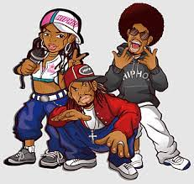
Prompt 7 (Social Studies):
Write a rap (old school hip hop style) that explains how and why the system of checks and balances
functions in the U.S. Constitution. Not more than 150 words. Integrate and boldface the words
allocate, initiate, perspective, and sustain. You may change the form of these words to it into the context.
Yo, listen up, America, gather 'round,
I'ma break down the Constitution sound by sound.
Checks and balances, the name of the game,
Keeps power in check, prevents political flame.
(Chorus)
Separation of powers, that's the key,
Legislative, Executive, Judiciary, you see.
Each branch with a role, none above the rest,
A dance of control, the founders' request.
(Verse 2)
Congress makes laws, they hold the pen,
But the Prez can veto, say "try again."
Judges in the courts, interpreting the law,
Balancing the scales, making sure it's raw.
(Chorus)
Separation of powers, a rhythm so tight,
No one branch overpowering in the fight.
Checks and balances, the Constitution's song,
In the land of the free, where liberty belongs.

Slide 80
Prompt 7 (Social Studies):
Write a rap (Nas style) that explains how and why the system of checks and balances
functions in the U.S. Constitution. Not more than 150 words. Integrate these words:
allocate, transform, debate, initiate, enforce, stable, sustain, regime, compile.
You may change the form of these words to it into the context.
Checks and balances, Nas style, that's how it goes.
Allocate the power, in the Constitution's vibe,
Transform the debate, where justice will thrive.
(Chorus)
Separation of powers, in the street's embrace,
Legislative, Executive, Judiciary, in their space.
Initiate the rhythm, where the struggle's enabled,
Enforce the stability, in a system so stable.
Verse 2:
Congress laying laws, like verses so bold,
Prez with the veto, in the stories told.
Judges in the courts, with a legal debate,
Balancing the game, keeping the nation straight.
(Chorus)
Separation of powers, sustaining the dream,
No branch too heavy, in this Nasregime.
Checks and balances, in the streets so wild,
In the USA, where the energy's compiled.

Slide 81
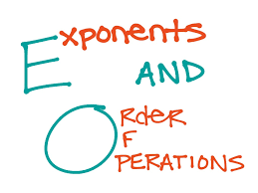
Prompt 8 (Math):
My eighth grade math students are learning how to apply the properties of integer exponents to generate equivalent numerical expressions. Put this concept in simple, everyday language. Not more than 100 words.
Imagine numbers are superheroes, and exponents are their superpowers.
When multiplying superheroes with the same power, add their strengths.
Dividing? Subtract the powers. Now, these superhero numbers can team up,
making equivalent expressions. Integer exponents are like the special codes
that unleash their super abilities.
Simple, right? It's like arithmetic with a supercharged twist!
Prompt 9: They still don’t understand. Can you make this a little longer to explain it more clearly?
We can go up to 150 words.

Slide 82
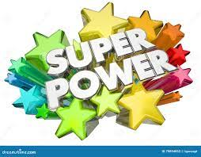
Prompt 9: They still don’t understand. Can you make this a little longer to explain it more clearly?
We can go up to 150 words.
Sure thing! Imagine numbers as superheroes, each with a unique power.
Exponents are like their super-levels. When you multiply superheroes
with the same power, you add their strengths – simple teamwork.
When dividing, subtract their powers. Now, these superhero numbers
can team up, creating different but equivalent expressions.
Integer exponents act as the special codes that unleash their super abilities.
For instance, if you have 2³ (2 to the power of 3) multiplied by 2²,
you add the powers since the base is the same.
So, 2³ * 2² is like saying 2^(3+2) which equals 2^5.
It's just a way to express the same superhero team,
but with a different formation. Integer exponents make
arithmetic more powerful – think of it as math with a superhero twist!

Slide 83
Prompt 10: Write the lyrics to a song that sounds like Taylor Swift wrote it. Not more than 150 words.
Include Include several of these words: analyze, approach, area, assess, assume, authority,
available, benefit, concept, consist, context, constitute, contract, data, define, derive, distribute, economy, environment, establish,estimate, evident, factor, finance, formula, function, income, indicate, individual, interpret, involve, issue, labor,
legal, legislate, major, method, occur, percent, period, principle, proceed, process, policy, require, research, respond, role,
section, sector, significant, similar, source, specific, structure, theory, vary. Change the form of these words to fit the context.
In this economic dance, we're spinning 'round,
Analyze the heartbeat of this ghost town.
Factor in the nights, subtract the tears,
Define the love we've had throughout the years.
(Pre-Chorus)
(Pre-Chorus melody: Building anticipation)
Establish a formula for you and me,
Assume the best, it's how it should be.
Legislate our love, a legal decree,
In the sector of us, where hearts roam free.
(Chorus)
(Chorus melody: Uplifting and anthemic)
Interpret the signs, like I would do,
In the context of love, I'm falling for you.
Respond to the rhythm, dance through the night,
Our significant love, a major delight.
(Verse 2)
(Verse melody: Sweet and melodic)
Proceed with caution, navigate the unknown,
In this area of dreams, our hearts have grown.
Estimate the joy, distribute the care,
Our love's a theory beyond compare.
(Pre-Chorus)
(Pre-Chorus melody: Building anticipation)
Research the moments, each memory,
In the structure of us, where love's the key.
Involve the laughter, in the labor of delight,
A melody of love, every day and night.
(Chorus)
(Chorus melody: Uplifting and anthemic)
Interpret the signs, like Taylor would do,
In the context of love, I'm falling for you.
Respond to the rhythm, dance through the night,
Our significant love, a major delight.

Slide 84
Prompt 10: Write the lyrics to a song that sounds like Taylor Swift wrote it. Not more than 150 words.
Include Include several of these words: analyze, approach, area, assess, assume, authority,
available, benefit, concept, consist, context, constitute, contract, data, define, derive, distribute, economy, environment, establish,estimate, evident, factor, finance, formula, function, income, indicate, individual, interpret, involve, issue, labor,
legal, legislate, major, method, occur, percent, period, principle, proceed, process, policy, require, research, respond, role,
section, sector, significant, similar, source, specific, structure, theory, vary. Change the form of these words to fit the context.
(Bridge)
(Bridge melody: Reflective and introspective)
In this period of us, where time stands still,
Evident is the love, a sweet, sweet thrill.
Consistently, we defy the odds,
Our love's a principle, against all gods.
(Chorus)
(Chorus melody: Uplifting and anthemic)
Interpret the signs, like Taylor would do,
In the context of love, I'm falling for you.
Respond to the rhythm, dance through the night,
Our significant love, a major delight.
(Outro)
(Outro melody: Sweet and reassuring)
In this love issue, where hearts intertwine,
We're the source of a love so divine.
Indicate forever, with every beat,
Our love's a function, oh, so sweet.

