Slide 1
The 7 Strategies (Mental Processes) of
Effective Reading Comprehension:
How Skillful Readers Think

Slide 2
The 7 Strategies (Mental Processes) of
Effective Reading Comprehension:
How Skillful Readers Think
1: Activate Background Knowledge
What do I already
know about this?

Slide 3
The 7 Strategies (Mental Processes) of
Effective Reading Comprehension:
How Skillful Readers Think
2: Draw inferences
I’m reading between
the lines.

Slide 4
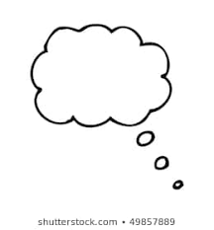
The 7 Strategies (Mental Processes) of
Effective Reading Comprehension:
How Skillful Readers Think
I should
find out what
this word means.
3: Self-Monitor
I should reread this.
I shouldn’t
try to read
when I’m tired.
I can’t concentrate
with all the noise
around me.
This might make
more sense if I
slowed down.

Slide 5
The 7 Strategies (Mental Processes) of
Effective Reading Comprehension:
How Skillful Readers Think
4: Ask questions
What the..?
Huh?
I wonder why…

Slide 6
The 7 Strategies (Mental Processes) of
Effective Reading Comprehension:
How Skillful Readers Think
5: Determine importance
This is a key point…
This is a little
side trip…

Slide 7
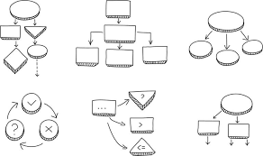
The 7 Strategies (Mental Processes) of
Effective Reading Comprehension:
How Skillful Readers Think
6: Visualize/Organize

Slide 8
The 7 Strategies (Mental Processes) of
Effective Reading Comprehension:
How Skillful Readers Think
7: Summarize

Slide 9
The 7 Strategies (Mental Processes) of
Effective Reading Comprehension:
How Skillful Readers Think
euvzailis /ageionzr

Slide 10
The 7 Strategies (Mental Processes) of
Effective Reading Comprehension:
How Skillful Readers Think
sak tqssioeun
What the..?
Huh?
I wonder why…

Slide 11
The 7 Strategies (Mental Processes) of
Effective Reading Comprehension:
How Skillful Readers Think
Icvtteaa dbnaucokrg wgeeoklnd
What do I already
know about this?

Slide 12
The 7 Strategies (Mental Processes) of
Effective Reading Comprehension:
How Skillful Readers Think
ward sieeefnnrc
I’m reading between
the lines.

Slide 13
The 7 Strategies (Mental Processes) of
Effective Reading Comprehension:
How Skillful Readers Think
zmusmaeir

Slide 14
The 7 Strategies (Mental Processes) of
Effective Reading Comprehension:
How Skillful Readers Think
eeeemdtmin ocmapniert
This is a key point…
This is a little
side trip…

Slide 15
The 7 Strategies (Mental Processes) of
Effective Reading Comprehension:
How Skillful Readers Think
I should
find out what
this word means.
esfl-trominom
I should reread this.
I shouldn’t
try to read
when I’m tired.
I can’t concentrate
with all the noise
around me.
This might make
more sense if I
slowed down.

