Slide 1
I. Tone-setting
II. Stages of Second Language Acquisition
III. Your Homework
IV. Two Kinds of English
V. All-Star List of Academic Words with Spanish Cognates
VI. Cognates, Cognates, Cognates
VII. Contrastive Analysis: English and Spanish
VIII. Double Objective: Content and Language (SIOP)

Slide 2
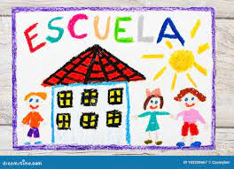
“But I Don’t Speak Spanish”
Workshop: How we can help our Spanish-speaking
students (even if we don’t speak Spanish….mucho.)
Presenter: Amy Benjamin
www.amybenjamin.com

Slide 3
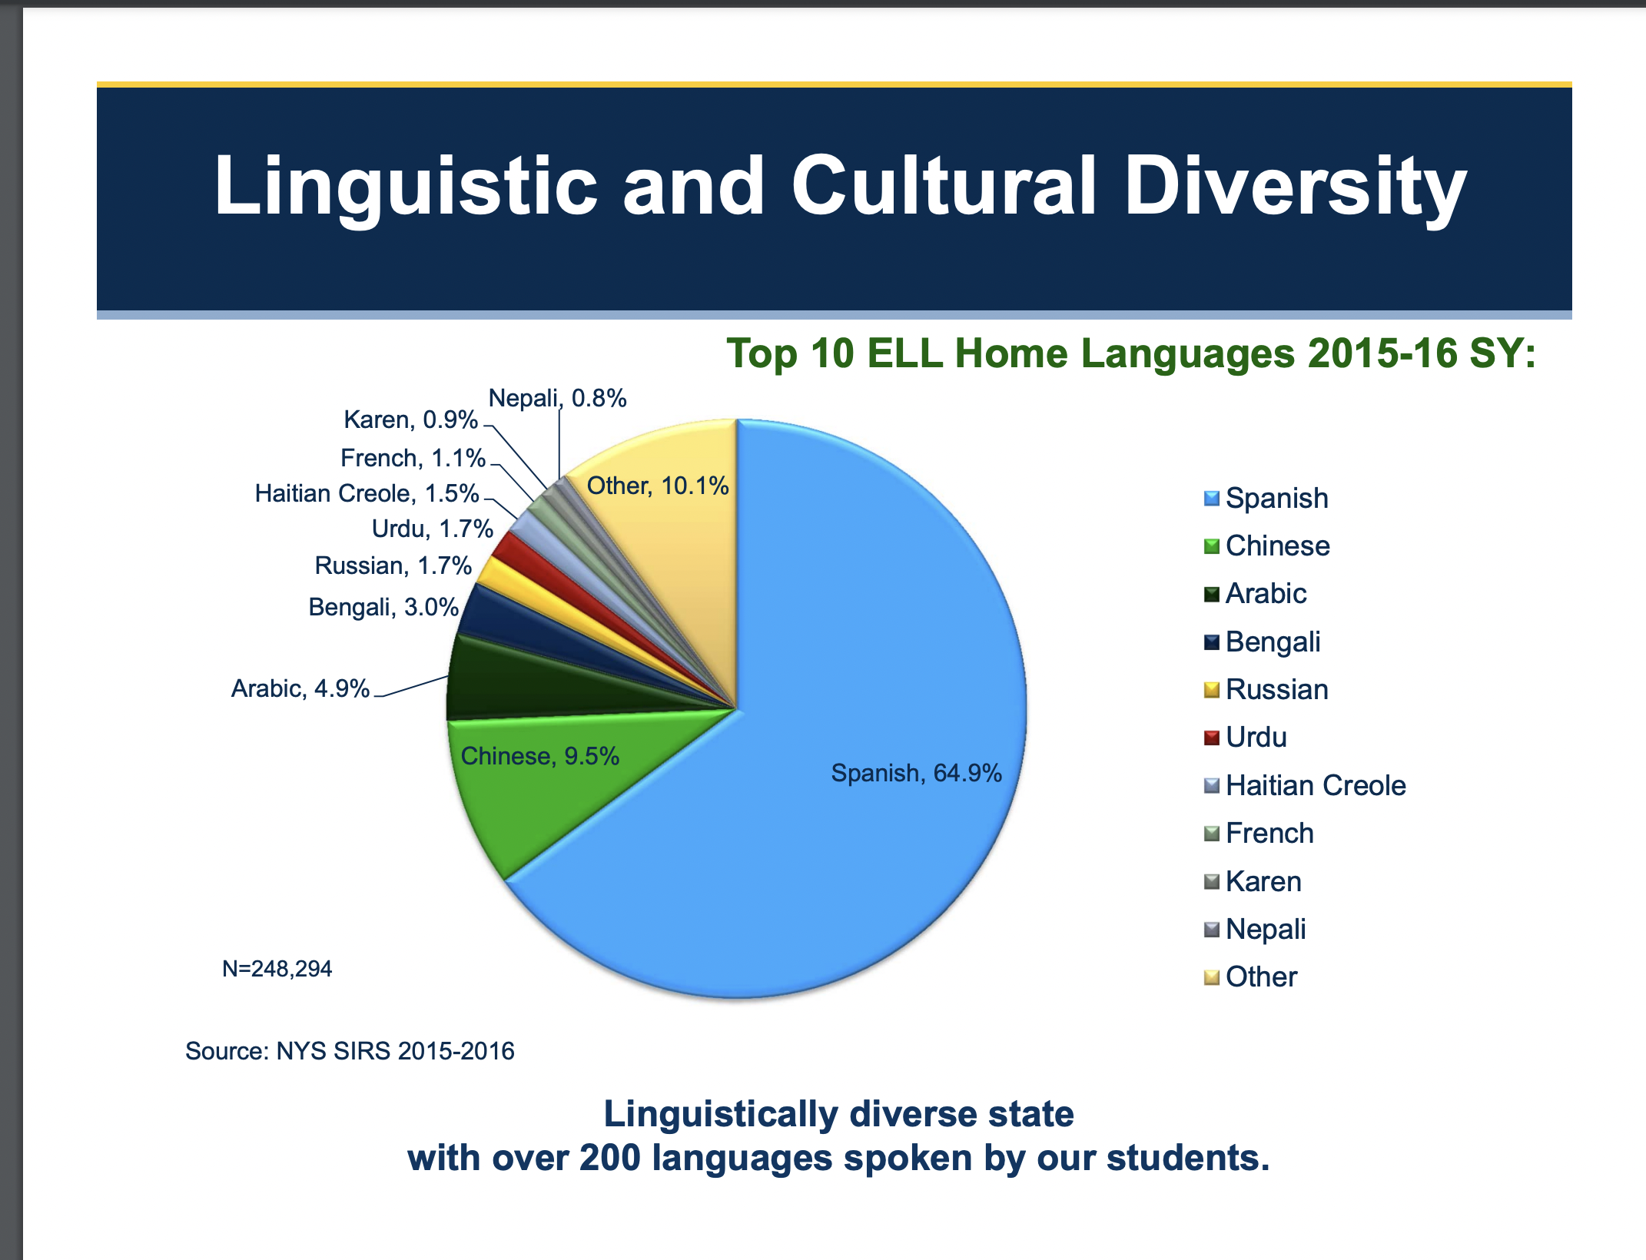

Slide 4
I. Tone-setting
II. Stages of Second Language Acquisition
III. Your Homework
IV. Two Kinds of English
V. All-Star List of Academic Words with Spanish Cognates
VI. Cognates, Cognates, Cognates
VII. Contrastive Analysis: English and Spanish
VIII. Double Objective: Content and Language (SIOP)

Slide 5
Setting a Welcoming Tone for Spanish-Speakers

Slide 6
What practices and materials in your library send a welcoming
message to Spanish-speakers?
Extensively
Occasionally
Rarely
Never
The collection includes
books in Spanish,
Spanish-English, and
Hispanic culture?
The displays include
words and pictures showing
respect for Hispanic culture?
Library activities foster
recognition of Hispanic
culture?
Technological resources
consider the needs of Spanish
speakers.
Outreach to classroom teachers
consider the needs of Spanish
speakers.
Outreach to public libraries
consider the needs of Spanish
speakers.
Your addition to this list:

Slide 7
I. Tone-setting
II. Stages of Second Language Acquisition
III. Your Homework
IV. Two Kinds of English
V. All-Star List of Academic Words with Spanish Cognates
VI. Cognates, Cognates, Cognates
VII. Contrastive Analysis: English and Spanish
VIII. Double Objective: Content and Language (SIOP)

Slide 9
Stages of Language Acquisition:
Stage I: Pre-Production
Characteristics: | How can I help?
This is also called the silent period. The child or teenager takes in the new language but does not speak it. However, the child or teenager is developing understanding and needs lots of “comprehensible input.” | Read-alouds, with lots of expression and gesture Lots of visuals to accompany stories Speak slowly.
 | Physically demonstrate what you want them to do. Do NOT prematurely encourage speech.
 | Ask more advanced ELLs to interpret. React to errors by modeling correct language usage. Do NOT explicitly correct.
 | Your addition to this list:
Source: https://www.colorincolorado.org/article/language-acquisition-overview
accessed October19, 2022.

Slide 10
Stages of Language Acquisition:
Stage II: Early Production
Characteristics: | How can I help? Build on the Stage I practices, and:
The child or teenager begins to speak, using short words and sentences, but the emphasis is still on listening and absorbing the new language. There will be many errors. | Carefully and supportively, add opportunities to speak and write in simple language. Ask yes/no or either/or questions. Have students work in groups or pairs to solve problems. If possible, pair a more advanced ELL with a child or teenager at this stage. Repeat sentence patterns, changing one word or phrase within the pattern. (This book looks interesting. This book looks boring. This book has pictures. This book is colorful, etc.) If age appropriate, present books and songs that use repeated English patterns. Continue to avoid explicit error correction. Reinforce learning by modeling the correct form.
 | Your addition to this list:
Source: https://www.colorincolorado.org/article/language-acquisition-overview
accessed October19, 2022.

Slide 11
Stages of Language Acquisition:
Stage III: Speech Emergent
Characteristics: | How can I help? Build on the Stage I and II practices, and:
Speech becomes more frequent. Words and sentences are longer, but the child or teenager still relies heavily on context clues and familiar topics. Vocabulary continues to increase and errors begin to decrease, especially in common or repeated interactions. | Begin to use more generic academic vocabulary, with contextual support. (All-Stars) Model how to use new words by using them in sentences, showing how they look in writing, and in various forms and contexts. Use as much comprehensible input as possible. Have students tell and re-tell stories or experiences . Use sentence frames for written assignments. Gently correct errors privately. If you know, explain the difference between English and Spanish which may account for this error. With academic texts, preview unfamiliar vocabulary and/or provide understandable definitions or translations. Introduce charts and graphs to convey relationships between simple items. Ask questions that require short answers.
 | Your addition to this list:
Source: https://www.colorincolorado.org/article/language-acquisition-overview
accessed October19, 2022.

Slide 12
Stages of Language Acquisition:
Stage IV: Beginning Fluency
Characteristics: | How can I help? Build on the Stage I, II, and III practices, and:
Speech is fairly fluent in social situations with minimal errors. New contexts and academic language are challenging; the child or teenager will struggle to express themselves due to gaps in vocabulary and appropriate phrases. | Have students work in pairs or groups to discuss content. Ask questions that require a full response with explanation. Gently ask for clarification. Paraphrase what you think the student said and ask if that is what they meant. Model increasingly complex academic phrasing and vocabulary. Talk about how English has some sounds that Spanish does not have (sh) and vice versa (trilled r, hard j). Be increasingly mindful of academic phraseology (the kind of phrasing that appears more in academic text than in social conversation). Be increasingly mindful of the differences of BICS and CALPS. The student is developing fluency with the BICS, but not necessarily with the CALPS. Be mindful of the All-Star List and use those words with sufficient context. Continue to provide visual supports and gesture. With lots of support and rehearsal, encourage the student to make brief presentations in front of the class, possibly with a partner.
 | Your addition to this list:
Source: https://www.colorincolorado.org/article/language-acquisition-overview.
accessed October19, 2022.

Slide 13
Stages of Language Acquisition:
Stage V: Intermediate Fluency
Characteristics: | How can I help? Build on the Stage I, II, III, and IV practices, and:
Communicating in English is fluent, especially in social situations. The child or teenager is able to speak almost fluently in new situations or in academic areas, but there will be gaps in vocabulary knowledge and some unknown expressions. There are very few errors, and the child or teenager is able to demonstrate higher order thinking skills in English, such as offering an opinion or analyzing a problem. | Intensify the language experiences of Stage IV, introducing more academic vocabulary by using words repeatedly in a rich context and in various forms. Expect many errors in written English, especially in written Academic English. Have a “guessing” time during silent reading where they circle words they don’t know and jot down their guess as to the meaning. Verify with a dictionary or with you. Expect misunderstandings of idioms and phrasal verbs. Be a little more assertive in correcting errors, but do so in private. Understand that progress will be incremental. Do NOT correct every error in writing. Think about that student’s zone of proximal development as well as the importance of a particular error in writing. Engage the child or teenager in higher level language activities such as brainstorming, prioritizing, justifying an answer or opinion, categorizing, paraphrasing, summarizing, comparing and contrasting. Build awareness of cognates. Teach how English words stem from Latin-Greek roots.
 | Your addition to this list:

Slide 14
Stages of Language Acquisition:
Stage VI: Advanced Fluency
Characteristics: | How can I help? Build on the Stage I, II, III, IV and V practices, and:
The child or teenager communicates fluently in all contexts and can maneuver successfully in new contexts and when exposed to new academic information. At this stage, the child or teenager may still have an accent and use idiomatic expressions incorrectly at times, but is essentially fluent and comfortable communicating and learning in English. | Children and teenagers at this level are close to native language fluency and can interact well in a variety of situations; however, they may still struggle with the CALPs level even though they are fluent at the social conversation level. Deficits will be most obvious in writing and in reading literature that has subtleties.
 | Your addition to this list:
Source: https://www.colorincolorado.org/article/language-acquisition-overview
accessed October19, 2022.

Slide 15
I. Tone-setting
II. Stages of Second Language Acquisition
III. Your Homework
IV. Two Kinds of English
V. All-Star List of Academic Words with Spanish Cognates

Slide 17
A Little Spanish for Educators
Un poco de español para educadores
General Pleasantries:
1. Welcome. Nice to see you.
2. Have a nice day.
3. Have a nice weekend.
4. Have a nice vacation.
5. Good morning/ Good afternoon
6. We missed you yesterday.
7. Bye. See you tomorrow.
2

Slide 18
A Little Spanish for Educators
Un poco de español para educadores
Words of Praise and Encouragement:
1. I notice that you’re trying.
2. Your English is getting better.
3. Don’t worry.
4. Take your time.
5. I notice that you’re making friends.
6. I’ll try to help you.
7. Please come up to the board.
3

Slide 19
A Little Spanish for Educators
Un poco de español para educadores
Words of Direction and Redirection:
1. Please put away your cell phone.
Por favor de guardar su celular.
2. Please take out your Chromebook.
3. Are you ready?
4. Please write this down.
5. I notice that you look tired today.
6. A little slower, please
7. A little louder, please
4

Slide 20
A Little Spanish for Educators
Un poco de español para educadores
Other :
1.
2.
3.
4.
5.
6.
7.
5

Slide 21
I. Tone-setting
II. Stages of Second Language Acquisition
III. Your Homework
IV. Two Kinds of English
V. All-Star List of Academic Words with Spanish Cognates
VI. Cognates, Cognates, Cognates
VII. Contrastive Analysis: English and Spanish
VIII. Double Objective: Content and Language (SIOP)

Slide 22


Two Kinds of Language Acquisition
“BICS”
“CALPS”

Slide 23
Two Types of Language Acquisition
BICS:
Basic Interpersonal Communication Skills
1-3 Years to Learn
2,000-3,000 Words
1-2 syllables

Slide 24
Two Types of Language Acquisition
CALPs:
Cognitive Academic Proficiency Skills
4-7 Years to Learn
3-5 Syllables:
Prefix
Stem (Root)
Suffix
Latin Etymology

Slide 25
Two Types of Language Acquisition
BICS:
Basic Interpersonal Communication Skills
Few Spanish-English cognates
Hi, I’m the new kid. Welcome to our school.
Hola, soy el nuevo niño. Bienvenudo a nuestra escuela.
Hallo, ich bin der Neue Kind. Willkommen in unserer Schule.

Slide 26
Two Types of Language Acquisition
CALPs:
Cognitive Academic Proficiency Skills
Approx. 20,000 Spanish-English Cognates

Slide 27
I. Tone-setting
II. Stages of Second Language Acquisition
III. Your Homework
IV. Two Kinds of English
V. All-Star List of Academic Words with Spanish Cognates
VI. Cognates, Cognates, Cognates
VII. Contrastive Analysis: English and Spanish
VIII. Double Objective: Content and Language (SIOP)

Slide 28
The Academic Word List (AWL):
(Handout)
Background: The Academic Word List consists of 570 word families that are not in the most
frequent 2,000 words of English but which occur frequently over a very wide range of academic texts.
These 570 word families are grouped into ten subsets that reflect word frequency.
A word like analyze falls into Subset 1, which contains the most frequent words, while the word
adjacent falls into Subset 10 which includes the least frequent (among this list of high incidence words).
The AWL is not restricted to a specific field of study. That means that the words are useful for learners
studying in disciplines as varied as literature, science, health, business, and law.
This high-utility academic word list does not contain technical words likely to appear in one,
specific field of study such as amortization, petroglyph, onomatopoeia, or cartilage.
Two-thirds of all academic English derive from Latin or Greek.
Understandably, knowledge of the most high-incidence academic words in English can significantly
boost a student’s comprehension level of school-based reading material. Students who are taught
these high-utility academic words and routinely placed in contexts requiring their usage are likely
to be able to master academic material with more confidence and efficiency, wasting less time and
energy in guessing words or consulting dictionaries than those who are only equipped with the most
basic 2000-3000 words that characterize ordinary conversation.
The following link gives you a two-page version of the list:
http://www.doe.in.gov/TitleI/pdf/Word_List_Feldman.pdf
Source: Coxhead, Averil. (2000). A new academic word list. TESOL Quarterly, 34, 213-238.

Slide 29

benefit
establish
evident
significant
Academic Word List: Subset 1
analyze, approach, area, assess, assume, authority, available, benefit, concept, consist, context, constitute, contract, data, define, derive, distribute, economy, environment, establish, estimate, evident, factor, finance, formula, function, income, indicate, individual, interpret, involve, issue, labor, legal, legislate, major, method, percent, period, principle, proceed, process, policy, require, research, respond, role, section, sector, significant, similar, source, specific, structure, theory, vary
Spanish Cognates:
analizar, el área, asumir, la autoridad, el beneficio/beneficiar, concepto, consistir, contexto, constituir, datos, definir, derivar, distribuir, la economía, establecer, estimar/estimado, evidente, la función, las finanzas, la fórmula, el indice, el individuo, interpretar, envolver, laborar, legal, legislar, el método, ocurrir, el por ciento, el período, principio, proceder, el proceso, requerir, responder, rol, sección, sector, significativo/significante, específica, estructura, la teoría, variar

Slide 30
potencial
estrategia
la consecuencia
seguro
Academic Word List: Subset 2
achieve, acquire, administrate, affect, appropriate, aspect, assist, category, chapter, commission, community, complex, compute, conclude, conduct, consequence, construct, consume, credit, culture, design, distinct, equate, element, evaluate, feature, final, focus, impact, injure, institute, invest, item, journal, maintain, normal, obtain, participate, perceive, positive, potential, previous, primary, purchase, range, region, regulate, relevant, reside, resource, restrict, secure, seek, select, site, strategy, survey, tradition, transfer
Spanish Cognates:
adquirir, administrar, afectar, apropiado, el aspecto, la categoría, la comisión, complejo, conducta, la consecuencia, construir, consumir, el crédito, la cultura, diseñar, distinto, el elemento, evaluar, el impacto, instituto, invertir, mantener, obtener, percibir, positivo, potencial, previo, primero, región, regular, relevante, residir, restringir, seguro, selecto, sitio, la estrategia, la tradición, transferir

Slide 31
especificar
ilustrar
filosofia
inicial
Academic Word List: Subset 3
alternative, circumstance, comment, compensate, component, consent, considerable, constant, constrain, contribute, convene, coordinate, core, corporate, correspond, criteria, deduce, demonstrate, document, dominate, emphasis, ensure, exclude, fund, framework, illustrate, immigrate, imply, initial, instance, interact, justify, layer, link, maximize, negate, outcome, philosophy, physical, proportion, publish, react, register, rely, scheme, sequence, shift, specify, sufficient, technical, technique, valid, volume
Spanish Cognates:
el alternativo, la circumstancia, el comentario, compensar consentimiento, constante, considerable, contribuir, la coordenada, corporativo, corresponder, los criterios, deducir, demonstrar, el document, dominar, el énfasis, el fondo, ilustrar, inmigrar, la instancia, inicial, interactuar, justificar, maximizar, la filosofía, la proporción, registrar, especificar, volumen

Slide 32
aparente
frase
retener
la estadistica
Academic Word List: Subset 4
access, adequacy, annual, apparent, approximate, attitude, attribute, civil, code, commit, concentrate, confer, contrast, cycle, debate, despite, dimension, domestic, emerge, ethnic, grant, hence, hypothesis, implement, implicate, impose, integrate, internal, investigate, mechanism, occupy, option, output, overall, parallel, parameter, phrase, prior, principal, professional, project, promote, regime, resolve, retain, series, statistic, status, stress, subsequent, undertake
Spanish Cognates:
acceso, la adecuación, la actitud, aparente, anual, aproximado,
atributo, civil, cometer, concentrarse, conferir, el contraste, el ciclo,
debatir, la dimensión, étnico, la hipótesis, implementar, imponer,
integrar, interno, investigar, el mecanismo, ocupar, la opción,
paralelo, el parámetro, la frase, el profesional, el proyecto,
promover, resolver, retener, la serie, la estadística, el estrado, subsecuente, emprender

Slide 33
la entidad, la capacidad
el estable
el simbolo
la nocion
Academic Word List: Subset 5
academy, adjust, alter, amend, capacity, clause, compound, consult, decline, discrete, enable, energy, enforce, entity, equivalent, evolve, expand, expose, external, facilitate, fundamental, generate, liberal, license, logic, margin, modify, monitor, network, notion, objective, orient, perspective, precise, prime, psychology, pursue, ratio, reject, revenue, stable, style, substitute, sustain, symbol, target, transit, trend, version, welfare, whereas
Spanish Cognates:
la academia, ajustar, alterar, enmendar, la capacidad, la clásula, compuesto, consultar, la energía, la entidad, equivalente, evolucionar, exponer, externo, facilitar, fundamental, generar, liberal, la licencia, la lógica, el margen, modificar, el monitor, la noción, el objectivo, orientar, la perspectiva, preciso, principal, la psicología, perseguir, el estable, el estilo, el sustituto, el símbolo, el tránsito, la versión

Slide 34
…ar, …er,…ir
Academic Word List: Subset 6
abstract, acknowledge, accuracy, aggregate, allocate, assign, bond, capable, cite, cooperate, discriminate, display, diverse, domain, edit, enhance, estate, exceed, explicit, federal, fee, flexible, furthermore, gender, incentive, incorporate, incidence, index, inhibit, initiate, input, interval, mitigate, minimum, ministry, motive, neutral, nevertheless, overseas, precede, presume, rational, recover, reveal, scope, subsidy, trace, transform, underlie, utilize
Spanish Cognates:
abstracto, el agregado, asignar, capaz, citar, cooperar, discriminar, diverso, el dominio, editar, la estancia, exceder, explícito, federal, flexible, el género, el incentive, incorporar, la incidencia, el índice, inhibir, iniciar, el intervalo, el mínima, el ministerio, el motivo, neutral, preceder, presumir, racional, recuperar, revelar, transformar, utilizar

Slide 35
modalidad, prioridad
Academic Word List: Subset 7
adapt, advocate, channel, classic, comprehensive, comprise, confirm, contrary, convert, decade, deny, differentiate, dispose, dynamic, equip, eliminate, empirical, extract finite, foundation, gradient, guarantee, hierarchy, identical, ideology, infer, innovate, insert, intervene, isolate, media, mode, paradigm, phenomenon, priority, prohibit, publication, quote, release, reverse, simulate, sole, somewhat, submit, successor, thesis, transmit, ultimate, unique, voluntary
Spanish Cognates:
adaptarse, abogado, el canal, clásico, comprehender, confirmar, contrario, convertir, la década, diferenciar, disponer, dinámico, equipar, eliminar, empírico, extraer, finito, la fundación, el gradiente, garantizar, idéntico, la ideología, inferir, insertar, intervenir, los medios de comunicación, el modo/la modalidad, el paradigma, fenómeno, la prioridad, prohibir, la publicación, el revés, simular, el sucesor, la tesis, transmitir, último, único, voluntario

Slide 36
la tension
crucial
minimiza, desplazar
inspeccionar
Academic Word List: Subset 8
abandon, accompany, accumulate, ambiguous, appendix, appreciate, arbitrary, automate, bias, chart, clarify, commodity, complement, conform, contemporary, contradict, crucial, currency, denote, detect, deviate, displace, eventual, exhibit, exploit, fluctuate, guideline, implicit, induce, inevitable, infrastructure, inspect, intense, manipulate, minimize, nuclear, offset, predominant, prospect, radical, reinforce, restore, revise, tension, terminate, theme, thereby, uniform, vehicle, via, virtual, widespread
Spanish Cognates:
abandonar, acompañar, acumular, ambiguo, el apéndice, arbitrario, aclarar, el complemento, contemporaneo, contradecir, crucial, denotar, detectar, desplazar, la exposición, explotar, fluctuar, implicito, inducir, inevitable, la infraestrutura, inspeccionar, intenso, manipular, minimiza, nuclear, el prospecto, radial, reforzar, revisar, la tensión, terminar, la tema, el uniforme, el vehículo, vía, virtual

Slide 37
acomodar
el escenario
a esfera
el suplemento
Academic Word List: Subset 9
accommodate, analogy, anticipate, assure, attain, behalf, cease, coherent, coincide, commence, compatible, concurrent, confine, controversy, converse, device, devote diminish, distort, duration, erode, ethic, found, format, inherent, insight, integral, intermediate, manual, mature, mediate, medium, military, minimal, mutual, norm, overlap, passive, portion, preliminary, protocol, qualitative, refine, restrain, revolution, rigid, route, scenario, sphere, subordinate, supplement, suspend, trigger, unify, violate
Spanish Cognates:
acomodar, analogia, asegurar, cesar, coherente, coincidir, comenzar, compatible, concurrente, confinar, la controversia, conversar, dedicar, disminuir, distorsionar, la duración, erosionar, fundar, el formato, inherente, la percepción, integrante, intermedio, manual, mediar, medio, mínimo, mutuo, la norma, pasivo, la porción, preliminar, el protocolo, refinar, la revolusion, rigido, la ruta, el escenario, la esfera, subordinar, el suplemento, suspender, unificar, violar

Slide 38
adyacente
invocar
Academic Word List: Subset 10
adjacent, albeit, assemble, collapse, colleague, compile, conceive, convince, depress, encounter, forthcoming, incline, integrity, intrinsic, invoke, levy, likewise, nonetheless, notwithstanding, ongoing, panel, persist, pose, reluctance, so-called, straightforward, undergo, whereby
Spanish Cognates:
adyacente, el colapso, el colega, compliar, convencer, el encuentro, inclinarse, la integridad, intrinsic, invocar, el panel, persistir, posar

Slide 40
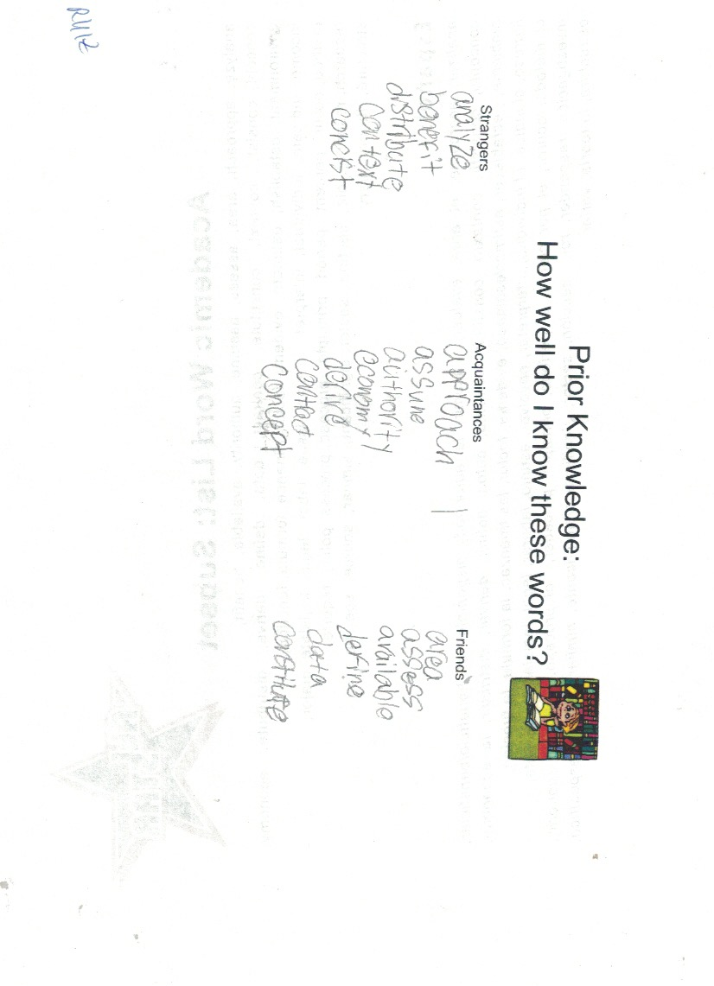

Slide 41
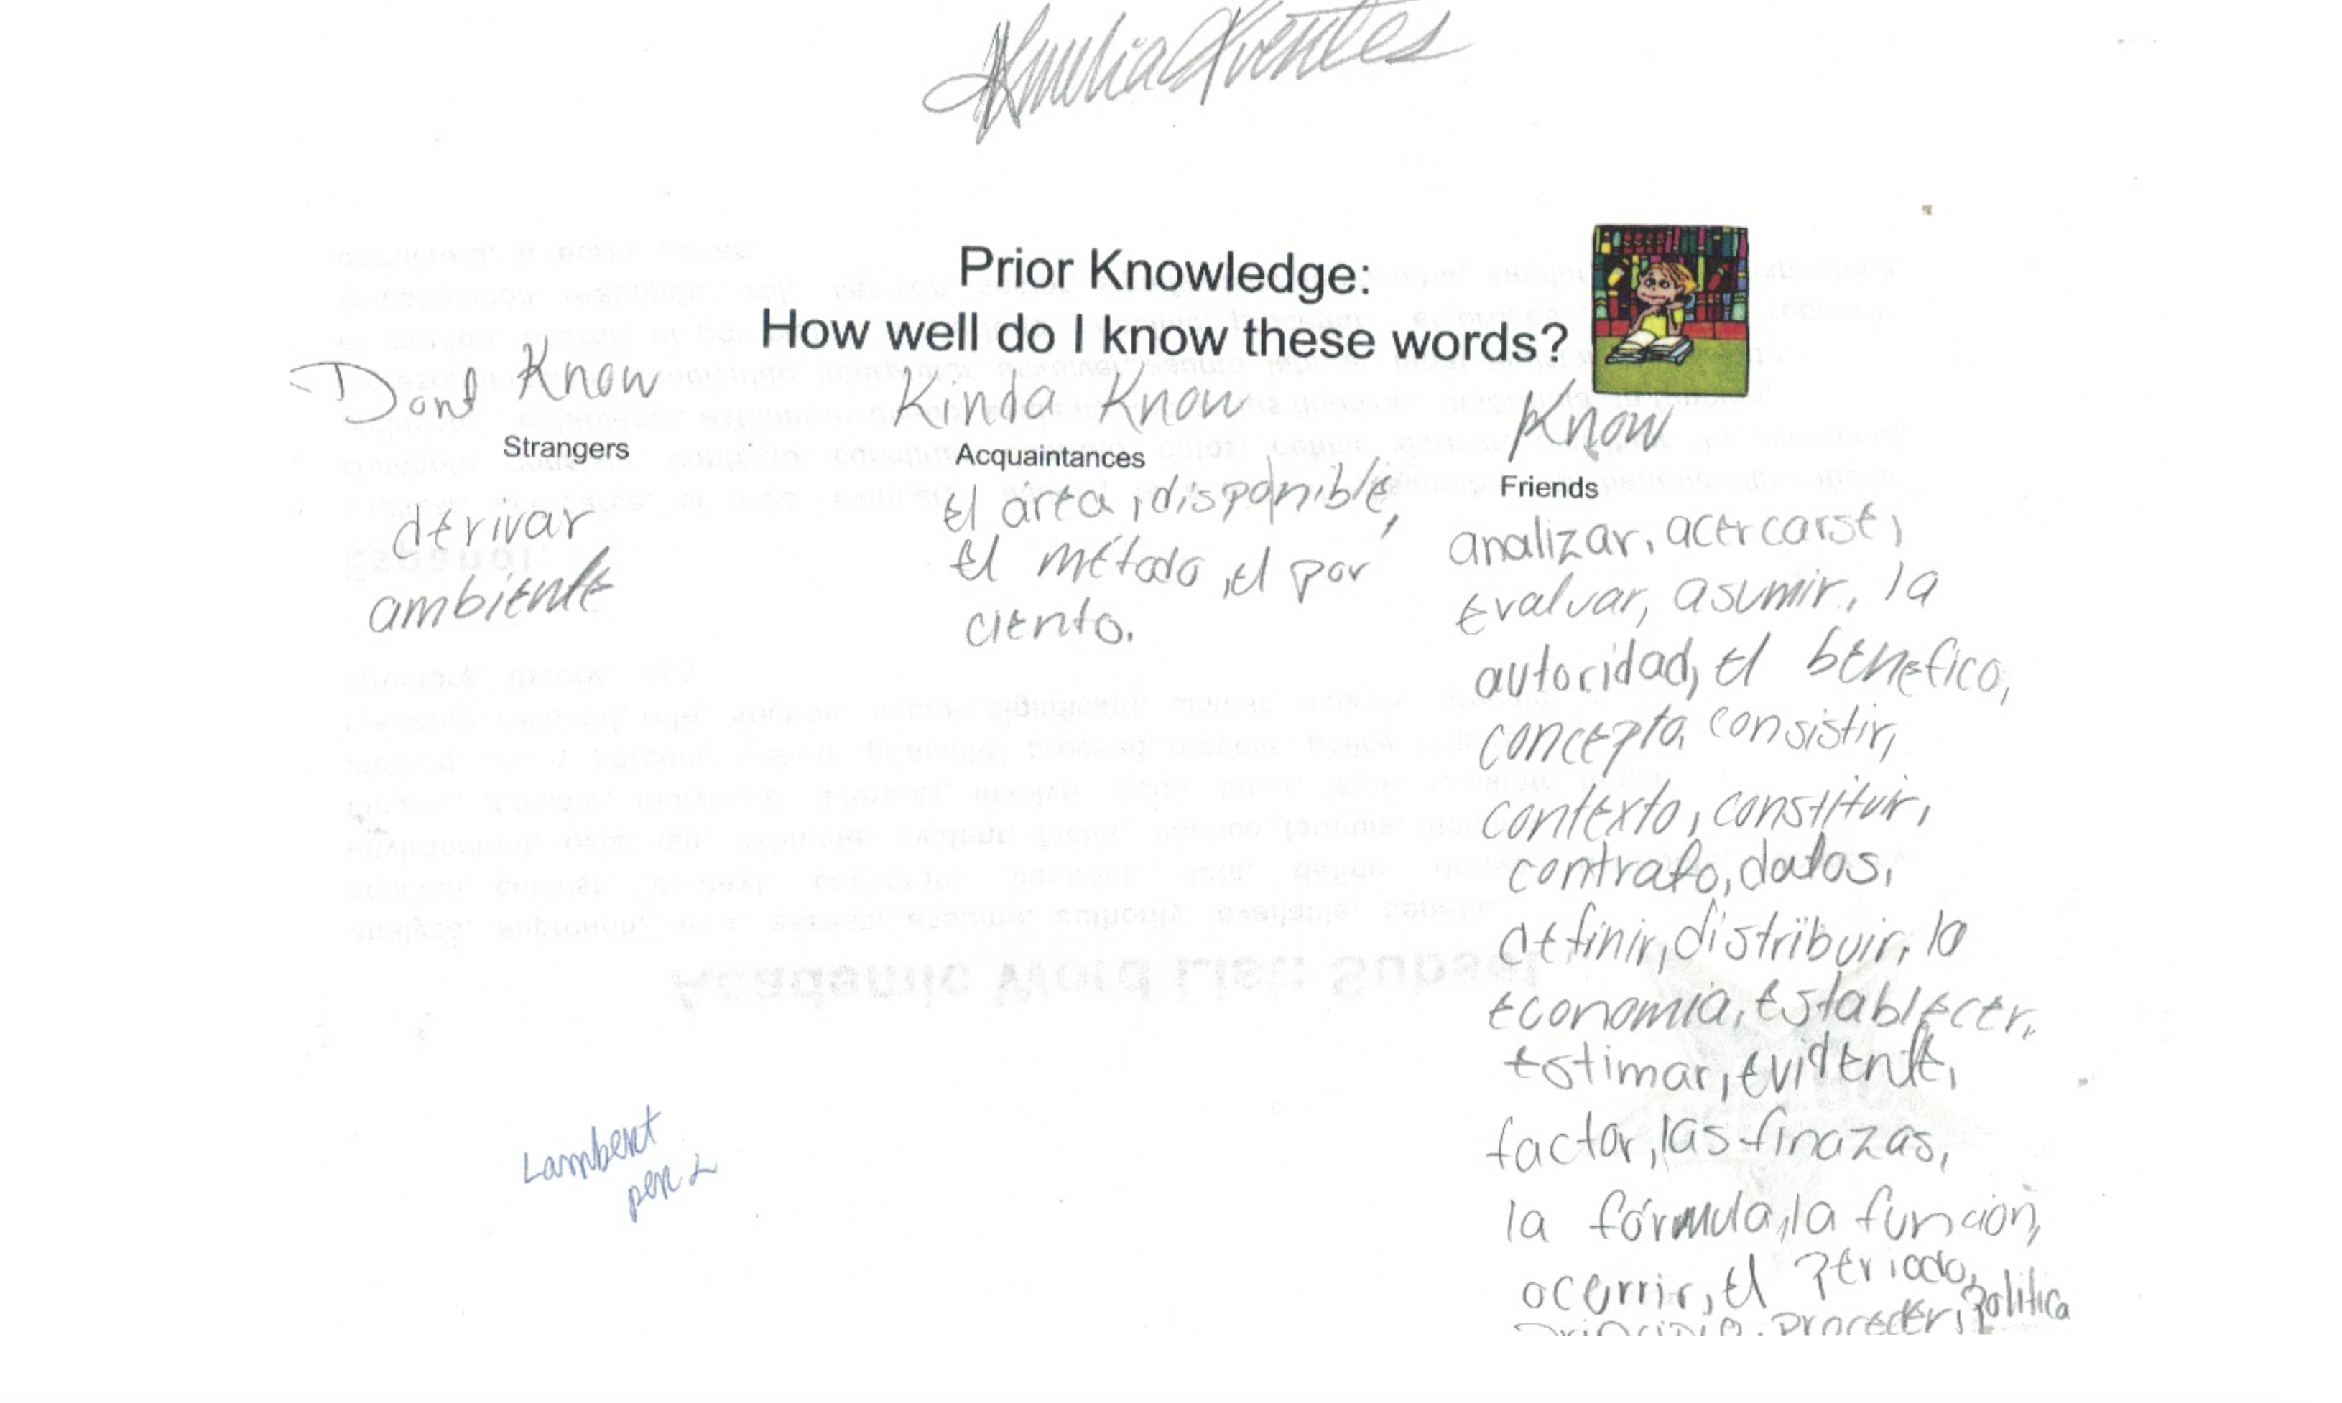

Slide 42
I. Tone-setting
II. Stages of Second Language Acquisition
III. Your Homework
IV. Two Kinds of English
V. All-Star List of Academic Words with Spanish Cognates
VI. Cognates, Cognates, Cognates
VII. Contrastive Analysis: English and Spanish
VIII. Double Objective: Content and Language (SIOP)

Slide 43
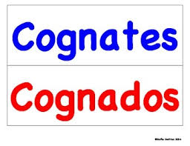
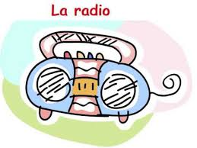
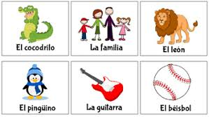
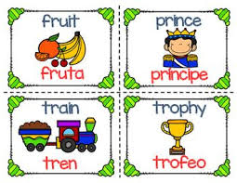

Slide 44

Hear the Text.
See the Text.

Slide 45
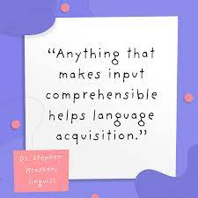
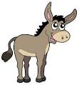


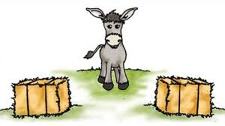
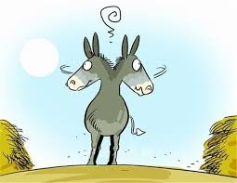
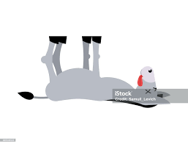

Slide 46





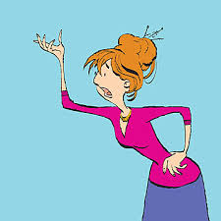


Slide 47
Group I
Not-So-Obvious Cognates Match-Up
Group II
Group IlI
comenzar
to enjoy
mirar
neighbor
el vecino/
la vecina
peligro
to turn back
intentar
hold back
business
la gente
to worry
jugar
try
el negocio
to look at
duro
preocupar
clothing
to avoid
seguro/segura
to turn
deber
monstrar
to raise
regresar
danger
to play
or manipulate
creer
to send
levantar
safe
proponer
people
gustar
to owe
situar
to forget
espacioso
to nominate
detener
lasting
olvidar
to locate
la ropa
roomy
evitar
begin
merecer
to show
enviar
believe
volver
to deserve

Slide 48

Contrastive Analysis:
English/español
Sounds
2. Stress
3. Grammar
4. Conventions of politeness
5. Punctuation and visuals

Slide 49
Sounds:
Contrastive Analysis:
English/español
English
español
a, e, i, o, u
a: avocado, agua
5 sounds
20-25 different sounds
(depending on regional accent)
e: cheso, Jose
i: chile, si
o: loco, hola
u: usted, los estados unidos

Slide 50
Stress:
Contrastive Analysis:
English/español
English
español
Various and complex accent rules
accent on the second-to-last syllable,
unless marked by an accent
I like this shirt, but I’m not going to buy it.
Me gusta esta camisa, pero no le voy a comprar.

Slide 51
Grammar:
Contrastive Analysis:
English/español
English
español
Adjective precedes the noun:
the big house
adjective follows the noun: la casa grande
The subject of the sentence must
be included: I have a book.
If the subject is a pronoun, it may be
omitted? Tengo un libro.
Inanimate things are designated as
masculine or feminine. el libro (masc.)
la mesa (fem.)
un
una silla (fem.)
Only animate beings are designated
as masculine or feminine.

Slide 52
Grammar:
Contrastive Analysis:
English/español
English
español
Adjectives change form (agree)
with the noun that they modify:
la casa grande
las casas grandes
Adjectives do not change according
the noun:
the big house

Slide 53
Conventions of
Politeness:
Contrastive Analysis:
English/español
English
español
Everyone is addressed as you
Tu and usted forms: familiar and formal
Adults addressed by name.
Adults addressed in English as
Miss or Mister

Slide 54
Visuals and
Punctuation:
Contrastive Analysis:
English/español
English
español
Question mark only after the question
Upside down question mark precedes
the question
(Same with exclamation points)

Slide 55
Anticipando y Analizando
de Algunos Problemas:
(Handout)
In English, what are
the letters that can be
doubled?
In Spanish, only three
letters are commonly doubled:
rr: el perro, el carro,
el zorro, arroz,
arriba, la carrera
ll: me llamo, llover,
amarillo, millon,
bombilla, llorar
cc: acceso, la sección, dirección,
leccion, protección

Slide 56
Anticipando y Analizando
de Algunos Problemas:
In English, what sounds do
the letters a,e,i,o,u represent?
Spanish vowels are predictable and phonetic:
a as in avocado
e as in grape
i as in eel
o as in oh! no!
u as in group

Slide 57
Anticipando y Analizando
de Algunos Problemas:
In English:
In Spanish:
Various forms of negation
(non-, il-, un-, dis-, dys-,
in-…)
Simple negation: no before the verb; very few prefixes
Double negative is
non-standard
Double negative is standard: No quira nada
Possessive apostrophe
No possessive form of nouns (de)

Slide 58
Anticipando y Analizando
de Algunos Problemas:
In English:
In Spanish:
adjective noun: big house
blue eyes
noun adjective: la casa grande
los ojos azules
Capitalize: days of the
week, months of the year,
languages, most words in
a title, religions
Do Not Capitalize: days of the
week, months of the year,
languages, most words in
a title, religions
Few forms of verbs
Numerous forms of verbs
Non-genderized nouns
Genderized nouns
Lots of non-phonetic spellings
Phonetic spellings

Slide 59
I. Tone-setting
II. Stages of Second Language Acquisition
III. Your Homework
IV. Two Kinds of English
V. All-Star List of Academic Words with Spanish Cognates
VI. Cognates, Cognates, Cognates
VII. Contrastive Analysis: English and Spanish
VIII. Double Objective: Content and Language (SIOP)

Slide 60
(Handout)
Content Objective: SWBAT determine the fastest and
cheapest means of transportation from their home to
Washington, D.C.
Language Objective: SWABAT use some of the following
vocabulary: transportation, fare, mileage, journey,
traffic, delay, rapidly, miles per hour
Content Objective: SWBAT research and describe a
tourist attraction in an American city.
Language Objective: SWABAT use the following
sentence frame: __________is a tourist attraction in
____________. People flock to visit it because __________
________________. The best season to see _______ is
________________because___________________

Slide 61
Content Objective: SWBAT find the lowest common
multiple (LCM) of 2 or more numbers.
Language Objective: SWABAT write the steps to
solve the problems.
Content Objective: SWBAT agree or disagree with
statements about the causes of the Civil War.
Language Objective: SWABAT explain their reasoning
about why a statement is or is not a cause of the
Civil War.

Slide 62
Content Objective: SWBAT find the lowest common
multiple (LCM) of 2 or more numbers.
Language Objective: SWABAT write the steps to
solve the problems.
Content Objective: SWBAT agree or disagree with
statements about the causes of the Civil War.
Language Objective: SWABAT explain their reasoning
about why a statement is or is not a cause of the
Civil War.

