Slide 1
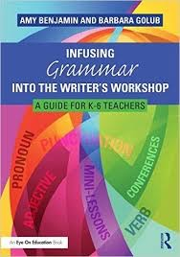
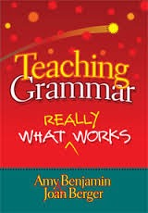
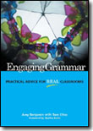
Teaching Grammar: What REALLY Works
with
Amy Benjamin
www.amybenjamin.com
Topics:
Introduction: Seeing Grammar Instruction With New Eyes
Teaching the Parts of Speech: It’s easier than you thought!
Teaching Sentence Structure Part I: Creating better writers (and readers
Standard English Usage: Special Victims Unit:
Adjective V. Adverb
      Pronoun Case
      Homophone Heartache
                Accelerated Auditory Patterning
4. Formal V. Informal Style

Slide 2
Teaching
Writing: Meeting the reader’s needs; self-
expression; content,
organization, diction,
absence of distracting
errors, establishing
credibility, appropriate
style, personal voice…
Grammar as
the study of
linguistics
(Learning grammar to
understand the inner
workings of a language)

Slide 3
Grammar as
the study of
linguistics
Teaching
Writing

Slide 4
I
?
teaching grammar.
I never “really” learned it.
Shouldn’t they already
have had this in the
lower grades?
Do kids really have to learn
all these terms?
I loved it! I thought
diagramming sentences
was fun!
There’s no interesting
way to teach grammar.
It’s just drill and workbook.
M

Slide 5
I.
II.
Cesar Chavez helped the farm workers.
He advocated for them. He did not
encourage violence. He led a boycott instead of violence. The boycott was an
effective method of resistance. (30)
Cesar Chavez helped the farm workers, and he advocated for them. He did not
encourage violence. He led a boycott instead of violence, and the boycott was an effective method of resistance. (32)
III.
Appositive: ,advocate for farm workers,
Parallel structure (encouraging…leading
(not by….but by
Adjective clause: , which was…
Cesar Chavez, advocate for farm
workers, helped them not by
encouraging violence, but by leading
a boycott, which was an effective
method of resistance. (24)
Grammatical choices elevate style.

Slide 6








2. Enriching the conversation
Use more
proper nouns,
to be specific.
Use some
prepositional phrases
for detail.
This verb needs
to be
in the past tense.
Let’s talk about
what you are
writing.
We need an adverb,
not an adjective
right here.
“You need subject-
verb agreement
here.”
You’re starting too
many sentences
with pronouns.
This is an irregular
verb. It goes
like this:
Use strong
action verbs.

Slide 7
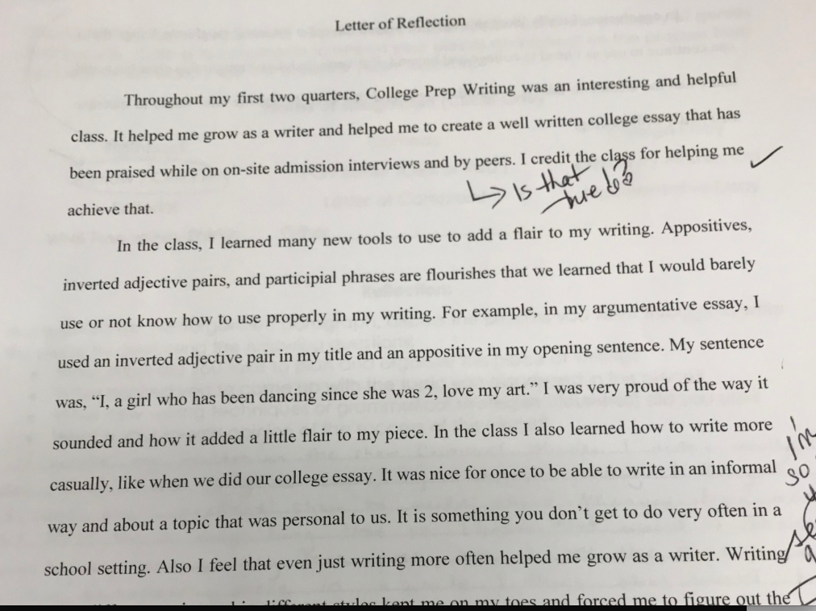

Slide 8
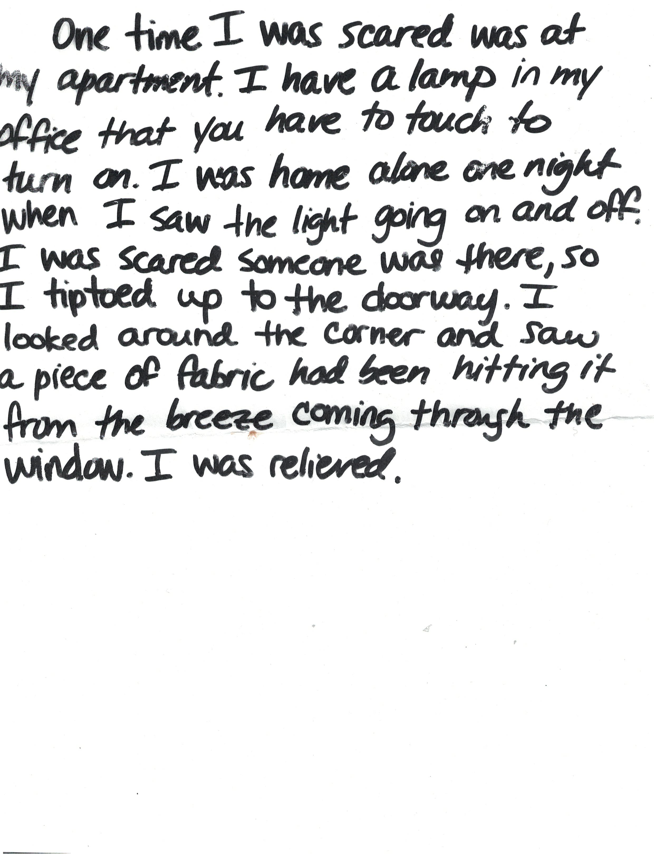
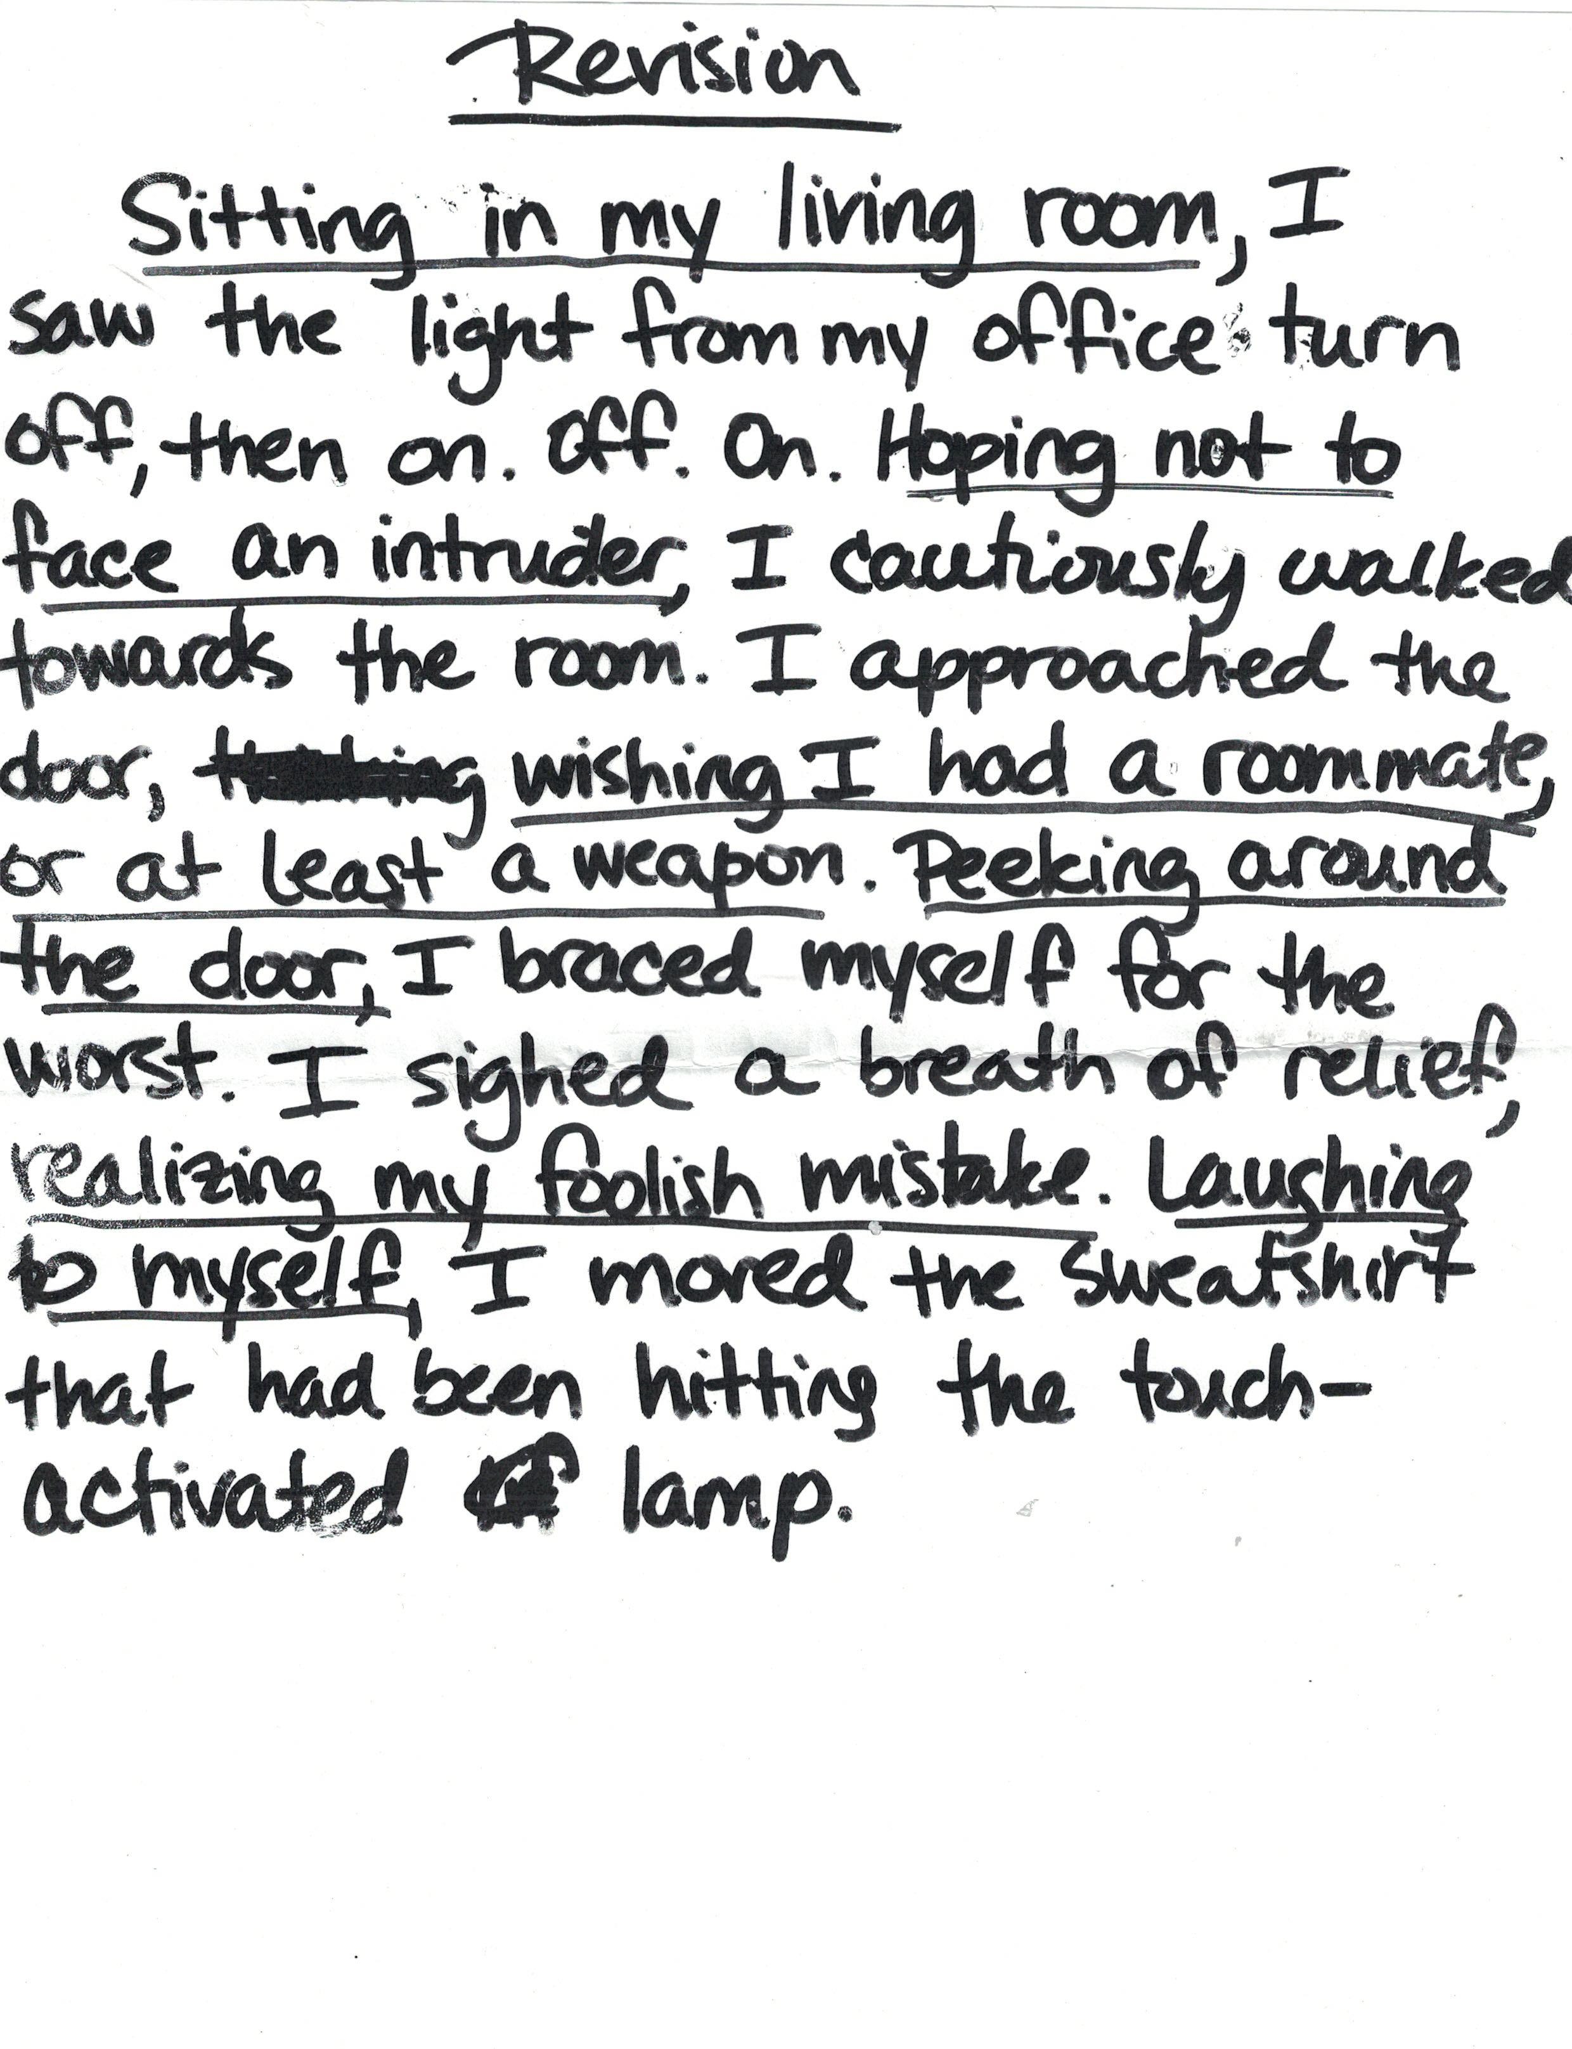

Slide 9
GRAMMAR IN THE HEART OF THE WRITING PROCESS:
Sharpen your nouns
Minimize your modifiers
Replace BE verbs and weak verbs with strong
action verbs
Achieve parallel structure
Combine sentences: create complex sentences
use appositives
use absolutes
Expand and shrink noun phrases. Turn clauses
into modifying phrases. Decide where
to place modifiers for desired effect.
Pre-writing
experience:
(non-sentence
form)
Drafting
Revising
Editing
Publication
Point of
intervention for
substantial language
improvement
Point of
intervention
for surface
error correction

Slide 10
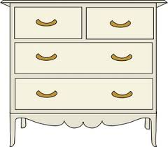
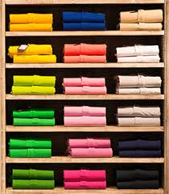
nouns
verbs
adjectives
adverbs

Slide 11

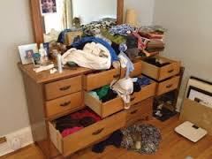
I run. He runs. We are running. They ran.
Let’s go for a run.
We kept a running record.
Running is fun.
She decided to run.
They took off running.

Slide 12
Kinds of Information
Anchor Charts
Nouns:
Who?
What?
Verbs:
Can Spiderman do it?
Adverbs:
Where?
When?
Why?
In what manner?
How often?
Adjectives:
What kind?

Slide 13
Morphology Chart
NOUNS: They will fit into this frame: The_____. | VERBS: They will fit into this frame: To____ or Can____or Is____ing | ADJECTIVES: They will fit into this frame: The ________truck | ADVERBS: They will fit into this frame: Do it ___________.
confession, s
confessional
confessor
confess
confesses
confessed
confessing
confessional
Nouns answer the question: What? or Who?
Verbs answer the question: What is it doing, having, feeling, or being?
Adjectives answer the question: What kind? (They may also answer the questions Which one? and
How many? but those kinds of adjectives do not fit into
the frame of The______truck.
Adverbs answer any of these questions: Where? When? Why? To what extent? How?

Slide 14
Morphology Chart
NOUNS: They will fit into this frame: The_____. | VERBS: They will fit into this frame: To____ or Can____or Is____ing | ADJECTIVES: They will fit into this frame: The ________truck | ADVERBS: They will fit into this frame: Do it ___________.
Nouns answer the question: What? or Who?
Verbs answer the question: What is it doing, having, feeling, or being?
Adjectives answer the question: What kind? (They may also answer the questions Which one? and
How many? but those kinds of adjectives do not fit into
the frame of The______truck.
Adverbs answer any of these questions: Where? When? Why? To what extent? How?

Slide 15
Morphology Kit
This “Morphology Kit”
is a great way to
expand vocabulary
because most
of the words
created by
these suffixes
express abstract
ideas.
Noun-Making Suffixes | Verb-Making Suffixes | Adjective-making suffixes
-ment -ness -ation, sion -ity -ism -hood -itude -ence -ance -ide | -ate -ify -ize | -acious,icious -y -ous, ious -ant -able, ible -er; est
Adverb-making suffix:
-ly
5

Slide 16
Noun: Owner’s Manual
Congratulations on your wise purchase of a NOUN. Your NOUN may be used to fit into the following frame:
The____________.
Your NOUN is used to name people, places, things, ideas, qualities, states of mind, and all kinds of other things that need naming.
Your NOUN may be easily converted into an adjective. All you have to do is put another NOUN after it and have it make sense. (COW pasture, for example).
Your NOUN may be the kind of NOUN that can be made plural. Only NOUNS may be made plural.
Your NOUN may be able to be made possessive by adding ‘s. Only NOUNS may be made possessive. When you make your NOUN possessive, it becomes an adjective.
You may add all kinds of modifiers before and after your NOUN. You may replace your NOUN along with its modifiers with a pronoun.
Feel free to use your NOUN as a subject, direct object, indirect object, object complement, object of a preposition, appositive, or predicate noun
Your noun may be called a nominal when we consider it together with its modifiers.

Slide 17
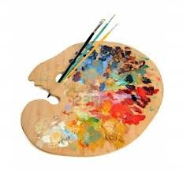

Slide 18

Senator Joseph McCarthy
Judge Danforth
John Proctor
Abigail
Salem, MA
Arthur Miller
HUAC
My Noun Palette
Proper Nouns:
Concrete Nouns:
witch
scaffold
document
courtroom
accuser
Abstract Nouns:
-tion,-sion,-ism,-ence, -ance,
-ness, -ment, -itude
accusation
persecution

Slide 19
Adjective: Owner’s Manual
Congratulations on your wise purchase of an ADJECTIVE. Your ADJECTIVE may be used to fit into the following frame:
The______________truck Or The truck was very_________.
Your ADJECTIVE likes to answer the question What kind?
If your ADJECTIVE doesn’t fit into either of these frames, maybe it is the kind of ADJECTIVE that answers the questions Which one? or How many?
Your ADJECTIVE may be capable of using the suffixes –er in the comparative form and –est in the superlative form. (If your ADJECTIVE doesn’t like these suffixes, just use more and most to accomplish comparison or superiority.)
Your ADJECTIVE reports to your NOUN, and your NOUN can easily become an ADJECTIVE to another NOUN.
Often, groups of words decide to get together and do ADJECTIVE-like work. We call such groups of words ADJECTIVALS, and they may be phrases or clauses that operate just like ADJECTIVES, answering those questions that ADJECTIVES answer.

Slide 20
Verb: Owner’s Manual
Congratulations on your wise purchase of a VERB. Your VERB may be used to fit into the following frame:
To______________
Your VERB is the part of the sentence that is capable of turning the sentence into a negative. It is also the part of the sentence that changes when you add yesterday or right now. (If your sentence does not change when you add yesterday to it, then your sentence is in the past tense. If your sentence does not change when you add right now to it, then it is in the present tense.)
Your VERB may be an action verb or a linking verb. Action verbs may take direct objects and are modified by adverbs. Linking verbs take predicate nouns and predicate adjectives. You can easily find a list of linking verbs.
Your VERB may take auxiliaries (forms of have, be) and modal auxiliaries (could, should, would, can, will, shall, may, might, must).
Your VERB sometimes uses a form of the word do to create a sentence, to emphasize, to negate, or to stand in for itself, as in: Do you think so? Yes, I do.

Slide 21



Why Teach Verbs?
1. Strong verbs energize writing.
2. Writers must decide on a consistent
verb tense.
3. Writers must decide whether to use
active or passive voice.
4. Errors in verb usage are highly stigmatized: Incorrect form of irregular verbs (*I seen, *brung, *have went, *have sang, etc.)
5. Whether we have an action verb or a BE verb
determines pronoun case use and adjective/adverb use.

Slide 22

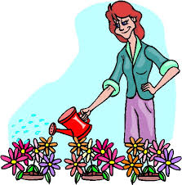
One-syllable verb:_______
Two-syllable verb:_______
Three-syllable verb:_______
Transitive Verb: Takes a direct object
Intransitive Verb: Does not take a direct object

Slide 23

Verbs

Slide 24
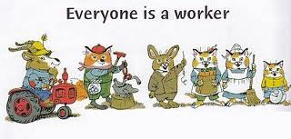
lifeguard, philosopher, scientist, shoemaker, matador, explorer, inventor,
court jester, makeup artist, treasure hunter, student, dragon slayer, carpenter,
jeweler, candymaker, ventriloquist, fisherman, nurse, banker, tyrant, butcher,
reporter, web designer, programmer
secret agent, flight attendant, cashier, beekeeper, gladiator, clockmaker,
superhero, innkeeper, botanist, magician’s assistant; racecar driver, wizard,
game show host, dentist, food taster, actor
cake decorator, sky-diver, birdwatcher, trapeze artist; librarian, stamp collector,
tight-rope walker; dog trainer, dishwasher, cyclist; bodyguard, prime suspect,
ichthyologist, manicurist, sheriff, piano tuner, stuntman, composer, tour guide,
principal, knight, exterminator, factory worker, roofer, sailor, impersonator,
park ranger, mathematician, balloonist, guitarist, welder, window washer,
weatherman, scout
juggler, cowboy, clown, astronaut, anesthesiologist, zookeeper, crossing guard,
vegetarian, seamstress, thief, comedian

Slide 25

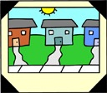

Verb Land, USA
Base form: walk, sing
Progressive form: walking, singing
Past form: walked, sang
Participial form: (have) walked, (have sung)
TO BE:
I am,was We are,were
You are ;were
He, she, it is They are,were
Active Voice: I stole the cookie
from the cookie jar.
Passive Voice: The cookie was
stolen from the cookie jar by me.
(BE + Participial form= passive voice)
Sense Verbs:
feel, look, sound
smell, taste
Also: seem,
become, appear
grow
Verbals:
1. Participle: (acts as adjective)
the dancing bear;
the stolen cookie
2. Infinitive: (acts as noun, adj. or adv.)
Let us never fear to negotiate.
The law to reduce noise has passed.
We went to London to see the queen.
3. Gerund: (Acts as noun)
Teaching makes me happy.
ACTION TOWN
BE TOWN
ACTION verbs are modified by
adverbs:She sings happily.
ACTION verbs take objective case pronouns as objects:
We saw him steal the cookie from the cookie jar.
BE verbs are completed by
adjectives: He is happy.
BE verbs take subjective case
pronouns as complements:
It was I who stole the cookie from
the cookie jar.
Auxiliaries:
Have: creates
the perfect tenses
(has sung, etc.)
Be: creates the
progressive tenses
(am singing, etc.)
Modal Auxiliaries:
Would Will
Should Shall
Could May
Can Might
Must
Auxiliaries and
modal auxiliaries
combine with action
verbs to create various
tenses.

Slide 26
In the English grammar system, the modifiers are represented
by two separate but equal parts of speech:
The adjectives, which answer the question “What kind?”
The adverbs, which answer the questions “How? When? Where? Why? How often? and To What Extent?”
These are their stories.

Slide 27

Adjectives: What kind?
(Used with linking verbs)
Adverbs: How?
(Used with action verbs)
fun
lazy
playfully
cute
mysteriously
independent
foolishly
Pepper is…
mischievously
Pepper feels…
mischievous
Pepper looks…
slyly
impulsively
Pepper acts..
independently
adventurous
selfish
selfishly
triumphantly
brave
foolish

Slide 28
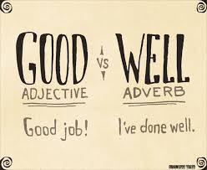
I am a good reader.
I read well.
I am a good bike rider.
I ride my bike well.
I am a good singer.
I sing well.
I am a good dancer.
I dance well.
I am a good student.
I learn well.

Slide 29


I am a bad reader.
I read badly.
I feel bad about what happened.
I feel badly about what happened.
Your haircut looks bad.
Your haircut looks badly.
I did bad on that test.
I did badly on that test.

Slide 30
Adverb: Owner’s Manual
Congratulations on your wise purchase of an ADVERB. Your adverb may be used to tell where, when, or how.
Adverbs that tell where may be replaced by the word there: We drove south for two miles. (We drove there for two miles.)
Adverbs that tell when may be replaced by the word then: We ate lunch late.
(We ate lunch then.)
Adverbs that tell how often end in –ly and may be replaced by the words like this: He joined the team eagerly. (He joined the team like this.)
You may move your adverbs around in the sentence. If you do, you’ll want to
set them off with commas.
Often, groups of words decide to get together to do ADVERB-like work, and when they do, we call these groups of words ADVERBIALS. ADVERBIALS may be phrases or clauses that do the work that adverbs do.

Slide 31

Subjective Team
Objective Team
I
we
me
us
1st Person:
you
you
you
2nd Person:
you
he, she, it
him,
her, it
3rd Person:
they
them
who
whom

Slide 32
A Pronoun Poem
As Mom and I walked homewardly,
A puppy followed her and me.
Both she and I were quick to see
He had adopted Mom and me.
At home we showed him where to pee
And where the doggy bed would be.
Then Mom and I made lunch for three,
A feast for him and Mom and me.
from Woe is I Jr: The Younger Grammarphobe’s Guide to Better English in Plain English. by Patricia T. O’Connor and Tom Stiglich.

Slide 33
Six Reasons for Teaching Prepositions:
1. Prepositions add time and place detail to sentences
2. Students can vary their sentence structure and set the stage for
a sentence by beginning some sentences with prepositions.
3. Students can add power to their writing by ending paragraphs with a
prepositional phrase. (Conversely: Students can avoid ending sentences
with prepositions so that their sentences are not weak or too informal.)
4. Students can avoid subject-verb agreement errors by recognizing
prepositional phrases that intervene between the subject and the verb, as in
“A box of matches (is, are) on the kitchen table.”
5. Students can create parallel structure by repeating prepositional phrases
deliberately.
6. Students can select the appropriate pronoun case as the object of
a preposition. (between you and me; for Joe and me)

Slide 34


Somewhere ________________ the rainbow

Slide 35

over
under
around
through
by
beside
behind
near
away from
with
in
on
at
Pre:
Prevent
Predict
Prepare
Precaution
Prefix
Preview
Position
Prepositions

Slide 36
object of the preposition
Somewhere ________________ the rainbow
Prepositional phrase

Slide 37

Now, You
Help your reader visualize by adding prepositional phrases to
your sentences.
in
on
at
for
with
Prepositional phrases help your reader visualize.

Slide 38
VERB
VERB
VERB
VERB
VERB

Slide 39
Verb Phrase
VERB
ADVERB

Slide 40
NOUN
NOUN
NOUN
NOUN
NOUN

Slide 41
Noun Phrase
ADJECTIVE
NOUN

Slide 42
Make a sentence that looks like this:

Slide 43
Take your adjective and exchange it
with someone else’s adjective.
adjective

Slide 44
Take your noun and exchange it
with someone else’s noun.
noun

Slide 45
Take your verb and exchange it
with someone else’s verb.
verb

Slide 46
Take your adverb and exchange it
with someone else’s adverb.
adverb

Slide 47


The THEIR Solution: The HIS Test
HIS
Their/there
Their
house is on the corner of Elm and Main.
HIS

Slide 48

The THEIR Solution: The HIS Test
HIS
Their/there
There
were no more cookies in the cookie jar.
HIS

Slide 49



What about THEY’RE?
they are
They’re
They’re/there
the parents of twins .
they are

Slide 50



it’s / its
it is
his
The cat chased
its / it’s
it is
his
tail.
its

Slide 51

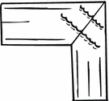


Common Hitching Devices
Coordinating
Conjunctions
Relative Pronouns
Subordinating
Conjunctions
Conjunctive Adverbs
Which
Who
That
However
Moreover
Therefore
Furthermore
As, although, after
While, when
Until
Because, before
If
AAAWWUBBI
And
But
So
Or/nor
Can join two independent
clauses to make a
compound sentence.
Warning: You must use
a comma with these
when they join
independent clauses.
You may use a
semicolon instead of
a coordinating conjunction
to join two independent
clauses.
Can attach to an
independent clause to
create a complex
sentence.
Warning: Many
sentence fragments
begin with these
words. Usually, you
must hitch these
words and the clauses
that they introduce to
your previous sentence.
Note: No comma is to be
used with that.
Can move within
own clause;
Requires commas
on both sides
Warning: If you
wish to use these
to join clauses, you
must use a semicolon.
Can hitch up to an
independent clause,
creating a subordinate
(dependent) clause,
forming
complex sentence.
Can appear after
main clause (no comma)
or before main clause
(needs a comma)

Slide 52


Common Hitching Devices
Coordinating
Conjunctions
And
But
So
Or/nor
Use the phrase “star-crossed lovers”
Can join two independent
clauses to make a
compound sentence.
Warning: You must use
a comma with these
when they join
independent clauses.
You may use a
semicolon instead of
a coordinating conjunction
to join two independent
clauses.

Slide 53
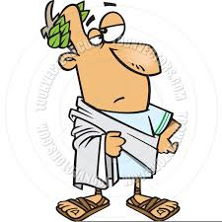
Common Hitching Devices
Relative Pronouns
Which
Who
That
Use the phrase “Ides of March”
Can attach to an
independent clause to
create a complex
sentence.
Warning: Many
sentence fragments
begin with these
words. Usually, you
must hitch these
words and the clauses
that they introduce to
your previous sentence.
Note: No comma is to be
used with that.

Slide 54
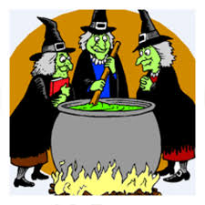
Common Hitching Devices
Conjunctive Adverbs
However
Moreover
Therefore
Furthermore
Use the phrase “the Weird Sisters”
Can move within
own clause;
Requires commas
on both sides
Warning: If you
wish to use these
to join clauses, you
must use a semicolon.

Slide 55
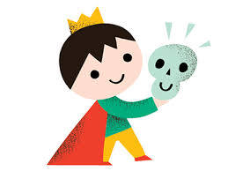
Common Hitching Devices
Subordinating
Conjunctions
As, although, after
While, when
Until
Because, before
If
AAAWWUBBI
Use the phrase “Prince of Denmark”
Can hitch up to an
independent clause,
creating a subordinate
(dependent) clause,
forming
complex sentence.
Can appear after
main clause (no comma)
or before main clause
(needs a comma)

Slide 56


Appositives
Participial Phrases
Inverted Adjective Pairs
What they look like:
Steve Jobs, a passionate golfer,
had a putting green installed in
his office.
A passionate golfer, Steve Jobs
had a putting green installed in
his office.
What they look like:
The dancer, graceful and confident, captivated
her audience.
Graceful and confident, the dancer captivated
her audience.
What they look like:
Racing down the stairs, I collided with
the principal.
The bicycle, broken years ago, rusted
in the garage.
My Dad is the man wearing the
Hawaiian shirt.
How grammar books define
them:
Adjectives usually go before the noun that they
modify, or after a form of the verb “to be.’ (The
graceful, confident dancer…; The dancer was
graceful and confident.)
But when adjectives are inverted, they are placed
by themselves in the sentence so as to attract
special attention.
How grammar books define
them:
An appositive is a noun or
noun phrase that gives another
name to the noun to which it
refers.
How grammar books define
them:
A participle is an adjective that is derived from a
Present participles end in -ing. Past participles
take the form of the verb that you would use
with the helping verbs ‘have’ (I have
broken my promise. I have seen a ghost. I have
walked my dog.)
A participial phrase, then, is simply a participle with
one or more words following it that go together.
How they are punctuated:
Usually, appositives are set
off by commas on both sides.
The commas are not necessary
if the appositive is very short.
How they are punctuated:
If the participle is separated from the word that
it modifies, set the participial phrase off by commas.
2. If the participle is right next to the word that it
modifies, use NO comma IF the participle defines
the noun that it modifies. USE a comma IF the
participle MERELY COMMENTS upon the noun that
it modifies.
How they are punctuated:
Adjective pair inversions are set off by commas.
Why excellent writers use
them:
Appositives allow you to pack
more information efficiently into
a single sentence.
Why excellent writers use
them:
Inverted adjective pairs get extra special
attention and add artistic flair to a sentence.
Why excellent writers use
them:
Participial phrases give action and
visuals concisely within a sentence.

Slide 57
Appositives
What they look like:
Steve Jobs, a passionate golfer,
had a putting green installed in
his office.
A passionate golfer, Steve Jobs
had a putting green installed in
his office.
Identify a character by using an appositive.
Atticus Finch, a soft-spoken country lawyer,
was modeled after Harper Lee’s own father.
How grammar books define
them:
An appositive is a noun or
noun phrase that gives another
name to the noun to which it
refers.
How they are punctuated:
Usually, appositives are set
off by commas on both sides.
The commas are not necessary
if the appositive is very short.
Why excellent writers use
them:
Appositives allow you to pack
more information efficiently into
a single sentence.

Slide 58
Inverted Adjective Pairs
What they look like:
The dancer, graceful and confident, captivated
her audience.
Graceful and confident, the dancer captivated
her audience.
Use an inverted
adjective pair to
describe a character.
How grammar books define
them:
Adjectives usually go before the noun that they
modify, or after a form of the verb “to be.’ (The
graceful, confident dancer…; The dancer was
graceful and confident.)
But when adjectives are inverted, they are placed
by themselves in the sentence so as to attract
special attention.
Rebecca Nurse, pious
and motherly, is executed
as a witch.
How they are punctuated:
Adjective pair inversions are set off by commas.
Why excellent writers use
them:
Inverted adjective pairs get extra special
attention and add artistic flair to a sentence.

Slide 59
Participial Phrases
What they look like:
Racing down the stairs, I collided with
the principal.
The bicycle, broken years ago, rusted
in the garage.
My Dad is the man wearing the
Hawaiian shirt.
The raging storms of February had pitched their white tents across the landscape of Starkfield, Massachusetts.
How grammar books define
them:
A participle is an adjective that is derived from a
Present participles end in -ing. Past participles
take the form of the verb that you would use
with the helping verbs ‘have’ (I have
broken my promise. I have seen a ghost. I have
walked my dog.)
A participial phrase, then, is simply a participle with
one or more words following it that go together.
Shadows in the darkened kitchen accented the
puckered hollows of her sunken cheeks.
How they are punctuated:
If the participle is separated from the word that
it modifies, set the participial phrase off by commas.
2. If the participle is right next to the word that it
modifies, use NO comma IF the participle defines
the noun that it modifies. USE a comma IF the
participle MERELY COMMENTS upon the noun that
it modifies.
Why excellent writers use
them:
Participial phrases give action and
visuals concisely within a sentence.

Slide 60
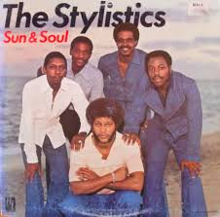
Noun Absolutes
Correlative Conjunctions
What they look like:
Alice was either in school or at home.
Alice was neither in school nor was she
at home.
Alice not only swims competitively, but she
also won the spelling bee.
Not only did Alice enter the race, but she
also managed to come in third.
Alice is respected as both a scholar and
a peer leader.
What they look like:
Their sails trimmed, the boats headed
into the wind.
The rattlesnake, fangs extended, awaited
its prey.
Robert eyes the Mustang, his eyes
aglow.
The water looking a bit murky, we hesitated
to wade in.
Parallel Structure
What it looks like:
We cannot dedicate, we cannot
consecrate, we cannot hallow this ground.
The president hopes that the war will end, the economy
will improve, and she will be re-elected.
Rebecca is upbeat, energetic, and friendly.
After the shouting, after the finger-pointing, after the
extended silence, Lawrence and Jennifer signed
an agreement.
How grammar books define
them:
Correlative conjunctions (aka
coordinating correlative conjunctions)
are conjunctions that are used in pairs.
The are either/or; neither/nor; not only/
but also; both/and
How grammar books define
them:
A noun absolute is a phrase that comes close
to being a clause. In a noun absolute, the form
of the linking verb has been omitted.
You could say:
Their sails were trimmed.
Its fangs were extended.
His eyes are aglow.
The water looked murky.
How grammar books define it:
Parallel structure is the style of putting all elements
of a series in the same grammatical form. Usually,
there are three elements.
How they are punctuated:
Unless the elements being joined consist of
one or two words, the elements being joined
should be separated by commas.
How they are punctuated:
The noun absolute is separated
from the rest of the sentence with a comma
(or, if in the middle of the sentence, two commas.)
How parallel elements are punctuated:
Elements in a series are separated by
commas. Most teachers prefer that writers use a
comma before the last element.
Why excellent writers use
them:
Correlative conjunctions allow the
writer to show relationships clearly and
efficiently.
Why excellent writers use
parallel structure:
Parallel structure tightens, clarifies, and strengthens
your writing.
Why excellent writers use
them:
The noun absolute is a sophisticated structure
that allows for a special close-up of a visual
detail.

Slide 61

Whole Sentence Modifiers
Gerunds
Infinitives
What they look like:
Unfortunately, we must cancel the
production due to lack of ticket sales.
We must, unfortunately, cancel the production
due to lack of ticket sales.
We must cancel the production due to lack of
ticket sales, unfortunately.
Others: fortunately; luckily; clearly; obviously;
naturally, ironically, oddly enough,…
What they look like:
I love reading on long flights.
James denies falling asleep in the back seat.
She believes in telling the truth.
Becoming an opera singer is my lifelong desire.
What they look like:
I love to read on long flights.
James tends to fall asleep in the back seat.
She was just about to tell the truth when
she was interrupted by the fire drill.
My lifelong desire has been to become
an opera singer.
How grammar books define
them:
Whole sentence modifiers are
adverbs. They may be single
words or phrases.
How grammar books define
them:
Infinitives consist of to + the base form
of the verb. An infinitive is usually used
as a noun.
How grammar books define them:
Gerunds are words that are functioning as nouns,
but are derived from verbs. All gerunds end in
-ing.
How they are punctuated:
A comma (or commas) is/are
placed after (or around) a whole
sentence modifier.
How they are punctuated:
No special punctuation is required.
How they are punctuated:
No special punctuation is required.
Why excellent writers use
them:
Whole sentence modifiers allow the writer to
express a feeling or attitude about the
information in the sentence.
Why excellent writers use them:
Gerunds allow the writer to give a noun
“verb DNA,” and, therefore, extra strength.
Why excellent writers use
them:
Infinitives allow the writer to give a
noun “verb DNA,” and, therefore,
extra strength.

Slide 62
Informal
Formal

Slide 63




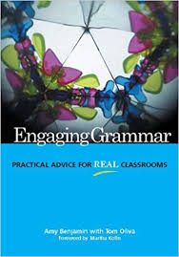
Informal and Formal English
Set your dial to the level of
formality that is appropriate
for your audience and purpose.

Slide 64
Informal and Formal
Handout: Page 11
backpack
flip-flops
McDonald’s
frisbee on the
lawn
snack
zapping/nuking
briefcase
dress shoes
sit-down restaurant
football on the team
lunch

Slide 66
