Slide 1
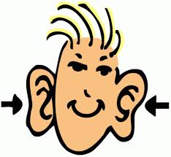
The Patterns of Standard English

Slide 2
I went to the zoo and I saw a

Slide 3
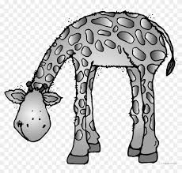
I went to the zoo and I saw a

Slide 4
I went to the zoo and I saw a

Slide 5
I went to the zoo and I saw a

Slide 6
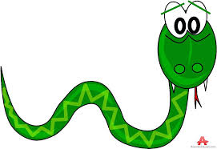
I went to the zoo and I saw a

Slide 7
I went to the zoo and I saw a

Slide 8
I went to the zoo and I saw a

Slide 9
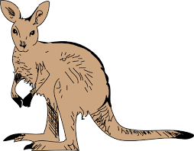
I went to the zoo and I saw a

Slide 10
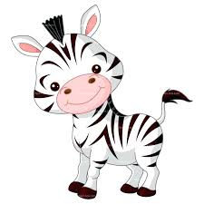
I went to the zoo and I saw a

Slide 11
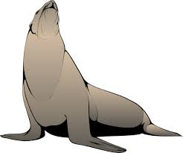
I went to the zoo and I saw a

Slide 12
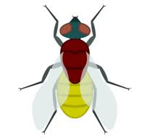
I went to the zoo and I saw a

Slide 13
I went to the zoo and I saw a

Slide 14
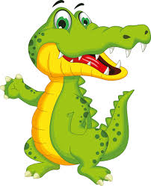
I went to the zoo and I saw a

Slide 15
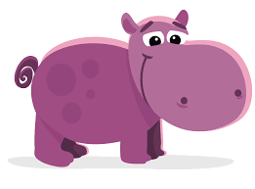
I went to the zoo and I saw a

Slide 16
I went to the zoo and I saw a

Slide 17
I went to the zoo and I saw a

Slide 18
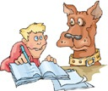
Rusty and I went to the…

Slide 19
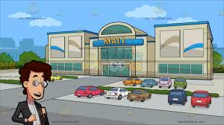
Rusty and I went to the…

Slide 20
Rusty and I went to the…

Slide 21
Rusty and I went to the…

Slide 22
Rusty and I went to the…

Slide 23
Rusty and I went to the…

Slide 24
Rusty and I went to the…

