Slide 1
GRAMMAR IN THE HEART OF THE WRITING PROCESS:
Sharpen your nouns
Minimize your modifiers
Replace BE verbs and weak verbs with strong
action verbs
Achieve parallel structure
Combine sentences: create complex sentences
use appositives
use absolutes
Expand and shrink noun phrases. Turn clauses
into modifying phrases. Decide where
to place modifiers for desired effect.
Pre-writing
experience:
(non-sentence
form)
Drafting
Revising
Editing
Publication
Point of
intervention for
substantial language
improvement
Point of
intervention
for surface
error correction

Slide 2

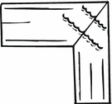
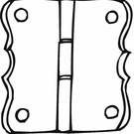

Common Hitching Devices
Coordinating
Conjunctions
Relative Pronouns
Conjunctive Adverbs
Subordinating
Conjunctions
Which
Who
That
However
Moreover
Therefore
Furthermore
As, although, after
while, when
until
because, before
if
AAAWWUBBI
And
But
So
Or/nor
Can join two independent
clauses to make a
compound sentence.
Warning: You must use
a comma with these
when they join
independent clauses.
You may use a
semicolon instead of
a coordinating conjunction
to join two independent
clauses.
Can attach to an
independent clause to
create a complex
sentence.
Warning: Many
sentence fragments
begin with these
words. Usually, you
must hitch these
words and the clauses
that they introduce to
your previous sentence.
Note: No comma is to be
used with that.
Can move within
own clause;
Requires commas
on both sides
Warning: If you
wish to use these
to join clauses, you
must use a semicolon.
Can hitch up to an
independent clause,
creating a subordinate
(dependent) clause,
forming
complex sentence.
Can appear after
main clause (no comma)
or before main clause
(needs a comma)

Slide 3


Common Hitching Devices
Coordinating
Conjunctions
And
But
So
Or/nor
Use the phrase “star-crossed lovers”
Can join two independent
clauses to make a
compound sentence.
Warning: You must use
a comma with these
when they join
independent clauses.
You may use a
semicolon instead of
a coordinating conjunction
to join two independent
clauses.

Slide 4
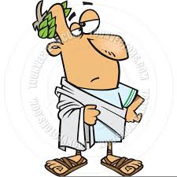
Common Hitching Devices
Relative Pronouns
Which
Who
That
Use the phrase “Ides of March”
Can attach to an
independent clause to
create a complex
sentence.
Warning: Many
sentence fragments
begin with these
words. Usually, you
must hitch these
words and the clauses
that they introduce to
your previous sentence.
Note: No comma is to be
used with that.

Slide 5
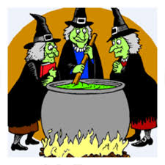
Common Hitching Devices
Conjunctive Adverbs
However
Moreover
Therefore
Furthermore
Use the phrase “the Weird Sisters”
Can move within
own clause;
Requires commas
on both sides
Warning: If you
wish to use these
to join clauses, you
must use a semicolon.

Slide 6
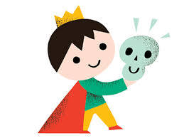
Common Hitching Devices
Subordinating
Conjunctions
As, although, after
While, when
Until
Because, before
If
AAAWWUBBI
Use the phrase “Prince of Denmark”
Can hitch up to an
independent clause,
creating a subordinate
(dependent) clause,
forming
complex sentence.
Can appear after
main clause (no comma)
or before main clause
(needs a comma)

Slide 7
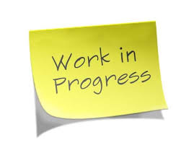

Appositives
Participial Phrases
Inverted Adjective Pairs
What they look like:
Steve Jobs, a passionate golfer,
had a putting green installed in
his office.
A passionate golfer, Steve Jobs
had a putting green installed in
his office.
What they look like:
The dancer, graceful and confident, captivated
her audience.
Graceful and confident, the dancer captivated
her audience.
What they look like:
Racing down the stairs, I collided with
the principal.
The bicycle, broken years ago, rusted
in the garage.
My Dad is the man wearing the
Hawaiian shirt.
How grammar books define
them:
Adjectives usually go before the noun that they
modify, or after a form of the verb “to be.’ (The
graceful, confident dancer…; The dancer was
graceful and confident.)
But when adjectives are inverted, they are placed
by themselves in the sentence so as to attract
special attention.
How grammar books define
them:
An appositive is a noun or
noun phrase that gives another
name to the noun to which it
refers.
How grammar books define
them:
A participle is an adjective that is derived from a
Present participles end in -ing. Past participles
take the form of the verb that you would use
with the helping verbs ‘have’ (I have
broken my promise. I have seen a ghost. I have
walked my dog.)
A participial phrase, then, is simply a participle with
one or more words following it that go together.
How they are punctuated:
Usually, appositives are set
off by commas on both sides.
The commas are not necessary
if the appositive is very short.
How they are punctuated:
If the participle is separated from the word that
it modifies, set the participial phrase off by commas.
2. If the participle is right next to the word that it
modifies, use NO comma IF the participle defines
the noun that it modifies. USE a comma IF the
participle MERELY COMMENTS upon the noun that
it modifies.
How they are punctuated:
Adjective pair inversions are set off by commas.
Why excellent writers use
them:
Appositives allow you to pack
more information efficiently into
a single sentence.
Why excellent writers use
them:
Inverted adjective pairs get extra special
attention and add artistic flair to a sentence.
Why excellent writers use
them:
Participial phrases give action and
visuals concisely within a sentence.

Slide 8
Appositives
What they look like:
Steve Jobs, a passionate golfer,
had a putting green installed in
his office.
A passionate golfer, Steve Jobs
had a putting green installed in
his office.
Identify a character by using an appositive.
Atticus Finch, a soft-spoken country lawyer,
was modeled after Harper Lee’s own father.
How grammar books define
them:
An appositive is a noun or
noun phrase that gives another
name to the noun to which it
refers.
How they are punctuated:
Usually, appositives are set
off by commas on both sides.
The commas are not necessary
if the appositive is very short.
Why excellent writers use
them:
Appositives allow you to pack
more information efficiently into
a single sentence.

Slide 9
Inverted Adjective Pairs
What they look like:
The dancer, graceful and confident, captivated
her audience.
Graceful and confident, the dancer captivated
her audience.
Use an inverted
adjective pair to
describe a character.
How grammar books define
them:
Adjectives usually go before the noun that they
modify, or after a form of the verb “to be.’ (The
graceful, confident dancer…; The dancer was
graceful and confident.)
But when adjectives are inverted, they are placed
by themselves in the sentence so as to attract
special attention.
Rebecca Nurse, pious
and motherly, is executed
as a witch.
How they are punctuated:
Adjective pair inversions are set off by commas.
Why excellent writers use
them:
Inverted adjective pairs get extra special
attention and add artistic flair to a sentence.

Slide 10
Participial Phrases
What they look like:
Racing down the stairs, I collided with
the principal.
The bicycle, broken years ago, rusted
in the garage.
My Dad is the man wearing the
Hawaiian shirt.
The raging storms of February had pitched their white tents across the landscape of Starkfield, Massachusetts.
How grammar books define
them:
A participle is an adjective that is derived from a
Present participles end in -ing. Past participles
take the form of the verb that you would use
with the helping verbs ‘have’ (I have
broken my promise. I have seen a ghost. I have
walked my dog.)
A participial phrase, then, is simply a participle with
one or more words following it that go together.
Shadows in the darkened kitchen accented the
puckered hollows of her sunken cheeks.
How they are punctuated:
If the participle is separated from the word that
it modifies, set the participial phrase off by commas.
2. If the participle is right next to the word that it
modifies, use NO comma IF the participle defines
the noun that it modifies. USE a comma IF the
participle MERELY COMMENTS upon the noun that
it modifies.
Why excellent writers use
them:
Participial phrases give action and
visuals concisely within a sentence.

