Slide 1
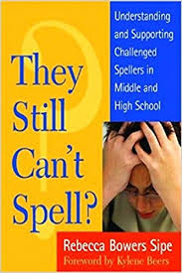
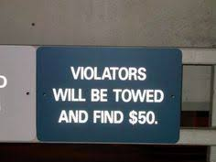
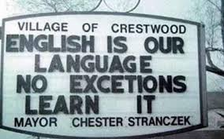
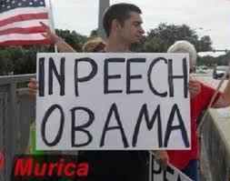
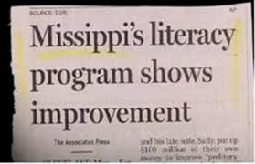
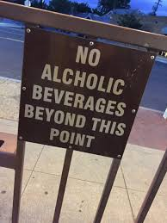
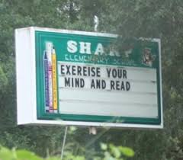
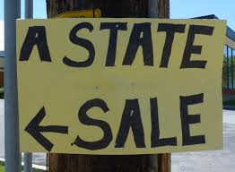
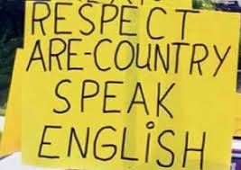
A Workshop with Amy Benjamin
www.amybenjamin.com

Slide 2
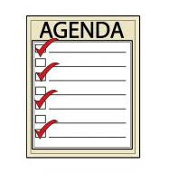
Today:
What works? What does not?
The Power of Spelling
Myths and Facts
Mini- and micro- lessons
Etymology
Metacognition
Mnemonic devices
Word Sorts
Morphology charting
Air Writing
Rules and Patterns
Games & Puzzles

Slide 3
“English spelling is unusual because our language is
a rich tapestry woven together from the tongues of the
Greeks, the Latins, the Angles, the Klaxtons, the Celtics,
the ‘76ers, and many other ancient peoples , all of whom
had serious drinking problems.”
-Dave Barry

Slide 4
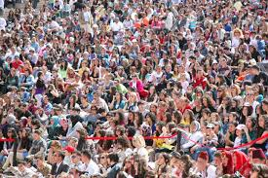
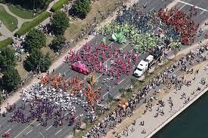
Anglo-Saxon: bright, night, tight,
light, flight, height,
might, plight, right
French: chauffeur, chef, champagne,
critique, antique, bouquet,
ballet, fillet
Latin: credible, flexible, audible, indelible,
viable, reliable, amiable, pliable
Greek: mystery, lyric, dynamic, cycle
phonic, physical, psychology

Slide 5
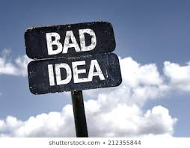
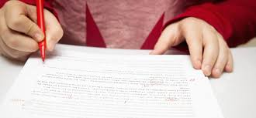
What Not To Do (Ever)
Have students “edit” someone else’s text by correcting
misspelled words

Slide 6
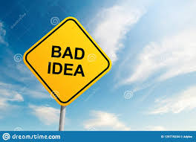
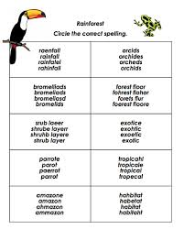
What Not To Do (Ever)
2. Have students pick out the correctly spelled word among
misspellings of a given word.

Slide 7
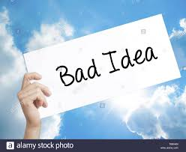
What Not To Do (Ever)
3. Give spelling lists based on topics, rather than patterns.
Electricity Unit Spelling List
current
pole
attract
repel
outlet
conductor
diode
magnetism
Spelling List for the Electricity Unit:
electric
electrical
electrify
electron
electrician

Slide 8
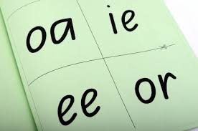
How is spelling taught in your classroom?
your school?
your district?

Slide 9
ELA Regents Exam
Anchor Paper
Level 6

Slide 10
ELA Regents Exam
Anchor Paper
Level 5

Slide 11
ELA Regents Exam
Anchor Paper
Level 4

Slide 12
ELA Regents Exam
Anchor Paper
Level 3

Slide 13
ELA Regents Exam
Anchor Paper
Level 2

Slide 14
Grade 7
ELA Test
Level 3 (out of 4)

Slide 15
Grade 7
ELA Test
Level 1 (out of 4)

Slide 16
Grade 8
ELA Test
Level 4 (out of 4)

Slide 17
Grade 8
ELA Test
Level 3 (out of 4)

Slide 18
Grade 8
ELA Test
Level 2 (out of 4)

Slide 19
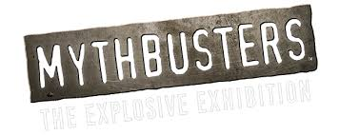
Myth I: …that spelling is entirely a visual skill
Learning to spell is a complex process involving
various mental modalities:
visual
auditory
rhythmic
kinesthetic
cognitive: learning rules
understanding etymology
recognizing letter patterns

Slide 20
Myth II: …that spelling is unrelated to other language skills
Spelling is deeply supportive of reading, writing,
pronunciation, handwriting, and vocabulary.

Slide 21
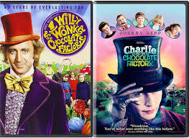
Myth III: …that knowing how to spell is not necessary because
of spell-checking technology
“Willie Wonka and the Cholera Factory”

Slide 22
Myth IV: …that someone else has already taught
spelling, so I don’t have to.
Too often, a coherent, effective
spelling scope & sequence is not
in place.
“Invented Spelling”: Meant to be temporary;
not for common words (they, went, said, who)
Proactive v. Reactive

Slide 23
Myth V: …that the English spelling doesn’t follow rules.
The English language is complex, and
even though pronunciation changes, spelling
does not, English is more patterned and
rule-based than you thought.
4%: aunt, does, of,

Slide 24
English DOES have more rules than you think!!
…k, …ck, …ke
…k
break, speak, creek, freak, leak, reek, seek, weak, beak,
steak
consonant + two vowels
…ck
back, click, dock, flock, luck, pluck, rack, wreck, truck, stuck, stick
short vowel
long vowel
…ke
bake, strike, bike, broke, take, mistake, fake, like, lake, spike, fluke

Slide 25
Some Reasons for Spelling Problems
ELL: Spanish: Spell what you hear; consistent rules
2. Hearing deficits: auditory discrimination problems will affect spelling
3. Pronunciation problems: If you mispronounce a word, you probably misspell it
4. Lack of sufficient experience as a reader. Visuals of spelling are not
fully imprinted unless you read enough.
5. Poor teaching:
1. Lists of orthographically unrelated words (no patterns)
2. Missed opportunities for “eyes on text” while listening to read-aloud
3. Missed opportunities to connect spelling to etymology, rules, patterns,
and morphology
4. “Spelling doesn’t count” attitude
5. Not varying the modes through which spelling is learned

Slide 26
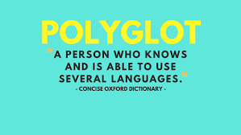
Principle I: English is an amalgamation of several languages.

Slide 27
Tier 3: glossary word:
Multisyllabic
Specific to a subject area
Latin or Greek-based
topography, photosynthesis, isoceles triangle,
sedimentary, oxygenated, cartographer
Tier 2: Words of education, business,
government, religion:
Components: Prefix, root, suffix
Latin-based
elevation, formation, protrude, expansive,
isolated, remote
Tier 1: Basic conversational words: Friends & family
1 or 2 syllables
Learned naturally, through exposure
hills, grass, rocks, land, sky, clouds, fly, climb,
green, high, said, does, friend, light

Slide 28
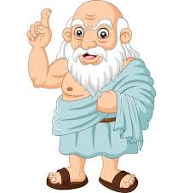
ph
.y……..
ch (K): chaos
…ology
silent p as first letter:
…omy
rh…

Slide 29
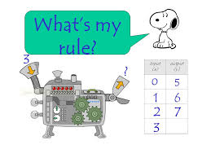
er/or
Anglo-Saxon:
Latin:
farmer
worker
baker
butcher
brewer
carpenter
teacher
professor
actor
doctor
educator
aviator
director
counselor

Slide 30
able/ible
Anglo-Saxon:
Latin:
passable
laughable
breakable
agreeable
punishable
flexible
credible
edible
audible
visible
indelible

Slide 31
ageless
courageous
gorgeous
management
arrangement
outrageous
knowledgeable

Slide 32
Principle II: English words are spelled according to sound and
morphemes (meaningful parts)
Looking at how a word is spelled gives clues to its meaning,
if you know its parts:
credit/incredible/incredulous
wild/wilderness
anxious/anxiety
heal/health
define/definition
rite/ritual
hear/rehearse

Slide 33
English spelling tends to preserve the spelling of the root word
when suffixes are added, despite changes in pronunciation
electric
electri__ity
electri__al
English spelling makes it EASIER to see that words are related:
act, action
complete, completion
compete, competitive, competition

Slide 34
Principle III: Almost all English words have other words that are
similarly spelled:
autumn, hymn, column, condemn, damn
limb, climb, comb
rhythm, rhyme, rhapsody, rhinoceros, rhinoplasty

Slide 35
Principle IV: English spelling patterns organize around letter placements
that usually happen, sometimes happen, or never happen
Ex: no word ends in j or v

Slide 36
Morphology Chart
NOUNS: They will fit into this frame: The_____. | VERBS: They will fit into this frame: To____ or Can____or Is____ing | ADJECTIVES: They will fit into this frame: The ________truck | ADVERBS: They will fit into this frame: Do it ___________.
Nouns answer the question: What? or Who?
Verbs answer the question: What is it doing, having, feeling, or being?
Adjectives answer the question: What kind? (They may also answer the questions Which one? and
How many? but those kinds of adjectives do not fit into
the frame of The______truck.
Adverbs answer any of these questions: Where? When? Why? To what extent? How?

Slide 37
Morphology Chart
NOUNS: They will fit into this frame: The_____. | VERBS: They will fit into this frame: To____ or Can____or Is____ing | ADJECTIVES: They will fit into this frame: The ________truck | ADVERBS: They will fit into this frame: Do it ___________.
Nouns answer the question: What? or Who?
Verbs answer the question: What is it doing, having, feeling, or being?
Adjectives answer the question: What kind? (They may also answer the questions Which one? and
How many? but those kinds of adjectives do not fit into
the frame of The______truck.
Adverbs answer any of these questions: Where? When? Why? To what extent? How?

Slide 38
Morphology Chart
NOUNS: They will fit into this frame: The_____. | VERBS: They will fit into this frame: To____ or Can____or Is____ing | ADJECTIVES: They will fit into this frame: The ________truck | ADVERBS: They will fit into this frame: Do it ___________.
Nouns answer the question: What? or Who?
Verbs answer the question: What is it doing, having, feeling, or being?
Adjectives answer the question: What kind? (They may also answer the questions Which one? and
How many? but those kinds of adjectives do not fit into
the frame of The______truck.
Adverbs answer any of these questions: Where? When? Why? To what extent? How?

Slide 39
Morphology Chart
NOUNS: They will fit into this frame: The_____. | VERBS: They will fit into this frame: To____ or Can____or Is____ing | ADJECTIVES: They will fit into this frame: The ________truck | ADVERBS: They will fit into this frame: Do it ___________.
Nouns answer the question: What? or Who?
Verbs answer the question: What is it doing, having, feeling, or being?
Adjectives answer the question: What kind? (They may also answer the questions Which one? and
How many? but those kinds of adjectives do not fit into
the frame of The______truck.
Adverbs answer any of these questions: Where? When? Why? To what extent? How?

Slide 40
Morphology Kit
This “Morphology Kit”
is a great way to
expand vocabulary
because most
of the words
created by
these suffixes
express abstract
ideas.
Noun-Making Suffixes | Verb-Making Suffixes | Adjective-making suffixes
-ment -ness -ation, sion -ity -ism -hood -itude -ence -ance -ide | -ate -ify -ize | -acious,icious -y -ous, ious -ant -able, ible -er; est
Adverb-making suffix:
-ly
5

