Slide 1
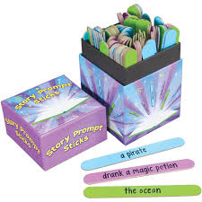
Creating various types of sentences, to bring words together to create
simple and complex relationships among ideas; clarifying meaning by
using correct punctuation
Subject/Predicate: Phrase; Clause; Simple sentence; Independent clause
Compound subject
Compound predicate
Compound Sentence
Coordinating conjunction
Relative Clause
Relative pronoun
Conjunctive adverbs
Dependent clause (aka subordinate clause)
Complex sentence
Main clause
Dependent clause (aka subordinate clause)
Subordinating conjunction

Slide 2
SIMPLE Sentence
They believed
that…
Sentence
(aka) Independent Clause
Subject
Predicate
What about it?
Who or what?

Slide 3
SIMPLE Sentence
Sentence
(aka) Independent Clause
Subject
and
Subject
Predicate
Compound Subject
Who or what?
What about it?

Slide 4
SIMPLE Sentence
Sentence
(aka) Independent Clause
Subject
Predicate
and
Predicate
Compound Predicate
What about it?
Who or what?

Slide 5
SIMPLE Sentence
Sentence
(aka) Independent Clause
Subject
Subject
Predicate
and
Predicate
and
Compound Subject
Compound Predicate
What about it?
Who or what?

Slide 6
COMPOUND Sentence
Sentence
Two Independent Clauses
Subject
Predicate
,
Subject
Predicate
and
,
but
,
so
What about it?
Who or what?
;
coordinating conjunctions

Slide 7
subject
subject
predicate
predicate
who
replace

Slide 8
relative pronouns
who
which
that
relative clause
which
who
predicate
that

Slide 9
Sentence with RELATIVE CLAUSE
,
who/which
,
subject
that
predicate
predicate

Slide 10
however
moreover
therefore
furthermore
CONJUNCTIVE ADVERBS
;
However
however
,
however.
,
,
,
however
,

Slide 11
COMPLEX Sentence, Part I
Sentence
One independent clause + one dependent clause
as
aka subordinate clause
Subject
Predicate
because
Subject
Predicate
when
subordinating conjunctions
What about it?
Who or what?

Slide 12
COMPLEX Sentence, Part II
Sentence
One dependent clause + one independent clause
As
aka subordinate clause
aka main clause
Because
Subject
Predicate
Subject
Predicate
,
When
subordinating conjunctions
What about it?
Who or what?

Slide 13
AAA
as
after
although
WW
when
while
Subordinating Conjunctions
UU
unless
until
BB
before
because
I
if
S
since

Slide 14
as
After
While
Although
When
Print on Green Paper
As
although
when
Before
after
while
unless
before
because
until
since
if
If
Since
Because
Until
Unless

Slide 15
,
and
and
and
and
and
Print on Pink Paper
but
and
and
but
but
but
and
but
but
but
so
and
so
so
so
so
so

Slide 16
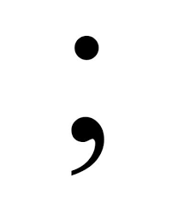
Print on Pink Paper

Slide 17
,
,
,
,
,
,
,
,
,
Print on Yellow Paper
,
,
,
,
,
,
,
,
,
,
,
,
,
,
,

Slide 18
however
moreover
therefore
furthermore
Print on White Paper
however
moreover
therefore
furthermore
However
,
Furthermore,
Therefore
,
Moreover
,
,

Slide 19
who
who
who
who
who
Print on Orange Paper
which
which
which
which
which
that
that
that
that
that

